Slide 1
The Secret Life of Semicolons
UHCL Writing Center

Slide 2
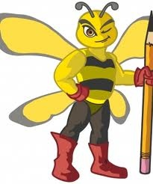
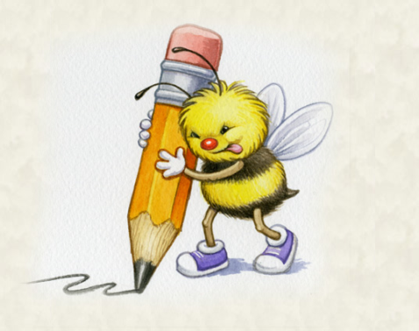
The Veil of Mystery Lifted!
One of the most elusive and misunderstood grammar elements is the semicolon. It could be compared to the mysterious lives of bees; however, similar to those honey-producing busybodies, the semicolon is governed by a couple of clearly defined and ironclad rules.

Slide 3
Semicolon Rule #1: Connecting Clauses
There are only three ways
to connect two independent clauses:
Period
  Ex. This workshop is exciting. I can’t wait to hear more.
Comma, Conjunction
  Ex. This workshop is exciting, and I can’t wait to hear more.
Semicolon
  Ex. This workshop is exciting; I can’t wait to hear more.

Slide 4
Semicolon Rule #1: Connecting Clauses
If the two clauses in your sentence are not related, use a period.
The cheese is old and moldy. Where is the bathroom?
The Smurfs are little and blue. I like to watch their show.
If the two clauses ARE related, you can use either a comma with a conjunction or a semicolon.
To make this decision, be aware of both rules.

Slide 5
FANBOYS conjunctions need commas in compound sentences.
A compound sentence consists of two or more parts that could each stand alone as a sentence. When the parts are joined by a coordinating conjunction – for, and, nor, but, or, yet, or so (FANBOYS) - use a comma BEFORE the conjunction to indicate a pause between the two thoughts.
Leaving out the comma and using just the FANBOYS results in a run-on sentence.
Using just a comma without the FANBOYS results in a comma splice--and fails to specify the intended relationship.

Slide 6

FANBOYS examples
He had turned into a giant cockroach, yet looked exactly the same.
The words “I do” may be short, but they mean a lifelong commitment.
At a red light, Sue jumped out of Dan's car and slammed the door, for she could not tolerate his polka music.
No Comma Necessary:
The bowl of stew is hot and delicious.
My cat loves being petted but hates bath time.

Slide 7
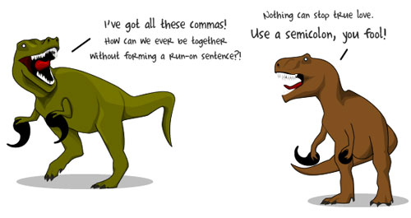

Slide 8
Using semicolons to fix run-ons and comma splices
Just take out the FANBOYS and insert a semicolon!
The workshop was getting interesting and I couldn’t believe what happened next! (incorrect)
The workshop was getting interesting; I couldn’t believe what happened next!
Just replace the comma with a semicolon!
I never believed it could be so easy to fix a comma splice, I can’t wait to learn more! (incorrect)
I never believed it could be so easy to fix a comma splice; I can’t wait to learn more!

Slide 9
Semicolon rule #2: The “However” rule
Similar to the FANBOYS rule, you can connect two independent clauses with a semicolon, a transitional phrase, and a comma.
I enjoyed The Artist; however, I feel that Hugo should have won the Oscar for Best Picture.
You’ll need some strawberries; in addition, you’ll need lots of shortcake.
The Writing Center provides many workshops; for example, the semicolon workshop is amazing!

Slide 10
Semicolon Rule #3:
Separating complex series
If subjects in a series utilize commas, use a semicolon to distinguish them.
My team consists of: Mary, who loves cats; Eric, who is originally from New Orleans; and Lori, a chronic knitter.
To build IKEA furniture, you will need Swedish parts, which fit their specific design; a blunt hammer, which will help you assemble without breaking the material; and a full day, because it will be a tremendous undertaking.

Slide 11
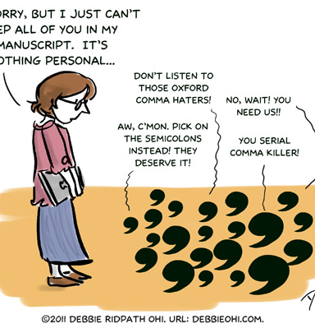
OTHER
COMMA
RULES

Slide 12

The Oxford Comma
When three or more items appear in a series, many disciplines require them to be separated from one another with commas. Although newspapers and magazines do not use a comma between the last two items, the best advice in writing other than journalism is to use a comma because a sentence can be ambiguous without one.

Slide 13
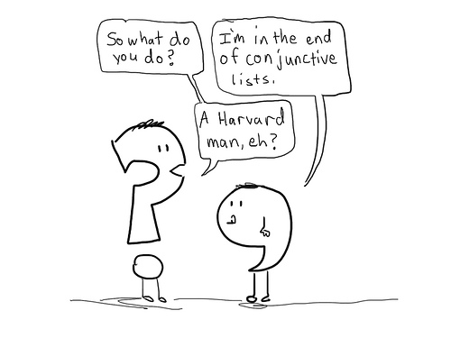
Oxford Comma Examples
I met two tall guys, George, and Pete.
I’d like to thank my parents, Jesus, and Oprah Winfrey.
Highlights of his global tour include encounters with Nelson Mandela, an 800-year-old demigod, and a pigeon collector.
The millionaire’s will left the estate to be divided by John, Mary, and Robert.

Slide 14
Once upon a time, an INTRODUCTORY PHRASE needed a comma.
Readers usually need a small pause between an introductory word, phrase, or clause and the main part of the sentence, a pause most often signaled by a comma. Try to get into the habit of using a comma after every introductory element. When the introductory element is very short, you don't always need a comma after it. But you're never wrong if you do use a comma.
Remember, these comma rules apply to the middle of sentences too, such as when you have an interrupter!

Slide 15
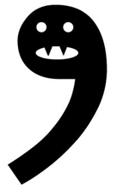
Introductory Phrase Examples
If you want to get something done right, you must do it yourself.
Determined to finish the job, we worked all weekend.
A long time ago, Luke resisted Vader’s invitation.
According to Peter Pan, “to die will be an awfully big adventure.”
(Interrupter) At first, I didn’t understand the TV show, but with all the songs and visuals, it became clearer.

Slide 16
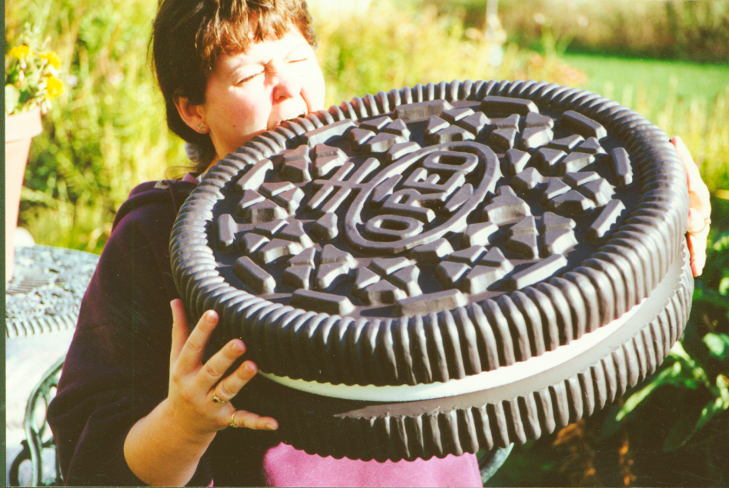
The Oreo Rule
A nonrestrictive element, one that is not essential to the basic meaning of the sentence, could be removed and the sentence would still make sense. Use commas to set off any nonrestrictive parts of a sentence.
Keywords – such as, who, which, especially
Examples:
  J.R.R. Tolkien, who wrote The Hobbit, is my hero.
  The tree, a.k.a. the kite eater, drives Charlie Brown crazy.

Slide 17
