Slide 1
Sentence sense
UHCL Writing Center

Slide 2
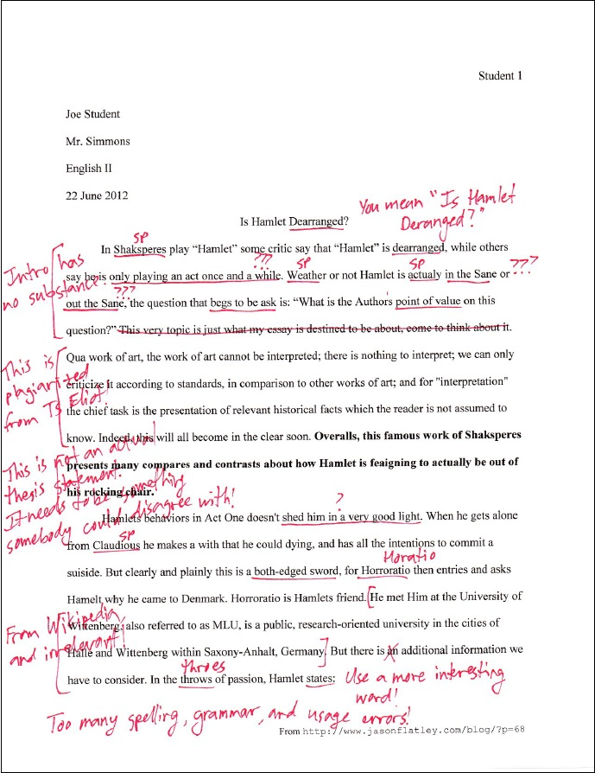

Slide 3
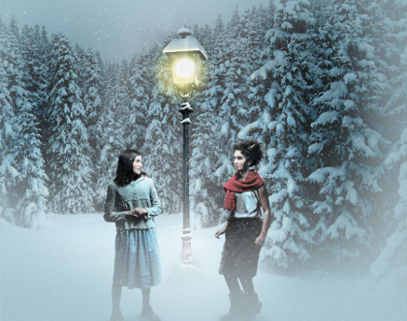
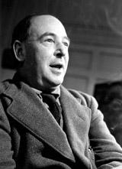
C. S. Lewis
“We all want progress, but if you're on the wrong road, progress means doing an about-turn and walking back to the right road; in that case, the man who turns back soonest is the most progressive.”
“Experience: that most brutal of teachers. But you learn, my God do you learn.”
“If you look for truth, you may find comfort in the end; if you look for comfort you will not get either comfort or truth only soft soap and wishful thinking to begin, and in the end, despair.”
“Education without values, as useful as it is, seems rather to make man a more clever devil.”

Slide 4

Oh, the places you’ll go. . .
We will cover
Parts of speech
Complete sentences
Fragments
Run-ons
Joining
Practice

Slide 5
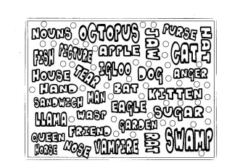
Parts of speech
Nouns: a person, place, or thing
Amanda writes A+ papers.
She visited the Writing Center.
Pronouns: a word that takes the place of a noun
She always knows what to say to him.
He went to their concert.

Slide 6

Parts of speech
Articles: a, an, and the
Mary is looking for an apartment.
I can’t find the right word.
Adjectives: words that modify a noun
Jeff throws awesome parties.
Clowns are scary.

Slide 7

Parts of speech
Verbs: words that exress action
Lori rides the bus to school.
Apple pies are delicious.
Adverbs: words that modify a verb
Jerry is doing well.
Matt wears extremely tight pants.

Slide 8
Parts of speech
Conjunctions: a joining word
I need two tacos and a beef enchilada.
Ellen will graduate in either December or May.
Preposition: spatial, temporal, or directional words
We are on the second floor.
Ruthi went to the meeting.

Slide 9
Complete sentences
Sentences are groups of words that express a complete thought. At the minimum, a sentence needs a subject (usually a noun) and a verb.
  Irma writes.
Often, a direct object follows.
  Irma writes an e-mail.
Sometimes, there are indirect objects.
  Irma writes an e-mail to her sister.

Slide 10
Complete sentences
We can add subjunctive clauses.
  Irma, my best friend, writes an e-mail to her sister.
We can add gerund phrases.
  Irma, my best friend, writes an e-mail to her sister, knowing her sister won’t respond.
We can add other parts of speech.
  Irma, my best friend, hurriedly writes an angry e-mail to her annoying sister, knowing her forgetful sister won’t respond.

Slide 11
Fragments
A sentence is called a fragment, if it is incomplete.
  UHCL offers many majors. Such as education, computer science, and composition.
So we have to revise the fragment to make it complete.
    UHCL offers many majors, such as education, computer science, and composition.

Slide 12
Run-ons
A sentence is called a run-on (or comma splice or fused sentence) when we do not use the correct punctuation to join together a compound sentence.
  Do not turn in a paper when you are done writing it first edit the paper.
So we have to revise the run-on to break up the sentence.
    Do not turn in a paper when you are done writing it; first, edit the paper.

Slide 13

Joining compound sentences
An independent clause is a clause that can be a complete sentence on its own. We can join together two independent clauses with the right punctuation.
This can be done with coordinating conjunctions or semi-colons.

Slide 14
Run-ons
With a coordinating conjunction:
  Run-on: I enjoy the finance and statistics class I just hate the writing classes I have to take.
  Correction: I enjoy the finance and statistics class, but I just hate the writing classes I have to take.
With a semi-colon.
  Run-on: It is hard to imagine a more stimulating topic than semi-colons I wonder what we will learn next.
  Correction: It is hard to imagine a more stimulating topic than semi-colons; I wonder what we will learn next.

Slide 15
Sentence sense
UHCL Writing Center
Source: Purdue Online Writing Lab http://owl.english.purdue.edu/owl/

