Slide 1
Grammar Refresher
UHCL Writing Center
Adapted from EasyWriter Resources, Andrea A. Lunsford, (http://bcs.bedfordstmartins.com/easywriter3e/20errors/default.asp)

Slide 2
1) Missing comma after an introductory element

Slide 3
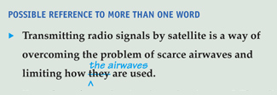
2) Vague pronoun reference

Slide 4
3) Missing comma in a compound sentence

Slide 5
4) Wrong word

Slide 6
5) Missing comma(s) with extra information

Slide 7
6) Wrong or missing verb ending

Slide 8
7) Wrong or missing preposition

Slide 9
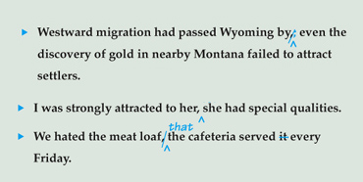
8) Comma splice

Slide 10
9) Missing or misplaced possessive apostrophe

Slide 11
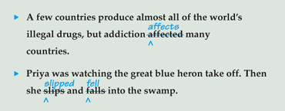
10) Unnecessary shift in tense

Slide 12
11) Unnecessary shift in pronoun

Slide 13
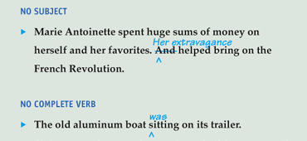
12) Sentence fragment

Slide 14
13) Wrong tense or verb form

Slide 15
14) Lack of subject-verb agreement

Slide 16
15) Missing comma in a series

Slide 17
16) Lack of agreement between pronoun and antecedent

Slide 18
17) Unnecessary comma(s) with a restrictive element

Slide 19
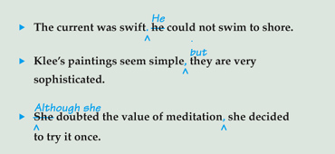
18) Run-on/ fused sentence

Slide 20
19) Misplaced or dangling modifier

Slide 21
20) Its/It's confusion

