Slide 1
Going beyond SURVIVING to THRIVING in Online Courses
UHCL Student Success Center studentsuccesscenter@uhcl.edu 281-283-2450

Slide 2
Doing this workshop for extra course credit?
No? Skip to the next slide ☺
Yes? To receive an email verification of your participation, choose one of the following items to do (instructions with videos in the slides) during or after the workshop and email screenshot, scan studentsuccesscenter@uhcl.edu or photo of the item(s) to with a message that you need verification for the Online Courses workshop:
Make a chronological, color coded assignment checklist for the semester (see slide 7)
Make a grid of your schedule (like in slide 9) complete with study times (don’t forget things like eating, commuting)
Use one of the digital time management options and mark out your month and a detailed week (see slide 10)
UHCL Student Success Center studentsuccesscenter@uhcl.edu 281-283-2450

Slide 3
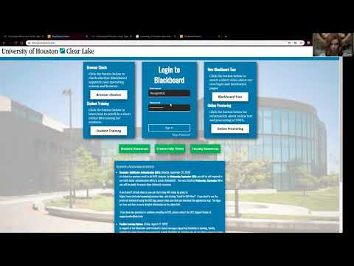
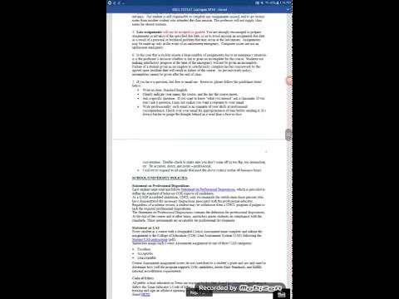
Before starting a new class…
Accessing UHCL Blackboard
How to read the course syllabus
Make sure you get your course syllabus!
UHCL Student Success Center studentsuccesscenter@uhcl.edu 281-283-2450

Slide 4
Blackboard Online Discussion Boards
Occasionally strange things happen in discussion threads
Write your post out in a Word or Google Doc and copy/paste it in right before you hit submit so you never lose work if there’s a glitch or the Blackboard page times out.
UHCL Student Success Center studentsuccesscenter@uhcl.edu 281-283-2450

Slide 5
Considerations
What percent of your course grade?
Where is the discussion in the course in Blackboard?
How many threads available/required?
Need to read an article/chapter first?
How many posts required?
Separate days?
How many original threads and how many replies to others’ posts?
Need to use course info and cite from course text?
Need to use outside sources?
What format (APA, MLA..) for citation ?
Need to add source link or attachment ?
Deadlines?
UHCL Student Success Center studentsuccesscenter@uhcl.edu 281-283-2450

Slide 6
Searching for posts
There’s a search box above the discussion area and above specific forums.
You can put in a name or key word.
Why? You may need to count how many posts you’ve made so far in the class or want to find a specific post for reference.
Correcting post mistakes
You can edit the post and resubmit if you see “Edit this post” on the bottom right.
If the option isn’t there, email your professor and ask about turning on post editing for students.
Otherwise, just reply to your post with the correction needed, like texting.
UHCL Student Success Center studentsuccesscenter@uhcl.edu 281-283-2450

Slide 7
Discussion Boards: How to post
UHCL Student Success Center studentsuccesscenter@uhcl.edu 281-283-2450

Slide 8
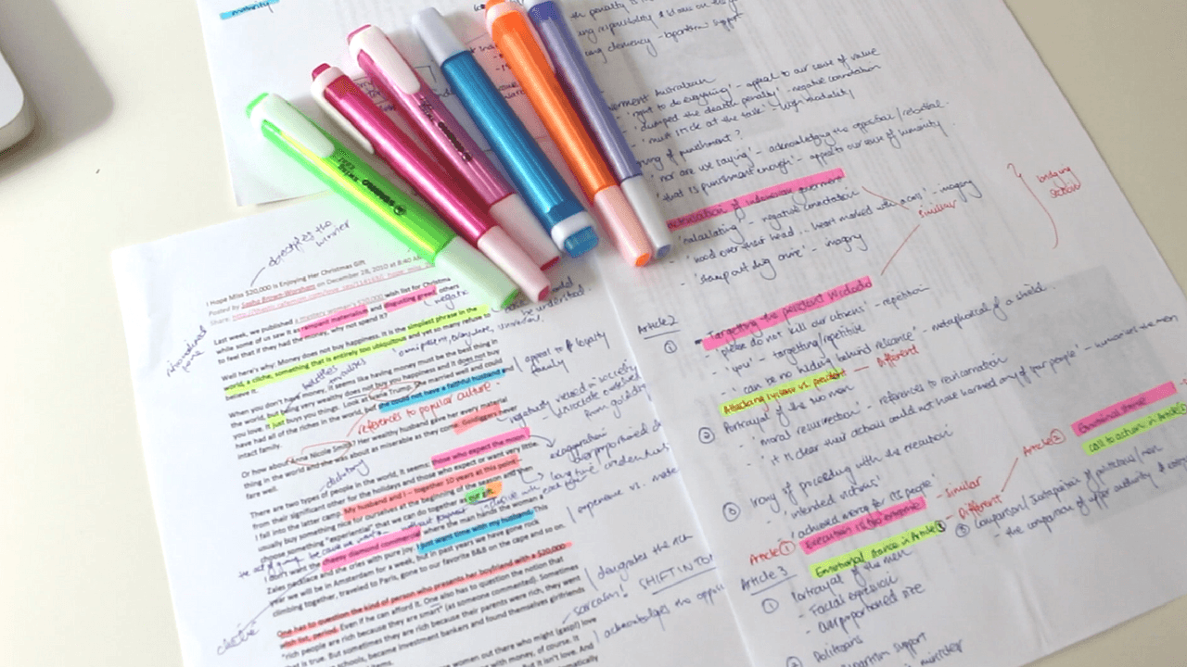
Student Success Center Workshops
Time management
Task management
Organization Skills
Note-taking strategies
Reading strategies
UHCL Student Success Center studentsuccesscenter@uhcl.edu 281-283-2450

Slide 9
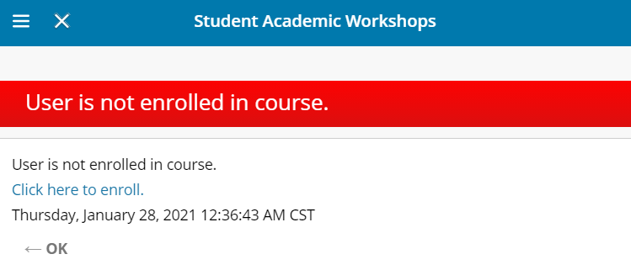
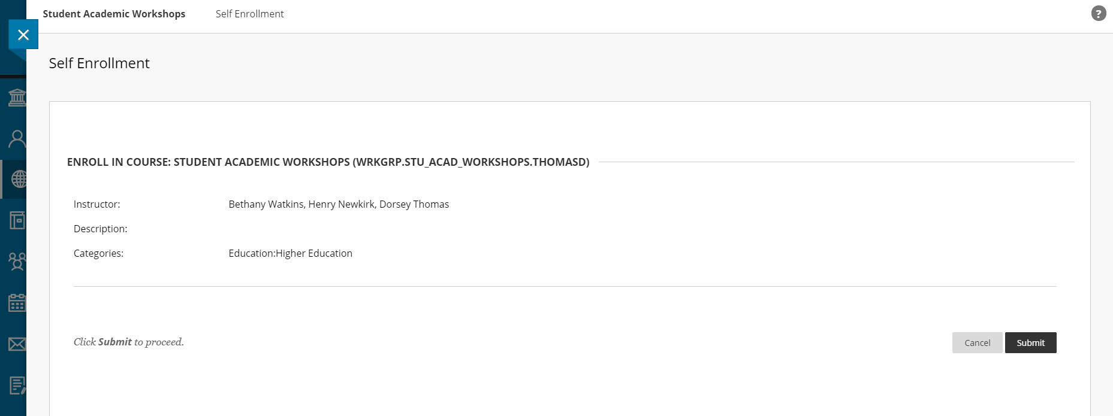
Workshops in more detail HERE
Step 1
Step 2
Step 3
Click the URL and follow the steps
Step 4
UHCL Student Success Center studentsuccesscenter@uhcl.edu 281-283-2450

Slide 10
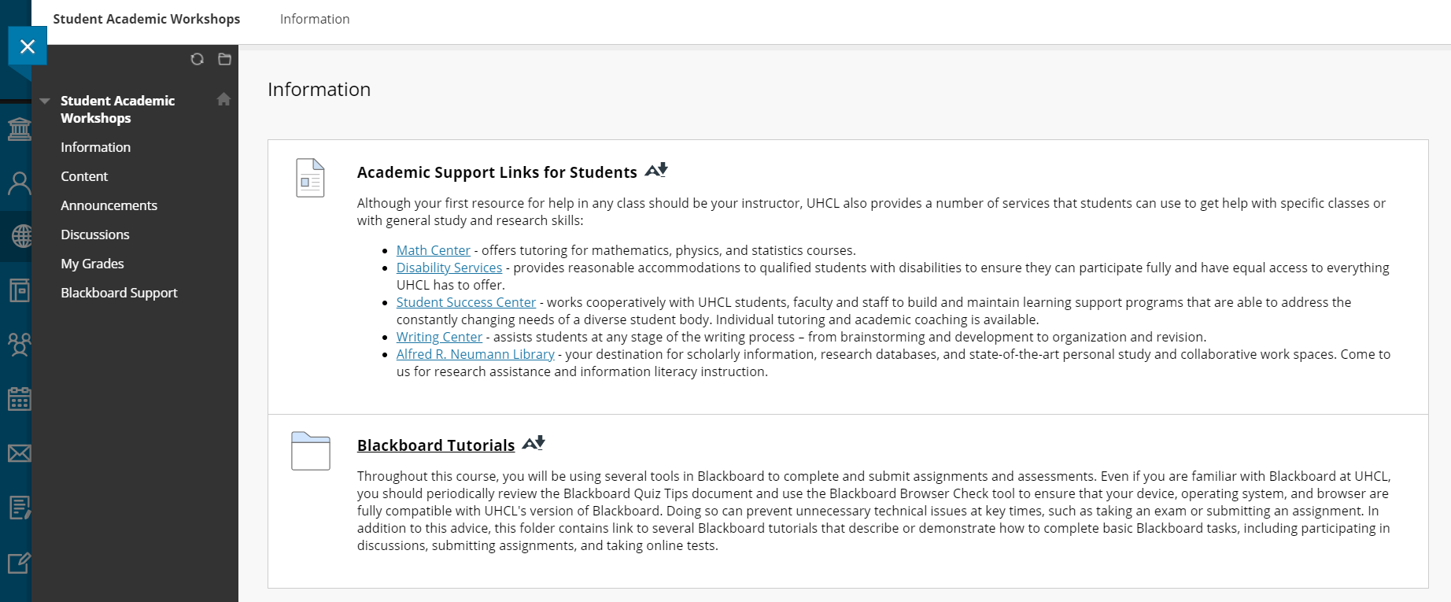
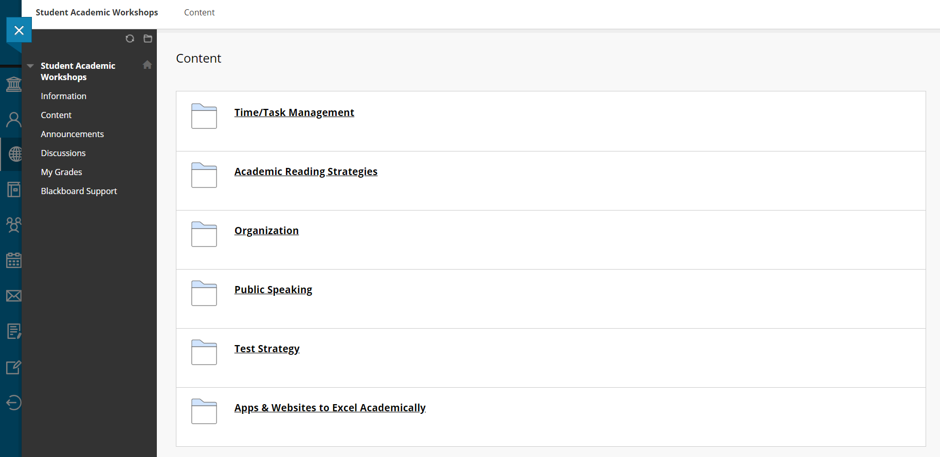
Workshops are located in the “Content” section
UHCL Student Success Center studentsuccesscenter@uhcl.edu 281-283-2450

Slide 11
Time management
Full workshop HERE or at
https://blackboard.uhcl.edu/ultra/courses/_25087_1/cl/outline
UHCL Student Success Center studentsuccesscenter@uhcl.edu 281-283-2450

Slide 12
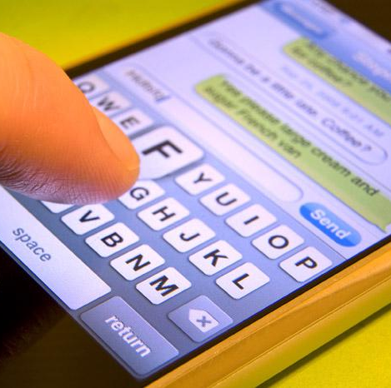
What Does Your Study/Project Time Really Look Like?
UHCL Student Success Center studentsuccesscenter@uhcl.edu 281-283-2450

Slide 13
Scheduling Principles
Know your limits
Set reasonable deadlines
Learn to say “no”
Build rapport with professors
Schedule complex/ harder tasks when you are more alert/ fresh
UHCL Student Success Center studentsuccesscenter@uhcl.edu 281-283-2450

Slide 14
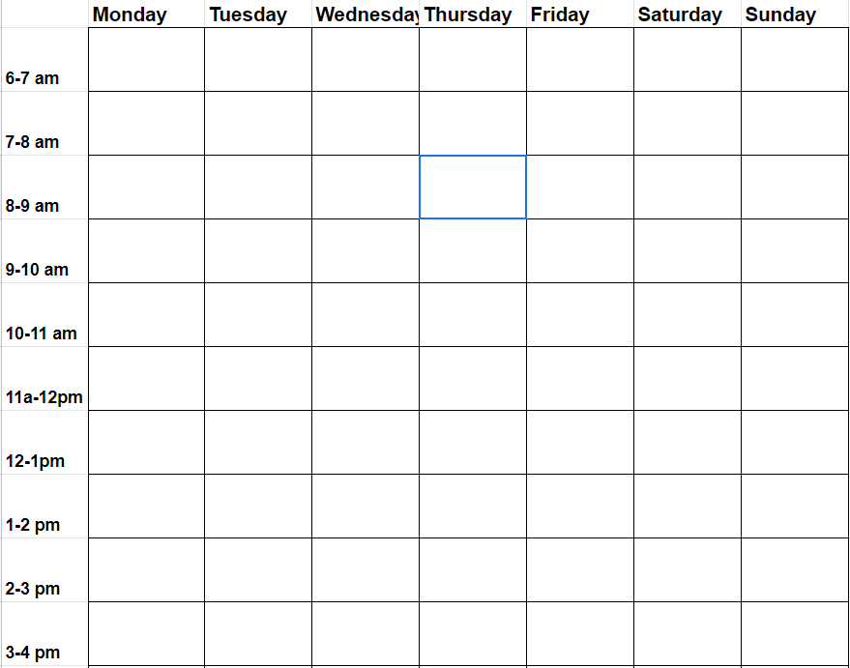
What does the semester look like?
Big picture planning (By Course) | Big picture planning (By Assignment) | Weekly daily planning
Anthropology
1/25 – 1 (Intro)
2/01 – 2 (Discussion 1)
2/08 – 3 (Dis 2; Quiz 1)
2/15 – 4 (Dis 3)
Brain & Behavior
2/01- 2/04- + Chapter 1
2/01- 2/04-+ Chapter 13 (336-340)
2/06-2/09- Exam 1
2/06-2/09- + Chapter 4
2/06-2/09- + Chapter 15 (390-398; 399-408)
Women’s Seminar
2/02 – Howard Response Due
2/09 – Rios Response Due
2/16 – Marcoline Response Due
--WEEK 1--
1/25 – Anthropology, 1 (Intro)
--WEEK 2--
2/01 – Anthro, 2 (Discussion 1)
2/01- B&B, Chapter 1
2/02 – Women’s Sem.,Howard Resp Due
--WEEK 3--
2/03-04 B&B, Chap13 (336-340), Ch 2
2/06 - 2/09= B&B, Exam 1
2/08 – Anthro, 3 (Dis 2; Quiz 1)
2/09 – WS, Rios Resp.
--WEEK 4--
2/12- B&B, Ch 4
2/15 – Anthro, 4 (Dis 3)
2/16 – WS, Marcoline Resp.
2/18- B&B, Ch15 (390-398; 399-408)
FIRST
Set routines and priorities
THEN
Flexible and occasional tasks
UHCL Student Success Center studentsuccesscenter@uhcl.edu 281-283-2450

Slide 15
Find out what works best
Which would work best for your schedule? Maybe a combination of both depending on the day?
This may change day to day and semester to semester depending on course load and work schedule outside of school
UHCL Student Success Center studentsuccesscenter@uhcl.edu 281-283-2450

Slide 16
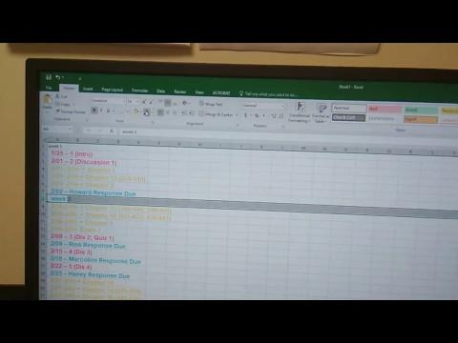
Creating a quick list via excel
UHCL Student Success Center studentsuccesscenter@uhcl.edu 281-283-2450

Slide 17
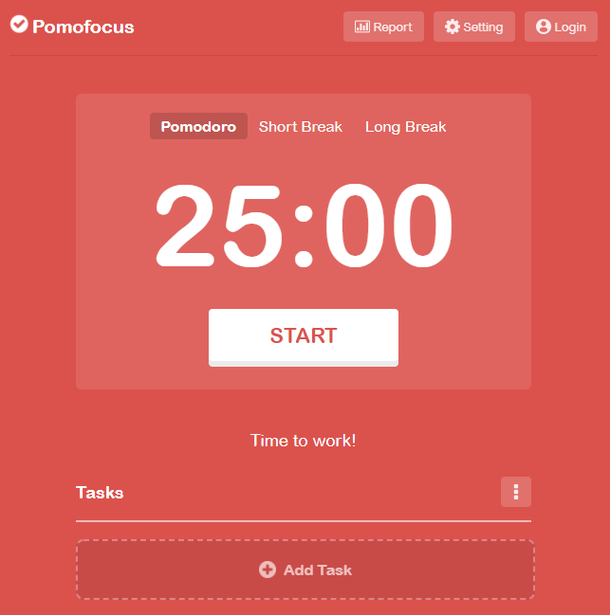
Time management applications
Google Calendar
calendar.google.com/
Pomofocus
pomofocus.io/
Cold Turkey
getcoldturkey.com/
Countdown timer
Timeanddate.com
UHCL Student Success Center studentsuccesscenter@uhcl.edu 281-283-2450

Slide 18
Task management
Full workshop HERE or at
https://blackboard.uhcl.edu/ultra/courses/_25087_1/cl/outline
UHCL Student Success Center studentsuccesscenter@uhcl.edu 281-283-2450

Slide 19
Breaking work into pieces
Class syllabus = best friend!
This week? Next week?
How many steps in the assignment/project?
Plan ahead to avoid conflict
Days, weeks, sometimes months
Allow for unexpected (family crisis, car breakdown)
UHCL Student Success Center studentsuccesscenter@uhcl.edu 281-283-2450

Slide 20
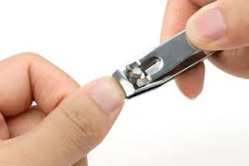
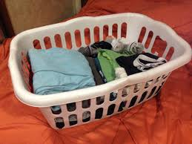
Chunking
Study Segment/Task
+
Study Segment/Task
+
Study Segment/Task
+
Break?
Short Task with Natural End
Short Task with Natural End
Short Task with Natural End
UHCL Student Success Center studentsuccesscenter@uhcl.edu 281-283-2450

Slide 21
Small windows
A | B | C
Study Segment/Task
+
Long or Routine Block (hours)
+
Long or Routine Block (hours)
Study Segment/Task
UHCL Student Success Center studentsuccesscenter@uhcl.edu 281-283-2450

Slide 22
Reading strategies
Full workshop HERE or at
https://blackboard.uhcl.edu/ultra/courses/_25087_1/cl/outline
UHCL Student Success Center studentsuccesscenter@uhcl.edu 281-283-2450

Slide 23
Effective academic reading =
Pre-reading + Targeted reading + Processing
UHCL Student Success Center studentsuccesscenter@uhcl.edu 281-283-2450

Slide 24
Skimming (“Survey”) &
Questioning
Scanning for answers & text marking
Organizing & connecting info
UHCL Student Success Center studentsuccesscenter@uhcl.edu 281-283-2450

Slide 25
Let’s Talk About Rewards…
UHCL Student Success Center studentsuccesscenter@uhcl.edu 281-283-2450

Slide 26
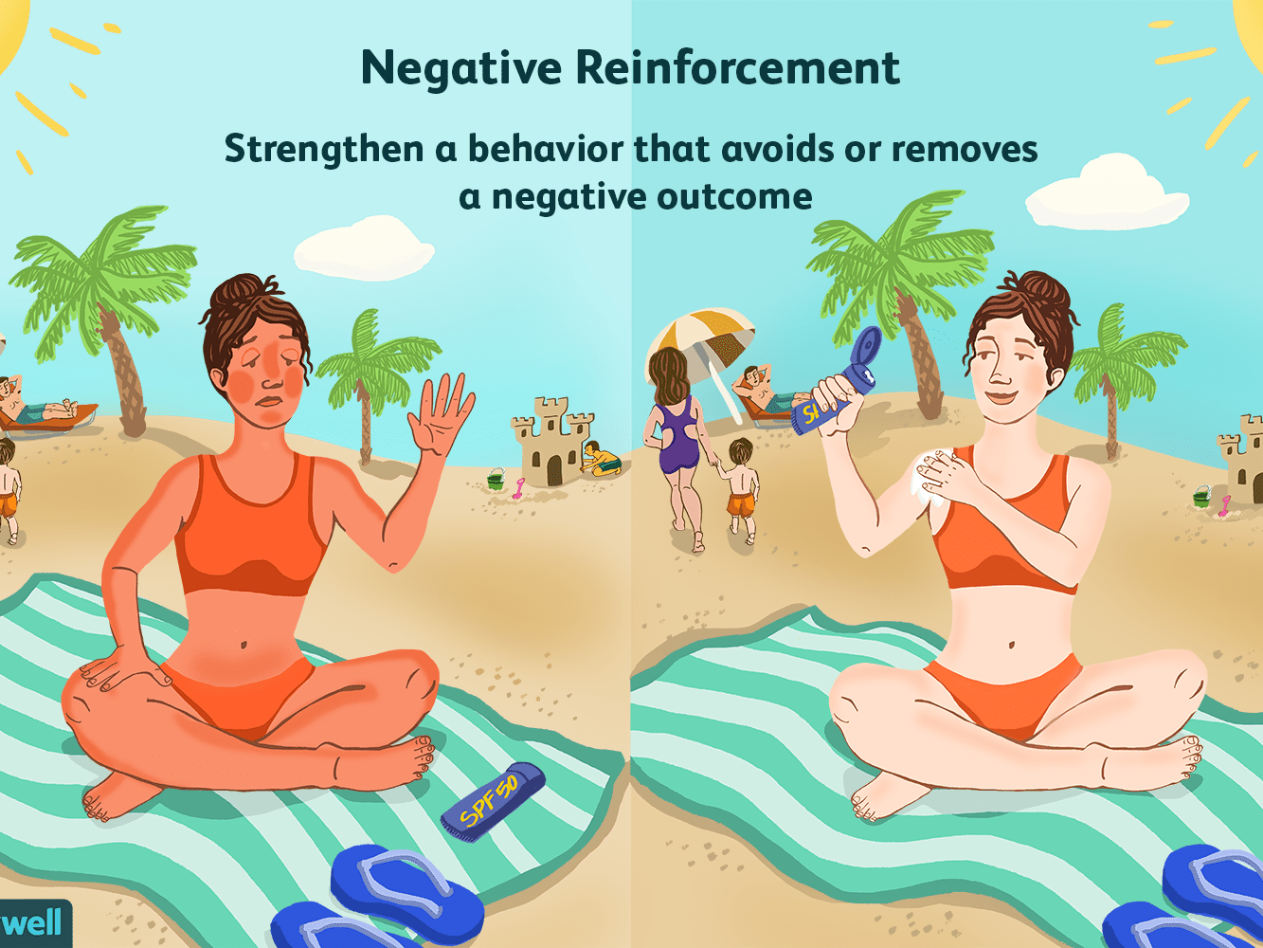
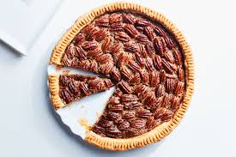
When your assignments are completed on time…
Positive Reinforcement
But in moderation!
Negative Reinforcement
UHCL Student Success Center studentsuccesscenter@uhcl.edu 281-283-2450

Slide 27
Overview: Habits for work/study balance
Prioritize (what if I DON’T do this today?)
Drop the unnecessary
Protect private time, personal and family
Accept help in all areas!
Study effectively / efficiently
Plan fun & relaxation
Let go of perfectionism!
UHCL Student Success Center studentsuccesscenter@uhcl.edu 281-283-2450

Slide 28
Thank you for participating!
We hope the information is useful in the semesters to come.
We provide online video sessions for academic coaching and tutoring in all 4 colleges (virtually anything except math and writing, since we have a Math Center and Writing Center).
Call or email 2 days in advance to set up online coaching or tutoring sessions.
UHCL Student Success Center studentsuccesscenter@uhcl.edu 281-283-2450

Slide 29
How helpful was this workshop?
3-question survey (30 sec-1 min) at this link: https://tinyurl.com/uhclsscworkshop
Let us know if we can be of help to you throughout the semester at studentsuccesscenter@uhcl.edu or 281-283-2450.
UHCL Student Success Center studentsuccesscenter@uhcl.edu 281-283-2450

