Slide 1
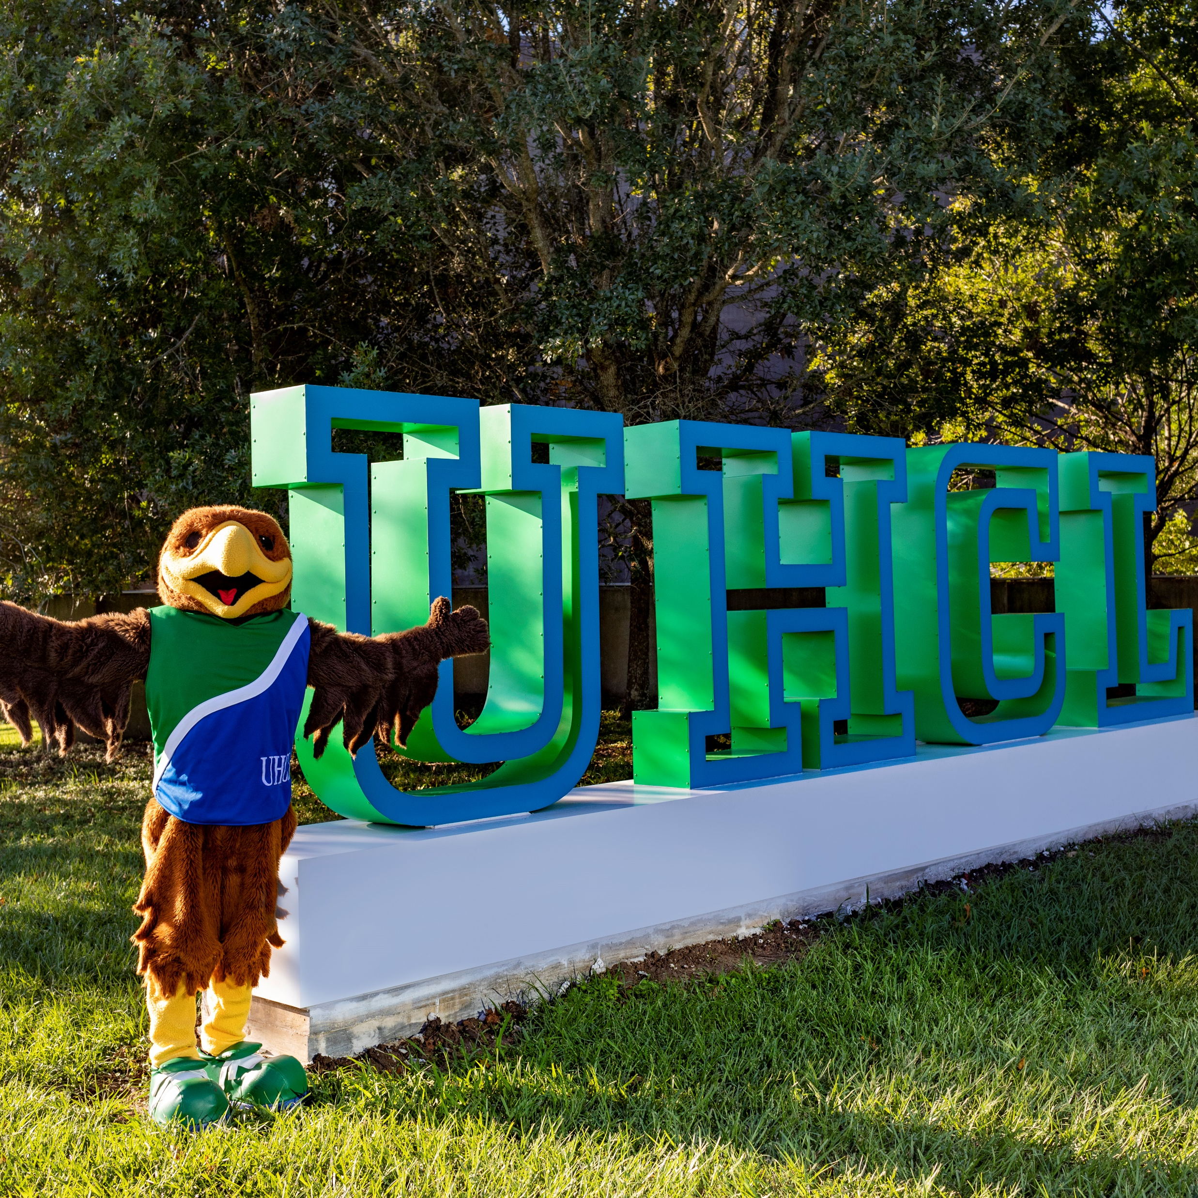
Third Year
Review
Using Workflow in Faculty Success

Slide 2
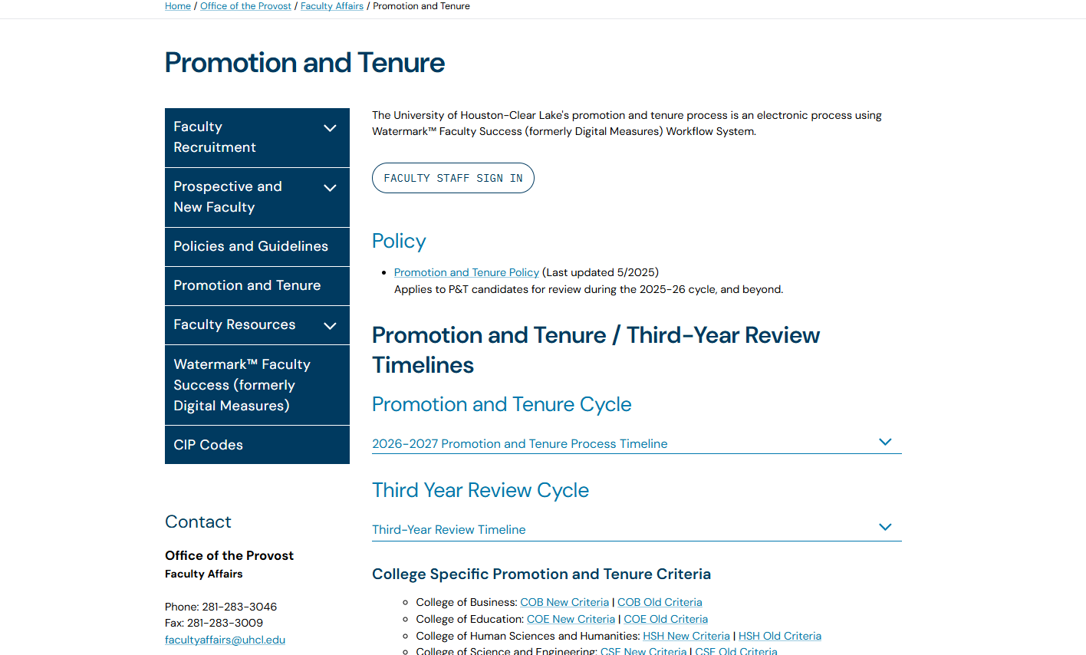
Key Resources
Faculty Affairs Webpage
Access:
TYR Policy
Support:
Workflow: facultyaffairs.edu
Policy: Contact Department Chair or Dean
Timeline
Criteria
Workflow Instructions
College | Support Administrator | Contact Info
Business | Joan Bruno | Bruno@uhcl.edu
Education | Dr. Jana Willis | Willis@uhcl.edu
Human Sciences and Humanities | Robin Alms | AlmsWinfrey@uhcl.edu
Science and Engineering | Dr. David Garrison | Garrison@uhcl.edu

Slide 3
Third Year Review Timeline
Date | Action Required
January 1 - January 31 | Candidates receive access to the TYR workflow and uploads required deliverables.
February 1 - March 15 | TYR committee completes their review, uploads their recommendation letter into workflow, records the committee’s overall recommendation for teaching, scholarship and service and forwards (submits) the candidate’s TYR file to the department chair.
March 16 - April 15 | Department chair completes their review, uploads the recommendation letter into workflow, records a recommendation for teaching, scholarship and service and forwards (submits) the TYR file to the Dean.
April 16 - May 31 | Dean completes their review, uploads the recommendation letter into workflow, records a recommendation for teaching, scholarship and service and finalizes the review.
Dates are subject to change with advanced notice.

Slide 4
Faculty Step 1- Required Uploads
Candidate Review Statement (1_1_XXX)
Applicable TYR Criteria (1_2_XXX)
Annual Evaluations (for each year since hire) (1_4a, 1_4b,etc.)
Current Curriculum Vitae (1_5_XXX)
TYR Narrative (1_6_XXX)
Appendix Materials (1_7_XXX)
Supporting Documents for: General, Teaching, Research, and Service (1_8a_1_8b,etc.)

Slide 5
Naming Convention
Follow the required file naming format for all uploads
Ensure file names are consistent and clearly labeled
Include required documents using correct naming structure
(e.g., 1_1_LastName, 1_4a_LastName)
PDF Format only (no portfolios)
Step 1. Faculty | Example Faculty: Cisneros
1.*Candidate Review Statement | 1_1_Cisneros Review Statement.pdf
2.*Applicable Third Year Review Criteria | 1_2_Cisneros P&T Criteria.pdf
3. Written Notifications of probationary period extensions(if applicable) | 1_3_Cisneros Probation Extensions.pdf
4.*Annual Evaluations from the Department Chair foreach year during the evaluative period | 1_4a_Cisneros Annual Evaluation 2024.pdf 1_4b_ Cisneros Annual Evaluation 2025.pdf
5. .*A current curriculum vitae | 1_5_Cisneros CV.pdf
6.*Candidate’s TYR Narrative | 1_6_Cisneros TYR Narrative.pdf
7. Appendix Material Table of Contents | 1_7_Cisneros Appendix TOC.pdf
8. Appendix Material | 1_8a_ Appendix Faculty Fellowship.pdf; 1_8b_ Appendix Researcher Award.pdf
8a. Appendix Material A: General 8b. Appendix Material B: Teaching 8c. Appendix Material C: Research 8d. Appendix Material D: Service | 1_8ageneral01_Cisneros Table of Annual Reviews.pdf 1_8bteaching01_Cisneros List of Courses by Semester.pdf 1_8cresearch01_Cisneros Summary of Journal Info.pdf 1_8dservice01_Cisneros Table of Professional Service.pdf

Slide 6
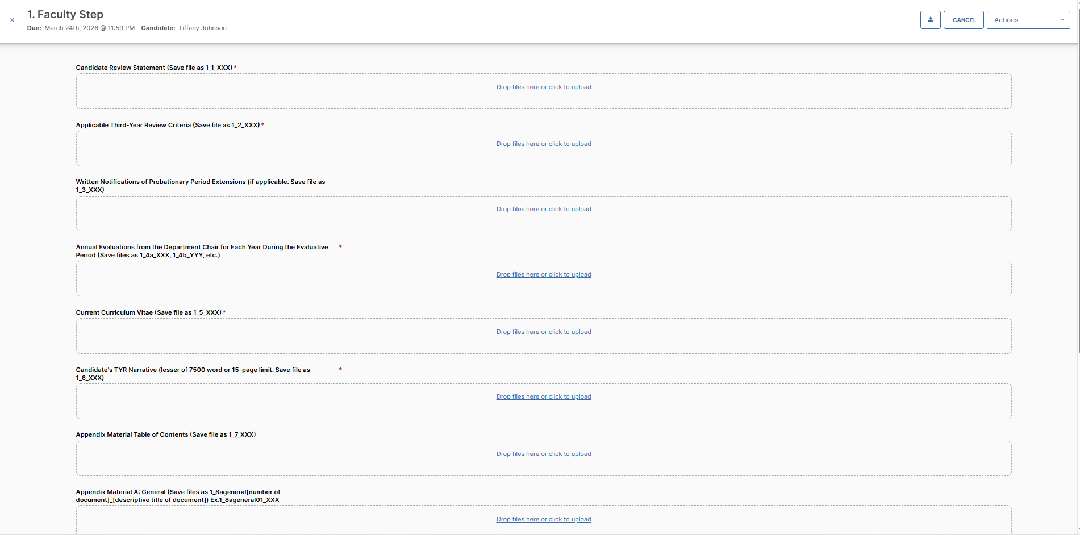
Faculty Application
Upload required documents in this screen
Ensure all required fields are completed before submitting

Slide 7
Recommendation for Narrative
Show how you meet or exceed Third Year Review criteria
Organize by Teaching, Research, and Service (include intro/conclusion if needed)
Focus on work completed at UHCL
Reference supporting appendix materials throughout
Highlight impact clearly and professionally
Explain roles that may not be clear from your CV
(e.g., Board of Directors for a national organization vs. UHCL Faculty Senator)

Slide 8
Workflow Steps
Each step must be completed before the workflow process advances.

Slide 9
Workflow Steps
Step 1 – Faculty Submission
Upload all required documents using correct naming conventions
Review materials for accuracy and completeness
Submit before the deadline to move forward
Step 2 – TYR Committee Review
Committee evaluates Teaching, Research, and Service
Step 3 – Department Chair Review
Reviews candidate materials and committee recommendation
Step 4 – Dean Review
Reviews full file and prior recommendations
Step 5 – Faculty Response (Required)
Select rating (e.g., Satisfactory) for each area Add comments (optional)
Upload Committee Recommendation (2_1_XXX)
Submit to next step
Research / Scholarly Activities
Service Activities (required)
Submit to next step
Select overall review status (e.g., Approved)
Upload required recommendation documents: Teaching & Educational Activities
Provides evaluation and recommendation
Submits to next step
Candidate must review and acknowledge prior evaluations
May upload a response or additional information (optional)
Submit within designated review window

Slide 10
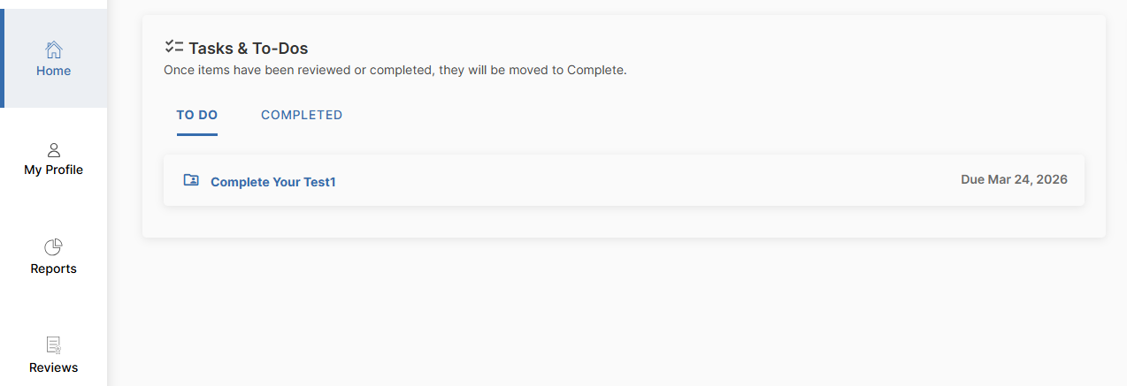
Your Inbox
Displays submissions that require action
Shows current step and due date
Select the process name to begin

Slide 11

Questions?
Visit the
Faculty Affairs Webpage
Email:
FacultyAffairs@uhcl.edu

