Slide 1
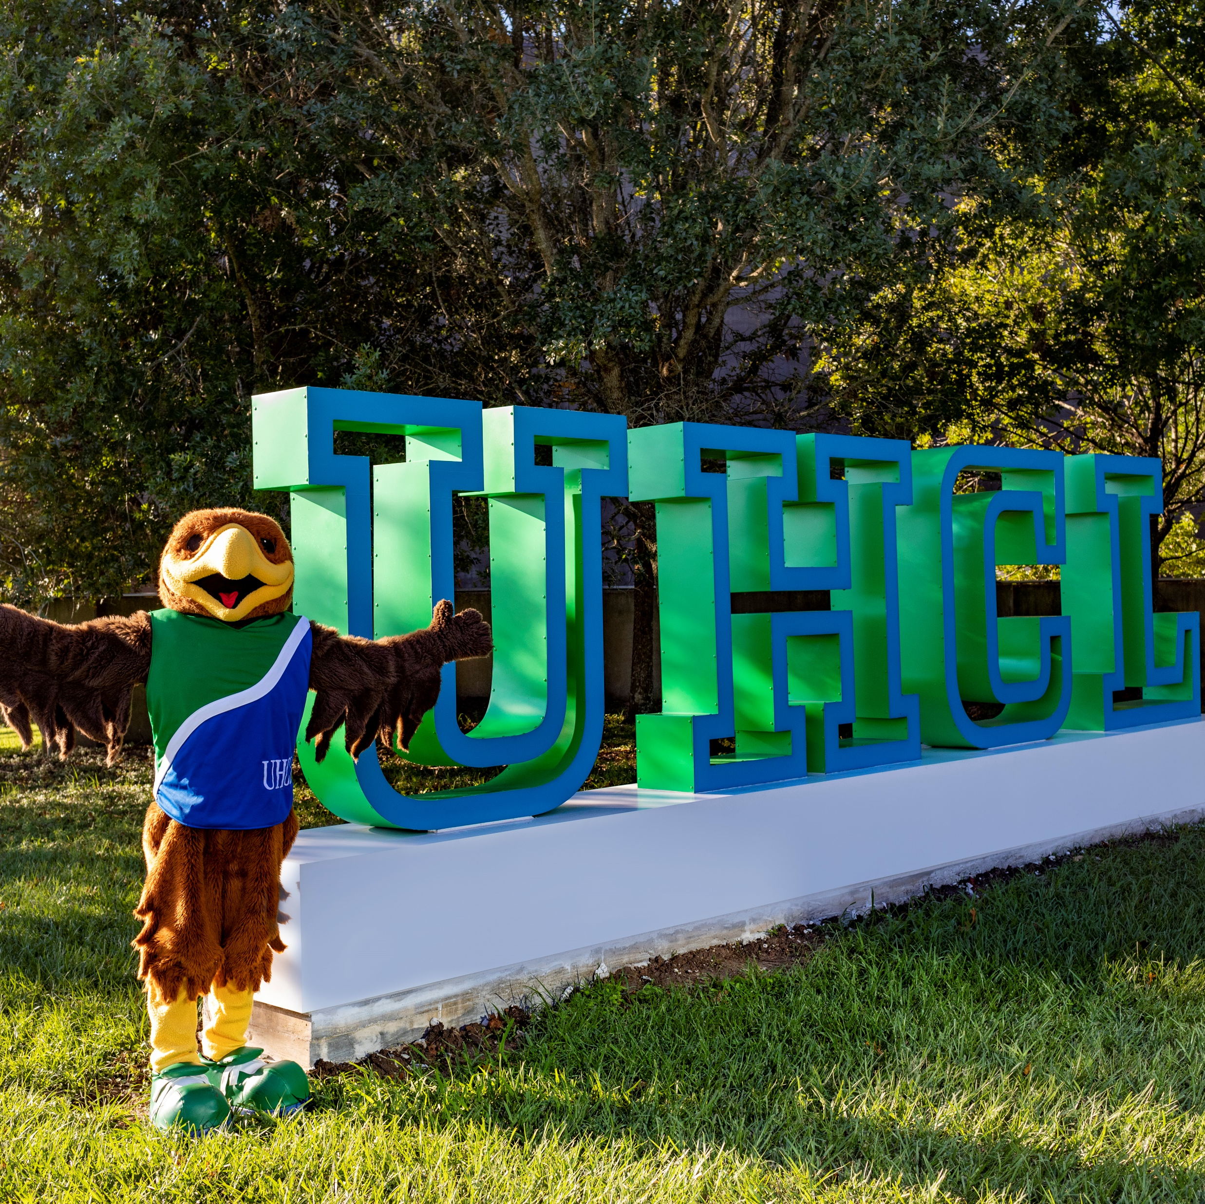
Promotion & Tenure
Using Workflow in Faculty Success
Academic Year: 2026-2027

Slide 2
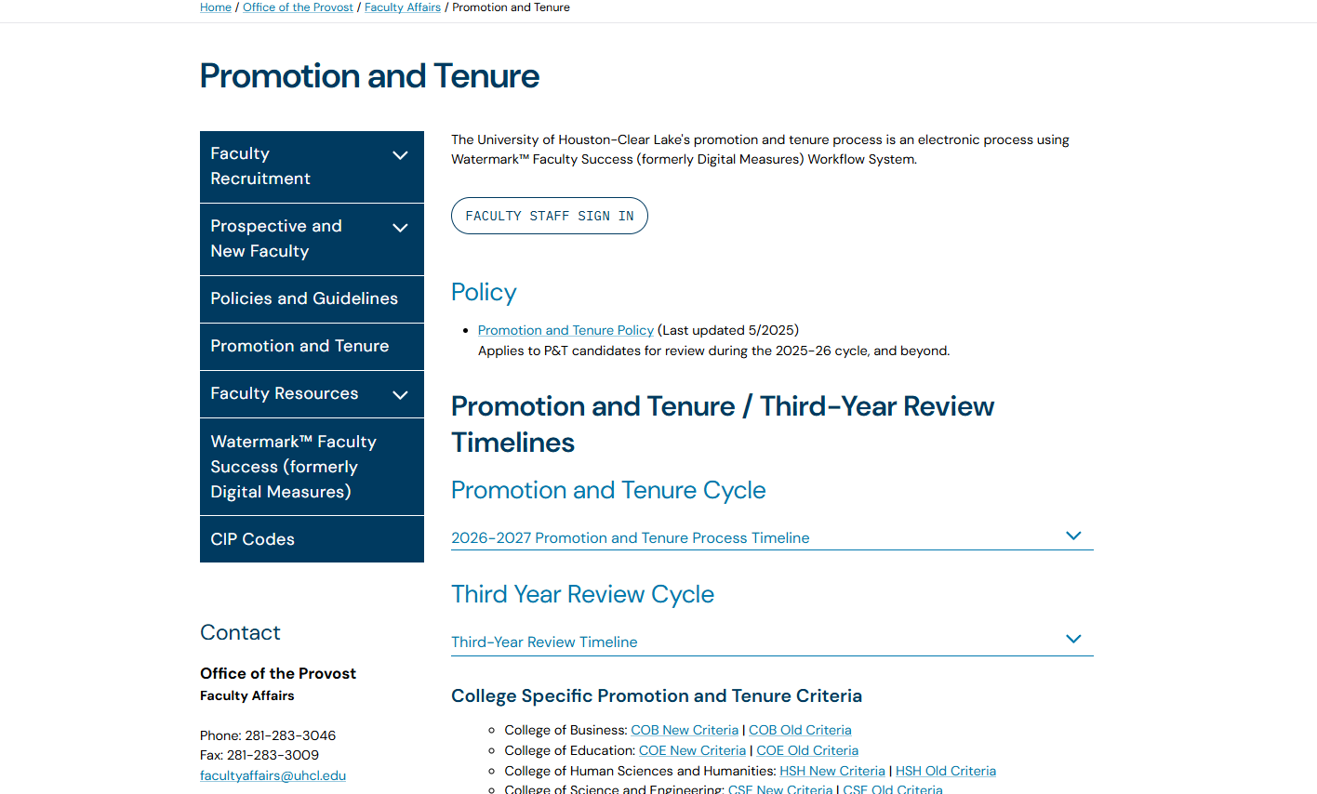
Key Resources
Access:
P&T Policy
Timeline
Criteria (Old & New)
Workflow Instructions
Support:
Contact your college-level support administrator for assistance with requesting additions/changes to role groups, role group training/responsibilities, or requested contributions to a submission.
Faculty Affairs Webpage
College | Support Administrator | Contact Info
Business | Joan Bruno | Bruno@uhcl.edu
Education | Dr. Jana Willis | Willis@uhcl.edu
Human Sciences and Humanities | Robin Alms | AlmsWinfrey@UHCL.edu
Science and Engineering | Dr. David Garrison | Garrison@uhcl.edu

Slide 3
P&T Workflow 2026-2027 Timeline
Date | Action Required
Friday, March 27, 2026 | Deans provide Office of the Provost with the following information: (1) associate professors going up for promotion to professor, (2) assistant professors going up for promotion and tenure to associate professor and (3) any associate professors or professors going up for tenure.
Thursday, April 2, 2026 | Office of the Provost approves the final list of candidates going up for P&T in 2026-27. Candidates requesting the addition of a PRC member from an appropriately related discipline or program across campus submit requests to Dean in writing.
Monday, April 27, 2026 | Each college provides Office of the Provost a list of peer review committees (members and chairs) and department chair reviewers for each candidate. Dean’s decision and justification provided to candidate in writing. Candidate notified in writing of final committee membership.
Monday, May 18, 2026 | Candidates receive access to the 2026-27 P&T workflow. Candidates submit a list of at least five external reviewers to their associate dean or their college designee.
Friday, May 29, 2026 | Candidates provide external review packet to their associate dean or their college designee.
Friday, June 12, 2026 | Associate dean or college designee sends external evaluation file to P&T candidate’s outside reviewers.

Slide 4
P&T Workflow 2026-2027 Timeline
Date | Action Required
Friday, September 11, 2026 | Candidates must submit their Promotion and Tenure Document in the 2026-27 P&T workflow. Department Chairs have access to files to facilitate submission of external review letters. This represents the deadline for external review letters to be received.
Friday, October 16, 2026 | Deadline for PRC to complete their review, upload their recommendation letter into workflow, record the committee’s overall recommendation for teaching, scholarship and service and forward (submit) the candidate’s P&T file to the department chair.
Friday, November 13, 2026 | Deadline for the department chair to complete their review, upload the recommendation letter into workflow, record a recommendation for teaching, scholarship and service and forward (submit) the P&T file to the submission box.
Friday, November 20, 2026 | Deadline for candidate’s 5 business day window to review their P&T file and add any candidate letter of information/rebuttal, if desired, to the P&T file. P&T file is released to the dean for review. If no rebuttal is needed, candidate forwards file to dean on or before this date.
Friday, January 1, 2027 | Deadline for dean to complete their review, upload the recommendation letter into workflow, record a recommendation for teaching, scholarship and service and forward (submit) the P&T file to the submission box.
Monday, January 11, 2027 | Deadline for candidate’s 5 business day window to review their P&T file and add any candidate letter of information/rebuttal, if desired, to the P&T file. P&T file is released to the University Promotion and Tenure Committee (UPTC) for review. If no rebuttal is needed, candidate forwards file to UPTC for review on or before this date.

Slide 5
Faculty Step 1- Required Uploads
Candidate Review Statement (1_1_XXX)
Applicable P&T Criteria (1_2_XXX)
Annual Evaluations (for each year since hire/ previous promotion) (1_4a, 1_4b,etc.)
Third-Year Review Letters (tenure-track candidates only)
Current Curriculum Vitae (1_5_XXX)
P&T Narrative (Below 7500 words and 15-page limit) (1_6_XXX)
Appendix Materials (1_7_XXX)
Supporting Documents for: General, Teaching, Research, and Service

Slide 6
Naming Convention
Follow the required file naming format for all uploads
Ensure file names are consistent and clearly labeled
Include required documents using correct naming structure (e.g., 1_1_LastName, 1_4a_LastName)
PDF Format only (no portfolios)
Step 1. Faculty | Example Faculty: Cisneros
1.*Candidate Review Statement | 1_1_Cisneros Review Statement.pdf
2.*Applicable Third Year Review Criteria | 1_2_Cisneros P&T Criteria.pdf
3. Written Notifications of probationary period extensions(if applicable) | 1_3_Cisneros Probation Extensions.pdf
4.*Annual Evaluations from the Department Chair foreach year during the evaluative period | 1_4a_Cisneros Annual Evaluation 2024.pdf 1_4b_ Cisneros Annual Evaluation 2025.pdf
5. Third-Year Review letters from peer committee and Department Chair | 1_5a_Cisneros Third Year Review.pdf; 1_5b_Cisneros Third Year Review.pdf
6.*A current curriculum vitae | 1_6_Cisneros CV.pdf
7.*Candidate’s P&T Narrative | 1_7_Cisneros PT Narrative.pdf
8. Appendix Material Table of Contents | 1_8_Cisneros Appendix TOC.pdf
9. Appendix Material | 1_9a_ Appendix Faculty Fellowship.pdf; 1_9b_ Appendix Researcher Award.pdf
9a. Appendix Material A: General 9b. Appendix Material B: Teaching 9c. Appendix Material C: Research 9d. Appendix Material D: Service | 1_9ageneral01_Cisneros Table of Annual Reviews.pdf 1_9bteaching01_Cisneros List of Courses by Semester.pdf 1_9cresearch01_Cisneros Summary of Journal Info.pdf 1_9dservice01_Cisneros Table of Professional Service.pdf

Slide 7
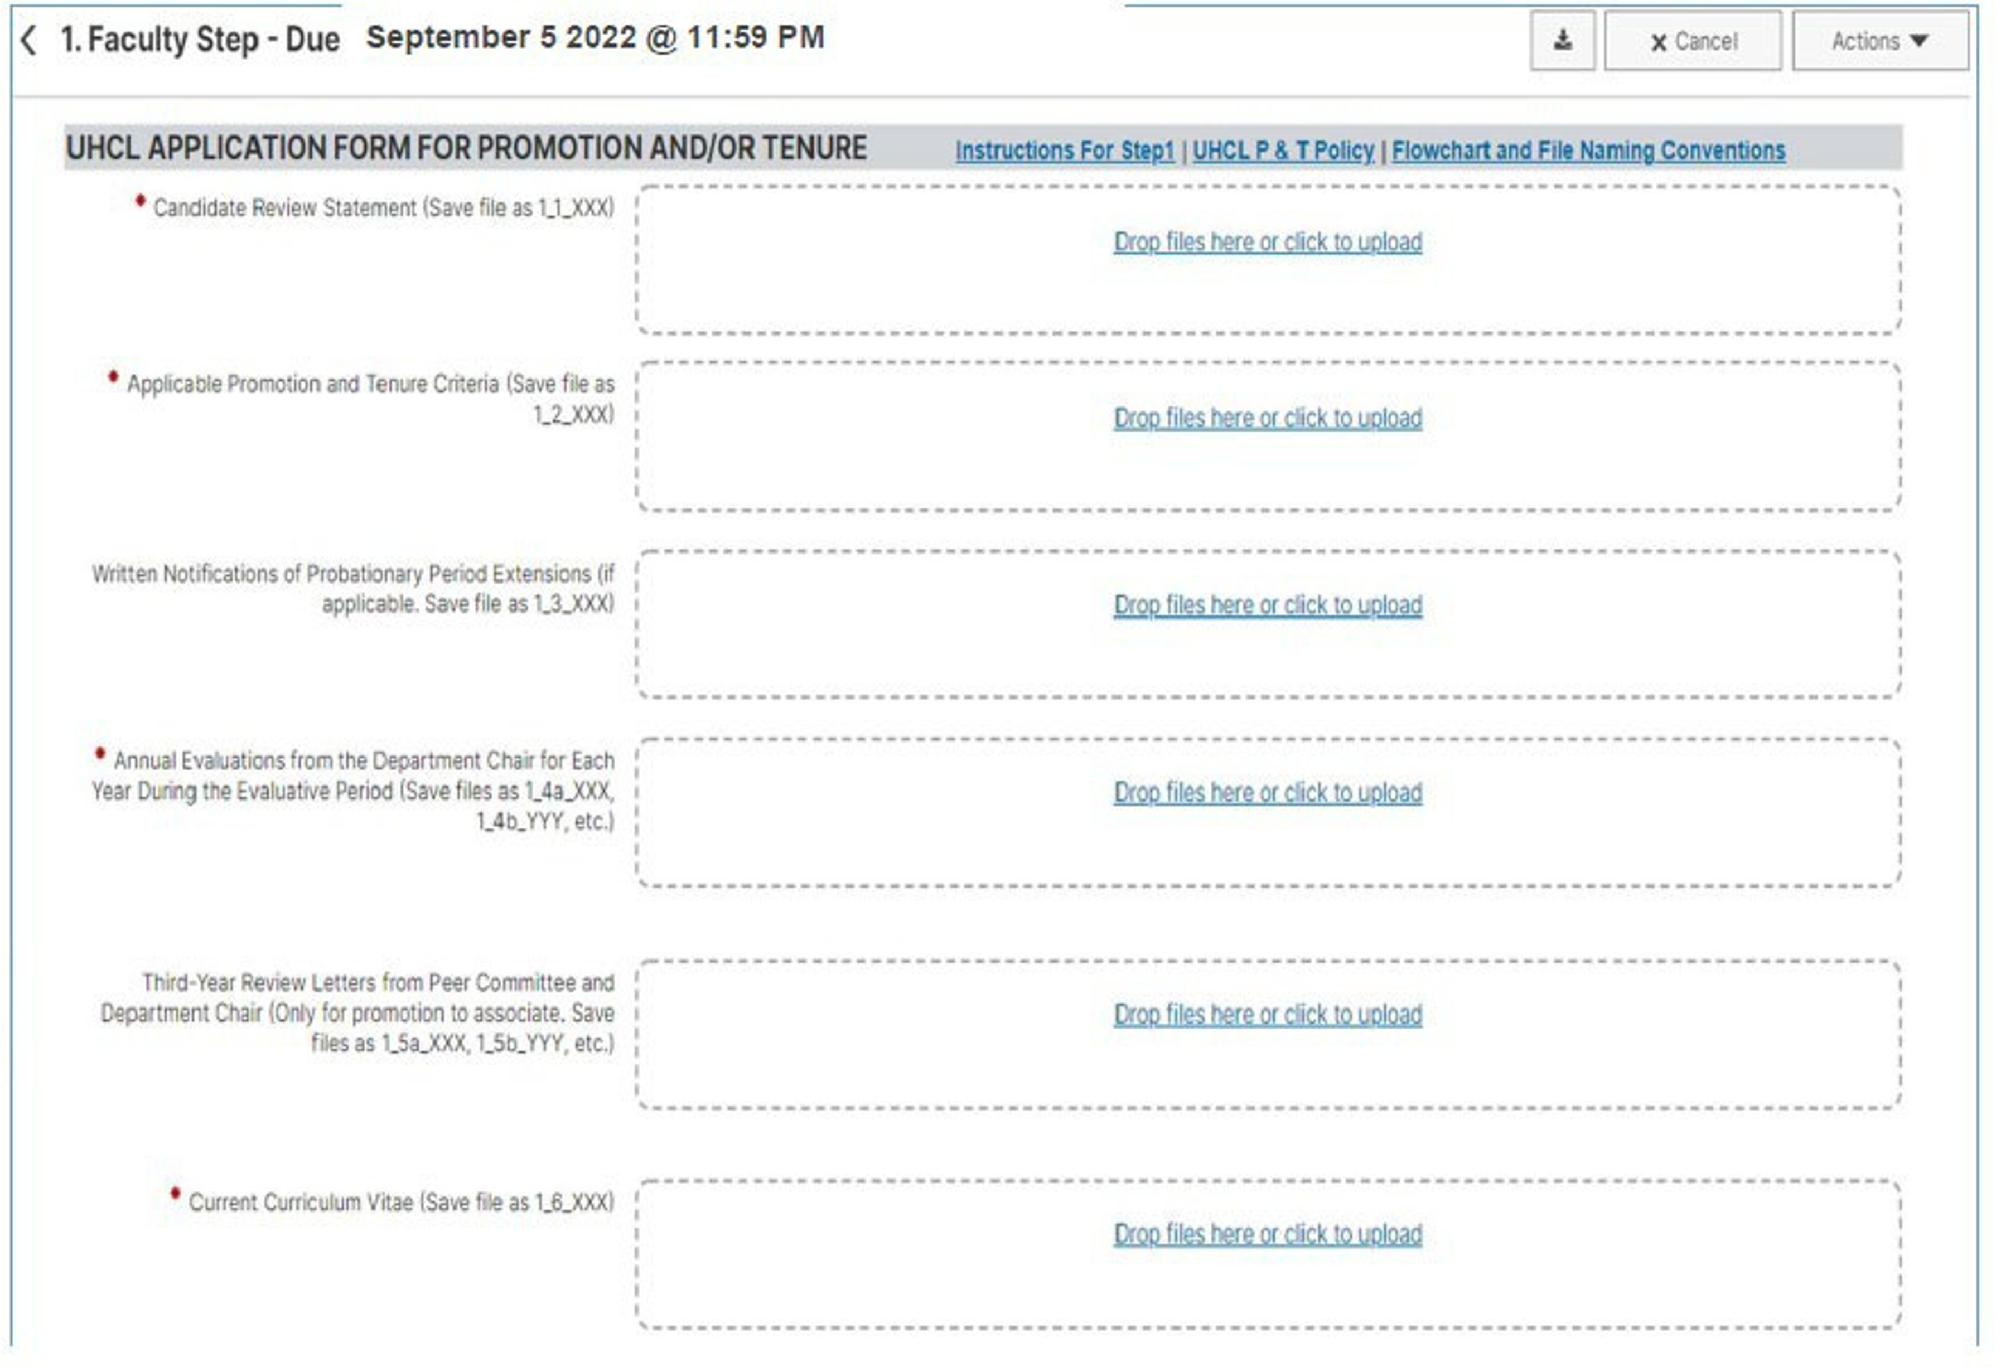
Faculty Application
Rename your files before uploading
You are required to upload, or the workload step will auto-advance at 12:00 midnight
PDF Files are ideal; Do NOT use PDF Portfolio Files
1GB max size for any files

Slide 8
Recommendation for Narrative
Show how you meet or exceed Promotion & Tenure criteria
Organize by Teaching, Research, and Service (include intro/conclusion if needed)
Focus on work completed at UHCL
Reference supporting appendix materials throughout
Highlight impact clearly and professionally
Explain roles that may not be clear from your CV (e.g., Board of Directors for a national organization vs. UHCL Faculty Senator)

Slide 9
Promotion Criteria: Old vs. New
Old Criteria
Applies to:
Promotion to Associate Professor (if hired Fall 2019 or earlier)
Promotion to Full Professor (valid through Sept. 2024 internal application)
Rating System:
Excellent
Very Good
Satisfactory
Less than Satisfactory
Poor(Applied to teaching, research, and service)
To Full Professor:
Excellent in Teaching or Research
At least Very Good in the other two areas
New Criteria (All Candidates)
Evaluation Areas:
Teaching
Scholarship
Service (Using college-specific criteria)
Ratings:
Recommend (Approve)
Do Not Recommend
Promotion Requirement:
Approval required in all three areas

Slide 10
Navigating the Promotion & Tenure
Workflow System

Slide 11
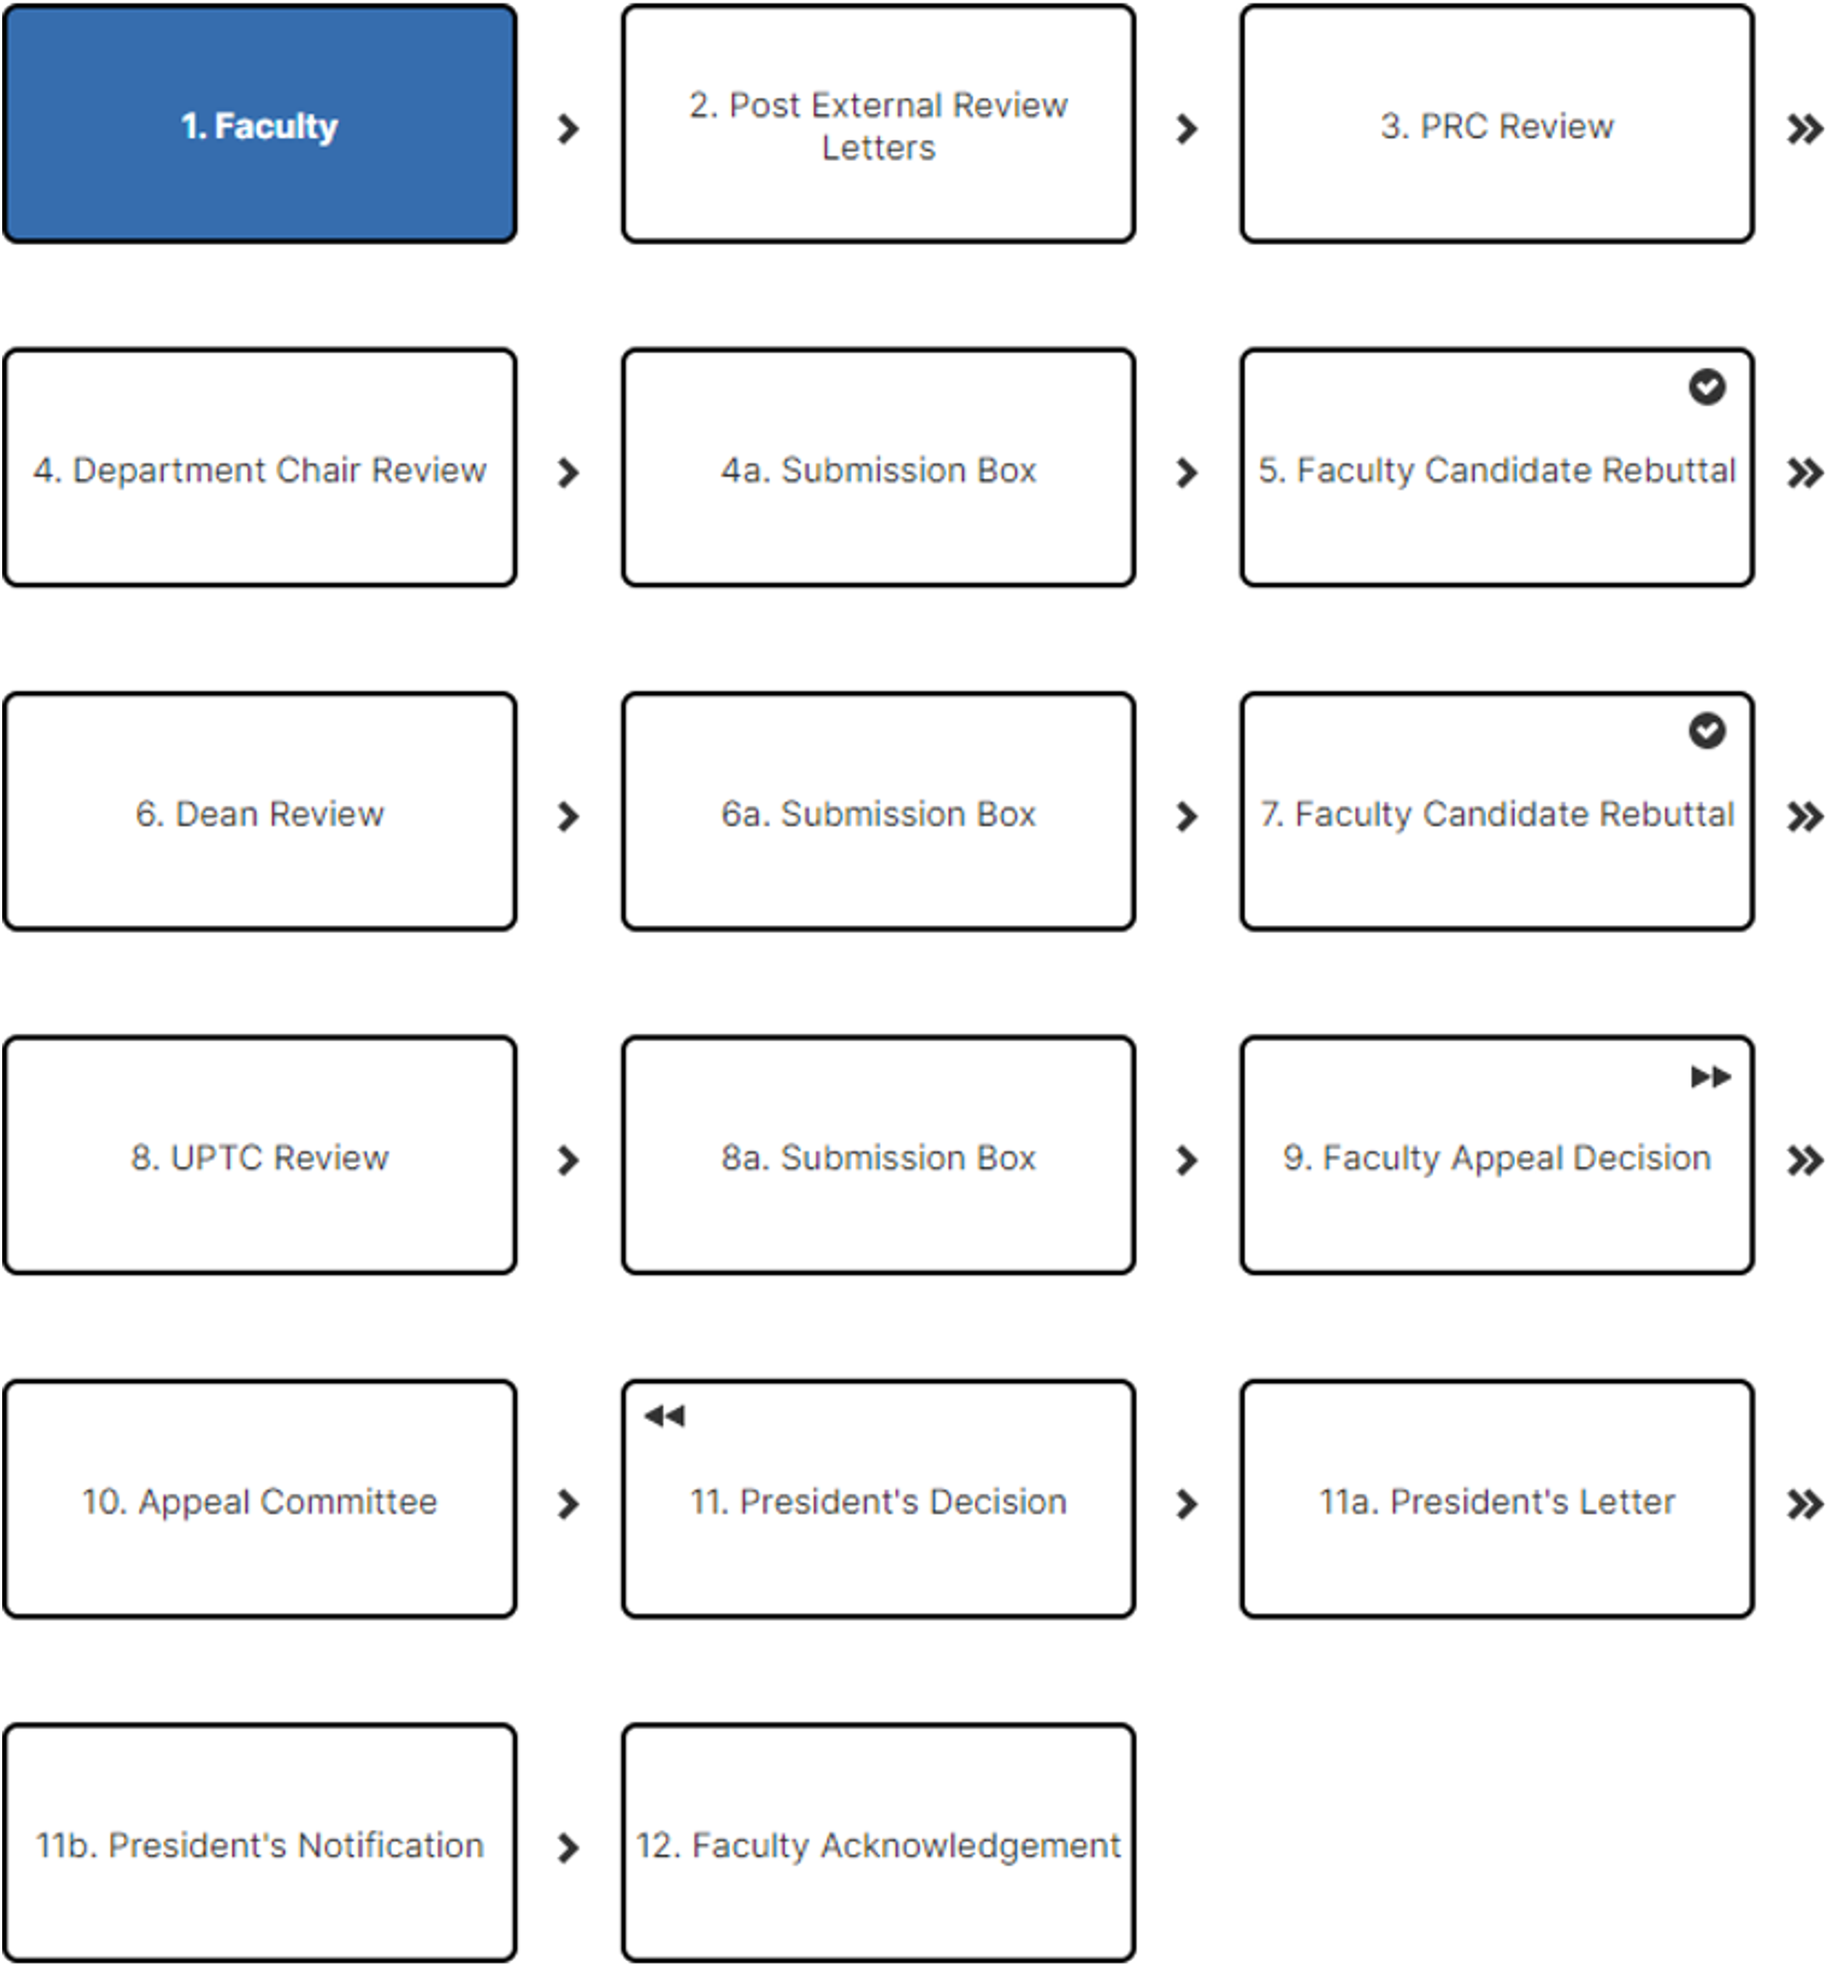
Workflow
Schedule

Slide 12
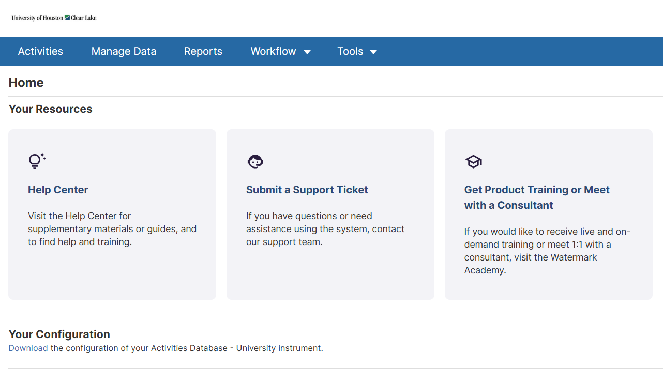
Your Inbox
Displays submissions that require action
Shows current step and due date
Select the process name to begin

Slide 13
Workflow Steps
Step 1 – Faculty Submission
Upload required materials
Submit application
Step 2 – External Review Letters
External review letters are uploaded to the file
Step 3 – Peer Review Committee (PRC)
Reviews materials and external letters
Evaluates Teaching, Research, and Service
Uploads recommendation
Step 4 – Department Chair Review
Reviews file and PRC recommendation
Provides evaluation and recommendation
Step 4a – Submission Box (Post-Chair)
Step 5 – Faculty Candidate Rebuttal
Required: Review and acknowledge
Optional: Submit rebuttal or additional information
Step 6 – Dean Review
Reviews full file and prior recommendations
Provides evaluation
Step 6a – Submission Box (Post-Dean)
Dean evaluation and recommendation are uploaded
Step 7 – Faculty Candidate Rebuttal
Required: Review and acknowledge
Optional: Submit rebuttal
Step 8 – UPTC Review
Committee reviews and votes on case
Step 8a – Submission Box (Post-UPTC)
File prepared for next step
Step 9 – Faculty Appeal Decision (If Applicable)
Candidate may initiate appeal
Step 10 – Appeal Committee (If Applicable)
Reviews appeal case
Step 11 – President’s Decision
Final institutional decision
Step 11a – President’s Letter / Notification
Decision letter issued to candidate
Step 11b – President’s Notification
Official notification provided
Step 12 – Faculty Acknowledgement
Candidate acknowledges final outcome
File is prepared for next step
Chair evaluation and recommendation are uploaded
File is prepared for the next step.
UPTC recommendation is uploaded

Slide 14
Key Elements
SUBMISSION BOX
24 hour before forwarding (Aligns with Due dates Timeline on Provost website.)
FACULTY REBUTTAL (Steps 5 & 7)
Accept and Submit
Add rebuttal and Submit on/or before due date
FACULTY APPEAL
Review Policy
Email Provost
Select Faculty Appeal
REMINDER
Save & Submit to next step or your materials will auto advance on the due date.

Slide 15

Questions?
Visit the
Faculty Affairs Webpage
Email:
FacultyAffairs@uhcl.edu

