Slide 1

Field Skills
Texas Envirothon 2025 | Forestry

Slide 2
Field Skills– Students will be able to…
Identify common local trees and plants by leaves, bark, branching patterns, buds, fruit, and other characteristics without the use of a key.
Identify uncommon local trees and plants with the use of a key.
Describe how foresters and plant ecologists use GIS in their work
Use common forestry tools, such as:
  Biltmore stick/Merritt hypsometer
  D-tape
  Wedge prism
  Tree caliper
  Clinometer
  Increment borer
  GPS

Slide 3
Field Skills– Students will be able to…
Make management recommendations based on ecological conditions of the forest and management goals (such as wildlife habitat, timber production, recreation, et cetera).
Identify common plant pests and diseases without use of a key, describe how they are spread, and list methods of control
Utilize and make common forestry measurements, such as diameter at breast height (DBH), chain, cord, total tree height, merchantable height, board feet, log, and basal area.
Interpret a site index graph.
Interpret current and historical aerial photographs in the context of land use, succession, and forest growth.

Slide 4
Measuring the Forest
Foresters use different units of measurement to determine how healthy and productive a forest is. These measurements help the forester determine what actions need to be taken to keep the forest functioning.

Slide 5
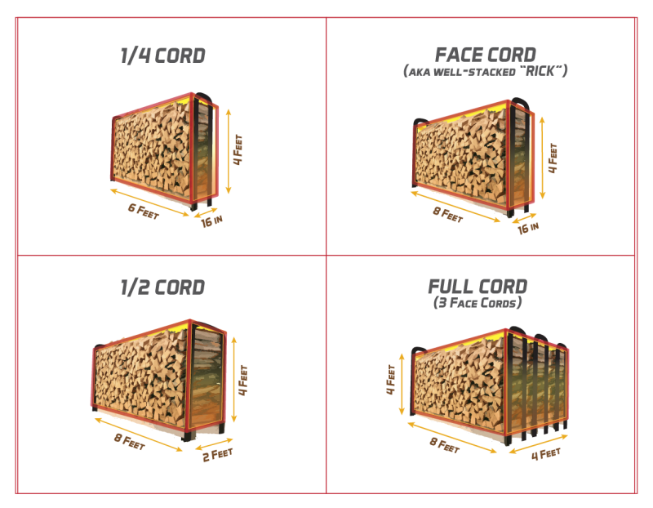
Forestry Units of Measurement
DBH: diameter at breast height (4.5ft off the ground in the U.S.)
Chain: 66ft; the length of a surveyor’s chain with 100 links. 10 square chains make up an acre.
Cord: amount of dried wood when “racked and well stowed” that occupies a volume of 128 cubic feet (4’x8’x4’)
Representations of a cord of wood,
Image from 100 Acre Firewood

Slide 6
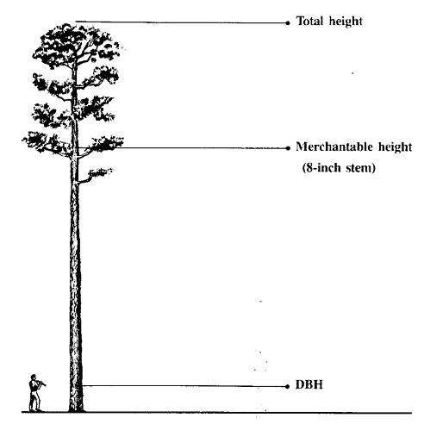
Forestry Units of Measurement
Total Tree Height: the height of a tree from the stump (1’ off the ground) to the top of the crown
Merchantable Height: the length of usable tree for making boards, starting at the stump (1’)
Board feet: The volume of a board of wood that is 1’x1’x1”
Three important tree heights
Mississippi State University Extension

Slide 7
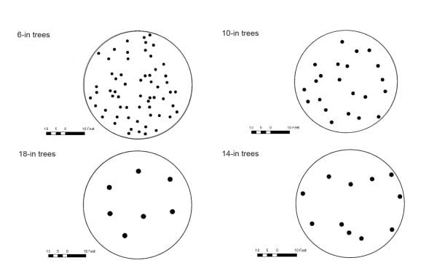
Forestry Units of Measurement
Basal Area: a measure of stand density.
  The cross-sectional area of all trees at breast height (4.5’ above ground level), measured in square feet per acre.
  The amount of space the base of a tree occupies
  Important tool for determining the optimal habitat requirements for wildlife, productivity, and stand management needs
A bird’s-eye view of 60 sq. ft basal area across trees of different sized diameters.
John Gilbert, Longleaf Pine Stand Dynamics Lab, School of Forestry and Wildlife Sciences, Auburn University

Slide 8
Forestry Tools
The tools a forester utilizes depends on job type and location. This list includes some of the common tools a forester may use when analyzing a forest.

Slide 9
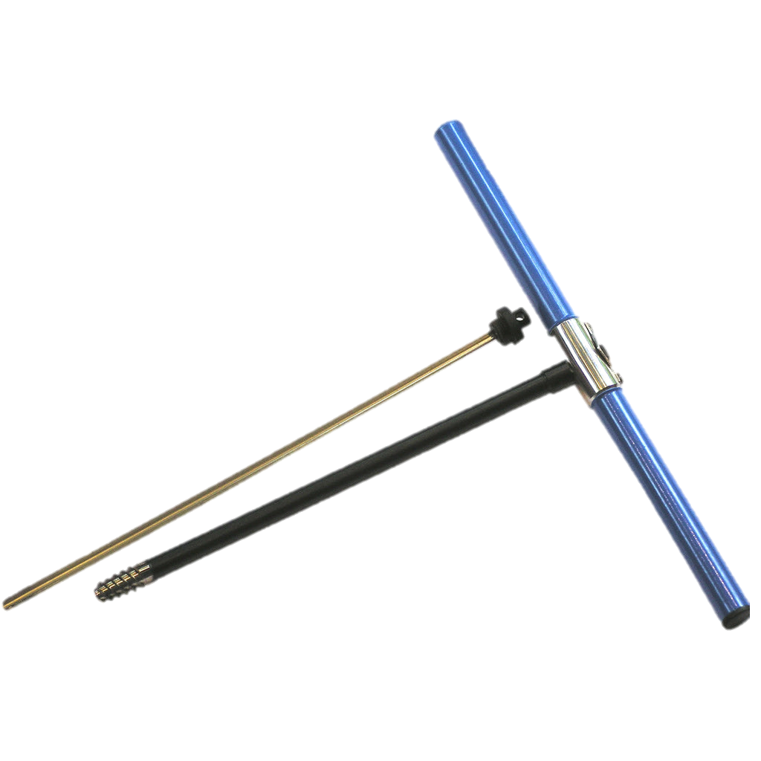
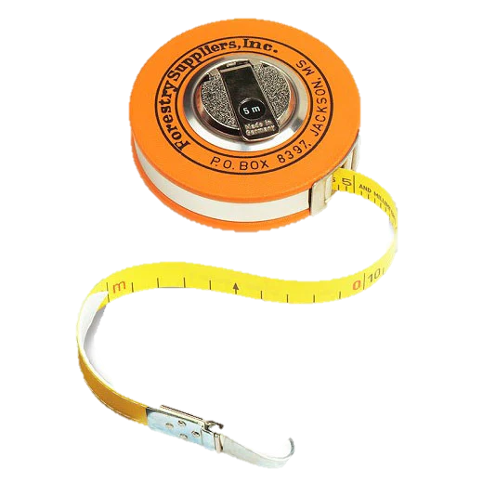


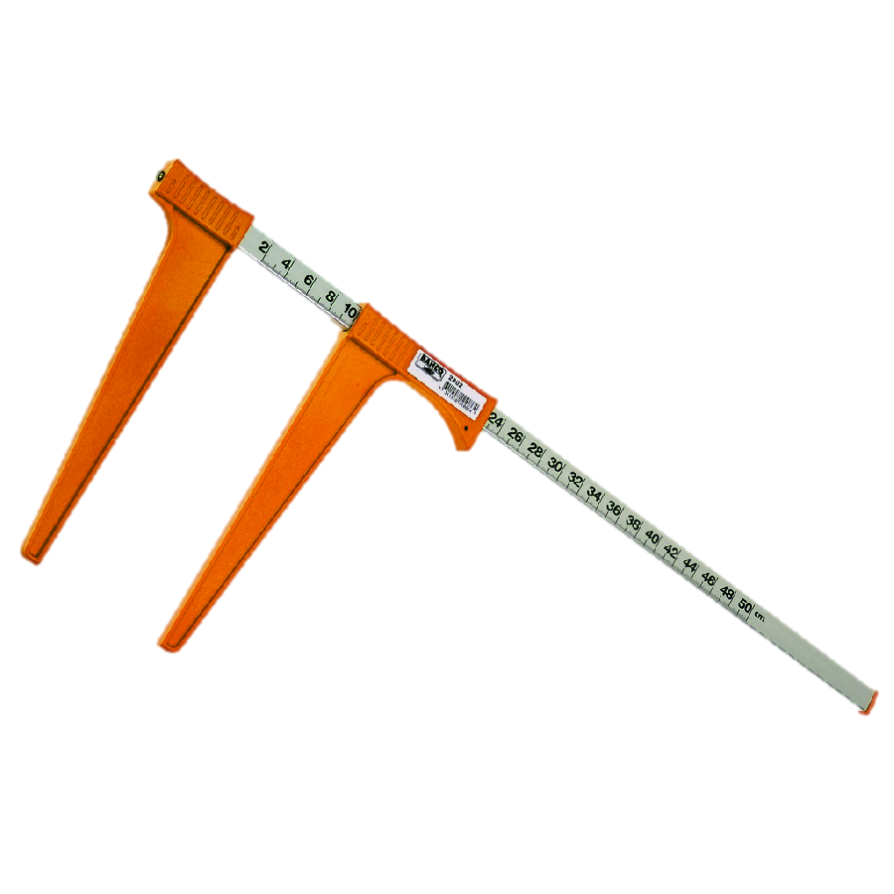

(diameter)
D-tape
Cruising prism
Increment borer
Biltmore stick with Merritt Hypsometer scale
Tree caliper
Clinometer
Notes:
Biltmore stick, Forestry Suppliers https://www.forestry-suppliers.com/p/59780/14431/english-biltmore-stick
D-tape, BioWeb https://www.global.bioweb.co/products/forestry-suppliers-fabric-diameter-tape
Clinometer, Whizz https://oman.whizzcart.com/product/1357064/suunto-pm-5-clinometer-accurately-measure-heights-vertical-angles-and-slopes/
Cruising prism, Forestry Suppliers https://www.forestry-suppliers.com/p/59026/13911/jim-gem-rectangular-cruising-prisms
Tree caliper, ToolSource https://www.toolsource.com/dial-calipers-c-614_265/caliper-50cm-p-391928.html
Increment borer, Forestry Tools https://www.forestrytools.com.au/products/haglof-increment-borer-600mm-2-thread

Slide 10
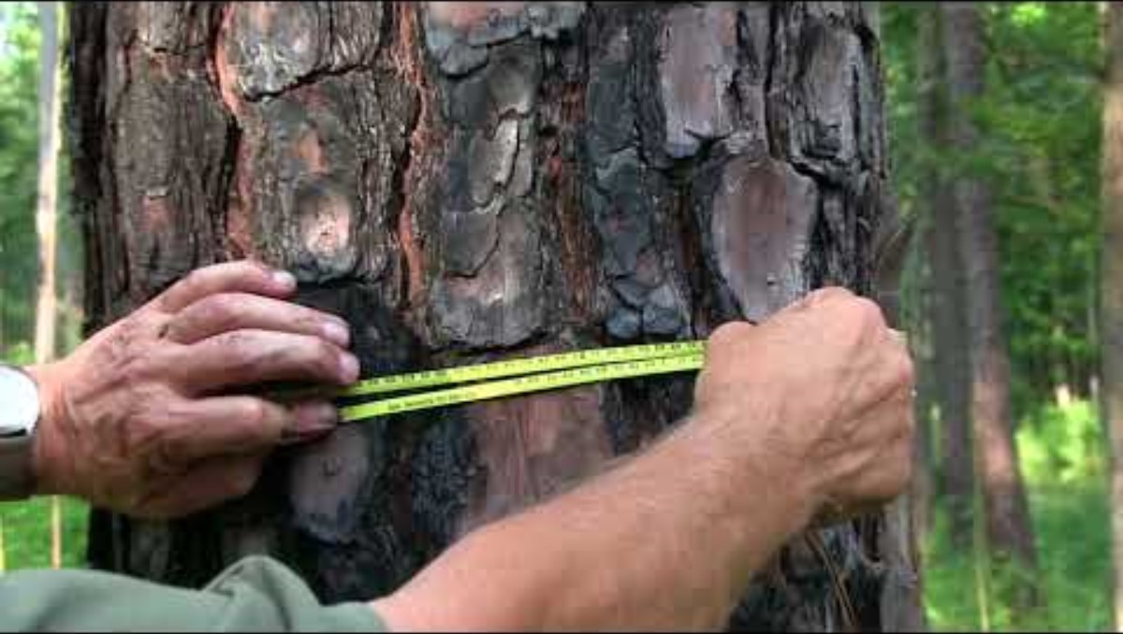
Measuring Diameter with a D-Tape
Diameter tape (d-tape) used to measure diameter of tree at DBH
Remember high school geometry: diameter = circumference/π
  D-tape units are already reduced by π, so no conversion is needed!
Measuring tree diameter using a diameter tape
North Carolina State University

Slide 11
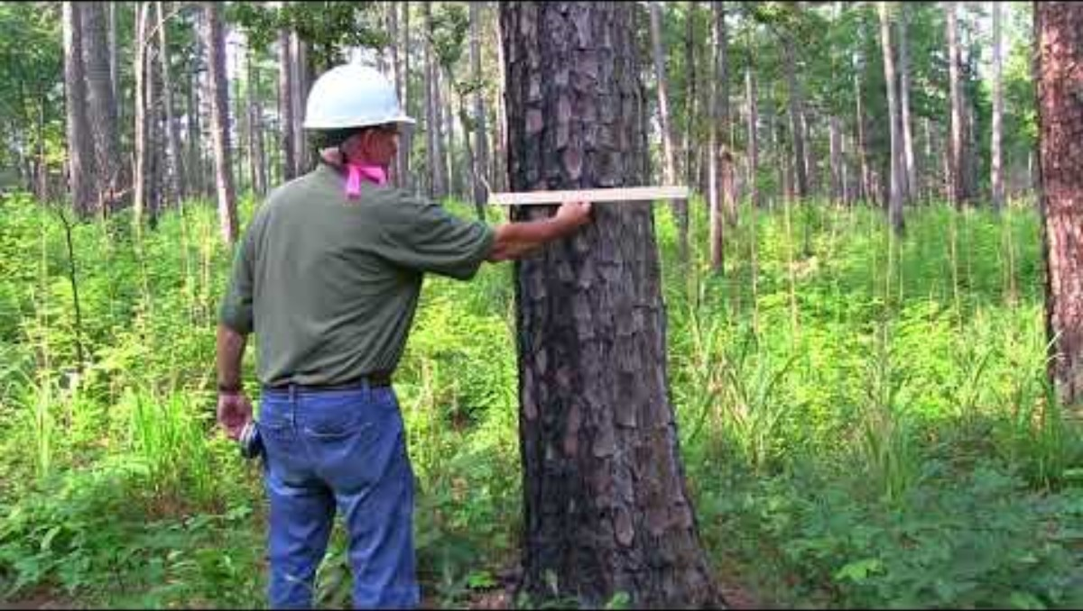
Measuring Diameter with a Biltmore Stick
Biltmore measurements and Merritt hypsometer scale are commonly included on the same tool, but on opposite sides.
Biltmore measurements are used to determine diameter
Merritt hypsometer scale is used to determine height
Measuring tree diameter using a Biltmore stick
North Carolina State University

Slide 12
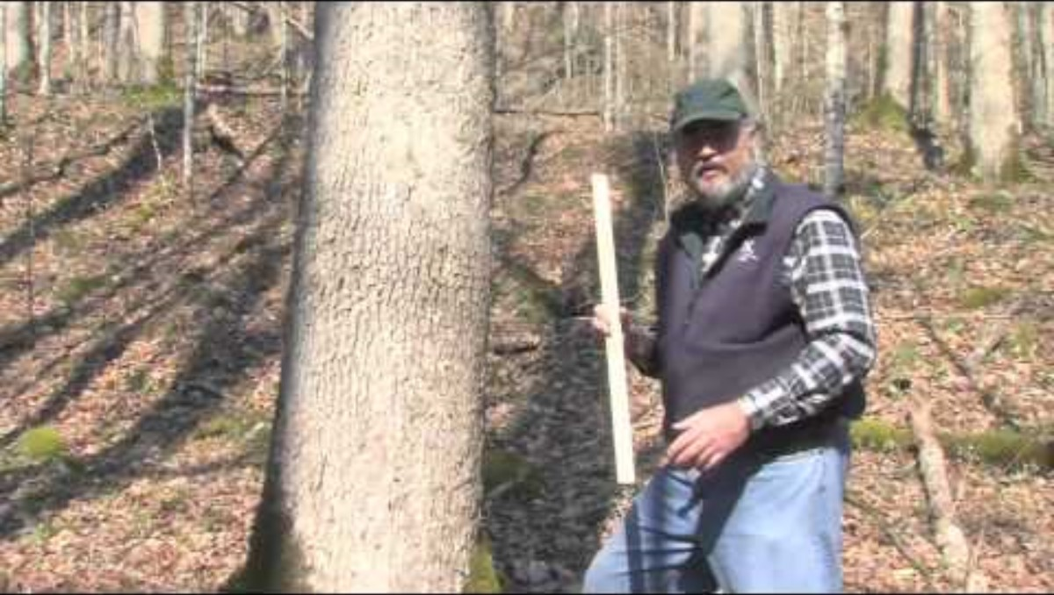
Measuring Diameter with a Tree Caliper
As with d-tape or a Biltmore stick, always measure from breast height
If the tree has an irregular shaped circumference (i.e. not perfectly round), take two measurements
  Measure the thinner side, the wider side, then find the average diameter.
Measuring tree diameter with a tree caliper
University of Kentucky Forestry and Natural Resources

Slide 13
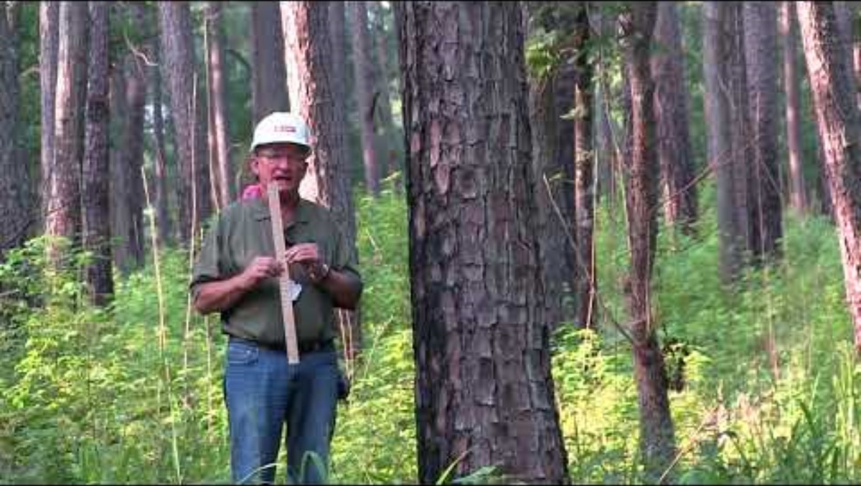
Measuring Merchantable Height using Merritt Hypsometer Scale
Merchantable height is the length of usable tree to make board products.
Three important tree measurements (MSU Extension)
Measuring Tree height with a Scale Stick
North Carolina State University

Slide 14
Measuring Merchantable Height using Merritt Hypsometer Scale
Merchantable height is the length of usable tree to make board products.
The standard length for a board of timber is 16ft
To convert the number of boards to total merchantable height:
# boards x 16ft = Merchantable height in ft
Three important tree measurements (MSU Extension)

Slide 15
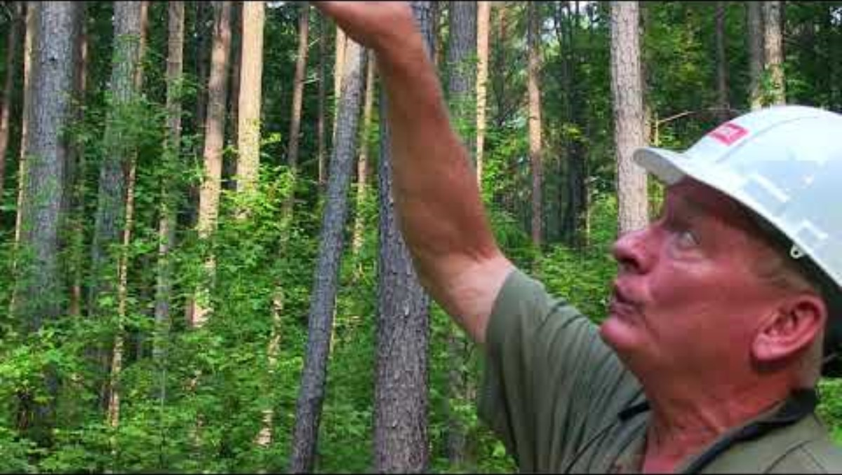
Measuring Height with a Clinometer
Depending on the brand, a clinometer may show different scales in the viewfinder. Common scales are:
Percentage scale
Topographic scale
Measuring tree height with a clinometer
North Carolina State University

Slide 16
Reading a Clinometer | Percent Scale
Remember: subtracting a negative number means you add its value.
Percent scale is useful for determining the height of a tree from any distance but requires conversions.
Determine your horizontal baseline distance from the tree in feet
Sight the top and bottom of the tree to find % to top and % to bottom.
% to top - % to bottom = total % height
Total % height x horizontal baseline distance = actual height
Example:
A forester measures the height of a tree from a distance of 100 feet. Using a clinometer, they sight the top of the tree as 70% and the bottom of the tree as -5%.
70% - (-5%) = 75%.
75% of 100ft is 75ft.
The tree has a height of 75ft.

Slide 17
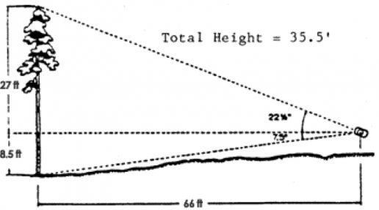
Reading a Clinometer | Topographic Scale
Remember: subtracting a negative number means you add its value.
Topographic scale measures directly in feet when viewed from one chain (66ft) away from the tree
Stand 66ft from base of tree
Sight the top and bottom of tree.
Subtract the height to bottom of tree from eye level from height to the top of tree from eye level
Example: 27ft - (-8.5ft) = 35.5ft
Measuring Tree Height using a Clinometer
Iowa State University

Slide 18
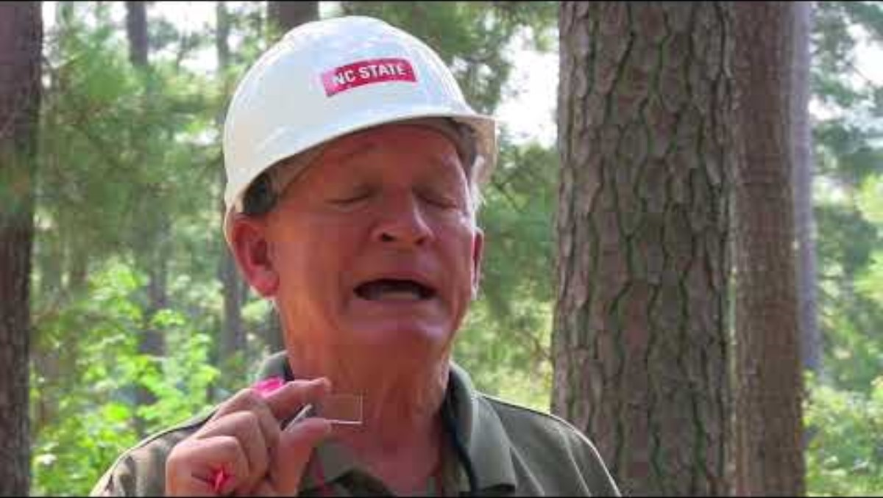
Determining Basal Area with a Prism
Basal area: the cross-sectional area of trees at DBH
Measurement for describing the density of a stand of trees
Important tool for determining the needs of wildlife, productivity, and stand management needs
Measuring stocking using a 10 factor prism
North Carolina State University

Slide 19
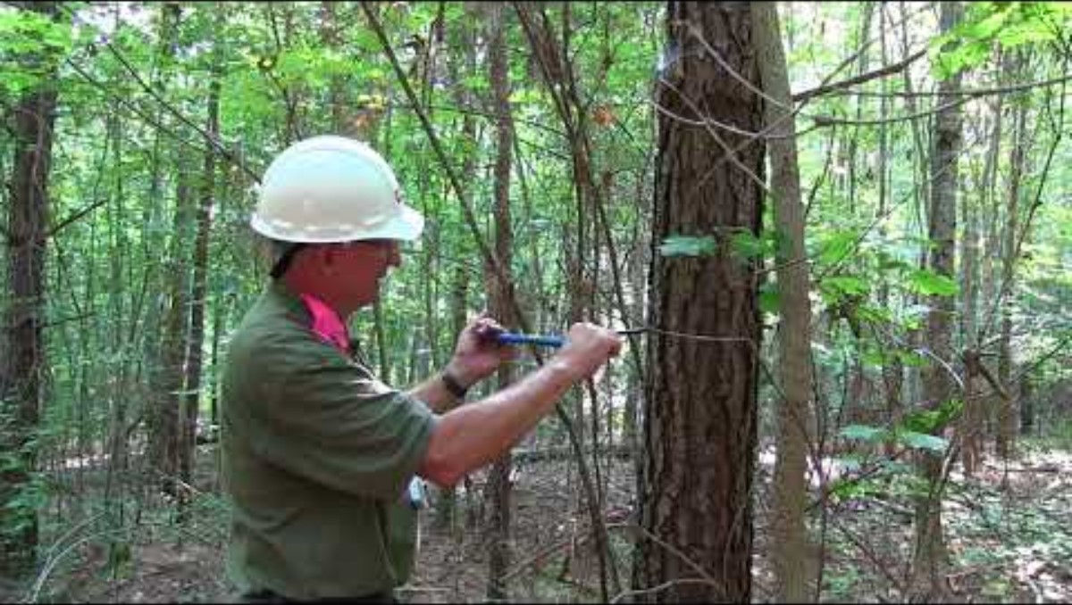
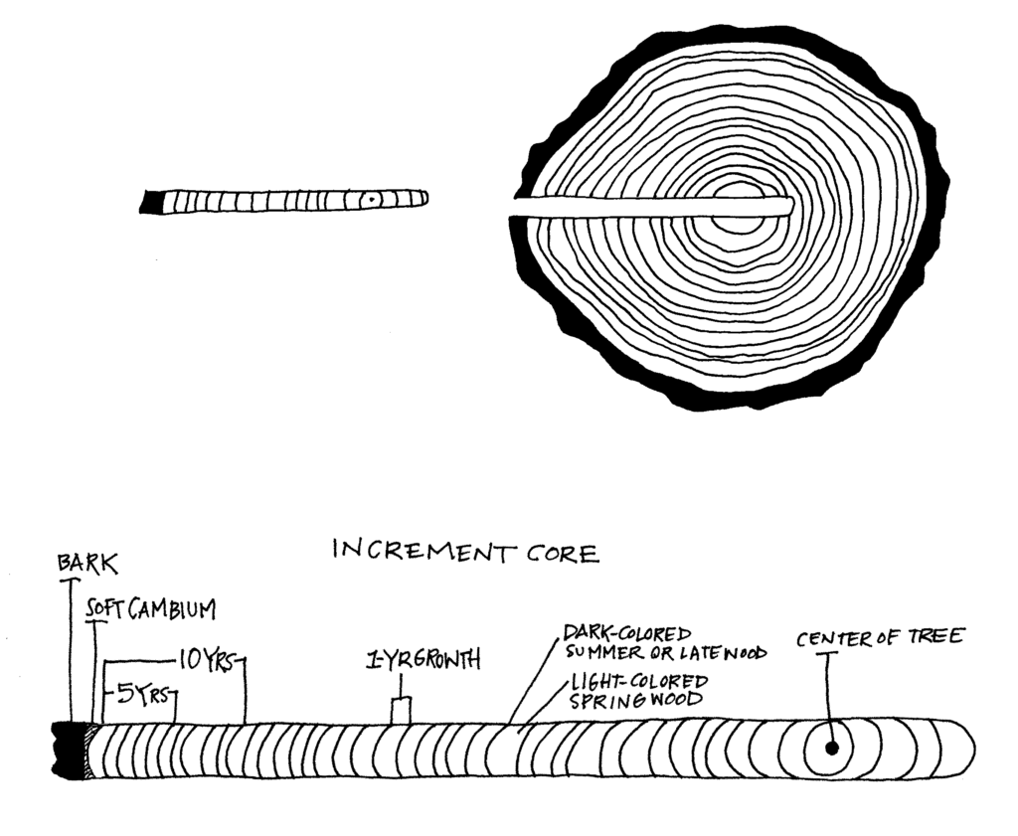
Determining Age with an Increment Borer
Only count one type of growth ring (either spring- or late-wood).
A cross-section of a tree that has been bored, showing the displaced core sample (Adapted from Fletcher et al. 1993), OpenOregon
Determining the age of a tree with an increment borer
North Carolina State University

Slide 20

Site Index
Site index: the average total height that the dominant and codominant trees in fully stocked, even-aged stands will attain at key ages
Useful for comparing site quality between stands
Measuring stocking using a 10 factor prism
North Carolina State University

Slide 21
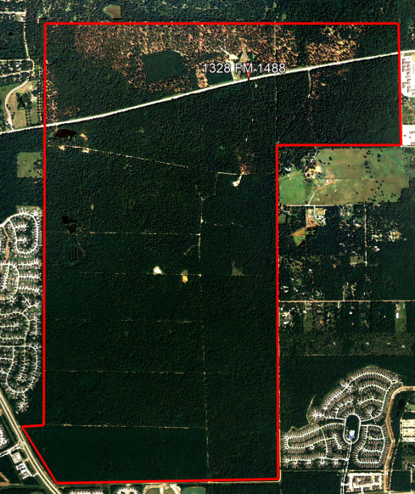
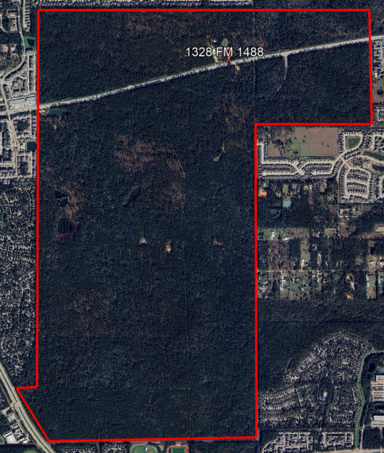
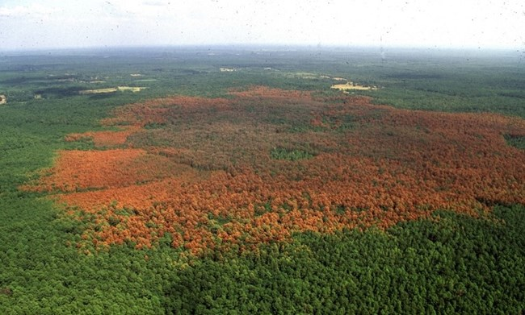
Aerial Photography
Aerial photography is a useful tool for monitoring changes in forests over time.
An aerial view of a southern pine beetle infestation.
Photo: Ronald F. Billings, Texas A&M Forest Service, Bugwood.org
Left: WG Jones Forest in 2005, depicting a mulched area on the north side prepared to support red cockaded woodpecker populations.
Right: WG Jones Forest in 2025.
Photos: Google Earth Pro

Slide 22
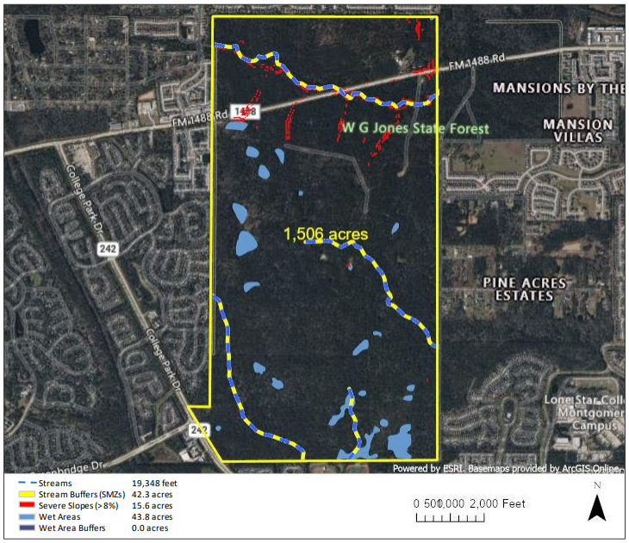
GIS and Forestry
Geographic Information System (GIS) allows foresters to visualize and analyze geographic data.
GIS is used in forestry to:
Map forest types, boundaries, and protected areas
Monitor forest health, deforestation, pest infestations
Plan harvest and reforestation efforts
A map of sensitive areas within the WG Jones State Forest

Slide 23

Prescribed Fire
Low-intensity fire intended to maintain healthy, resilient landscapes
Mimics the small, frequent fires historically experienced in native forests
Prescribed Burns Explained
Texas A&M Forest Service

Slide 24
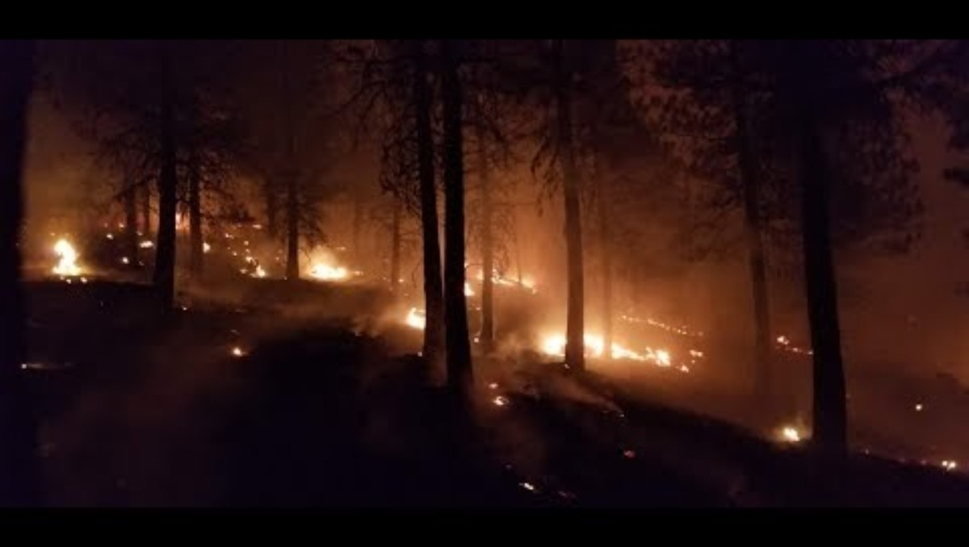
Prescribed Fire Benefits
Lowers fuel loads, reducing the intensity of wildfires
Removes unwanted understory species
Recycles nutrients back to the soil
Promotes germination of native, fire-adapted species
The Story of Prescribed Fires
United States Forest Service

Slide 25
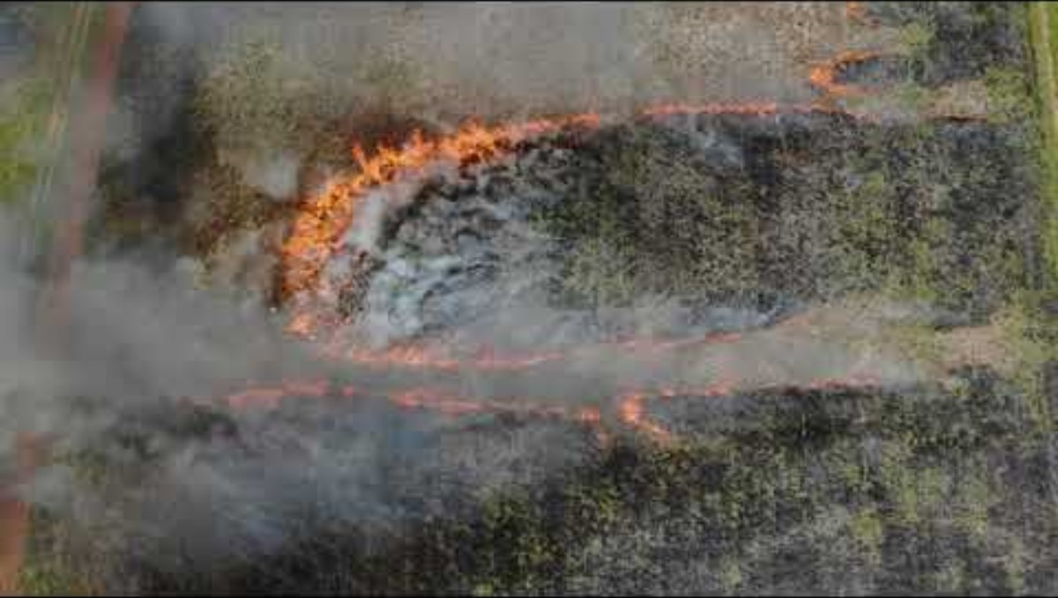
Prescribed Fire in Grasslands
Historically, fire has played a role in maintaining healthy ecosystems across many different habitat types in Texas
Caddo Mounds State Historic Site Prescribed Burn
Texas A&M Forest Service

Slide 26
Common Trees of the Gulf Coast
This is a very condensed list of some of the common and significant trees in the Gulf Coast region.
List adapted from Tree & Shrub Field Guide (Harris County Flood Control District), Tree Planting Guide (Houston Area Urban Forestry Council), with help from Mickey Merritt and Matt Weaver (Texas A&M Forest Service).
Information from Trees of Texas (Texas A&M Forest Service) and Trees of North America: A Guide to Field Identification (C. Frank Brockman)

Slide 27

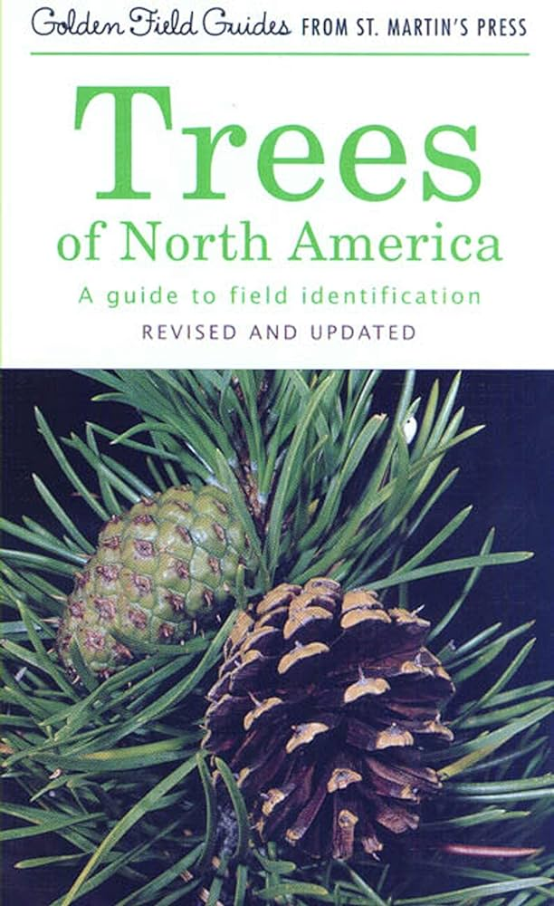
Additional Resources
National Audubon Society Field Guide to North American Trees: Eastern Region
Trees of North America: A Guide to Field Identification

Slide 28
Tree Identification
When trying to identify a species of tree, the following characteristics can be used.
Note that a species may not have leaves, flowers, or fruit when you are trying to ID it, so knowing multiple characteristics of that species is beneficial.
Tree Identification Characteristics
Habitat | Tree Form
Twigs | Buds
Bark | Flowers
Leaves | Leaf arrangement
Leaf shape | Fruit
Parts of leaf | Seeds
Cones | Wood

Slide 29
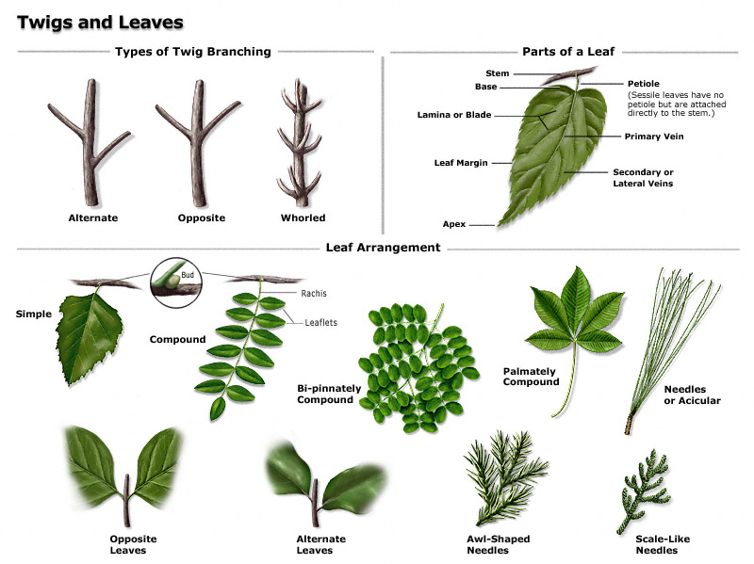
Leaf Morphology
Refer to the Plant Biology slide deck for more information on tree morphology and taxonomic classification.

Slide 30
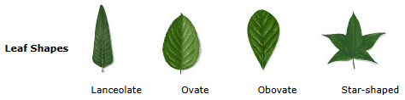
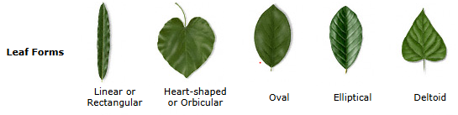
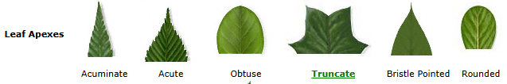
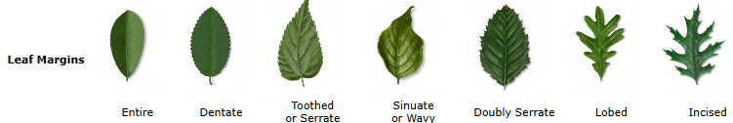
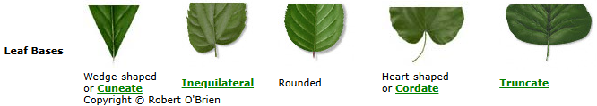
Common Leaf Shapes
Notes:
http://texastreeid.tamu.edu/content/howToID/

Slide 31
Gymnosperms
All included in this set are conifers;
Seeds are within cones, needle- or scale-like leaves, mainly evergreen but some deciduous

Slide 32
Redwood Family | Taxodiaceae
Leaves linear or awl-like, single and in spirals on twig. Most species evergreen.

Slide 33
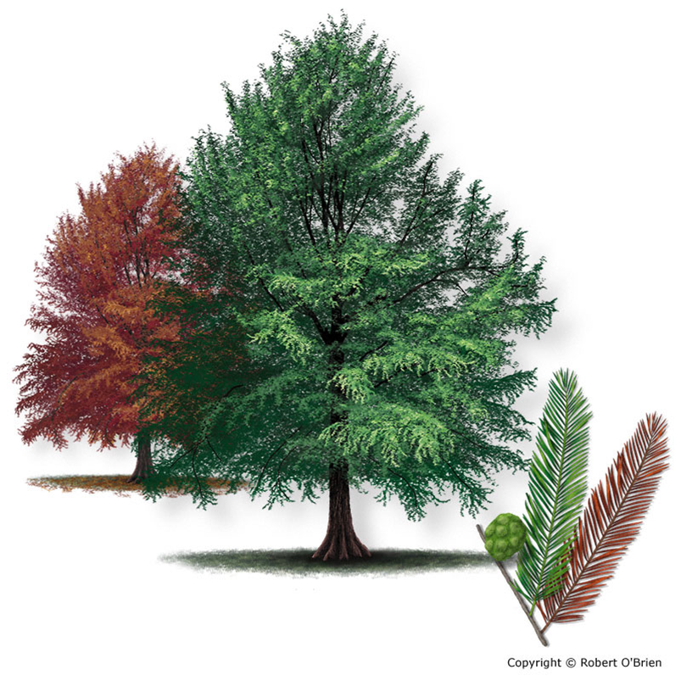
Bald Cypress
Taxodium distichum
Tree Description: One of the few deciduous conifers of North America, baldcypress is a large tree to over 100 feet tall and a straight trunk to 8 feet in diameter, with numerous ascending branches. Young trees display a narrow, conical outline, but old trees have a swollen, fluted base, a slowly tapering trunk, and a broad, open, flat top. In swamps they develop distinctive woody growths from the root system called "knees."
Leaf: The slender, light green leaves are flattened, about 0.5" to 0.75" long, very narrow, and arranged in feather-like fashion along two sides of small branchlets 2" to 4" long, which are deciduous in the autumn with the leaves still attached. Flowering branchlets sometimes have awl-like leaves. Fall color is a striking copper or reddish-brown.
Flower: Male conelets or "flowers" arranged along a thread-like catkin 3" to 4" long, appearing in the spring; female conelets small and inconspicuous.
Fruit: A rounded cone about 1" in diameter, wrinkled into thick rough scales, greenish or with a waxy coating.
Bark: Silvery to cinnamon-red, with papery scales on branches but developing larger flat-topped ridges and numerous longitudinal fissures with age.

Slide 34
Cedar Family | Cupressaceae
Foliage evergreen, opposite or whorled, usually scalelike and overlapping, or awl-like and spreading, occasionally in 3’s, sometimes both on same tree.

Slide 35
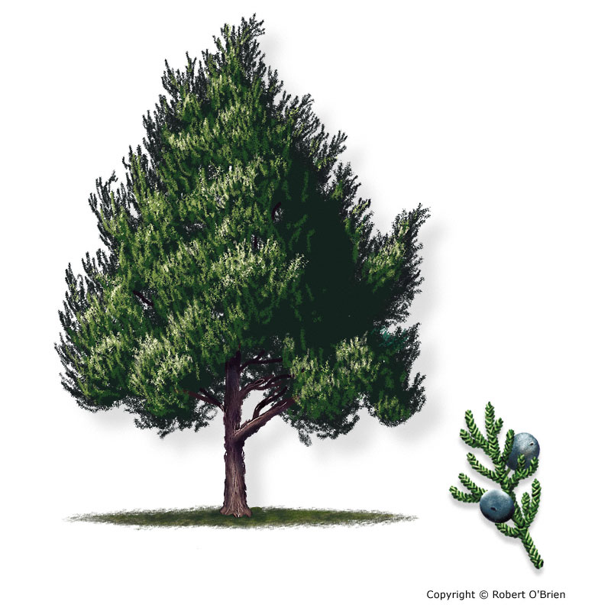
Eastern Red Cedar Juniperus virginiana
Tree Description: A large tree to 50 feet tall, with a straight, fluted trunk 12" to 24" in diameter and a dense, narrow, conical or columnar crown of dark green foliage.
Leaf: Usually dark green, minute, and scale-like, clasping the twig in four ranks so that the twig appears square. The leaves can also be awl-shaped, sharp-pointed, and whitened on young growth or vigorous shoots.
Flower: Male and female conelets are borne on separate trees in February or March, at the ends of the smallest twigs. When releasing their pollen, male trees appear golden-colored.
Fruit: A dark blue, berry-like cone, 0.25" in diameter, maturing in one season, with a waxy coating, the sweet flesh enclosing one or two seeds.
Bark: Thin, reddish-brown, turning ash-gray on exposed surfaces, and peeling off in long, shredding strips.

Slide 36
Pine Family | Pinaceae
Leaves evergreen (deciduous in larches), either needle-like or linear, single, in bundles (fascicles) or clusters.

Slide 37
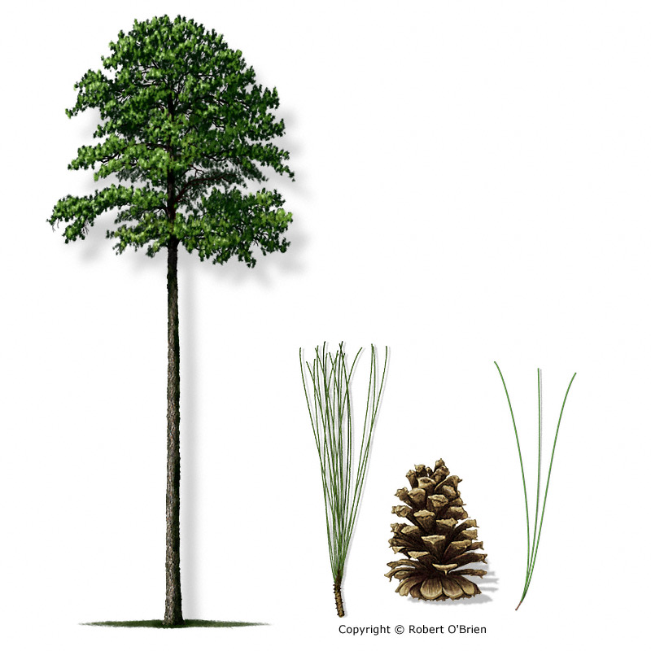
Loblolly Pine
Pinus taeda
Tree Description: A large, fast-growing tree of forests and abandoned fields, reaching heights of 125 feet and a trunk to 4 feet in diameter, with a dense, rounded crown of dark, blue-green foliage.
Leaf: The needles are borne in bundles of 3, mostly 5" to 10" long, and dull blue-green; in the spring, bright green clumps of needles grow at the end of branches and give the tree a luxuriant appearance.
Flower: Male conelets are yellow-green to purple, about 2" long, appearing in spring at the tips of branchlets; female cones are 0.5" long and yellowish.
Fruit: A woody, stalkless cone, 3" to 5" long, oval, reddish-brown, armed with prickles on the tips of the scales, and requiring two years to mature. The winged seeds are shed during the fall and early winter after the cones open fully.
Bark: Thick, dark red-brown to black, breaking into irregular, flaky plates and deep fissures.

Slide 38
Angiosperms

Slide 39
Beech Family | Fagaceae
Leaves mostly deciduous, simple, alternate.

Slide 40
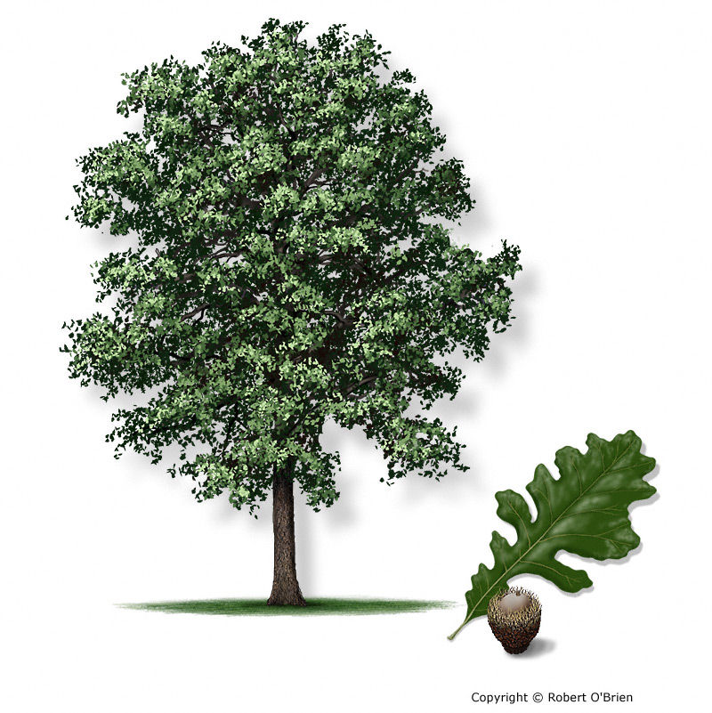
Bur Oak
Quercus macrocarpa
Tree Description: A large tree of the prairies reaching a height of 80 feet or more and a trunk diameter of 5 feet, with a short body and heavy branches that form an open, spreading crown of dark green foliage.
Leaf: Simple, alternate, 6" to 12" long and 3" to 6" wide, with 5 to 9 highly variable lobes that lack bristle-tips; lobes are divided by at least one pair of very deep sinuses, and the upper one-third of the leaf typically has a roughly-toothed or weakly-lobed margin.
Flower: Separate male and female flowers appear in spring on the same tree. Male flowers borne on a yellowish catkin 4" to 6" long; inconspicuous female flowers reddish in color.
Fruit: An acorn, requiring a single season to mature, 1" to 2" long, ovoid, set deeply in a mossy-fringed cup that gives the species its common name.
Bark: Twigs and branches are thick, developing conspicuous corky ridges after the second year; bark is light gray, rough and breaks into small, narrow flakes on young trees, then develops very thick bark with deep fissures and narrow plates.

Slide 41
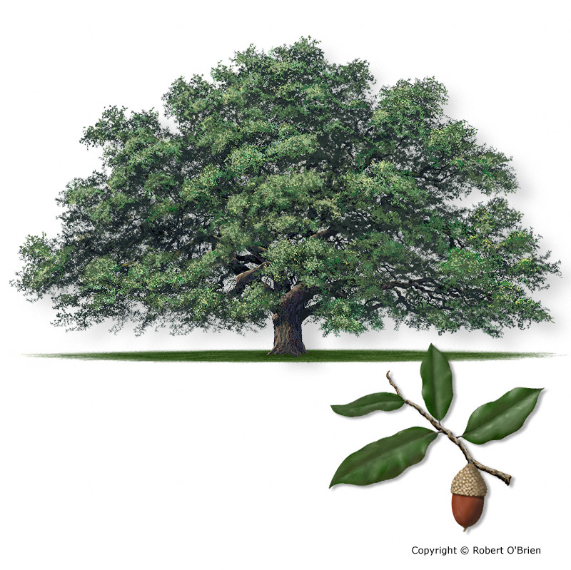
Southern Live Oak
Quercus virginiana
Tree Description: A large, stately tree, commonly to 50 feet tall with a short, stout trunk of 4 feet or more in diameter, dividing into several large, twisting limbs that form a low, dense crown that can spread more than 100 feet, the limbs often touching the ground in open-grown settings.
Leaf: Simple, alternate, evergreen, thick, and leathery; oval, oblong, or elliptical in shape, 2" to 4" long and 0.5" to 2" wide; smooth, glossy, and dark green above, pale and silvery white beneath. Leaves can sometimes be toothed, especially towards the tip.
Flower: Borne in spring on the same tree, the male flowers on catkins up to 3" long, the female flowers on a peduncle 1" to 3" long in the leaf axils.
Fruit: An acorn, requiring one year to mature, about 1" long and 0.5" in diameter, oblong, dark brown and shiny, set about one-half its length in a gray, downy cup that is borne on a long stem or peduncle.
Bark: Dark brown, rough, and furrowed on trunk and large branches, developing very thick, interlacing ridges and deep furrows on older trees. Some specimens have thinner, paler, scaly bark.

Slide 42
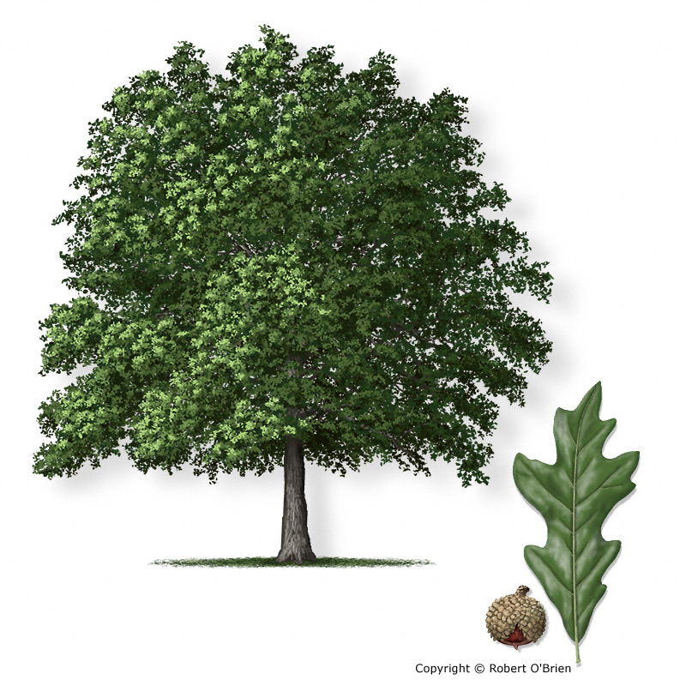
Overcup Oak
Quercus lyrata
Tree Description: A large tree of forested wetlands, to 90 feet tall and a buttressed trunk to 3 feet in diameter, with many small, crooked or drooping branches forming an open, irregular crown.
Leaf: Simple, alternate, 4" to 6" long, 1" to 3" wide, very narrow at the base and wider toward the tip, with 5 to 9 lobes that are pointed but not bristle-tipped. Leaf color is dark green and somewhat glossy above, whitish beneath, frequently turning deep scarlet or orange in the fall.
Flower: Separate male and female flowers on the same tree. Male flowers borne on a catkin 3" to 6" long; inconspicuous female flowers borne on a long, pubescent stalk.
Fruit: An acorn, ripening in one season, rounded or somewhat flattened, 0.5" to 1" long and 1" or more across, nearly covered by the spherical cup, which is thickened at the base but gradually grows thinner and often splits towards the tip.
Bark: Gray, tinged with red, somewhat flaky and developing narrow, flattened ridges and furrows on older trunks.

Slide 43
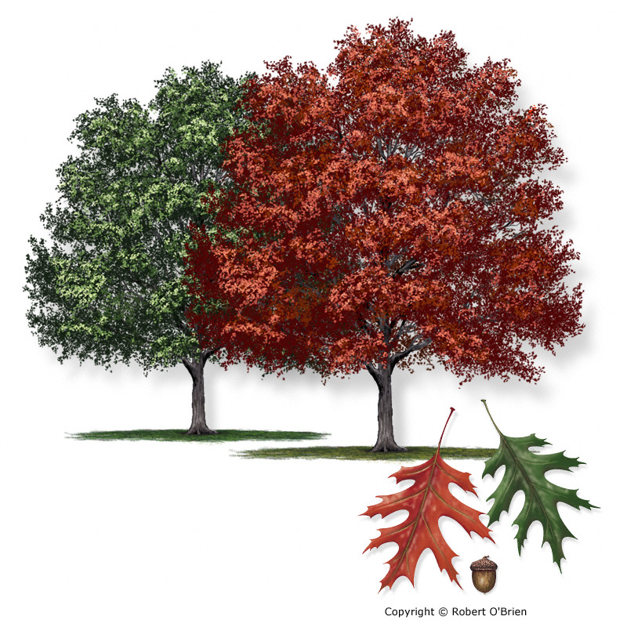
Shumard Oak
Quercus shumardii
Tree Description: A large forest tree reaching heights of 100 feet or more and a trunk to 3 feet in diameter, with a wide-spreading, symmetrical crown. It often occurs as a single tree or in small groups in forest stands, and is an excellent landscape tree.
Leaf: Simple, alternate, 6" to 8" long and 4" to 5" wide, usually with 7 to 9 bristle-tipped lobes (rarely 5), the widest lobes on the upper half of the leaf, with one or more pairs of deep, rounded sinuses between the lobes. Leaves are glossy, dark green on top, light green and smooth beneath, except for small tufts of pubescence in the axils of the veins.
Flower: Male and female flowers borne in spring on the same tree, the male flowers on catkins 6" to 7" long, the female flowers solitary or paired in the leaf axils.
Fruit: An acorn, requiring two years to mature, 0.75" to 1.25" long and 0.5" to 1" in diameter, set only at the base in a shallow, saucer-like cup.
Bark: Dark gray, smooth and tight at first, but developing flat, interlacing ridges and rough fissures with age. Old trees can have deep fissures between the smooth ridges.

Slide 44
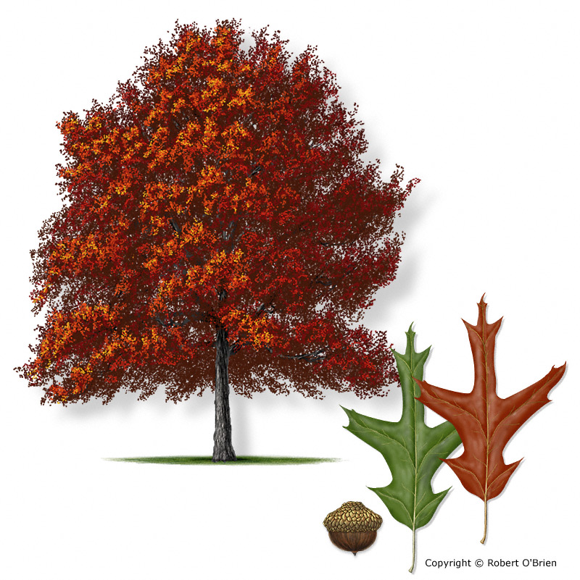
Southern Red Oak
Quercus falcata
Tree Description: A large forest tree to 100 feet tall and a trunk sometimes exceeding 3 feet in diameter, with an open, rounded crown of glossy foliage. A common, but highly variable species.
Leaf: Simple, alternate, highly variable, but usually 5" to 10" long and up to 5" wide, with 3 to 5 bristle-tipped lobes, the central lobe often longest; lobes typically come off the midrib at acute angles (not perpendicular) and are often limited to the upper half of the leaf. Leaf color is glossy and gray-green on top, paler gray below, with soft pubescence.
Flower: Male and female flowers borne separately in spring on the same tree; male catkins 3" to 5" long, yellowish-green, female flowers inconspicuous and borne on a short, downy stalk.
Fruit: An acorn, requiring two years to mature, 0.5" long, rounded or hemispheric, set about one-third its length in a thin, saucer-shaped cup that tapers to a short stalk.
Bark: Light gray on younger trees, turning dark gray, rough, and not deeply furrowed on older trunks.

Slide 45
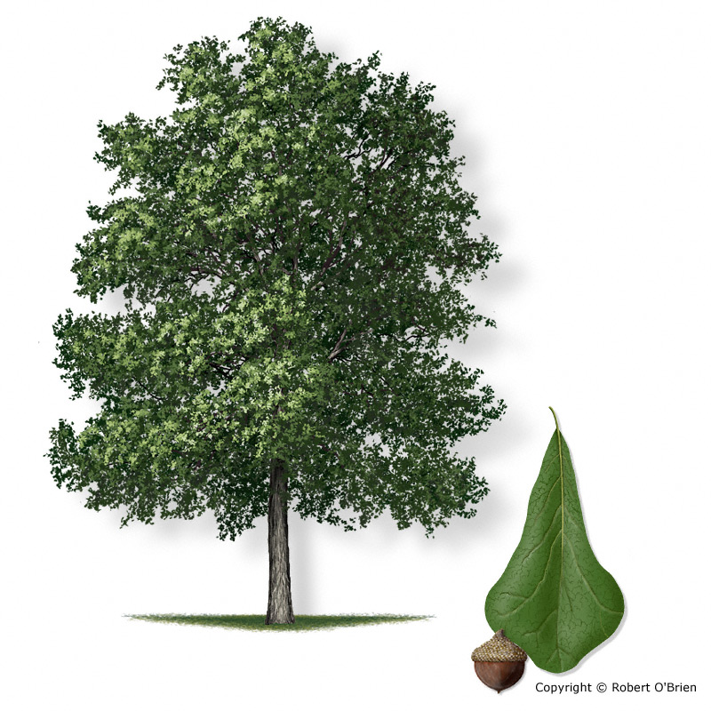
Water Oak
Quercus nigra
Tree Description: A large tree to 90 feet or more and a trunk to 3 feet in diameter, with a dense, round crown of dark green foliage.
Leaf: Simple, alternate, 2" to 4" long and 1" to 2" wide, obovate or slightly three-lobed at the outer end, bristle-tipped, thin, dull bluish-green above and lighter green beneath, persisting on the twigs late into winter. Juvenile leaves are highly variable and have a mix of sharp teeth and rounded lobes.
Flower: Separate male and female flowers appear on the same tree in spring when the leaves begin to unfold; male flowers are borne on a yellowish catkin 2" to 3" long; the female flowers are less conspicuous and clustered on a short stalk.
Fruit: An acorn, requiring two years to mature, 0.5" to 0.75" long and wide, light brown or yellowish-brown and enclosed only at the base in the thin, saucer-shaped cup.
Bark: Smooth, light brown to dark gray, with many thin scales over the surface; developing broad, smooth plates on older trunks.

Slide 46
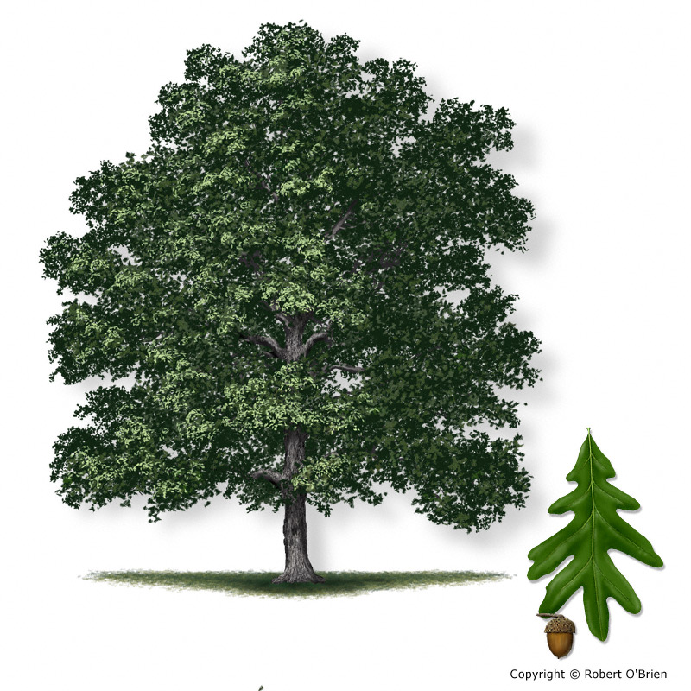
White Oak
Quercus alba
Tree Description: A large forest or shade tree to 100 feet tall and a trunk to 3 feet or more in diameter, with a broad, rounded crown of dense foliage. Open grown specimens often develop a short trunk and far-reaching limbs.
Leaf: Simple, alternate, 6" to 9" long and about half as wide, deeply divided into 7 to 11 rounded, finger­like lobes without bristle tips. Young leaves are a soft silvery-gray or reddish while unfolding, later becoming blue-green, dull above and very pale below.
Flower: Male and female flowers borne separately in spring on the same tree; male catkins 3" to 4" long, yellowish-green, female flowers reddish, about 0.5" long, usually solitary.
Fruit: An acorn, requiring one season to mature, 0.75" to 1" long, light brown, about one-fourth enclosed in a warty bowl-shaped cup.
Bark: Smooth and red-brown on young trees, quickly developing white to ash-gray scales that ultimately form broad, loose plates giving the trunk a "shaggy" appearance. Old trees develop dark, thin ridges and deep fissures.

Slide 47
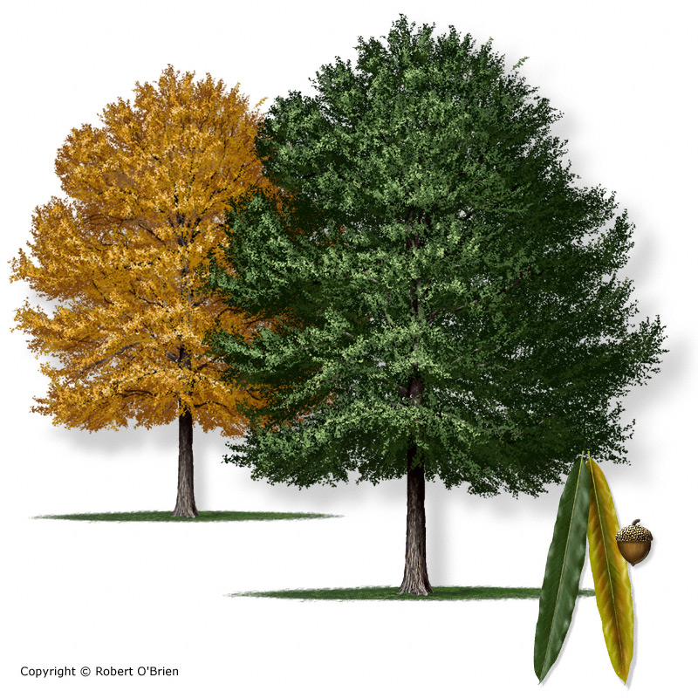
Willow Oak
Quercus phellos
Tree Description: A large tree to 90 feet tall and a trunk to 3 feet in diameter, with an open, rounded crown of slender, green foliage, making a beautiful tree that is desirable for roadsides, lawns and parks.
Leaf: Simple, alternate, 2" to 5" long and 0.5" to 0.75" wide, linear to lanceolate in shape, with a bristle at the tip; leaves are smooth, medium green and shiny above, dull, light green and smooth below, turning golden brown in fall.
Flower: Separate male and female flowers appear on the same tree in spring when the leaves begin to unfold; male flowers are borne on a yellowish catkin 2" to 3" long; the female flowers are less conspicuous and clustered on a short stalk in the leaf axil.
Fruit: An acorn, requiring two years to mature, hemispheric, about 0.5" in diameter, light yellow-brown, its base scarcely enclosed in the shallow, greenish-brown cup.
Bark: Smooth and reddish-brown, with age becoming roughened by narrow ridges.

Slide 48
Birch Family | Betulaceae
Leaves deciduous, simple, alternate, toothed.

Slide 49
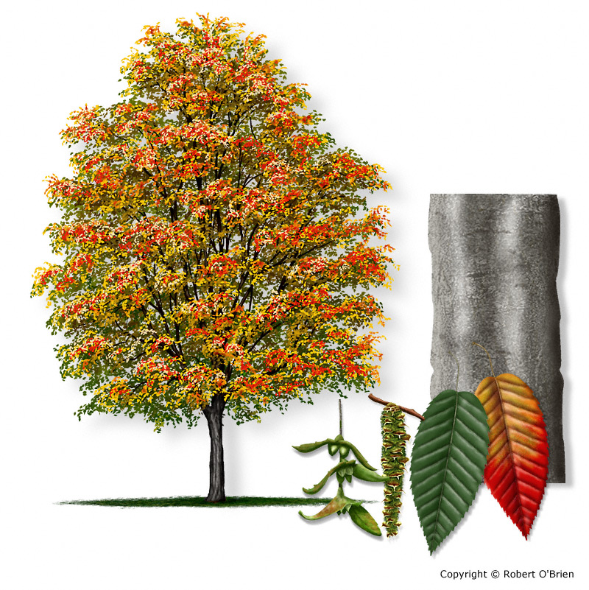
American Hornbeam Carpinus caroliniana
Tree Description: A slow growing, small to medium-sized forest tree to 30 feet tall and a trunk 4" to 8" in diameter, with a broad, dense, flat-topped crown and a smooth, blue-gray, fluted trunk that gives it a "muscular" appearance.
Leaf: Alternate, simple, 2" to 3" long and 1" to 1.5" wide, oval-shaped with a rounded leaf base, doubly-toothed along the margin, and pointed at the tip; dark blue-green above, paler below, turning reddish in the fall.
Flower: Male and female flowers borne separately on the same tree; the male catkins are greenish, 1" to 1.5" long, and the female catkins at the end of the twigs are 0.5" long, with small, leaf-like, three-lobed green scales.
Fruit: Fruits form a loose cluster at the ends of the twigs, each one a nutlet about 0.33" long, attached at the base to a three-lobed, leaf-like bract, which acts as a wing to facilitate distribution by the wind.
Bark: Smooth, tight, thin, dark bluish-gray in color, sometimes marked with dark horizontal bands, and fluted with irregular ridges or "muscles" extending up and down the tree.
Notes:
Template for slides

Slide 50
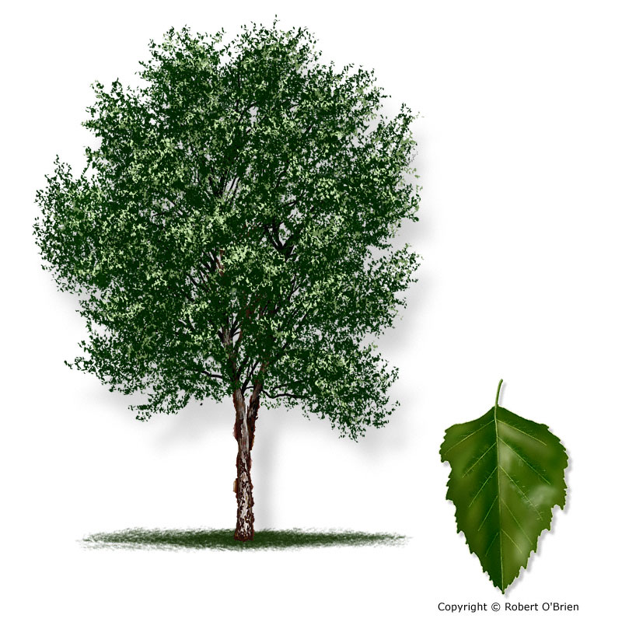
River Birch
Betula nigra
Tree Description: Usually a medium-sized tree to 40 feet tall and one or more trunks 8" to 12" in diameter, but can reach heights of up to 90 feet, with an oval crown of drooping branches. Trunks are wrapped with peeling sheets of papery bark.
Leaf: Simple, alternate, 2" to 3.5" long and 1" to 2" wide, ovate or somewhat triangular-shaped, with a double-toothed margin and a wedge-shaped base. The upper surface is dark green and shiny, the lower surface paler and pubescent.
Flower: Male and female flowers borne in early spring, separately on the same tree; male catkins at the ends of the twigs, drooping, brown, 1" to 3.5" long; female catkins are smaller, 0.5" long, greenish, upright, and borne in the leaf axils.
Fruit: A cylindrical cone, about 1" long, densely crowded with tiny winged nutlets that ripen from May to June.
Bark: Thin, tight, and grayish with horizontal lenticels when young, but quickly developing the reddish, peeling layers that identify the species. Layers persist on the trunk, presenting a ragged and quite distinctive appearance. Unlike the bark of other birches the thin paper layers are usually covered with a gray powder. On older trees, the bark on the main trunk becomes thick, with broad plates divided by deep, rough, black furrows.
Notes:
Template for slides

Slide 51
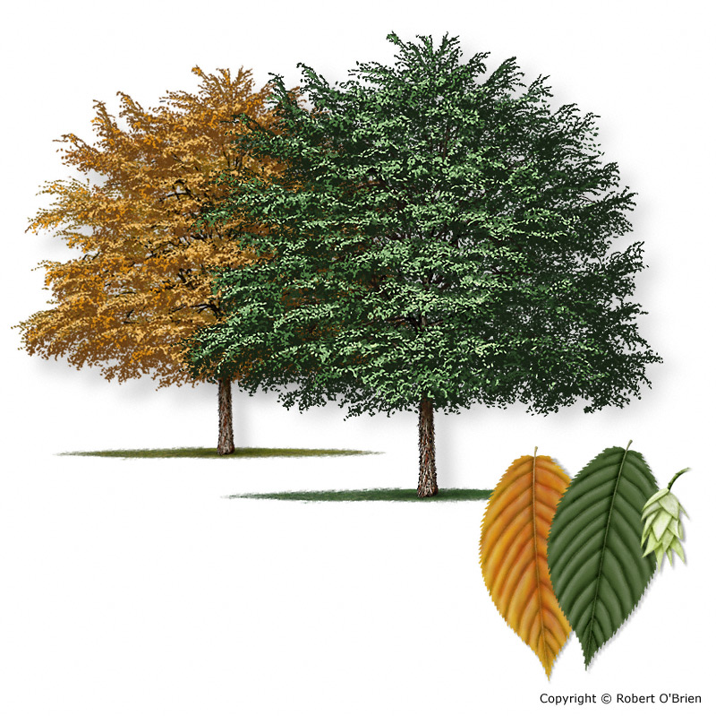
Eastern Hophornbeam Ostrya virginiana var. virginiana
Tree Description: A small or medium-sized forest tree, generally to 35 feet tall and a trunk 7" to 10" in diameter, with long, slender, drooping branches that form a rounded crown of fine twigs.
Leaf: Simple, alternate, 2" to 3" long, generally oval, sharply double-toothed along the margin, with a rounded leaf base and a pointed tip. Leaves are dull green on top, lighter beneath, and downy-pubescent on both sides; leaves turn yellow-gold in the fall.
Flower: Male and female flowers borne separately on the same tree; the male in drooping catkins which form in the fall and overwinter as 0.5" buds at the branch tips, then expanding in spring to 2" long. Female catkins are formed in spring on the new twigs, as upright catkins 0.25" long.
Fruit: A light green cluster 1" to 2" long -- resembling common hops used for fermenting -- consisting of tightly packed leafy bracts, each containing the flat, ribbed nutlets.
Bark: Dark brown and tight on small branches, with horizontal lenticels; developing gray-brown, flaky scales on older trunks that peel away from the trunk in short lengthwise strips.
Notes:
Template for slides

Slide 52
Ebony Family | Ebenaceae
Leaves deciduous, simple, alternate, smooth-margined

Slide 53
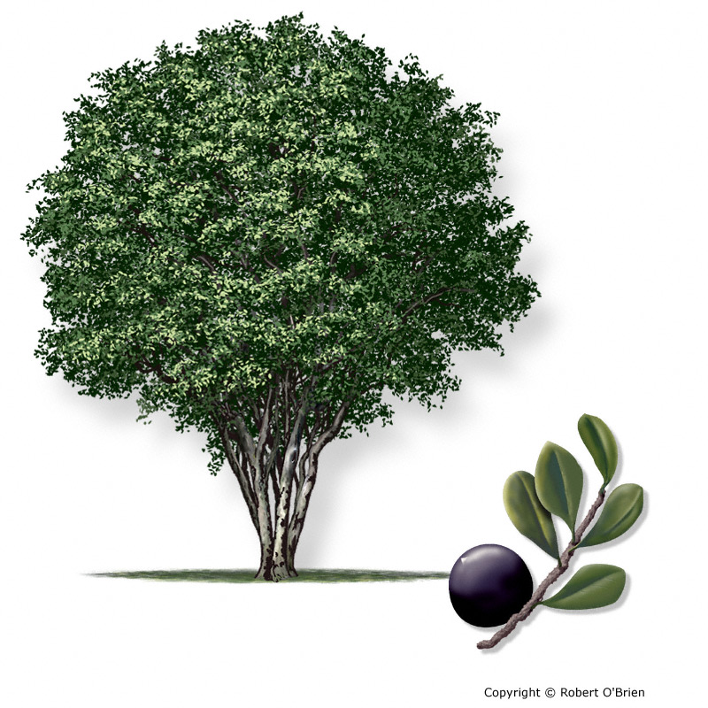
Texas Persimmon
Diospyros texana
Tree Description: A small tree to 40 feet, often low-forking or multi-trunked, with an open, oval crown. Notable for its muscular or fluted trunk and branches.
Leaf: Simple, alternate, with almost no petiole, 1" to 2" long, obovate, thick and leathery, pubescent underneath; leaf edge without teeth, sometimes rolled under during droughts.
Flower: Male and female flowers on separate trees. Male flowers inconspicuous; female flowers small, white, five-petaled, appearing in spring and attracting many insects.
Fruit: A sweet, round fruit, 1" across and slightly depressed at the tip, black when ripe. Favored by wildlife and edible by humans.
Bark: Smooth, gray, and tight, developing olive or light brown patches that peel away to show the lighter bark beneath.
Notes:
Template for slides

Slide 54
Elm Family | Ulmaceae
Leaves deciduous, simple, alternate, toothed

Slide 55
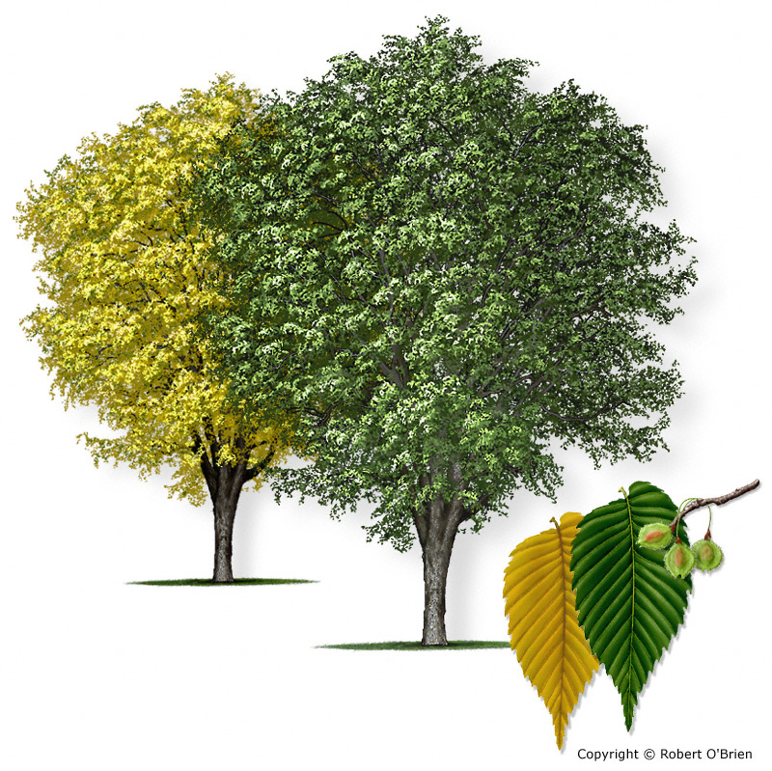
American Elm
Ulmus americana
Tree Description: A large tree to 90 feet tall and a trunk diameter to 3 feet, with a buttressed base and upright branches that form a spreading, vase-shaped crown.
Leaf: Alternate, simple, 4" to 6" long and 2" to 3" wide, oval or ovate in shape, tip drawn to a point, lopsided at the base, and double-toothed along the margin; leaf surface is either smooth or rough above and pubescent or smooth below, with raised veins.
Flower: Appearing before the leaves in early spring as small, greenish clusters on slender stalks in the axils of the leaves.
Fruit: An oval "samara" (winged fruit), with the seed portion in the center surrounded entirely by a wing with a fuzzy edge, ripening in the spring. The hairs on the samara margin and the deep notch in the end are characteristic of the species.
Bark: Dark gray, divided into irregular flat-topped, thick ridges, with narrow fissures between. An incision into an outer ridge of bark will show alternating brown and cream colored layers.
Notes:
Template for slides

Slide 56
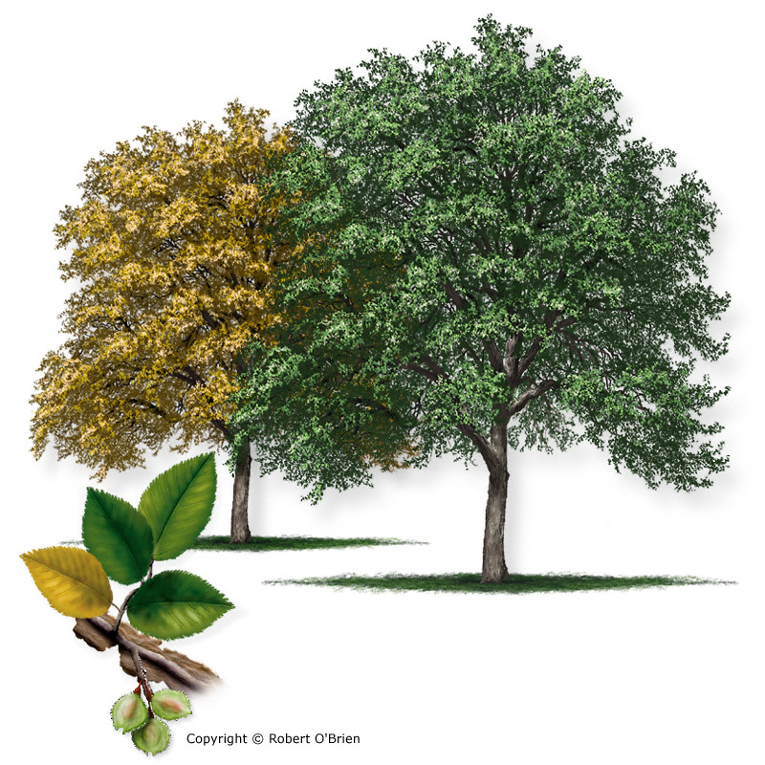
Cedar Elm
Ulmus crassifolia
Tree Description: A large tree to 75 feet tall with a tall straight trunk 2 to 3 feet in diameter and stiff branches that form a narrow, oblong crown.
Leaf: Alternate, simple, 1" to 2.5" long and 0.75" to 1" wide, oval to elliptical in shape, finely-toothed or sometimes double-toothed along the margin, and blunt at the tip. The upper surface is dark green, shiny, and rough, while the lower surface and petiole are pubescent. Twigs sometimes have thin, corky "wings" and the leaves can turn gold to orange-red in the fall.
Flower: Appear in late summer or autumn as hairy, short-stalked clusters in the leaf axils.
Fruit: An oval "samara," 0.25" to 0.5" long, the seed centered in the middle of the wing, deeply notched at the tip and hairy all over, especially along the margin. Seeds are borne in the fall, which distinguishes this species from the other native elms.
Bark: Light brown to gray, with flattened ridges that break into thin, loose, flaky scales.
Notes:
Template for slides

Slide 57
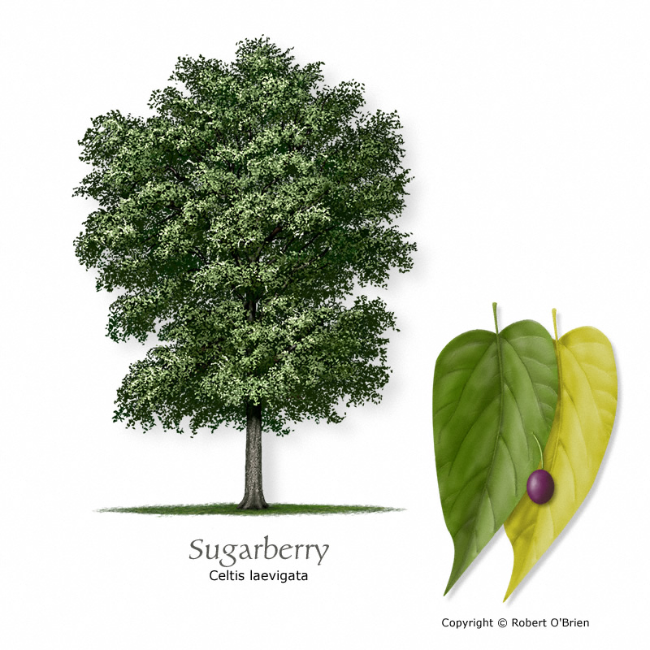
Sugarberry
Celtis laevigata var. laevigata
Tree Description: A very common, large tree to 90 feet tall and a trunk 2 feet or more in diameter, though usually smaller in stature, with a round or oval crown of light green foliage.
Leaf: Alternate, simple, 2.5" to 5" long and 1" to 2" wide, ovate or lanceolate, base lopsided, margin smooth or with a few remote teeth near the base, and long-pointed; leaf texture thin, smooth, with 3 prominent veins at the base beneath; leaf color light green turning yellow in fall.
Flower: Borne on slender stalks in the leaf axils in April or May, inconspicuous, greenish-white in color.
Fruit: Ripening in September as an orange-red, round or oblong drupe, about 0.25" in diameter, on a stalk up to 0.5" long, turning dark purple to black later in the fall.
Bark: Gray or gray-brown, smooth and thin at first, developing the distinctive warty bumps and ridges on larger trunks and branches.
Notes:
Template for slides

Slide 58
Holly Family | Aquifoliaceae
Leaves alternate, simple, usually evergreen with spiny-toothed (occasionally smooth) margins

Slide 59
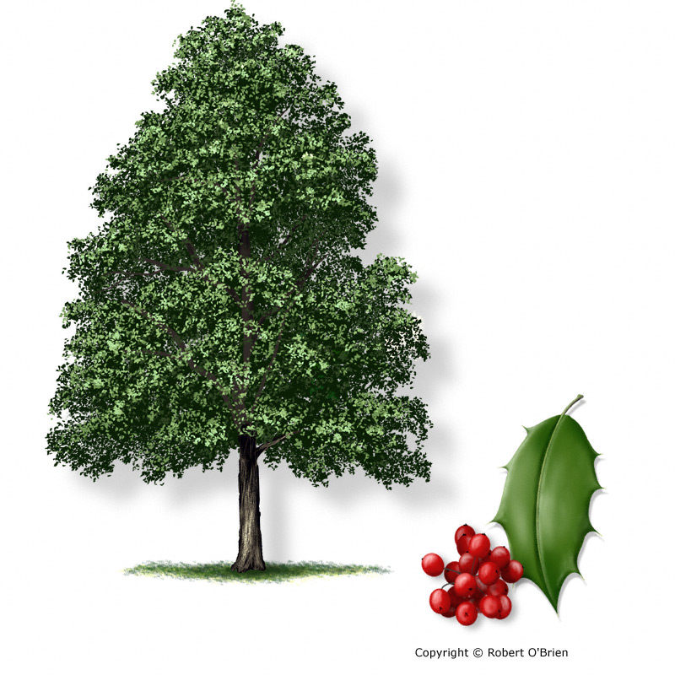
American Holly
Ilex opaca
Tree Description: An upright, evergreen tree to 50 feet tall and a trunk to 3 feet in diameter; with numerous, slender branches that form a dense pyramidal or oval crown of striking dark green color. Open-grown specimens have branches that often extend to the ground.
Leaf: Simple, alternate, 2" to 4" long and 1" to 2" wide, oval, with several spiny teeth along the margin. Leaves are dark green and glossy on top, stiff, leathery, sometimes cupped at the edge, and light green underneath. They remain on the branches three years, dropping off in the spring.
Flower: Small and whitish, not showy; male and female flowers are usually borne on separate trees.
Fruit: A round, or somewhat oval, fleshy drupe, 0.25" to 0.5" long, dull red or sometimes yellow, that ripens late in the fall on the trees bearing female flowers, and enclosing 4 to 6 grooved, ribbed nutlets.
Bark: Light gray, tight, leathery, and roughened by wart-like growths and blotches on older specimens.
Notes:
Template for slides

Slide 60
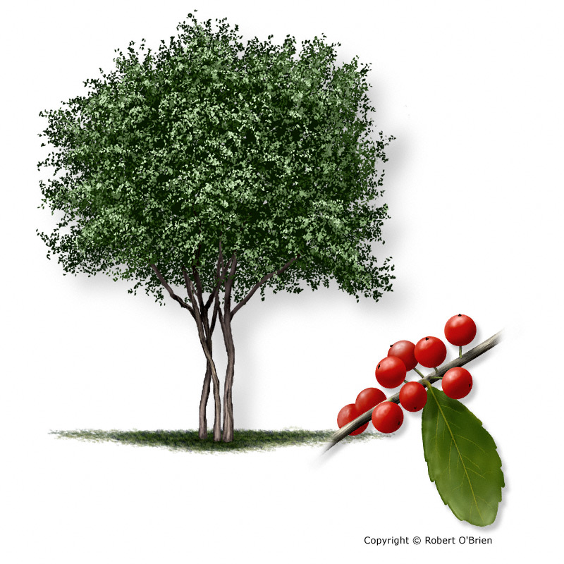
Yaupon
Ilex vomitoria
Tree Description: A thicket-forming shrub or small, multi-trunked tree to 25 feet tall and stems up to 6" in diameter, with a dense, conical or rounded crown of dark green foliage.
Leaf: Simple, alternate, 1" to 2" long by 0.5" to 1" wide, oval, leathery, with blunt teeth along the margin. Leaves are glossy and dark green above, paler below, evergreen, and persistent for 2 to 3 years
Flower: Small, whitish, not showy; male and female flowers are borne on separate plants.
Fruit: A red, translucent, berry-like drupe, about 0.25" in diameter, on a short stalk, ripening in late fall and often produced in great abundance be the female plants.
Bark: Light gray, smooth or leathery, sometimes developing thin scales and blotches on larger stems.
Native to southeast Texas but can grown aggressively and become invasive in forests that lack fire and other management practices. Read more about the effects of yaupon on Texas forests here.
Notes:
Template for slides

Slide 61
Laurel Family | Lauraceae
Leaves evergreen or deciduous, simple, alternate, lobed or unlobed with smooth margins, aromatic

Slide 62
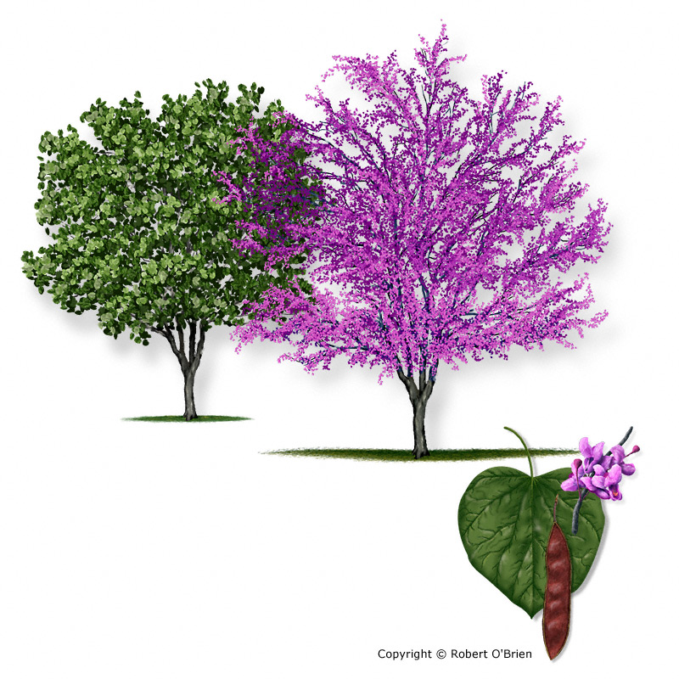
Eastern Redbud
Cercis canadensis var. canadensis
Tree Description: A small or medium-sized tree, usually less than 40 feet tall and a trunk to 12" in diameter, with arching branches that form a wide, flat-topped crown.
Leaf: Alternate, simple, heart-shaped, 3" to 5" long and wide, leaf edge smooth; upper surface dull, dark green, and lighter beneath, turning yellow in the fall.
Flower: One of the first trees to bloom in early spring, the flowers appear before the leaves as conspicuous, pink to purplish, pea-shaped flowers in clusters along the twigs and small branches.
Fruit: A flattened, many-seeded pod, 2" to 4" long and 0.5" wide, tapering at the ends, reddish during the summer and brown when ripe, often hanging on the tree through the following winter.
Bark: Reddish-brown, smooth when young, but developing a scaly texture and then long, narrow plates and shallow fissures on older trunks.
Notes:
Template for slides

Slide 63
Loosestrife Family | Lythraceae

Slide 64
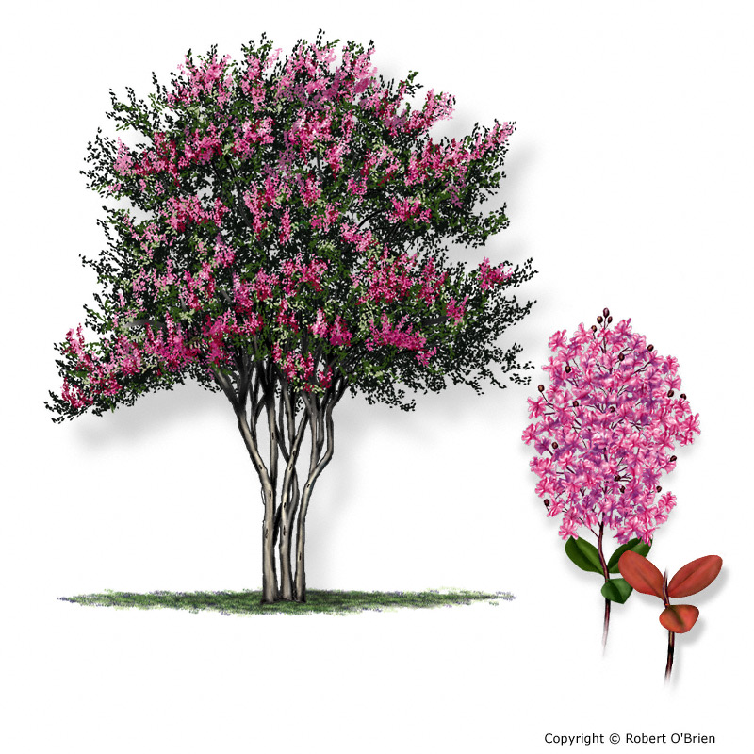
Crapemyrtle
Lagerstroemia indica
Tree Description: Perhaps the most common small landscape tree or large shrub planted in Texas, crapemyrtle is usually multi-trunked with smooth, muscular limbs, grows to 20 feet tall and 15 feet wide, with mature trunks ranging from 4" to 12" in diameter.
Leaf: Simple, alternate, 1.5" to 3" long, oval to oblong, thin, blunt-tipped, without teeth along leaf edge. Some cultivars turn red or orange in the fall.
Flower: Showy spikes of white, pink, red, or purple flowers appear throughout the summer, each made up of petals that resemble crepe-paper. Not fragrant.
Fruit: An upright spike of round 0.5" diameter green fruits develops in late summer, drying to brown spherical capsules that open to release the winged seeds up to 0.25" long.
Bark: Smooth, muscular, in irregular patches ranging from tan to chocolate-colored, peeling during the growing season into long, thin strips that fall away to reveal new bark beneath.
Notes:
Template for slides

Slide 65
Magnolia Family | Magnoliaceae
Leaves alternate, simple (entire or lobed), mostly deciduous

Slide 66

Southern Magnolia
Magnolia grandiflora
Tree Description: A large forest or landscape tree, reaching heights of 90 feet or more and a trunk to 4 feet in diameter, with a dense, pyramidal or oval crown, the spreading branches often reaching the ground in open settings.
Leaf: Simple, alternate, 6" to 8" long and 2" to 3" wide, elliptical or oval in shape, thick, leathery, dark green and glossy above, rusty and pubescent beneath, with prominent midribs. They remain on the tree for about two years.
Flower: Large, showy and fragrant, 6" to 8" across, cup shaped, with pure white petals surrounding a splash of bright purple in the center, borne in spring and summer.
Fruit: A rounded or oval aggregation of seeds, shaped like a cone, 3" to 4" long, containing many seeds. The fruits open in the fall and display the bright red seeds dangling on slender threads.
Bark: Gray-brown, smooth at first and developing scales on larger branches and trunks.
Notes:
Template for slides

Slide 67
Maple Family | Aceraceae
Leaves deciduous, opposite, usually simple and palmately lobed

Slide 68

Red Maple
Acer rubrum
Tree Description: A medium sized, fast-growing tree that reaches 90 feet tall and a trunk to 2 feet in diameter, red maple has a somewhat narrow, rounded crown.
Leaf: Leaf blades are 2" to 5" long, on a petiole 2" to 4" long, and have from 3 to 5 pointed saw-toothed lobes separated by sharp angular sinuses or openings. In autumn, the leaves turn a brilliant shade of red, or in some varieties, orange-yellow.
Flower: The red flowers appear in dense clusters in early spring before the leaves, the buds turning a deep red sometimes before they open.
Fruit: A "key," or double samara, ripening in late spring or early summer, red to brownish-red. Each half measures between 0.5" to 1" long.
Bark: Smooth and light gray on young tree trunks and branches; breaking into rough, scaly, dark gray bark on old limbs and trunks.
Notes:
Template for slides

Slide 69
Mulberry Family | Moraceae
Leaves simple and alternate, deciduous or evergreen

Slide 70

Red Mulberry
Morus rubra
Tree Description: A medium or large tree, to 50 feet tall, with a trunk up to 2 feet in diameter and a spreading crown.
Leaf: Simple, alternate, 3" to 9" long and 2" to 5" wide, heart-shaped or rounded at the base, leaf margin sharp-toothed; some leaves are mitten-shaped or 3 to 5-lobed. Leaves are rough-hairy above and soft-hairy beneath, turning yellow in the fall.
Flower: Male and female flowers borne on separate trees as cylindrical spikes; the male are 2" to 3" long and the female flowers just 1" long, appearing with the leaves in spring.
Fruit: A composite fruit shaped like an elongated blackberry, 0.75" to 1" long; red, turning dark purple or black when ripe, and edible.
Bark: Thin, dark grayish-brown, and peeling into long, narrow strips.
Notes:
Template for slides

Slide 71
Olive Family | Oleaceae
Leaves mostly deciduous, opposite, simple or, in ashes, pinnately compound

Slide 72

White Fringetree Chionanthus virginicus
Tree Description: A small understory tree growing to 25 feet tall, with a slender trunk to 6" in diameter and upright branches that form a loose, irregular crown.
Leaf: Simple, oppositely attached to the twigs, 3" to 8" long and 0.5" to 4" wide, dark green on the upper surface and paler underneath, turning a clear bright yellow in the fall.
Flower: The flowers appear in the axils of the new leaves in spring as loose, drooping clusters 4" to 8" long; each flower has long, narrow, white petals that give the appearance of confetti and provide the common name, "fringetree."
Fruit: A large, berry-like drupe, sometimes as much as 1" long, dark blue, purple, or black, with a waxy coating or "bloom;" fruits are grouped together in loose, drooping clusters and are favored by a variety of wildlife species.
Bark: Brown or gray, similar to that of a young ash tree, but rougher and paler.
Notes:
Template for slides

Slide 73

Green Ash
Fraxinus pennsylvanica
Tree Description: A large forest tree to 70 feet and a trunk to 2 feet in diameter, with spreading branches and an oval crown.
Leaf: Opposite, compound, 10" to 12" long, with 7 to 9 leaflets arranged pinnately; leaflets are 2" to 6" long and 1" to 2" wide, short-stalked, ovate to lanceolate, pointed at the tip, margin smooth or faintly toothed. Leaf color is dark green above and light green beneath, turning yellow in the fall. Buds sit on top of the half-moon-shaped leaf scars left on the twigs after leaf drop.
Flower: Male and female flowers borne on separate trees. Female flowers in loose clusters; male flowers appear as dark clusters of stamens near the end of the twigs, before the leaves.
Fruit: A flat, winged "samara," 1" to 1.5" long and 0.25" to 0.33" wide, the winged portion extending well down past the middle of the seed, maturing in late summer and distributed by the wind.
Bark: Light brown to gray, thick, with flat-topped narrow ridges forming an interlaced pattern, the furrows dark.
Notes:
Template for slides

Slide 74
Rose Family | Rosaceae
Leaves usually alternate, toothed, simple or pinnately compound, deciduous or evergreen

Slide 75

Cherry Laurel
Prunus caroliniana
Tree Description: A small or medium-sized evergreen tree to 40 feet tall and a trunk to 18" in diameter, with a narrow, dense crown of dark green foliage.
Leaf: Simple, alternate, 2" to 4" long and 1" to 1.5" wide, elliptical or oblong-lanceolate, shiny and dark green above, paler below; leaf margin smooth or remotely-toothed, with a few tiny sharp teeth; leaves aromatic when crushed.
Flower: Short clusters of small white flowers appear in the leaf axils in early spring.
Fruit: A shiny black drupe, borne in loose clusters, each fruit about 0.5" long, oval-shaped, pointed at the tip, ripening in the fall and persisting until the following spring.
Bark: Smooth, dark gray, often marked by dark blotches; older trunks develop rough, black, scaly bark.
Notes:
Template for slides

Slide 76

Mexican Plum
Prunus mexicana
Tree Description: A small tree to 25 feet tall and a short trunk 8" to 10" in diameter, with a short, irregular crown of dull green foliage.
Leaf: Simple, alternate, 2" to 4" long and 1.5" to 3" wide, oval, often cupped at the edges, abruptly pointed at the tip and rounded at the base, and finely toothed (sometimes double-toothed) along the margin. The upper surface is smooth, thickened, and textured, yellow-green; lower surface lighter, hairy along the veins; leaves turn yellow or sometimes red in the fall.
Flower: Numerous clusters of white, five-petaled flowers, 0.75" in diameter, appear in March before the leaves.
Fruit: A plum (actually a drupe) that ripens in late summer, 1.25" in diameter, dark purple-red with a bluish "bloom", with a smooth stone 0.75" long under the juicy flesh.
Bark: Dark gray to nearly black, smooth when young with horizontal lenticels, developing broad plates with curled edges when older.
Notes:
Template for slides

Slide 77

Hawthorn
Crataegus spp.
Tree Description: A group of 30 or so species, usually small trees or shrubs to 20 feet tall and one or more straight trunks to 4" in diameter, often bearing straight thorns, white blossoms, and red or yellow fruit.
Leaf: Simple, alternate, usually 2" to 3" long; shapes highly variable, ranging from oval, round, or elliptical (or even obovate in some species); rounded or wedge-shaped at the base, leaf edge toothed or double-toothed; most species with long, straight thorns on the twigs.
Flower: Dense, flat clusters of white, 0.5" flowers appear in spring after the new leaves. Some give off a slightly unpleasant odor.
Fruit: Variable; a round, red or yellow berry, 0.25" to 1" in diameter; when ripe, some have a pulpy, sweet, edible flesh, surrounding 1 to 5 bony seeds.
Bark: Thin, smooth, gray to red-brown at first, developing thin gray scales that peel away from trunks and branches to expose the new bark beneath. Old trunks are very rough, gray, and fissured.
Notes:
Template for slides

Slide 78
Spurge Family | Euphorbiaceae
Leaves evergreen or late deciduous, simple, alternate

Slide 79

Chinese Tallow
Triadica sebiferum
Tree Description: A small to medium-sized tree with a crooked trunk 12" to 18" in diameter and a height to 50 feet at maturity.
Leaf: Simple, alternate, 2" to 4" long, generally triangular, with a wedge-shaped leaf base and a long, pointed tip; leaf edge smooth. Fall color varies from yellow, orange, red, and purple, sometimes on the same tree.
Flower: A long, yellow spike of flowers, 8" to 10" long, appearing after the leaves in the spring.
Fruit: Dark gray, 0.5" diameter, three-parted seed clusters open to reveal white, popcorn-like waxy seeds in late fall or winter. Birds eat and spread the seeds.
Bark: Tan and bumpy when young, developing flattened ridges that flake outward on older trunks to give a slightly shaggy appearance.
INVASIVE
Notes:
Template for slides

Slide 80
Sycamore Family | Platanaceae
Leaves deciduous, alternate, simple, scaly below, smooth margins

Slide 81

American Sycamore Platanus occidentalis
Tree Description: Considered the largest deciduous tree in North America, sycamore in Texas can exceed 100 feet in height and 4 feet in diameter, with a stout trunk and large, speading limbs that create an oval or round, spreading crown.
Leaf: Simple, alternate, 4" to 12" wide and about as long, palmately-veined with the 3 to 5 main veins ending at the tip of a wide lobe, leaf edge coarsely-toothed between the lobes; leaves are bright green and smooth above, paler and pubescent below, turning brown in the fall. The base of the petiole is hollow and covers the winter bud.
Flower: Male and female flowers borne separately on the same tree as 0.5" round clusters on short stalks.
Fruit: A spherical ball about 1" in diameter, attached to a flexible stalk 3" to 5" long. During early spring the fruit balls break up into the individual nutlets, which have long hairs that help scatter them by wind or water.
Bark: The bark on the younger trunk and large limbs is smooth and greenish-gray or white in color; as the tree ages, the outer bark of limbs and trunk flakes off in irregular, brown patches and exposes the nearly white younger bark beneath.
Notes:
Template for slides

Slide 82
Walnut Family | Juglandaceae
Leaves deciduous, alternate, pinnately compound

Slide 83

Black Walnut
Juglans nigra
Tree Description: A large tree to 100 feet tall and a trunk to 3 feet or more, with a straight stem often clear of branches for half of its height, and an open, rounded crown of foliage.
Leaf: Alternate, once-compound, 12" to 24" long, yellowish-green in color, pubescent beneath, consisting of 15 to 23 leaflets, each 3" to 5" long and 1" to 2" wide, the largest ones in the middle of the leaf, finely-toothed along the margin and tapering to a long point at the tip.
Flower: Male and female flowers borne separately on the same tree in early spring; the male flowers as stout, greenish-yellow catkins 2" to 5" long; female flowers occur in groups of 1 to 4 on new growth at the end of twigs.
Fruit: A large, round nut, borne singly or in pairs, 1.5" to 2.5" in diameter, enclosed in a solid green, leathery husk that does not split even after ripening; the nut is black, with a thick, hard, finely-ridged shell that holds the oily, but edible, kernel.
Bark: Thick, dark brown, with blocky or rounded ridges divided by deep fissures. The trunk, branches, and leaves are free of prickles or thorns.
Notes:
Template for slides

Slide 84

Pecan
Carya illinoensis
Tree Description: A large tree to 120 feet tall and a trunk to 4 feet in diameter, with a broad, spreading crown when grown in the open. In wooded settings it grows tall and slender, with ascending branches and a tight, flat-topped crown.
Leaf: Alternate, once-compound, 12" to 20" long, with 11 to 17 leaflets, each 4" to 8" long and up to 2" wide, lanceolate in shape, often falcate or inequilateral, finely-toothed and long-pointed; largest leaflets are typically towards the end of the leaf. Branches, twigs, and leaves lack thorns or prickles.
Flower: Male and female flowers appear in early spring, separately on the same tree; male catkins are 3" to 6" long, female flowers in short spikes at the tips of the branches.
Fruit: A large, cylindrical or oval nut, 1" to 2" long and up to 1" in diameter, enclosed in a thin husk which opens along grooved seams when the fruit ripens in the fall. The nuts vary considerably in size and thickness of shell and are rich in protein, oil, and minerals.
Bark: Gray-brown and smooth at first, later breaking into thin scales that flake as the bark grows older, developing a rough texture of narrow, flat ridges and shallow fissures on older trunks.
Notes:
Template for slides

Slide 85

Water Hickory
Carya aquatica
Tree Description: A slender tree of forested wetlands, attaining a height of 100 feet and a trunk diameter up to 2 feet, with its upright branches forming a narrow crown. The branches, twigs, and leaves lack prickles or thorns.
Leaf: Alternate, once-compound, 9" to 15" long, with 11 to 15 slender leaflets, though sometimes fewer; each leaflet is 3" to 5" long and 0.5" to 1" wide, lanceolate, and finely-toothed along the margin; the terminal leaflets are usually longer than the ones towards the base of the leaf. Leaves are light green on top, paler beneath, turning yellow in fall.
Flower: Male and female flowers borne separately on the same tree in spring; the male in three-branched catkins 2.5" to 3" long, the female in short clusters at the end of the branches.
Fruit: The fruits are often borne in clusters of 3 or 4; the nut itself is flattened, oval, 1.5" long and 1" wide, pointed, and enclosed in a thin, red-brown, four-angled hull that splits to the base. The shell of the nut is thin, with a bitter kernel, giving it one of its common names, "bitter pecan."
Bark: Gray-brown and smooth at first, developing into long, loose, thick, plate-like scales.
Notes:
Template for slides

Slide 86
Waxmyrtle/Bayberry Family | Myricaceae
Leaves evergreen, simple, alternate, aromatic, and with tiny resin dots

Slide 87

Wax Myrtle/Southern Bayberry
Morella cerifera
Tree Description: A shrub or small, multi-trunked tree to 20 feet tall and a trunk to 6" in diameter, with an open crown of light green foliage.
Leaf: Simple, alternate, 2" to 4" long and 0.5" to 0.75" wide, obovate, with a few sharp teeth along the upper half of the leaf margin. Leaves are evergreen, light green in color, and shiny above.
Flower: Male and female flowers on separate trees. Male flowers appear along the twigs in spring as short, 0.5"long, yellowish catkins; female flowers similar in size and shape to the male flowers, but reddish.
Fruit: A round, light green drupe, about 0.1" to 0.2" in diameter, clustered along the twigs, each fruit covered with a thick coating of whitish wax.
Bark: Smooth, gray, blotched on older trunks, developing shallow fissures on only the largest trunks.
Notes:
Template for slides

Slide 88
Willow Family | Salicaceae
Leaves simple, alternate, deciduous. Leaves of Willows slender, leaves of Poplars broad

Slide 89

Black Willow
Salix nigra
Tree Description: A large tree usually growing to 50 feet tall, but can reach 100 feet, with one or more trunks to 3 feet in diameter and an upright branching habit. In winter the reddish-brown or golden twigs are conspicuous.
Leaf: Simple, alternate, 3" to 6" long and 0.5" to 0.75" wide, linear-lanceolate in shape, leaf margin finely-toothed; leaves are bright green on both sides, turning pale yellow in the fall.
Flower: Male and female flowers are borne on separate trees in the spring as catkins, 1" to 3" long.
Fruit: A long, cylindrical string of capsules, 3" to 4" long, each containing numerous small seeds with long silky hairs which enable them to be blown long distances.
Bark: Light brown, gray, or black, developing broad plates that separate from the trunk and give it a somewhat shaggy appearance.
Notes:
Template for slides

Slide 90

Eastern Cottonwood Populus deltoides
Tree Description: A large tree to 100 feet tall and a stout trunk to 6 feet or more in diameter, with thick, heavy branches that form a rounded, spreading crown.
Leaf: Simple, alternate, leaf blade 3" to 5" long and across, triangular in shape, on a flattened petiole 2" to 3" long; pointed at the tip, square at the base or slightly heart-shaped, and coarsely toothed on the margin; shiny and medium green on top, lighter beneath. The flat petiole makes the leaves twist and shimmer even in a light breeze.
Flower: Male and female flowers borne on separate trees before the leaves emerge; male catkins 2" long, female catkins 3" to 3.5" long, in loose clusters.
Fruit: A long string of capsules, 8" to 12" long, ripening in early summer, each containing several seeds with white silky hairs which permit the winds to carry them for long distances.
Bark: Thin, smooth, green to yellowish on twigs and young branches, turning brown with age; older branches and trunks are gray or brown, with thick, flattened ridges and deep furrows.
Notes:
Template for slides

Slide 91
Witch-Hazel Family | Hamamelidaceae
Leaves deciduous, alternate, simple, unlobed or palmately lobed

Slide 92

Sweetgum
Liquidambar styraciflua
Tree Description: A large forest tree to 100 feet tall or more and a straight trunk to 3 feet or more in diameter, with a conical shape when young and an upright, broad crown on older trees.
Leaf: Simple, alternate, star-shaped, 4" to 7" long and wide, with 5 to 7 pointed lobes and a finely-toothed leaf margin. Leaves are aromatic when crushed and turn brilliant colors of yellow, orange, red, and purple in the fall.
Flower: Male and female flowers are borne separately on the same tree, opening with the leaves; male flowers are small, greenish, inconspicuous; the female flowers are small round heads on a long stalk.
Fruit: A composite fruit shaped like a spiked ball, 1" to 1.5" in diameter, on a long stalk, made up of many capsules enclosing the seeds. Fruits hangs on the twigs late into winter.
Bark: Twigs are reddish-brown and sometimes have corky wings; bark is light gray, turning rough with rounded, corky ridges that develop into broader plates and deep furrows on older trunks.
Notes:
Template for slides

Slide 93
Common Forest Pests
This is a very condensed list of significant pests that affect Texas forests.
Special thanks to the Texas A&M Forest Service - Forest Health program for helping to develop this list.
Information from A Pocket Guide to Texas Forest Health, Texas A&M Forest Service.

Slide 94











Tree/Forest Insect Pests
Photos | Pest Species/Affected Tree | Tree Symptoms | Galleries
 | Pine Tip Moth Pine species, especially loblolly and shortleaf | Brown, dying shoots, sometimes with webbing or resin on the end of the terminal | -
 | Southern Pine Beetle Pine species, especially loblolly and shortleaf | Whitish to reddish pitch tubes | S-shaped and winding
 | Ips Bark Beetles Pine species | Whitish to reddish pitch tubes Blue-stained wood from fungus carried by beetle | I-, Y-, H-, or X-shaped vertical galleries
 | Emerald Ash Borer Ash species | D-shaped exit holes Leafy shoots form trunk Dead branches at top of tree Split bark over gallery Increased woodpecker activity. | S-shaped
 | Twig Girdler Many hardwood species | Girdled twigs on ground Partially-girdled twigs may still be attached to tree | -
 | Forest Tent Caterpillar Many species of oaks, several other hardwoods | Defoliated trees (trees with no leaves) “Mats” of caterpillars may be visible on bark and twigs | -
Notes:
See individual slides for picture citations.

Slide 95








Tree/Forest Pests Continued
Photos | Pest Species/Affected Tree | Tree Symptoms
 | Oak Wilt Oaks, especially red oaks | Dying tissue along leaf margin and leaf vein Leaves may prematurely fall off Fungal mats beneath bark
 | Brown Spot Needle Blight Various pine species, especially loblolly and longleaf | Yellow spots on leaves that turn reddish brown Brown bands on leaves surrounded by yellow halo Bare lower branches Slow growth
 | Hypoxylon Canker Many hardwood trees, especially oaks | Cankers that are brown, grey, or black, often powdery, present on limbs and trunk
 | Butt (Root) Rots Many woody plant species | Swelling and cracks in bark, Conks (shelf-like mushrooms), especially along base and trunk of tree
 | Oak Galls Various oak species | Abnormal tissue growth on twigs, leaves
 | Sapsuckers and Woodpeckers Many tree species | Shallow holes in rows (sapsuckers) Holes in a random pattern (woodpeckers)
Notes:
See individual slides for picture citations.

Slide 96
Insect Pests

Slide 97


Pine Tip Moth
Rhyacionia frustrana
Loblolly Pine,
Pinus taeda
Adult pine tip moth.
Photo: James Richmond
Loblolly with multiple attacks by pine tip moth.
Photo: Don Grosman
Hosts: Pines (Pinus), especially loblolly and shortleaf pine.
Significance: Larval feedings can cause the death of growing terminals on young pines, leading to growth loss, multiple leading stems, and busy trees.
Identification: On pines, look for brown, dying shoots, sometimes with webbing or resin on the end of the terminal.
Management: Chemical control using insecticides at the time of planting. Hand pruning may be effective in urban/landscape trees.
Loblolly tip damage by pine tip moth.
Photo: Don Grosman

Slide 98
Southern Pine Beetle
Dendroctonus frontalis
Loblolly Pine,
Pinus taeda
SPB galleries
Pitch tubes on an infected tree.
Hosts: Pines (Pinus), especially loblolly and shortleaf.
Significance: Can kill large acreages of healthy pines when populations erupt, causing huge economic impacts.
Identification: S-shaped and winding galleries. Whitish to reddish pitch tubes are formed, usually in the cracks of bark.
  A pitch tube is created when trees release resin and pitch from a bore hole to attempt to expel out an insect. The pitch may also collect boring dust, giving it a distinctive color.
Management: Removal of infested trees and buffer of healthy trees to cut off spread to remaining forest. The best treatment is prevention by supporting healthy tree populations.
Aerial view of a SPB outbreak.
All photos by Ronald F. Billings, Texas A&M Forest Service, Bugwood.org

Slide 99

Ips Bark Beetles
Ips spp.
Loblolly Pine,
Pinus taeda
Ips calligraphus X-shaped gallery.
Blue stain in Ips-killed loblolly pine.
Hosts: Pines (Pinus)
Significance: Frequently infest drought stressed trees and regional outbreaks occur with recurrent drought cycles.
Identification: Whitish or reddish pitch tubes. Adults create I-, Y-, H-, or X-shaped vertical galleries under bark. Needles on infested trees turn yellow, then red, then brown. Beetles carry fungus which may discolor wood with blue stain.
Management: Infestations are short-lived and generally don’t require management. Good forest health prevents infestations.
Red needles on an Ips-infested pine.
All photos by Ronald F. Billings, Texas A&M Forest Service, Bugwood.org

Slide 100

Emerald Ash Borer (EAB)
Agrilus planipennis
Green Ash,
Fraxinus pennsylvanica
Hosts: Ash (Fraxinus) species
Significance: Larval feeding on the phloem of branches and trunks can kill ash trees.
Identification: S-shaped galleries. Emerging adults produce D-shaped exit holes. Affected ash may produce leafy shoots from the trunk, have dead branches near the top of the tree, have split bark over galleries, and show increased woodpecker activity.
Management: Repeated stem-injections of insecticides if caught early. Tree removal to slow the spread.

Slide 101
Twig Girdler
Oncideres cingulata
Pecan,
Carya illinoensis
Hosts: Many hardwood species, especially pecan, hickory, elm, persimmon, oaks, dogwood, poplar, and various fruit and landscape trees.
Significance: Feeding damage is rarely fatal but can weaken trees or affect aesthetic quality.
Identification: Larvae are white, hairless, and found inside twigs. Adults have long antennae and generally grayish in color. Girdled twigs may litter ground.
Management: Collect and destroy fallen twigs in winter to reduce insect population levels.
Twig that has been partially girdled by an adult twig girdler.
Photo: Clemson University – USDA Cooperative Extension slide series, Bugwood.org

Slide 102


Forest Tent Caterpillar
Malacosoma disstria
Live Oak, Quercus virginiana
Hosts: Prefer many species of oaks, and several other hardwoods. Will not eat red maple or conifers.
Significance: High populations can defoliate trees, but this rarely kills the tree.
Identification: Larvae have white “boot prints”, “key holes”, or “penguins” in a line along their back. Adult moths are brown. Despite their name, larvae do not make tents.
Management: Usually not necessary, though insecticides can be used in urban settings.
Tree defoliation by forest tent caterpillars
Pupal casing of forest tent caterpillars
Malacosoma disstria larvae
All photos by Herbert A. ‘Joe’ Pase III, Texas A&M Forest Service, Bugwood.org

Slide 103
Fungal Pests

Slide 104

Oak Wilt
Bretiziella fagacearum
Live Oak, Quercus virginiana
Hosts: Oaks, especially red oaks
Significance: This lethal vascular wilt disease of oaks is one of the worst diseases of this genus in the U.S.
Identification: Leaves on infected trees turn dull green to bronze and have dying tissue along leaf margins and veins. Later, leaves turn yellow to brown and prematurely fall off. Fungal mats may be observed beneath bark when it cracks.
Management: No cure for infected tree. Only prune during dormant periods. Trench around infected trees to prevent root-to-root transmission.
Oak Wilt Rising – Combating a Destructive Tree Disease
Texas A&M Forest Service

Slide 105
Brown Spot Needle Blight
Lecanosticta acicola
Loblolly Pine,
Pinus taeda
Hosts: Various pine (Pinus) species, especially loblolly and longleaf.
Significance: Infected trees have slow growth and often have bare lower branches. Can kill young trees that are repeatedly infected.
Identification: Yellow spots on leaves that turn reddish brown. Brown “bands” will be surrounded by yellow halo.
Management: Prolonged leaf wetness leads to greater disease severity. Keep stand uncrowded through prescribed fire.
Brown spots surrounded by yellow halos.
Photo: D.D. Skilling, USFS, Bugwood.org

Slide 106
Hypoxylon Canker
Biscogniauxia spp.
Water Oak,
Quercus nigra
A grey hypoxylon canker.
Photo: Robert L. Anderson, USDA Forest Service, Bugwood.org
Hosts: Many hardwood trees, especially oaks.
Significance: Infects limbs and stems of stressed trees.
Identification: Infected trees develop cankers that may be brown (often powdery), grey, or black. Commonly observed in trees stressed from drought.
Management: No effective chemical treatment. If caught early, pruning infected branches may be helpful. The best defense is keeping trees healthy.
A brown and black hypoxylon canker.
Photo: Region 8 – Southern, USDA Forest Service, Bugwood.org

Slide 107


Butt (Root) Rots
Many species, especially Ganoderma spp.,
Ganoderma sp. shelf fungus
Photo: Johnny N. Dell, Bugwood.org
Hosts: Many woody plant species
Significance: These fungi contribute to the decline and death of many trees, especially those in urban/landscape environments. The presence of conks can indicate that some level of decay is occurring inside the tree.
Identification: Swelling and cracks in bark, conk (some shelf-like) mushrooms growing along base and trunk of tree.
Management: Good tree health is the best prevention. Avoid injuries to large roots and lower tree stem.
Conks growing through the ground near an urban tree, indicating infected roots.
Photo: Elizabeth Bush, Virginia Polytechnic Institute and State University, Bugwood.org
Conks growing on a dead, fallen tree.
Photo: Joseph Obrien, USDA Forest Service, Bugwod.org

Slide 108
Other Pests and Abnormalities

Slide 109
Oak Galls
White Oak, Quercus alba
Hosts: Various oak species
Significance: Generally, not a cause of mortality but can weaken a tree.
Identification: Abnormal plant tissue growth on twigs and the underside of leaves caused by wasps laying eggs.
Below: a gall formed by a Cynipid wasp.
Photo: Ronald F. Billings, Texas A&M Forest Service, Bugwood.org
Above; a gall on the underside of an oak leaf.
Photo: Herbert A. ‘Joe’ Pase III, Texas A&M Forest Service, Bugwood.org
Galls can form on other species of trees as well, particularly hardwoods. They are rarely fatal, and are a response to egg-laying and feeding by insects and colonization by fungi, bacteria, etc.

Slide 110

Sapsucker and Woodpecker Damage
Hosts: Many tree species.
Significance: Most woodpeckers do not negatively impact trees. Woodpeckers are predators on insects that feed inside living trees, and these birds can help control insect populations.
Identification: Sapsuckers drill shallow holes in rows through the bark of a tree, feeding on its sap and insects that the sap attracts. Woodpeckers peck holes in a random pattern, often in decaying cavities, to feed on insects.
Management: These birds often prefer foraging from snags (dead trees), so leaving dead trees standing can deter them from pecking at healthy trees.
Yellow-bellied sapsucker with foraging holes in a row.
Picture: James Solomon, USDA Forest Service, Bugwood.org
Extensive sapsucker damage.
Photo: Chazz Hesselein, Alabama Cooperative Extension System, Bugwood.org

