Slide 1
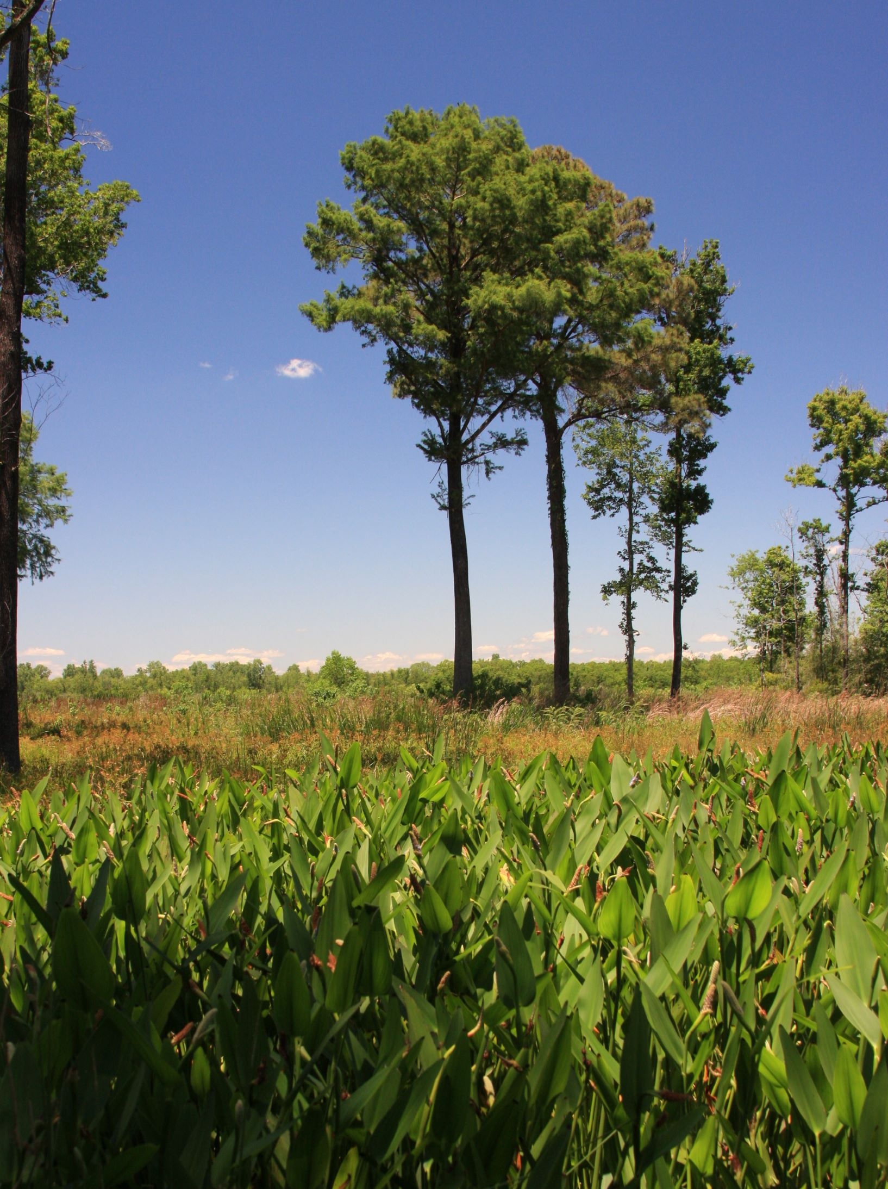
Conservation of Southeast Texas’ Natural Landscapes in a Changing Climate
Andrew Sipocz
State Parks
Texas Parks and Wildlife Dept.
andrew.sipocz@tpwd.texas.gov

Slide 2
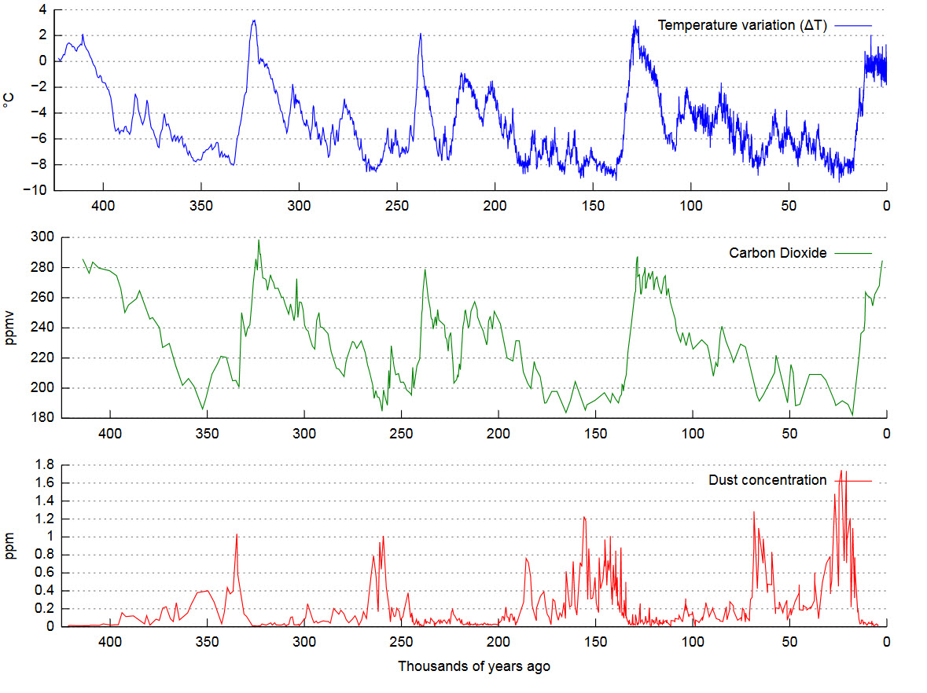
Understanding Climate Change
Global average temperature marches in lock step with carbon dioxide concentrations.
CO2 levels rise and fall over a 120,000-year cycle ultimately driven by changes in the earth’s orbit and tilt that increase and decrease the amount of sunlight received by the northern hemisphere. Positive and negative feedbacks from changes in CO2 greatly amplify the temperature changes directly caused by the relatively small variation in energy received from sunlight. Global climate is a temperamental beast!
These graphs were developed from Antarctic ice cores.
By Vostok-ice-core-petit.png: NOAAderivative work: CC BY-SA 3.0, https://commons.wikimedia.org/w/index.php?curid=10684392

Slide 3
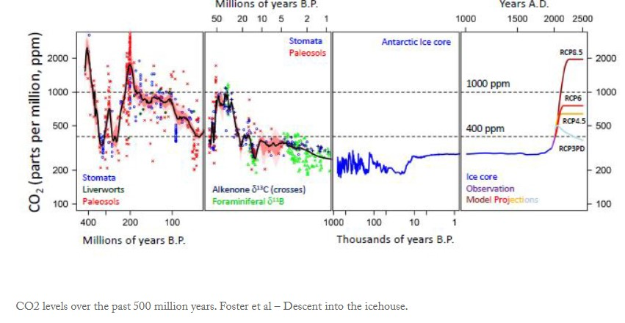
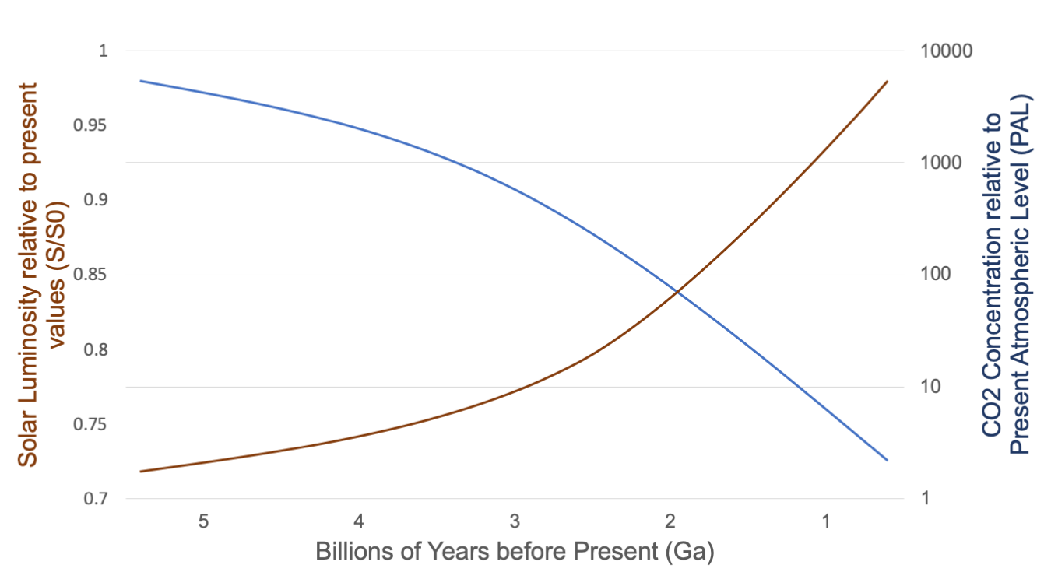
The Long History of Atmospheric CO2 Concentration and Global Temperature
RCP 4.5 – What we have already chosen by 2100: all coral reef and massive biodiversity loss, sea level rise of 3’, possible halt of AMOC.
Long term without fossil fuel disruption and climate modification: Loss of Greenland and West Antarctic Ice Sheets with additional 40’ - 80’ SLR, certain halt of AMOC making northern Europe a mess.
RCP 6 – Loss of Antarctic ice cap with another 200’ of sea level rise. Missouri and Tennessee will have beach front property. Texas will be uninhabitable desert.
RCP 8.5 - We need space suits to breath.
By Gretashum CC BY-SA 4.0 Commons Wikimedia

Slide 4
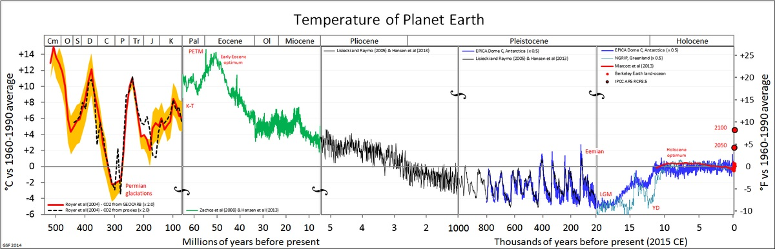
Past Climate Change and Plant Evolution
By Glen Fergus - Own work; data sources are cited below
The movement of Antarctica and Greenland towards the poles allowed ice caps to form.
The rise of the Himalayas is thought to have greatly increased the erosion of silicate rocks which increases the drawdown of Carbon from the atmosphere. This has cooled the planet leading to the formation of the Antarctic (30 mya) and Greenland ice sheets (3 mya).

Slide 5
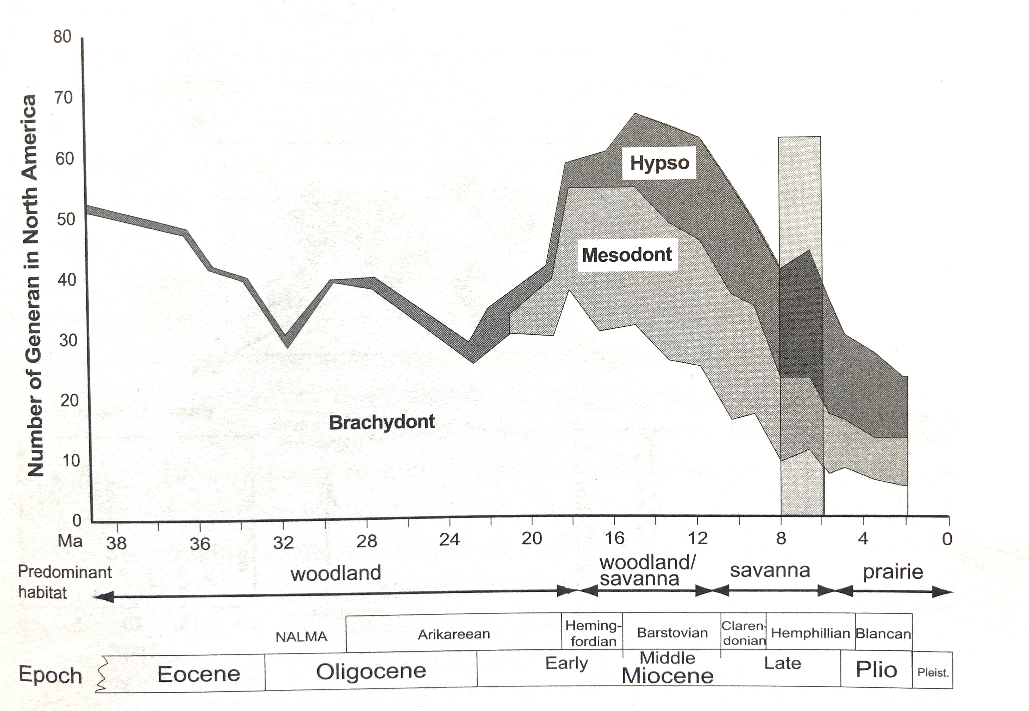
Long Term Plant Community Change
Lower CO2 concentrations and global temperatures spurred the evolution of grasses due to the more frequent drought and greater seasonal temperature swings. Which led to the evolution of mammalian browsers and grazers and a decrease in forest cover.
The evolution of the C4 photosynthetic pathway of warm season grasses 8 mya lead to a massive increase (1,000x) in fire and the formation of the world’s temperate and subtropical grasslands – prairies and savannas. Today’s world.
Janis, C.M. et.al. 2002. The Origins and Evolution of the N.A. Grassland Biome: The Story of Hoofed Mammals.

Slide 6
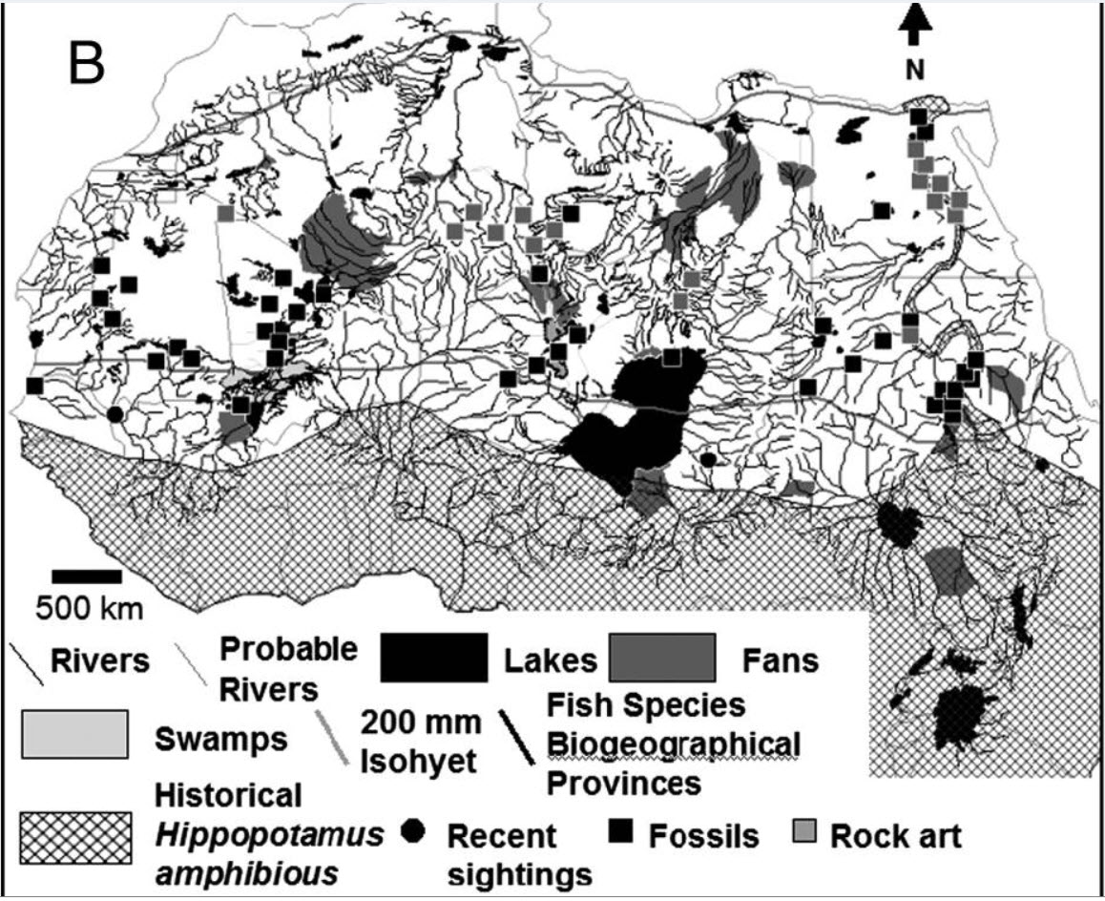
Examples of More Recent Climate and Plant Community Changes
10,000 years ago the Sahel and Sahara were relatively lush. Water courses, swamps and lakes were scattered throughout as evidenced by hippo fossils and rock art.
Ancient watercourses and biogeography of the Sahara explain the peopling of the desert. Nick A. Drake, Roger M. Blench, Simon J. Armitage, Charlie S. Bristow, and Kevin H. White. Proceedings of the National Academy of Sciences. 2010.

Slide 7
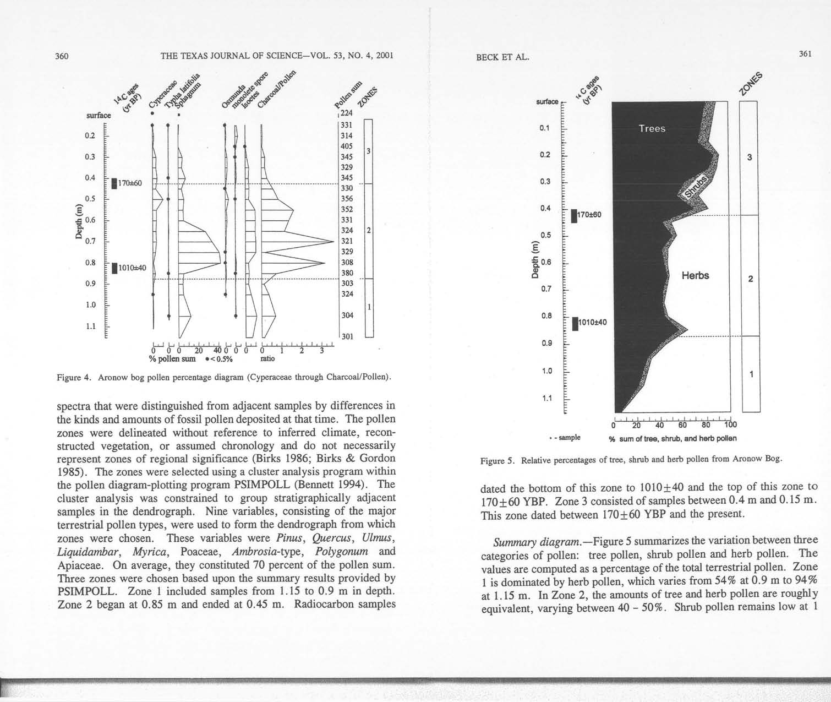
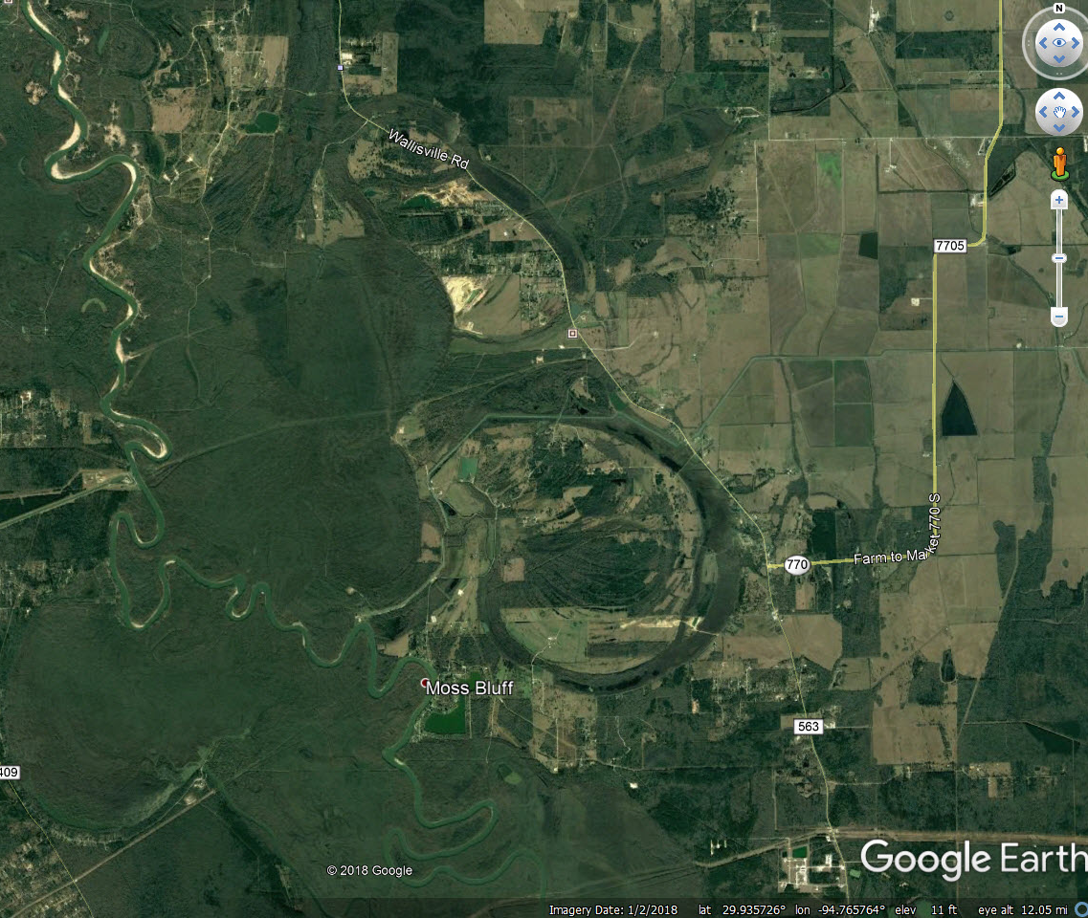
Houston Area Change - Deweyville Terrace River Channels and Aronow Bog Study

Slide 8
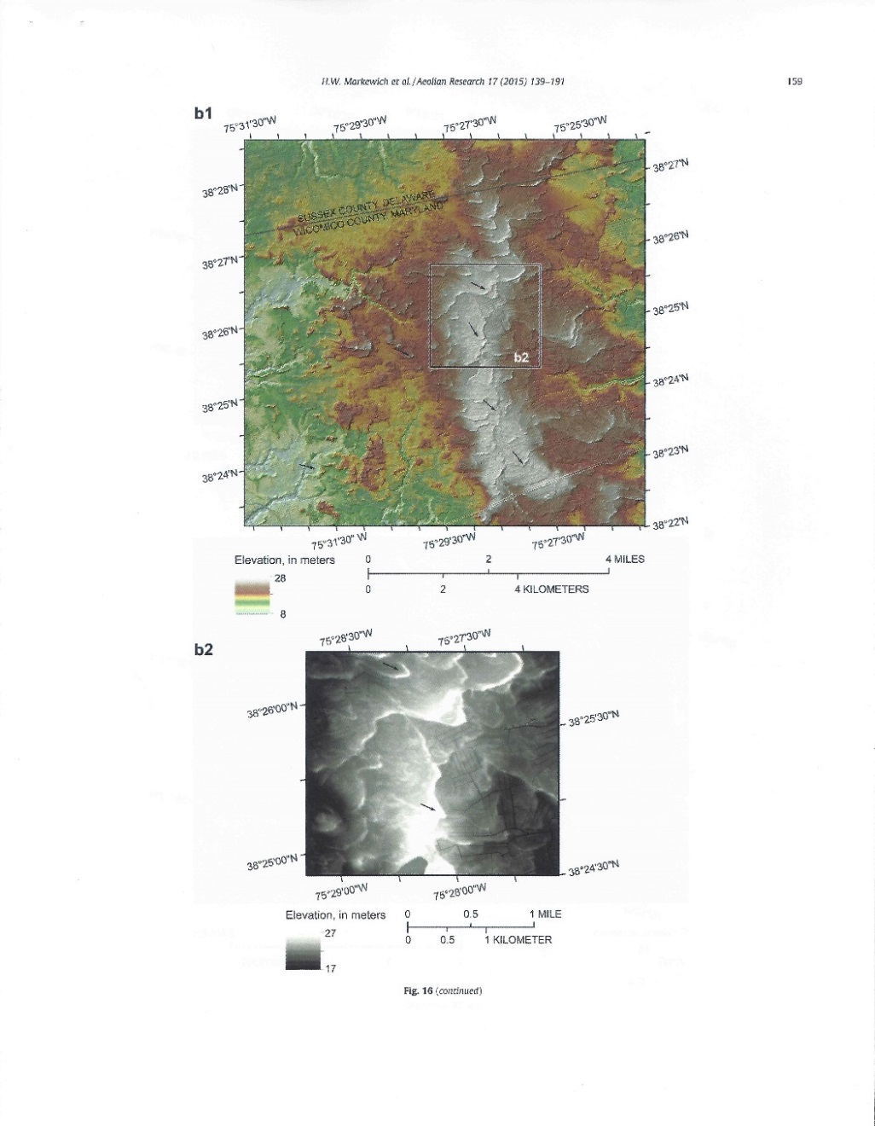
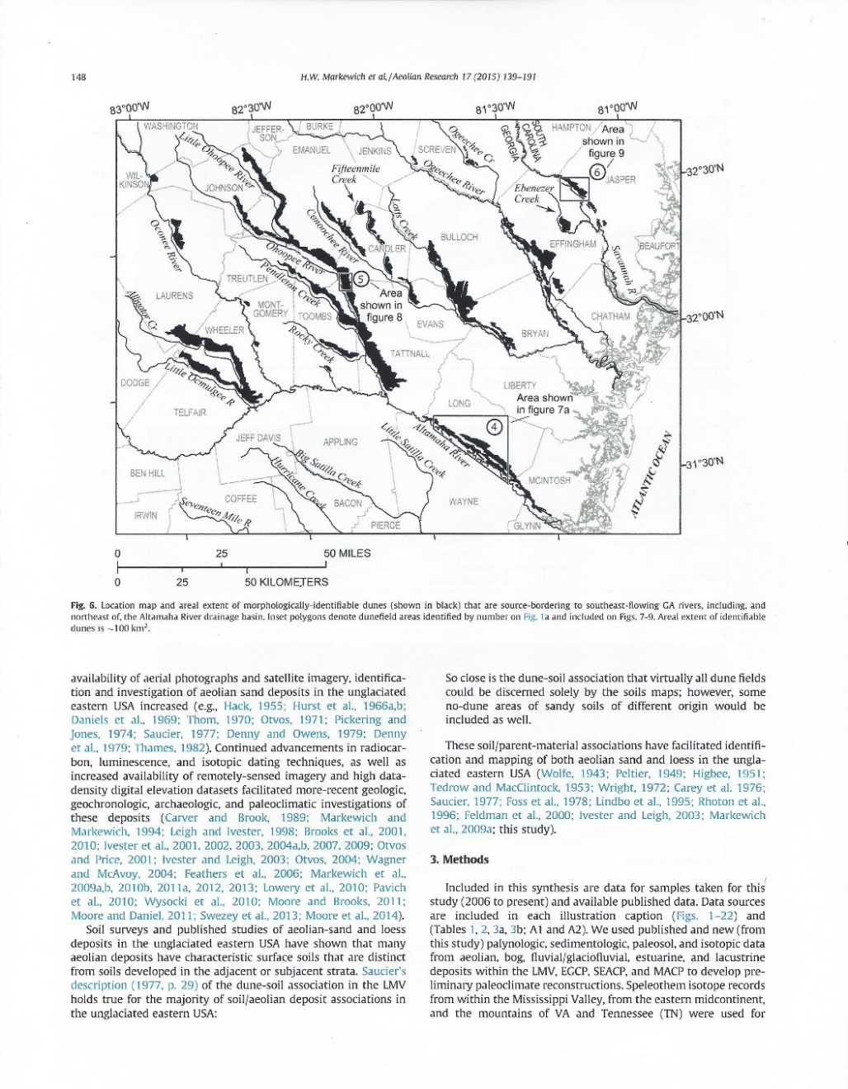
Holocene Optimum
Atlantic Coastal Plain Sand and Silt Dunes
Deep sands provide a dry microclimate for grasses and flowers adapted to dry lands to thrive amidst moist forests.

Slide 9
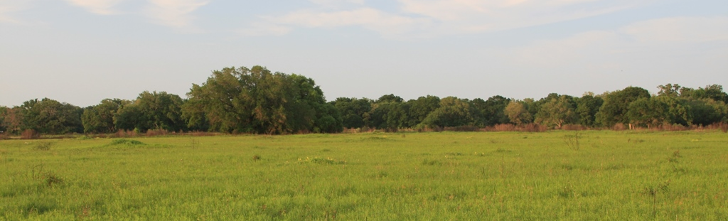
Mima Mounds – Brazos Bend State Park
These formed during the Holocene Optimum and other more recent severe dry periods.

Slide 10
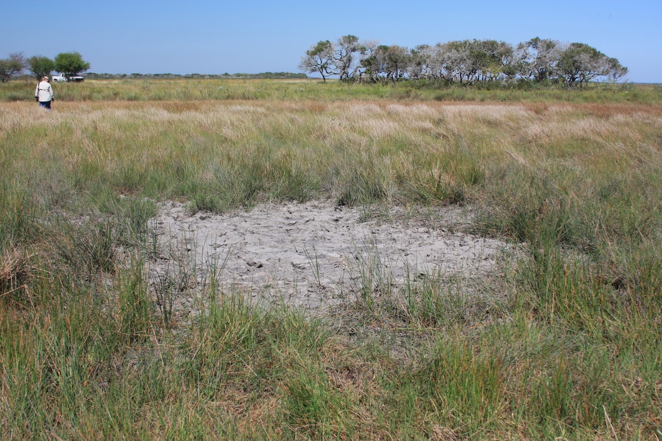
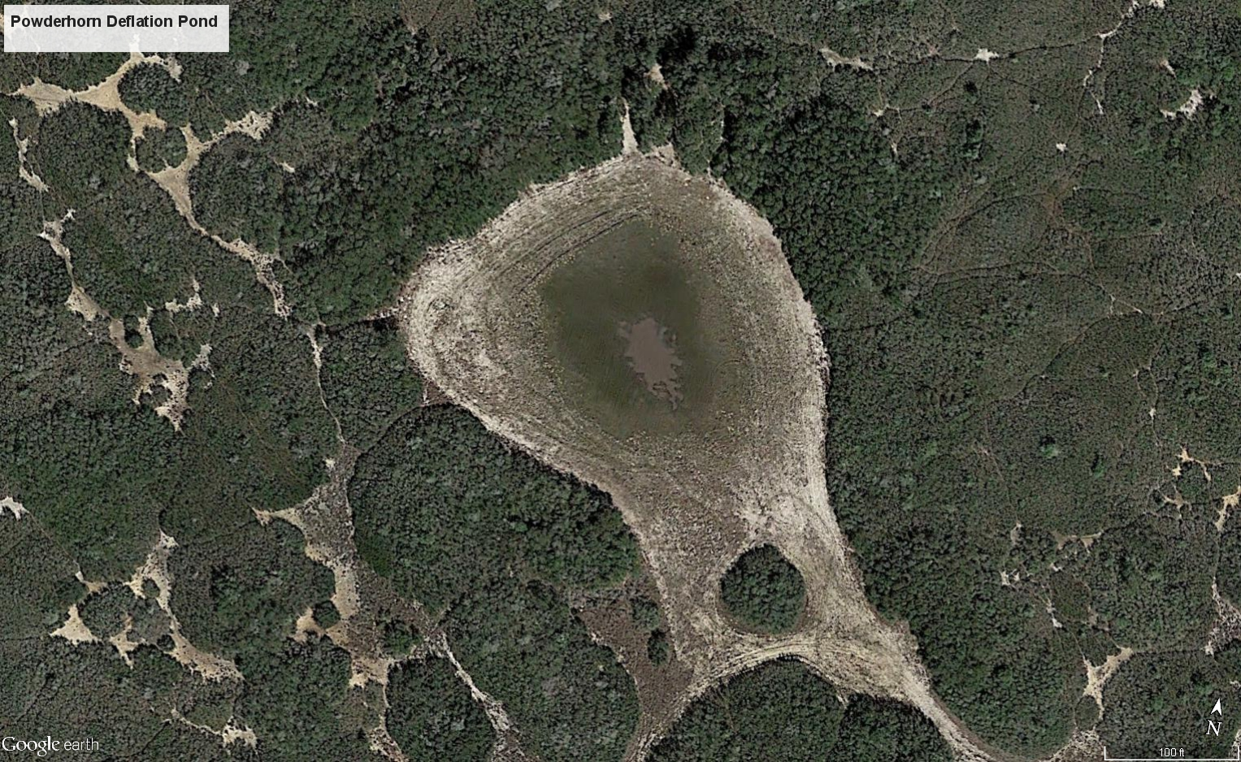
On drier parts of the Texas coast, dunes and ponds are still being formed. Houston’s warm season climate was once dry enough to resemble this landscape; and may be again this century.

Slide 11
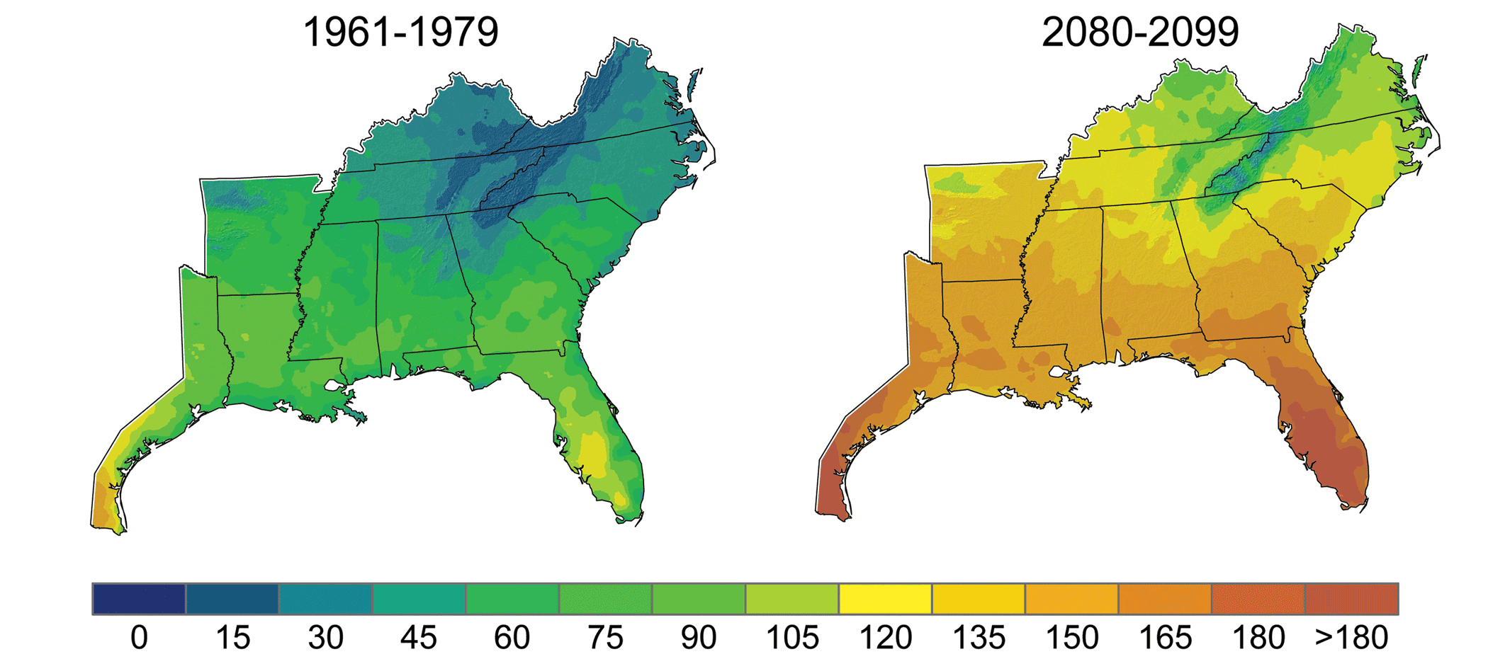
Expected Temperature Increase with Climate Change Due to Increasing CO2 concentrations

Slide 12
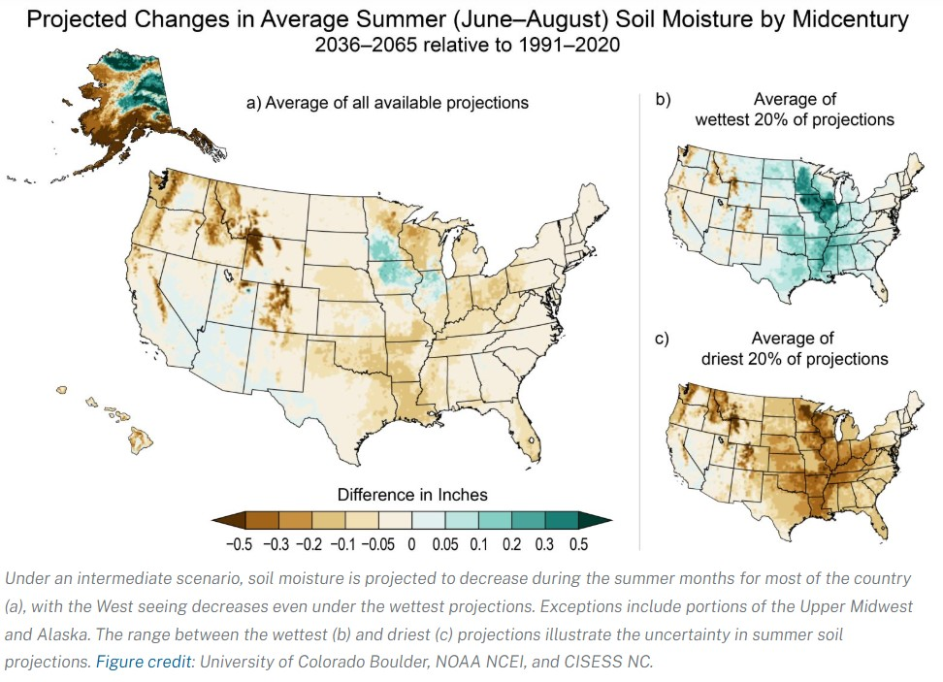
Expected Soil Moisture Changes with Climate Change Due to Increasing CO2 concentrations

Slide 13
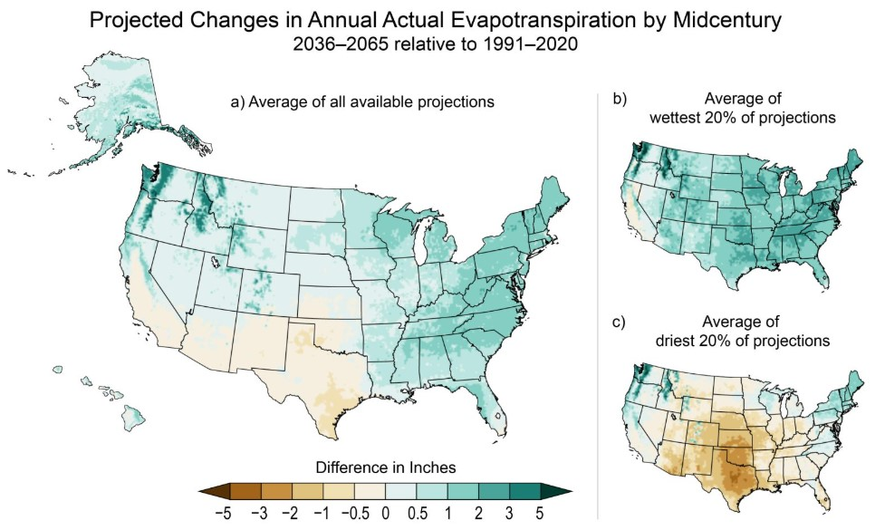
Expected Evapotranspiration Changes with Climate Change Due to Increasing CO2 concentrations

Slide 14
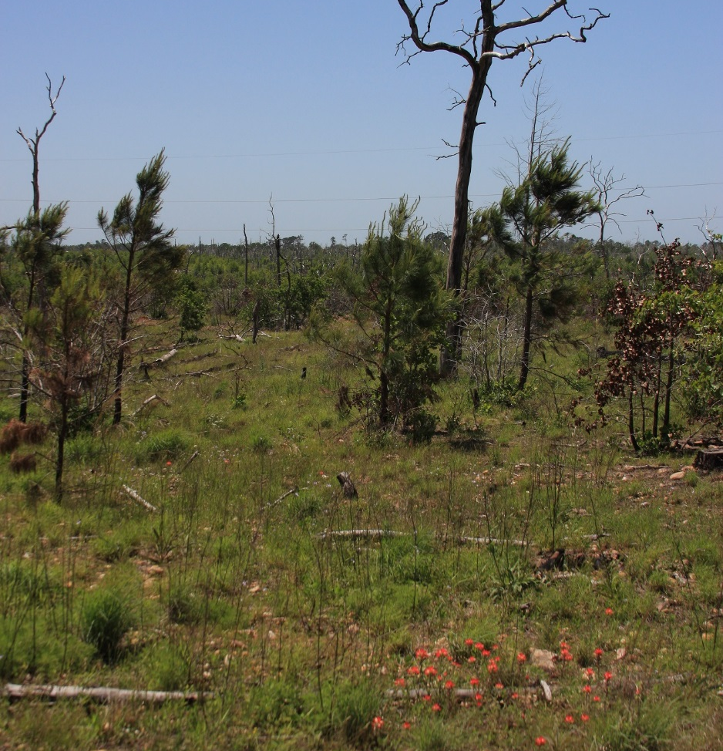
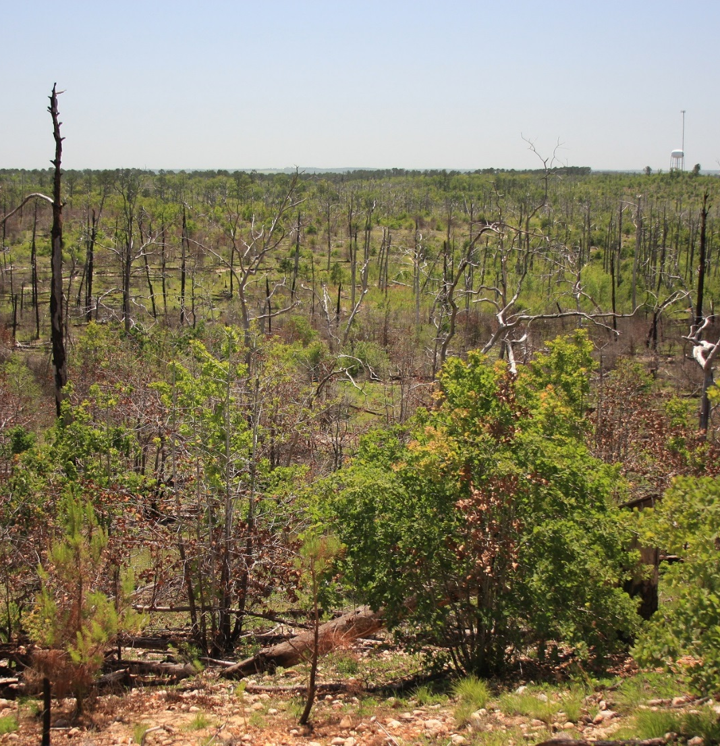
In many cases the changes will be the result of abrupt events like the Bastrop Fires

Slide 15
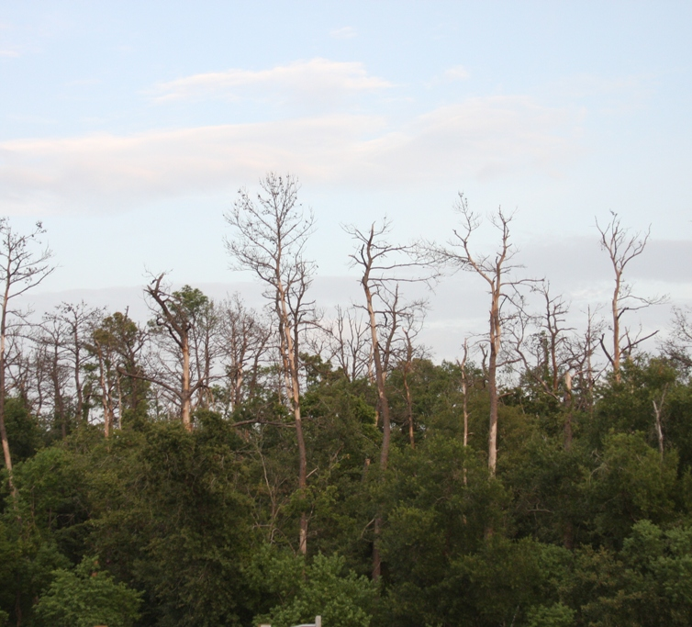
Drought, disease and other agents of change exist, but climate change will be the ultimate cause
Herman Brown Park, Harris County, Texas
2011 Drought

Slide 16
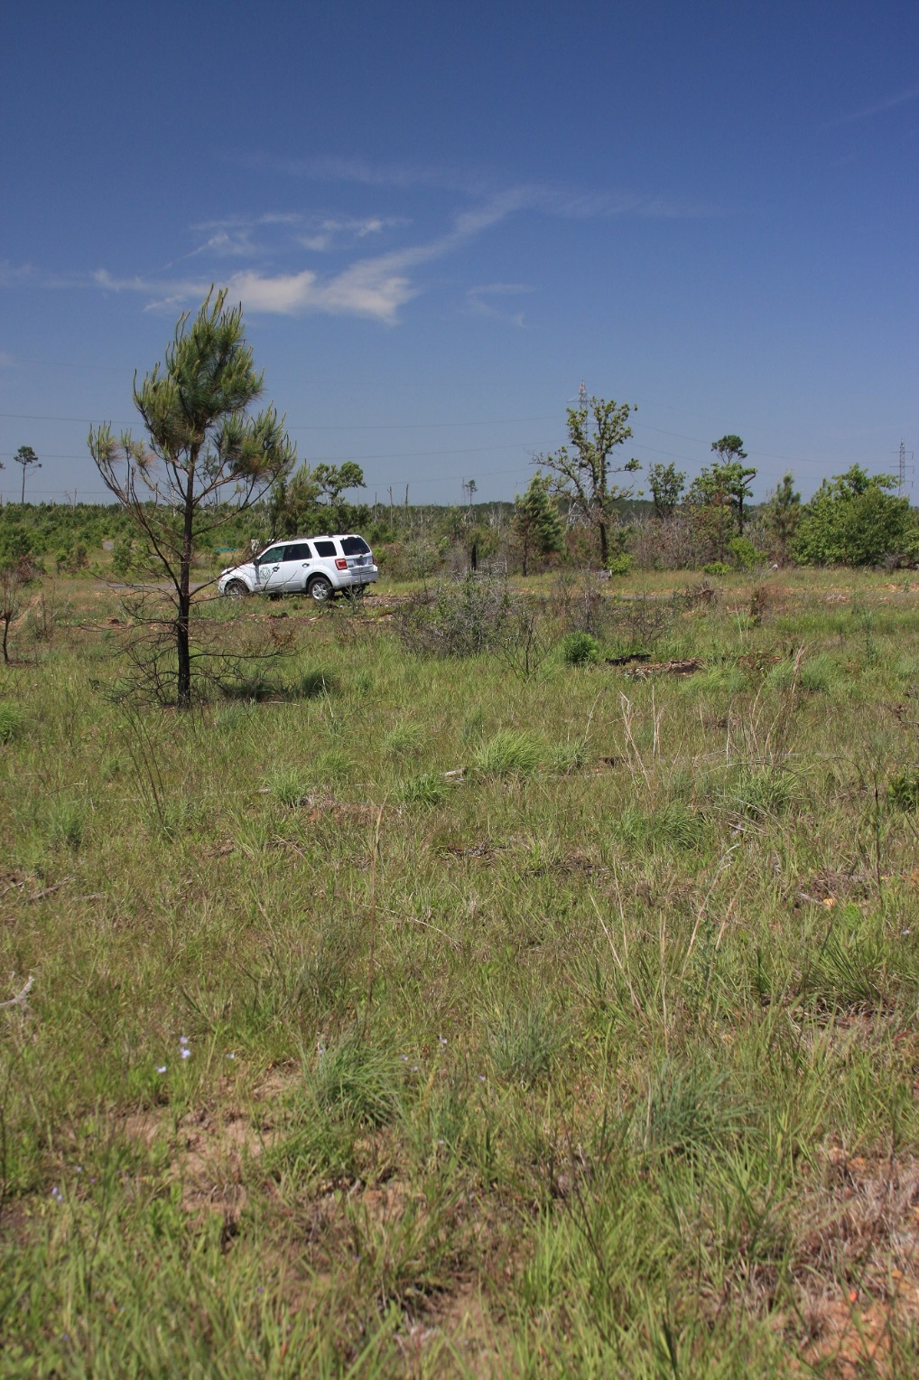
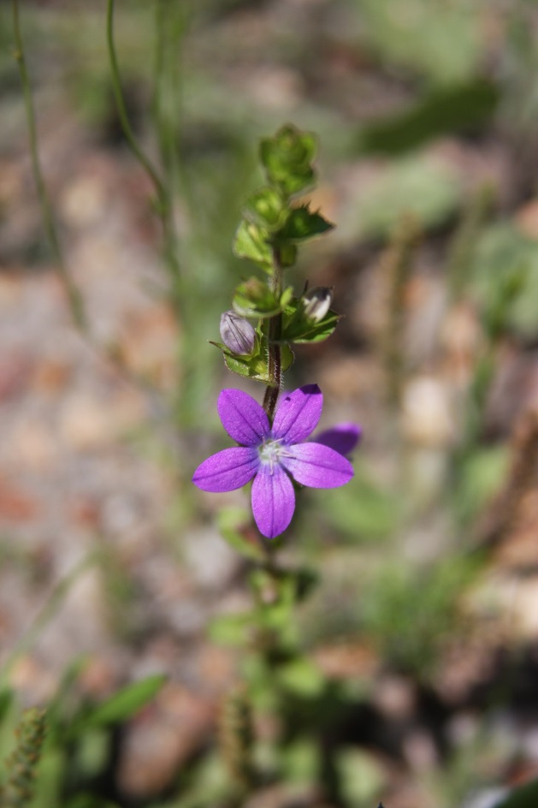
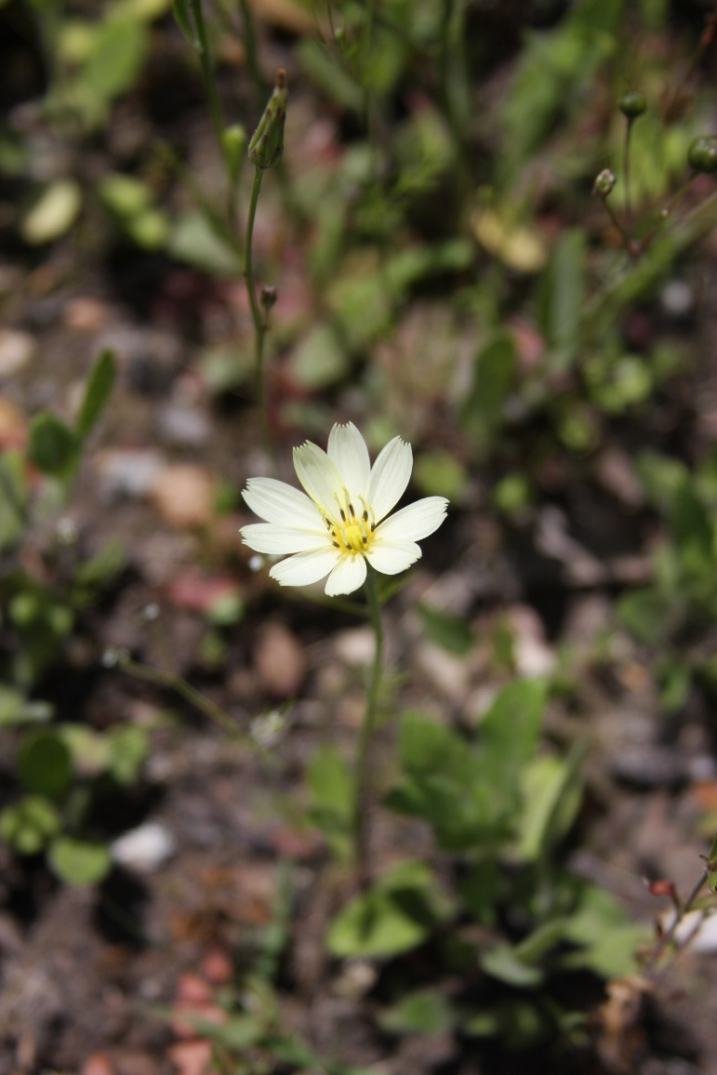
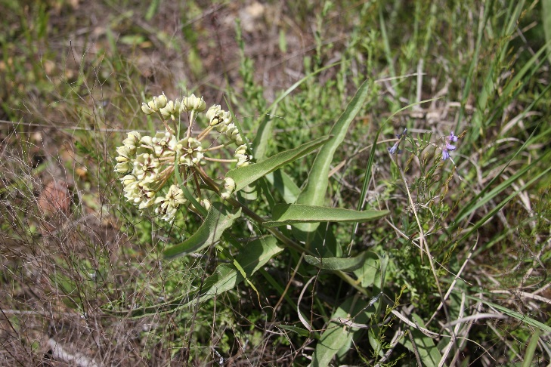
How do we conserve native plant communities?

Slide 17
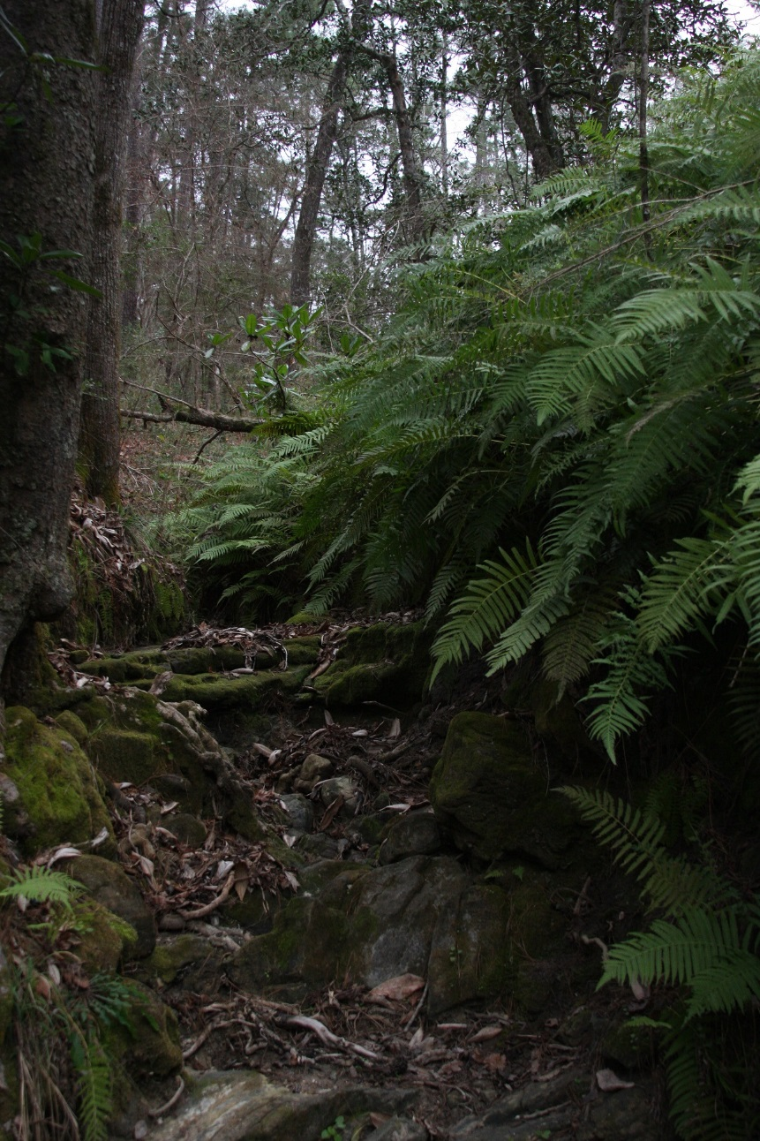
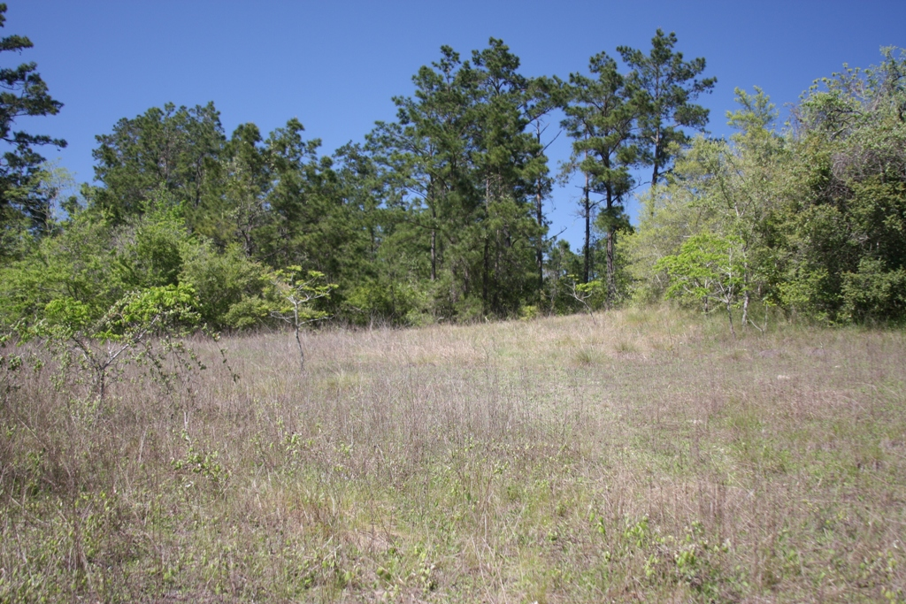
Conserve the Range of Native Plant Diversity and Climate Refugia
The first rule to intelligent tinkering is to save all the parts – Aldo Leopold
A sandstone gorge at Davis Hill SNA holds plants adapted to a cooler and wetter climate
A sandstone barren at Davis Hill SNA hosts plants adapted to a warmer and drier climate

Slide 18
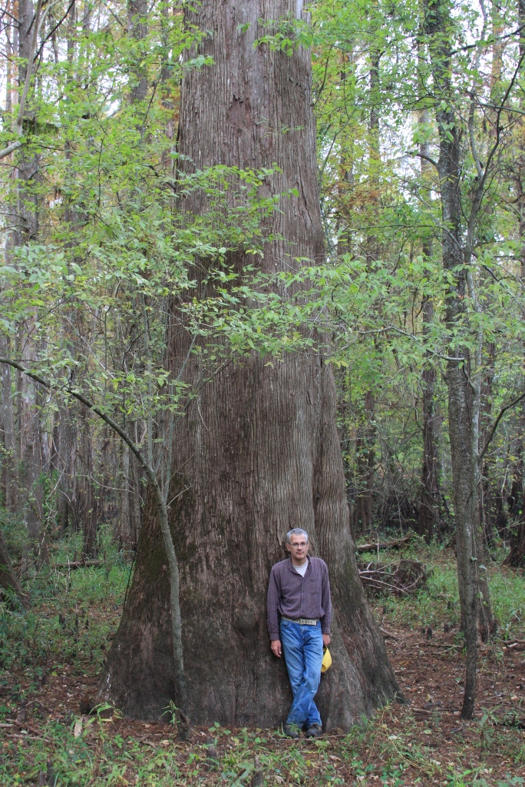
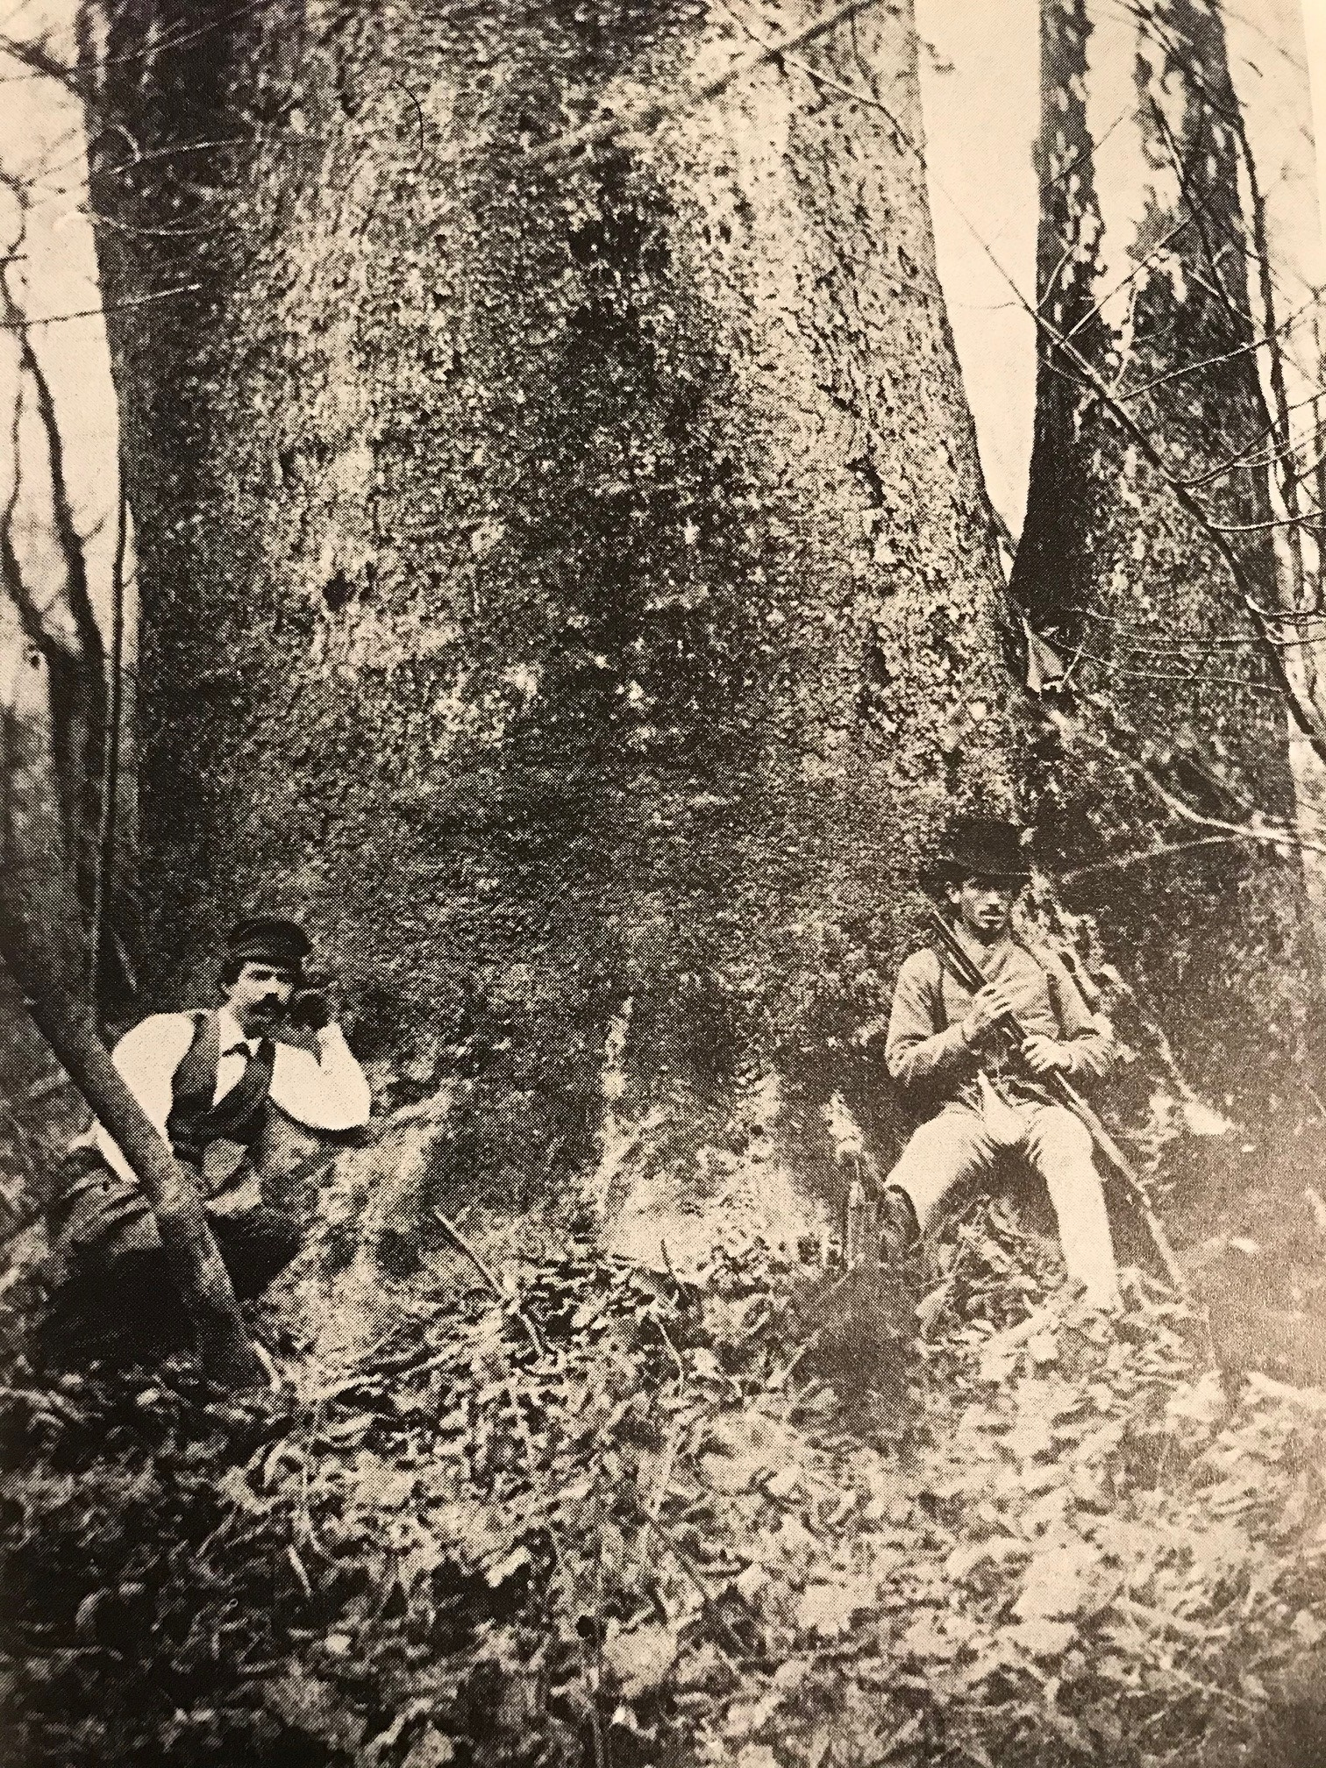
Davis Hill State Natural Area
The greatest number of plant communities of any State Park (Liberty County)

Slide 19
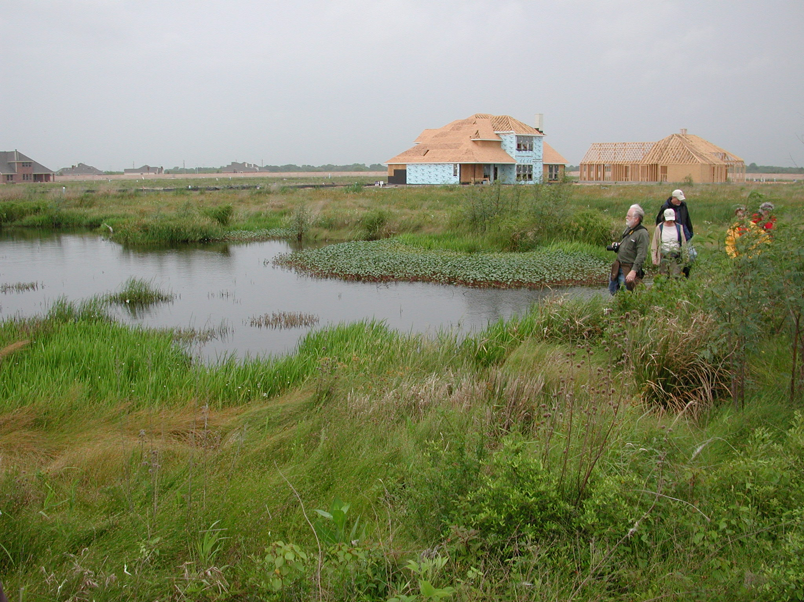
Dick Benoit Prairie Park, Galveston County, Texas

Slide 20
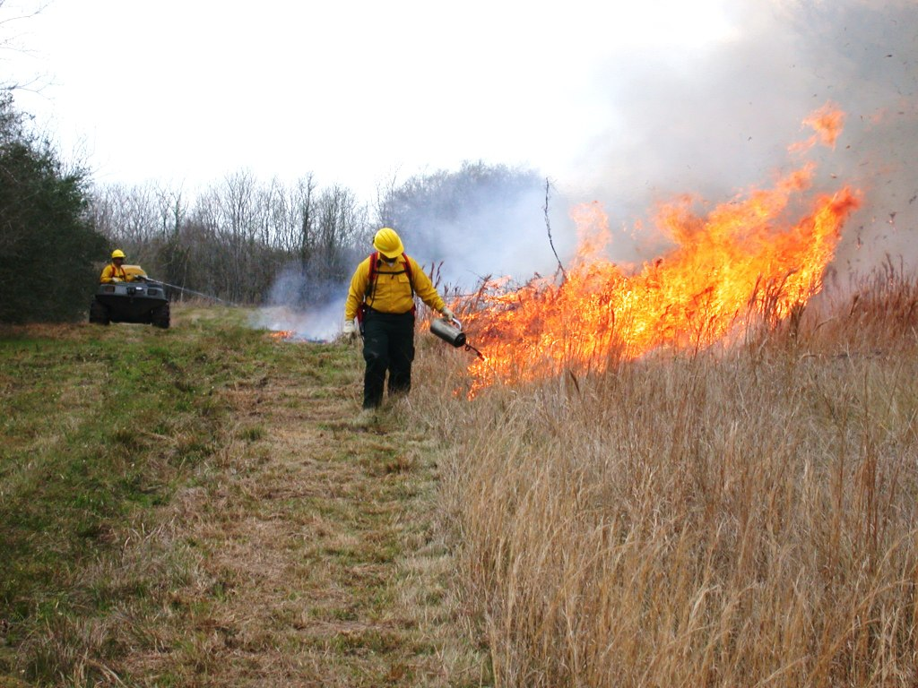
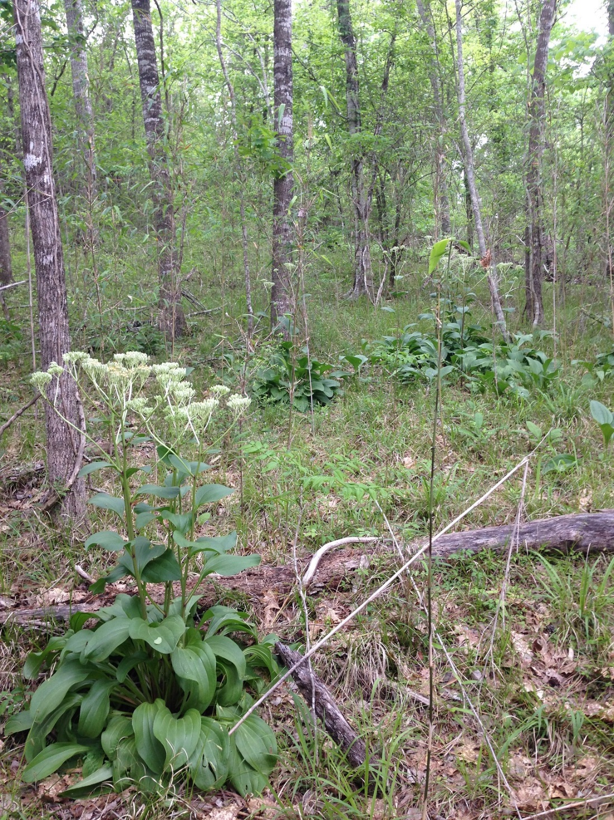
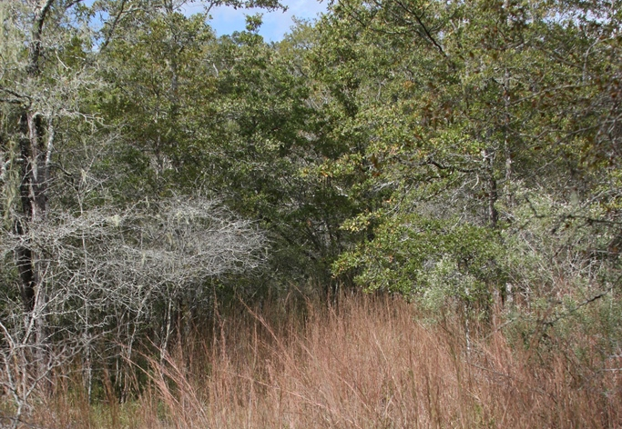
Maintain/Replace Natural Processes with Management Actions

Slide 21
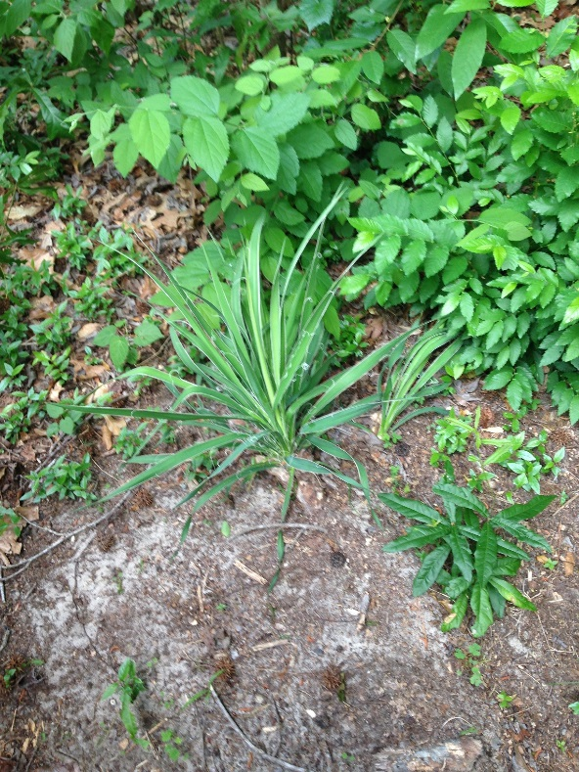
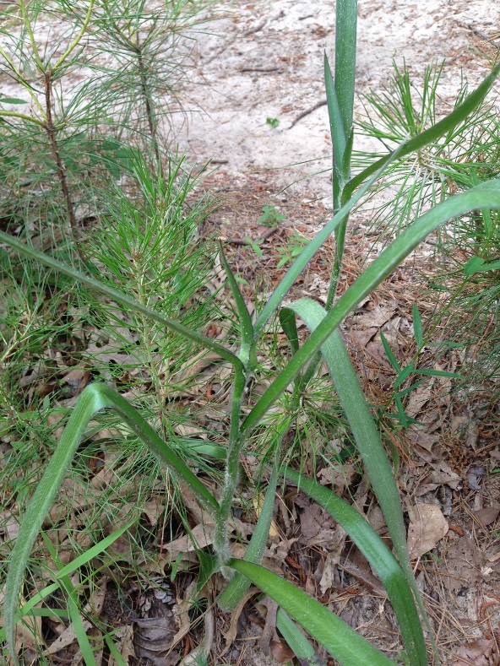
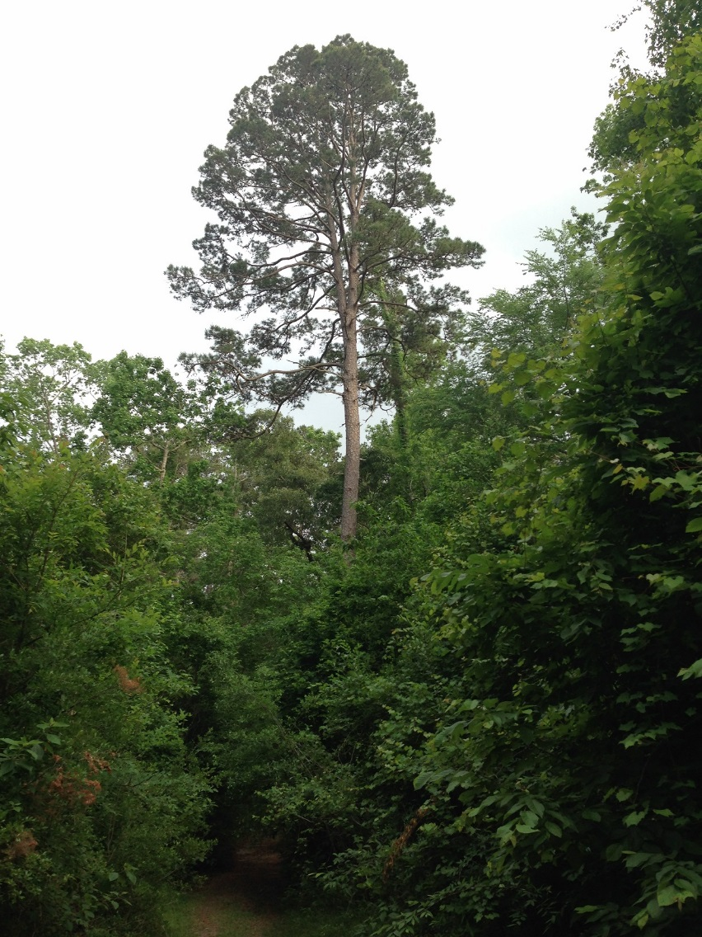
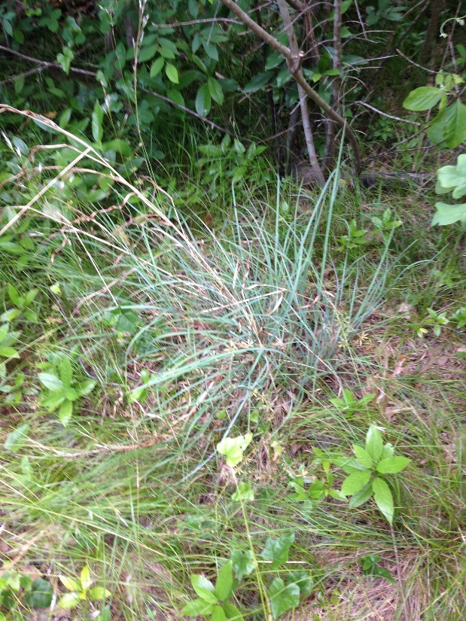
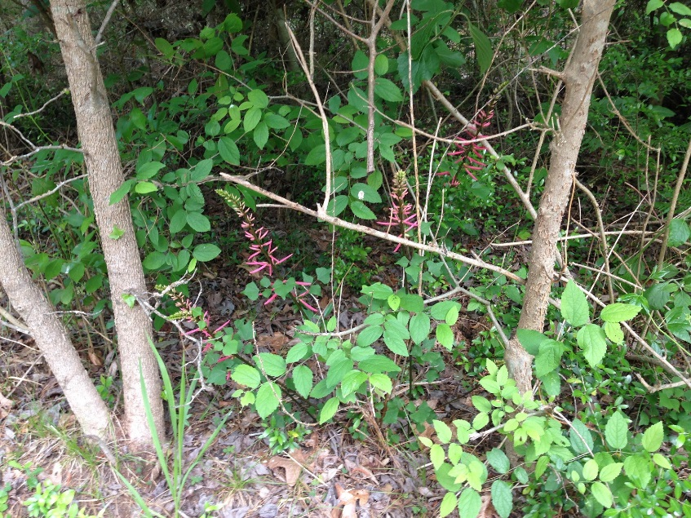
Manage Plant Communities for their Pre-European Condition Which are Often Fire and Drought Adapted
Huntsville State Park

Slide 22
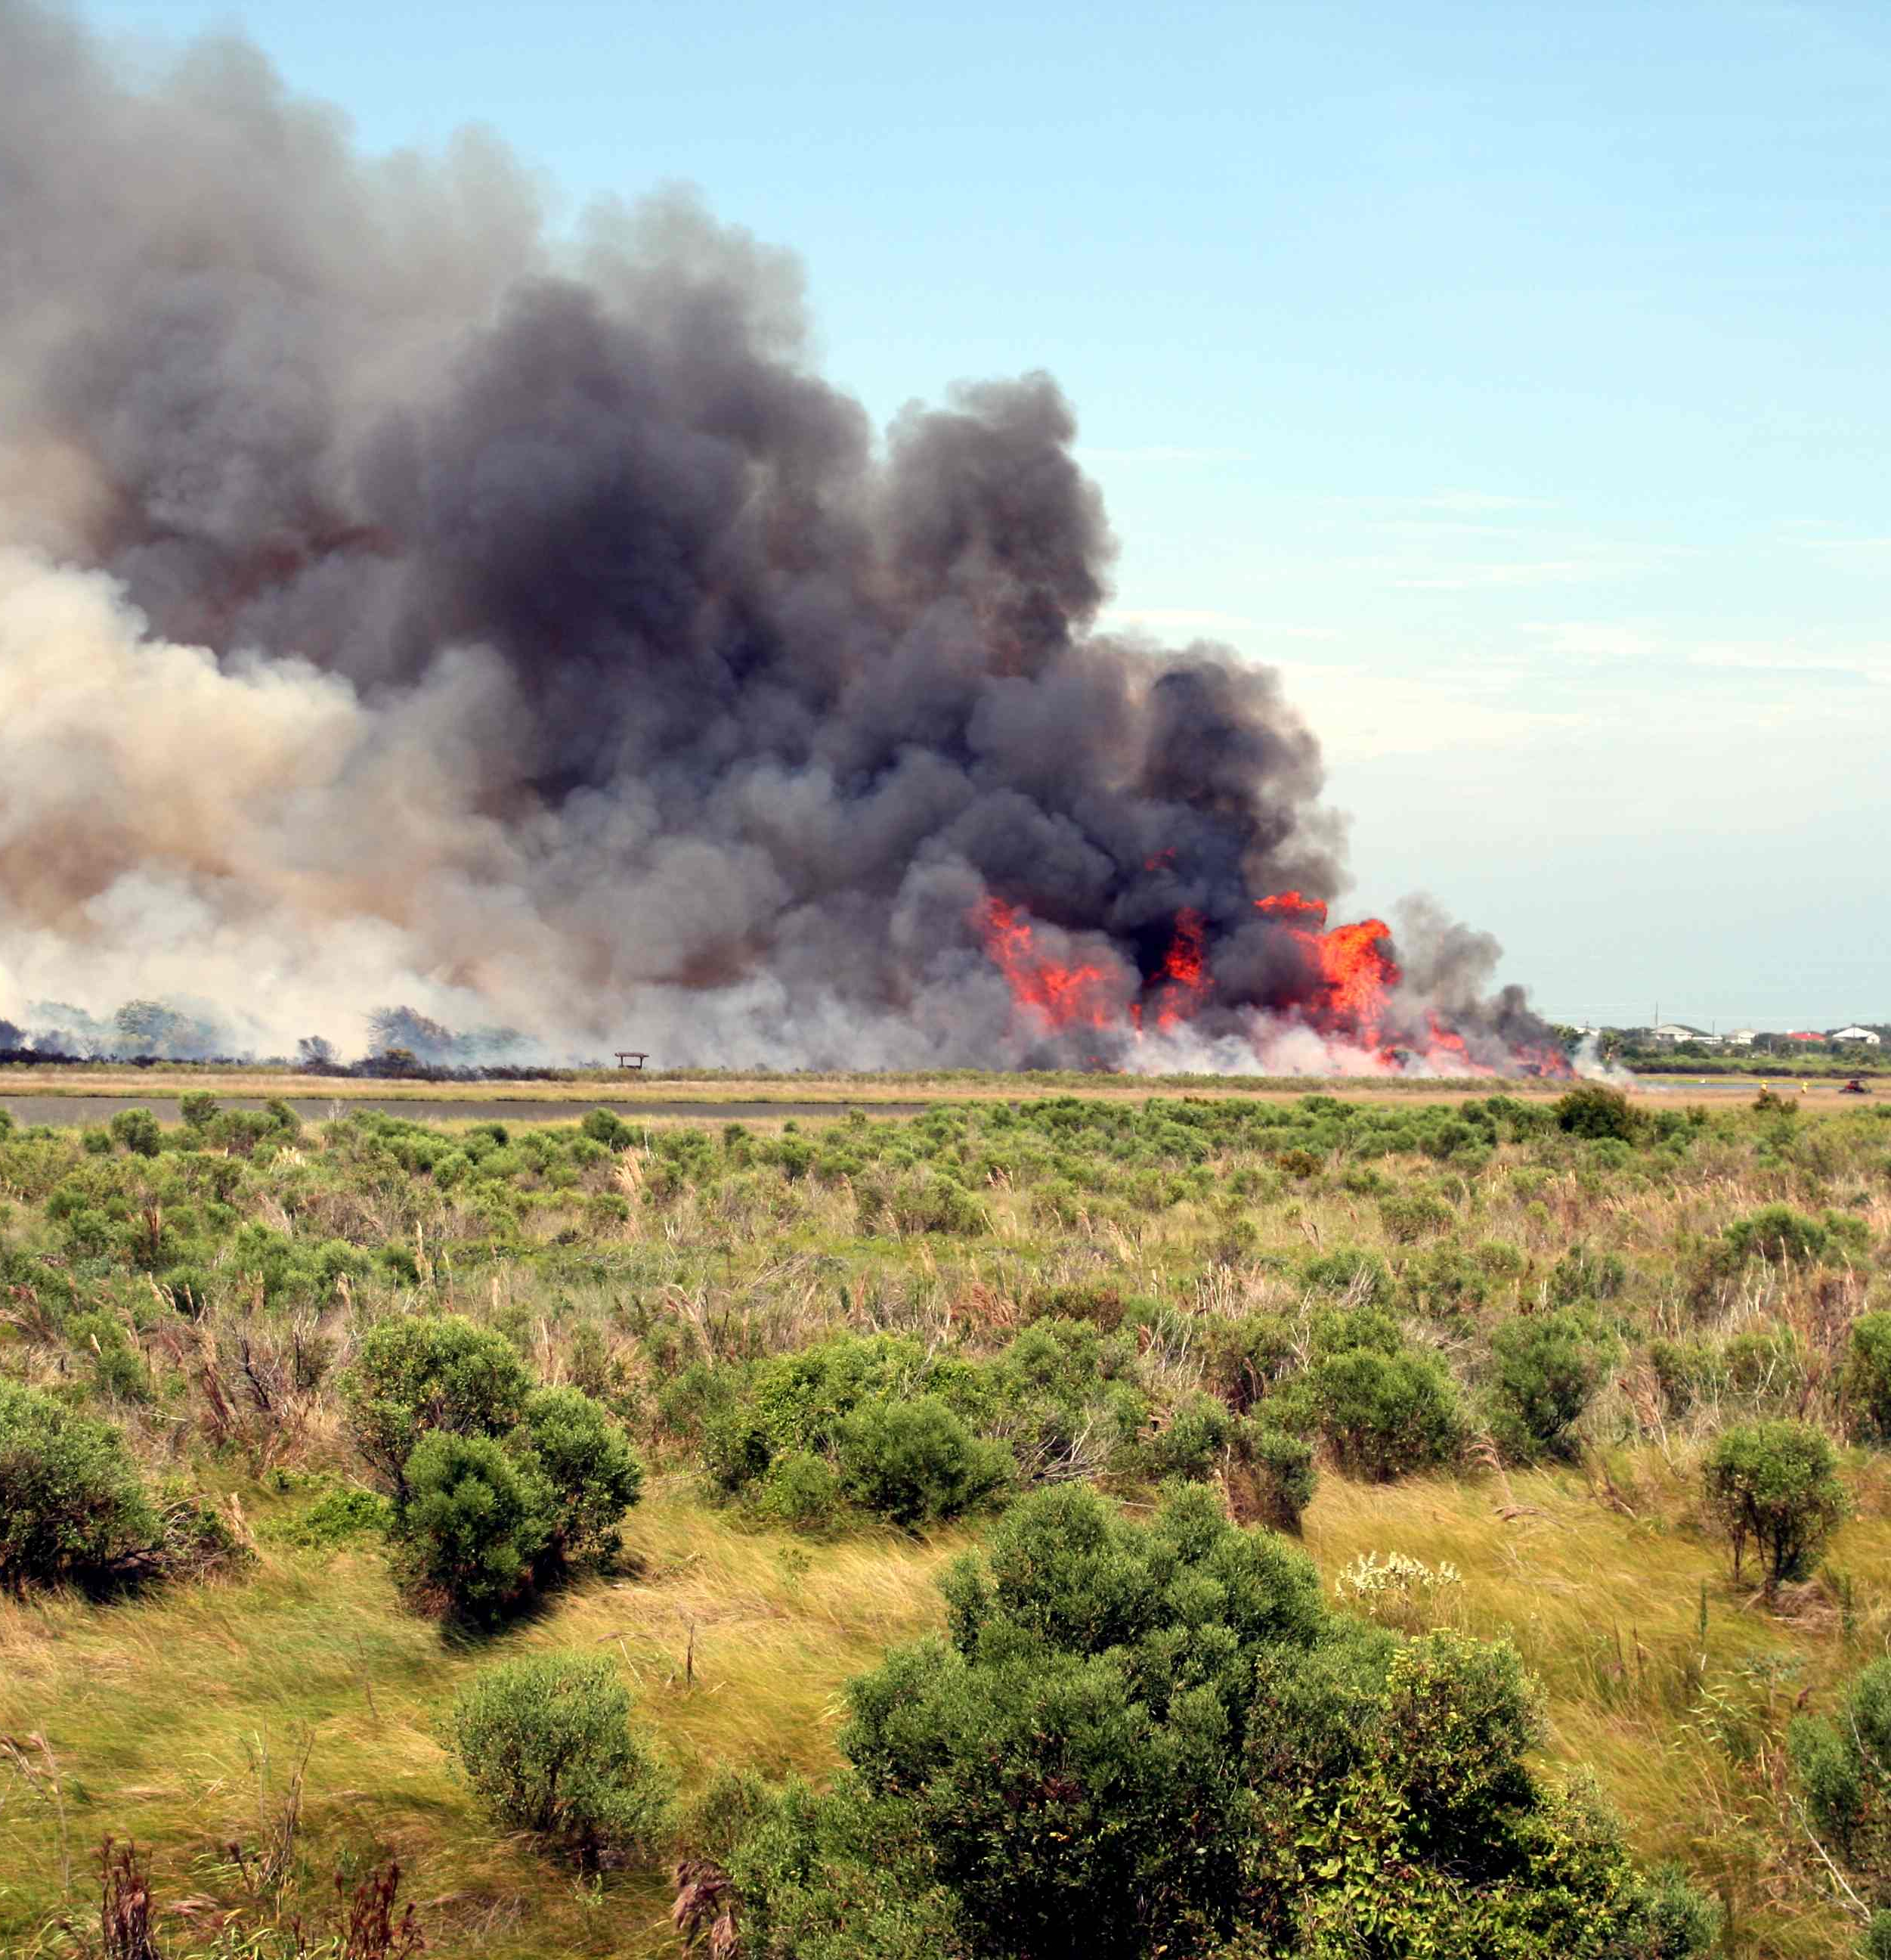
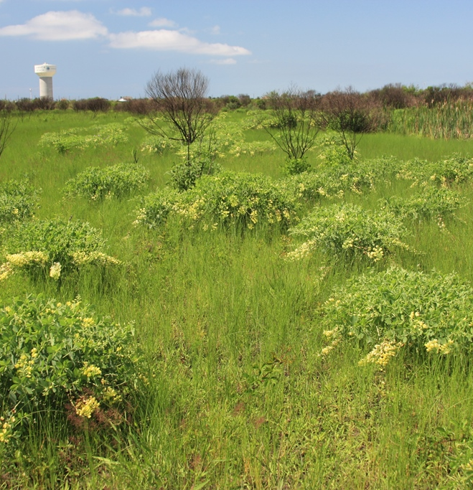

Slide 23
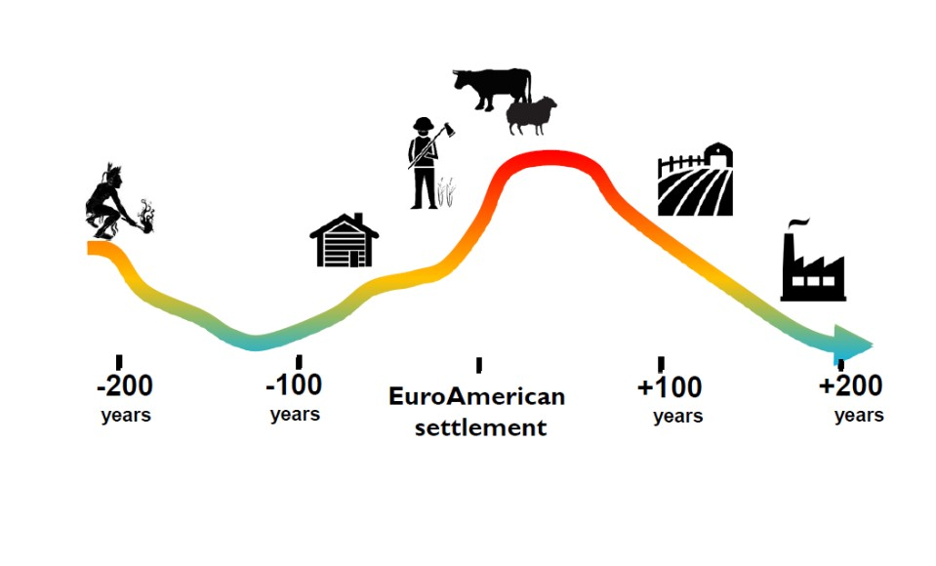
Massive Habitat Losses From Lack of Fire
From “Wave of Fire – Michael Stambaugh

Slide 24
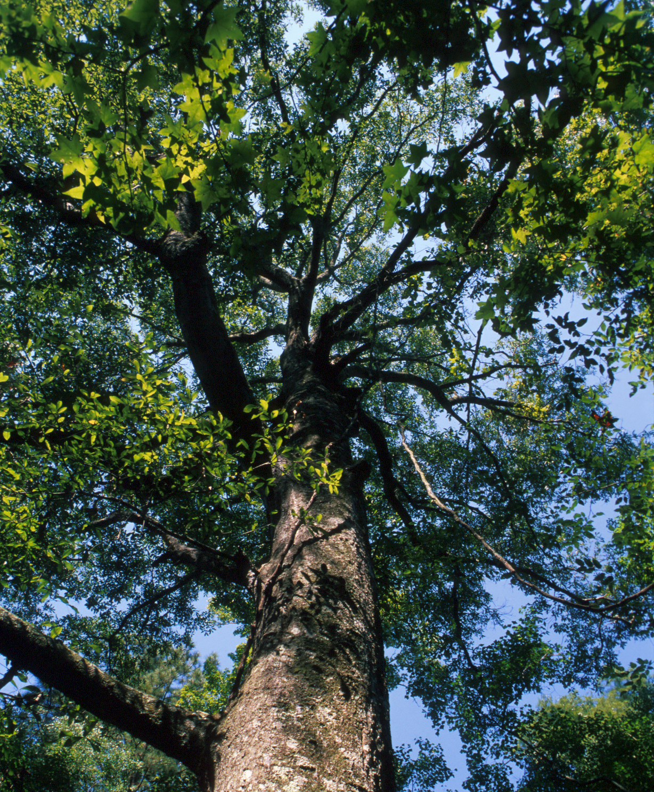
Assisted Migration
Trees have very long generation times, so they move and adapt slowly to climate change. Adults are much more resilient to climate change than seedlings. They may live hundreds of years in a location that is unsuitable for reproduction.
Unless we track reproduction and recruitment into the canopy, we won’t know they are in trouble. BTW We do (did) this with fruit and nut crops.
The same applies to mid-story, understory and ground cover plant species.

Slide 25
Assisted Migration
Forest flora was squeezed into the southeast U.S. (including areas now under the waters of the Gulf of Mexico) during the last ice age. By 11,000 years ago they were colonizing previous ice-covered lands in the north. However, climate change is proceeding even more quickly today, and trees can’t keep up.
Genetic diversity allows a species to live over a wide climate range. Seeds collected from trees inhabiting the southern portion of their range are being collected by scientists for planting experimentally among the same species in northern locations to see if they thrive in the new climate (The Nature Conservancy).

Slide 26
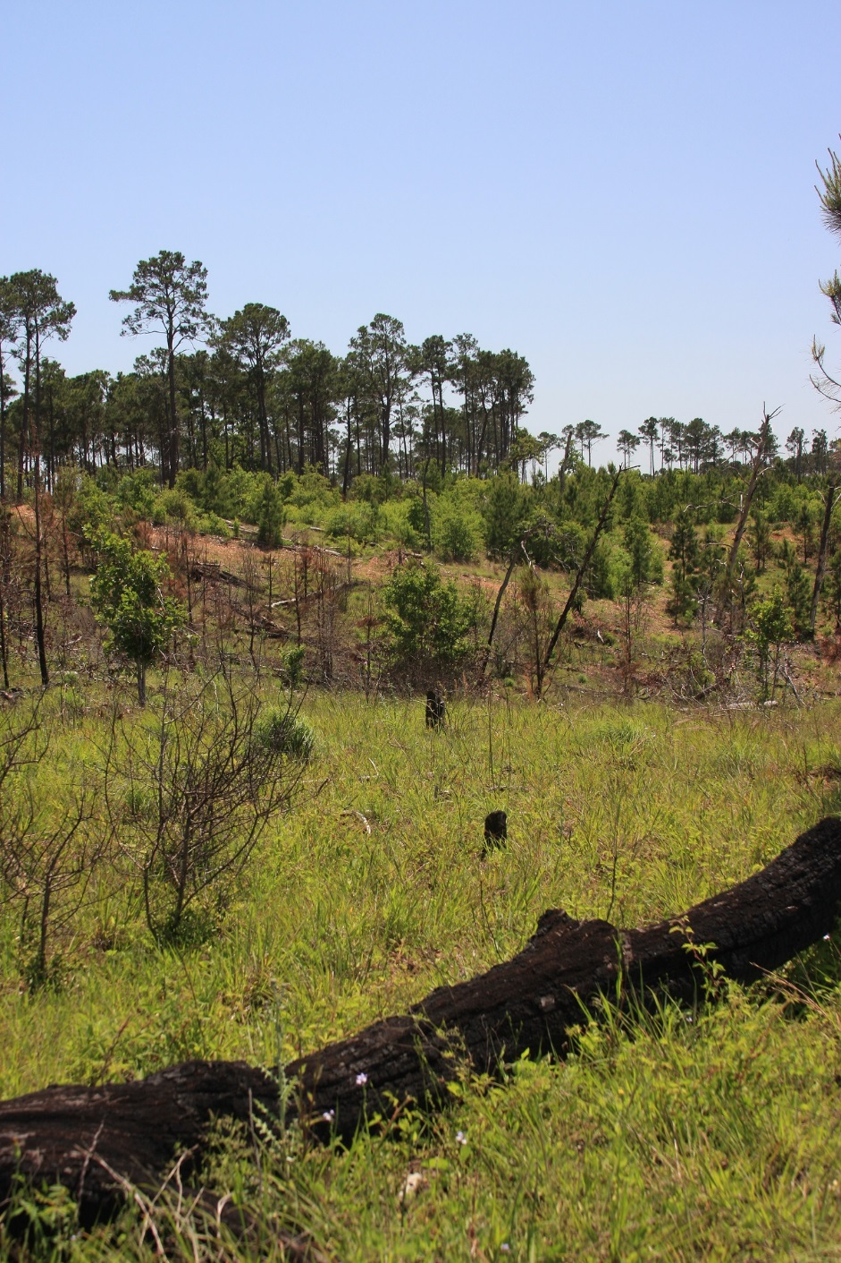
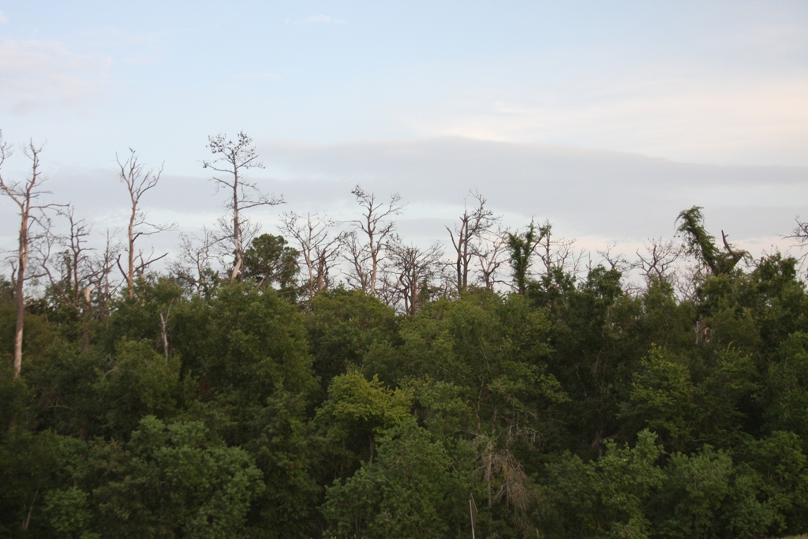
Allow Change to Happen
Should we replant loblolly pine at the Houston Arboretum or Bastrop SP?

Slide 27
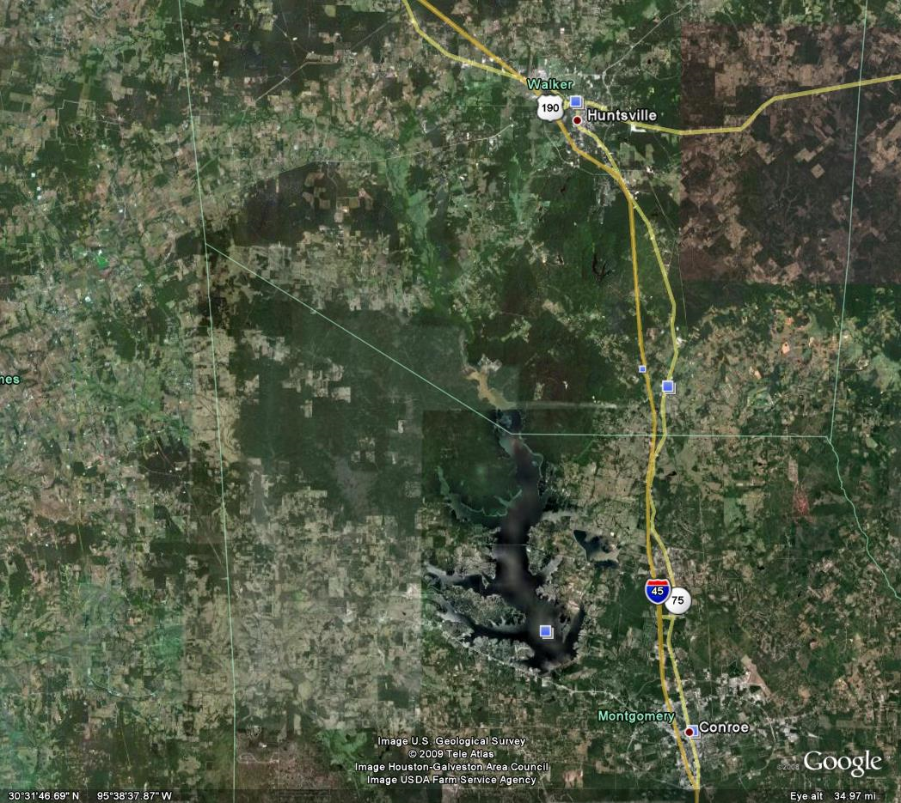
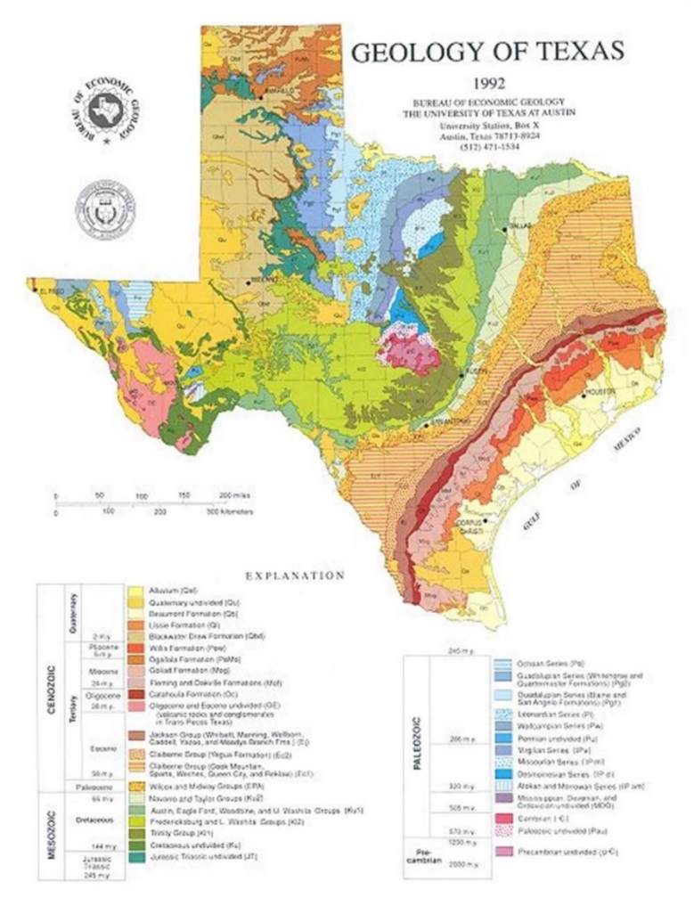
Average rainfall diminishes in a direction perpendicular to the geologic strata and yet plant community boundaries follow more closely the geology, not the climate. Therefore, plant communities will tend to be “sticky”. And there are many barriers to plant migration.
A Couple Flies in the Ointment
There are many barriers to plant migration.

Slide 28
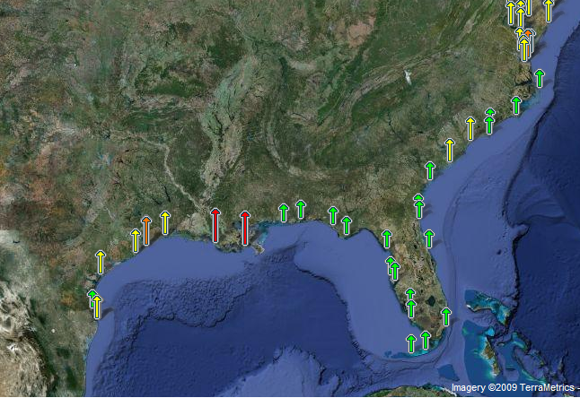
A Huge Fly in the Ointment – We’re Losing Ground - Literally
U.S. Sea Level Trends - NOAA

Slide 29
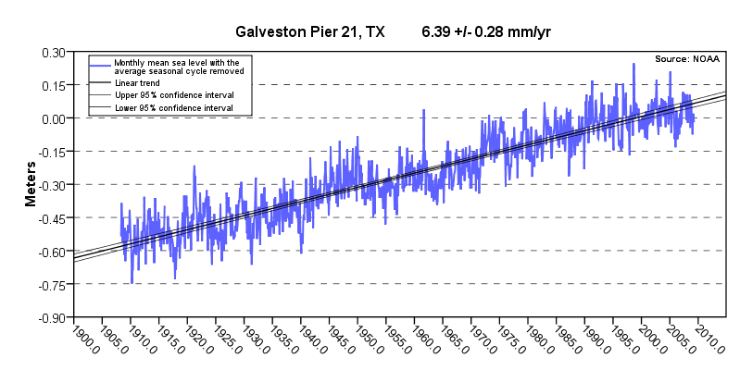
The mean sea level trend is 6.39 millimeters/year with a 95% confidence
interval of +/- 0.28 mm/yr based on monthly mean sea level data from
1908 to 2006 which is equivalent to a change of 2.10 feet in 100 years (NOAA 2009). The change from a flat trend to a rising one occurred in approximately 1930.

Slide 30
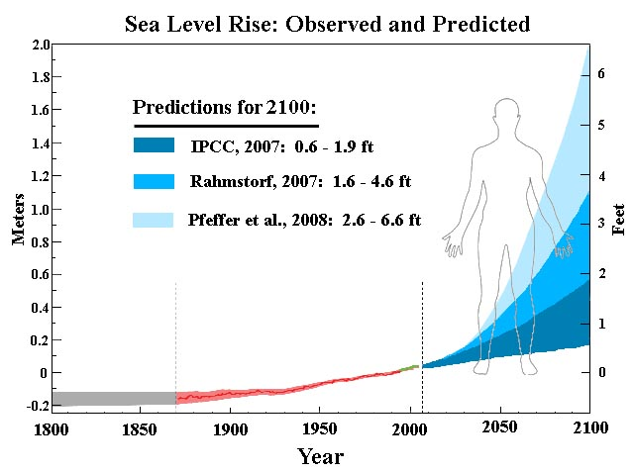

Slide 31
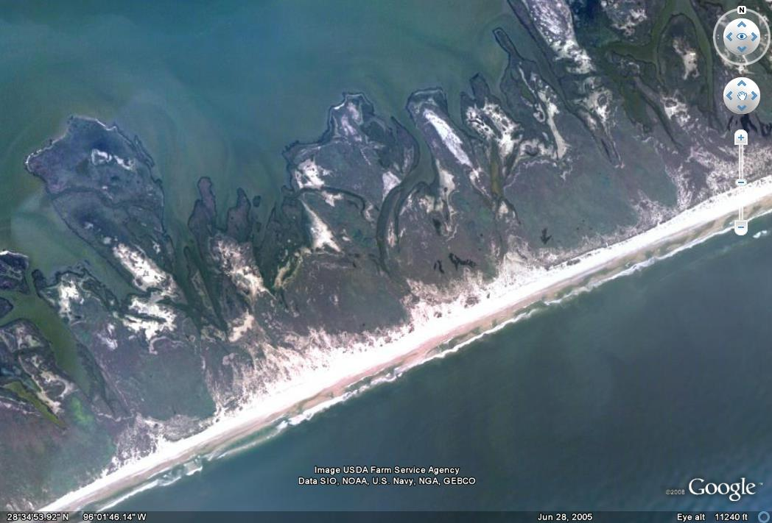
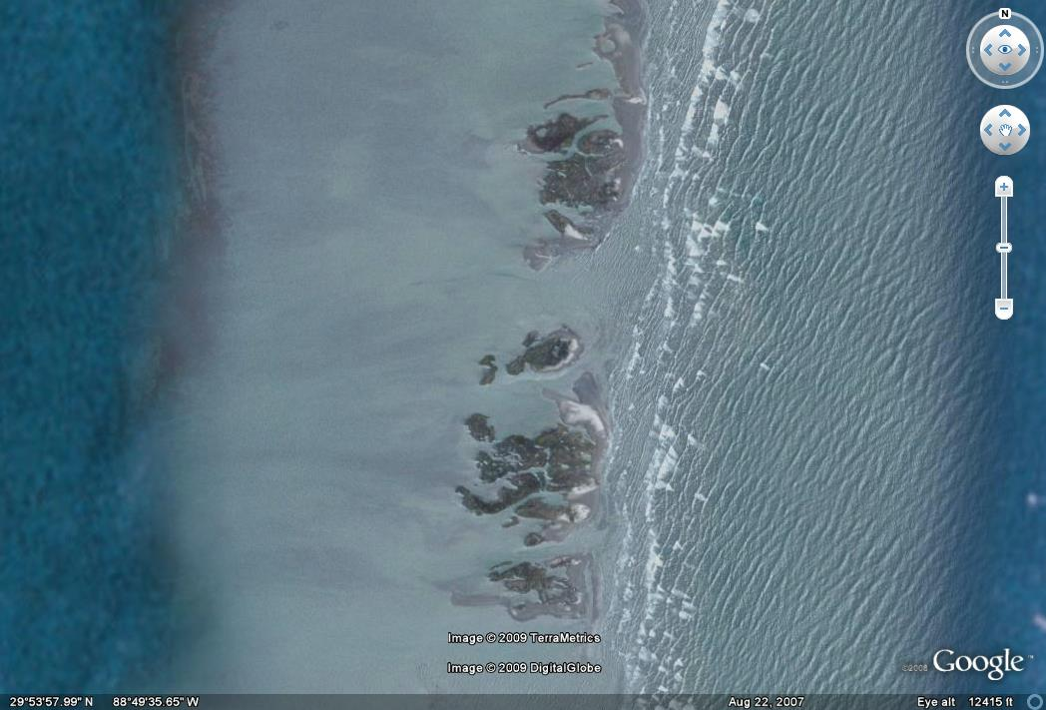
Matagorda Peninsula, TX
Chandeleur Island, LA
Galveston has already experienced enough sea level to cause the Island to migrate approximately 3,150 feet inland.

Slide 32

Barrier Islands and Coastal Marsh have been Drowned in Place
Kobashi, et al. Gulf Coast Association of Geological Societies Transactions, Volume 55, 2005

Slide 33

This is Already Lost
Brazoria National Wildlife Refuge, Elev. 4’

Slide 34


Slide 35


Slide 36

Pinus taeda invading coastal prairie Harris County, TX

Slide 37

My Office, 1950’s

Slide 38



Slide 39

Restore Natural Landscapes Where the Opportunity Exists

Slide 41



Slide 42



Slide 43


Slide 44



Slide 45



