Slide 1
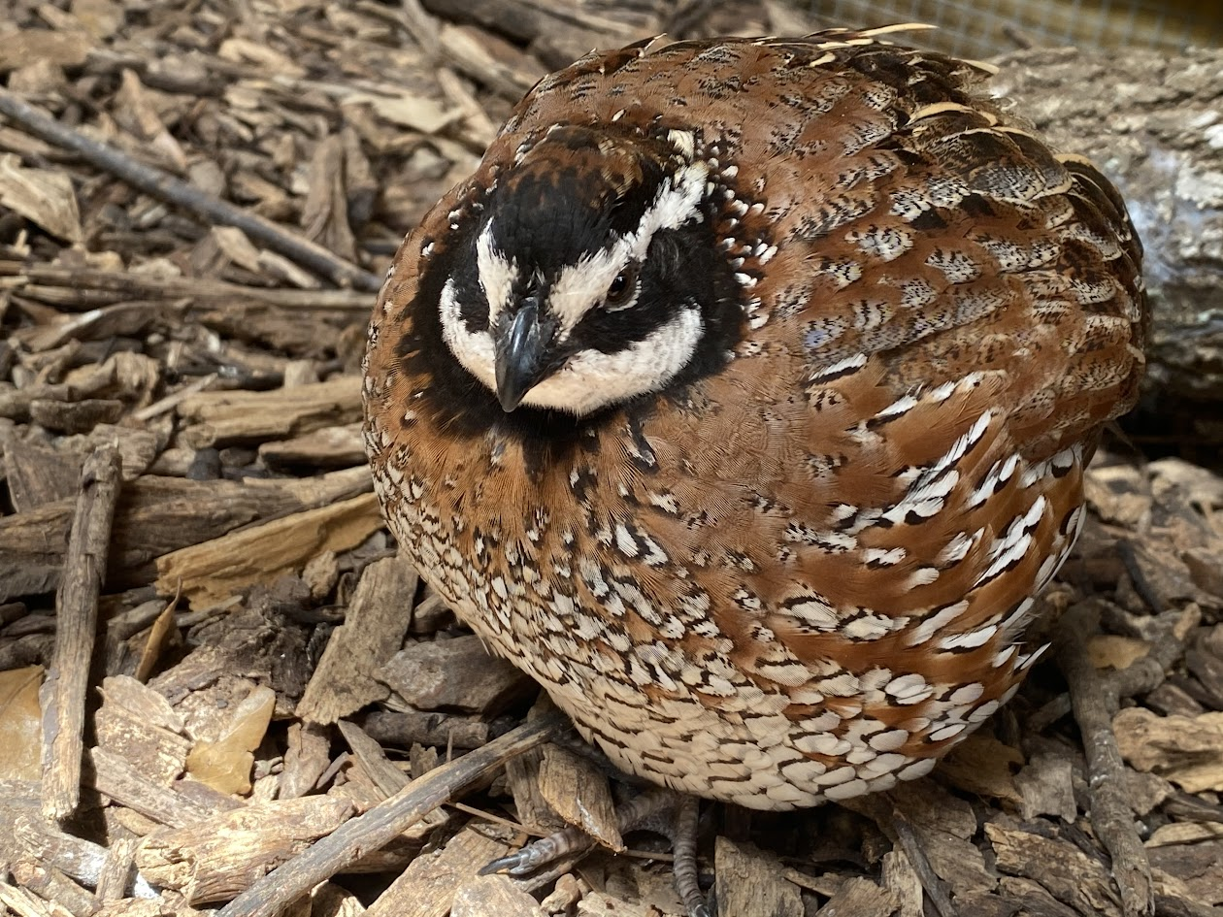
Northern Bobwhite Biology
Colinus virginianus

Slide 2
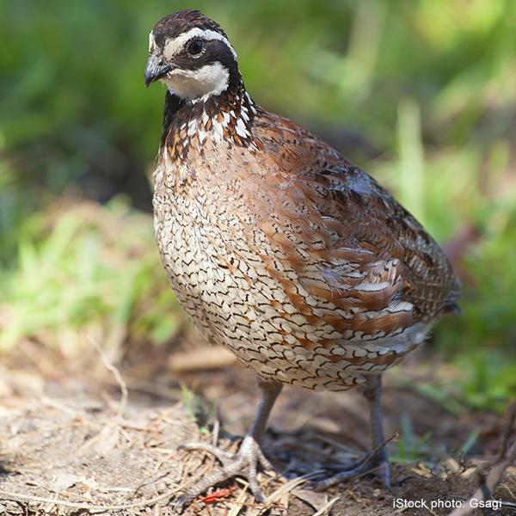
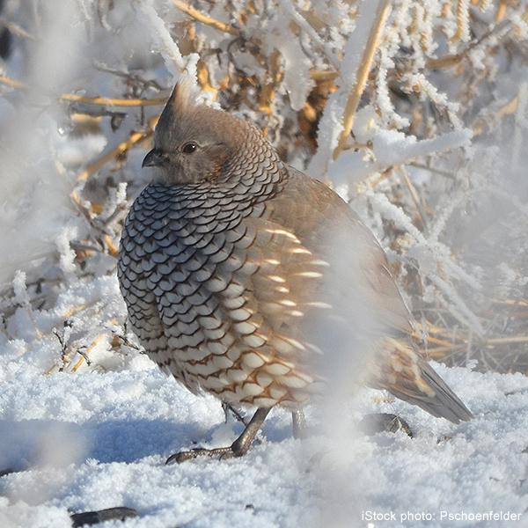
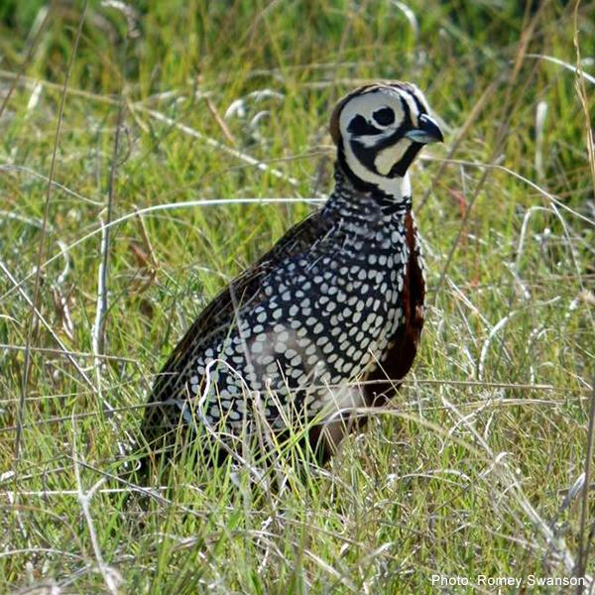
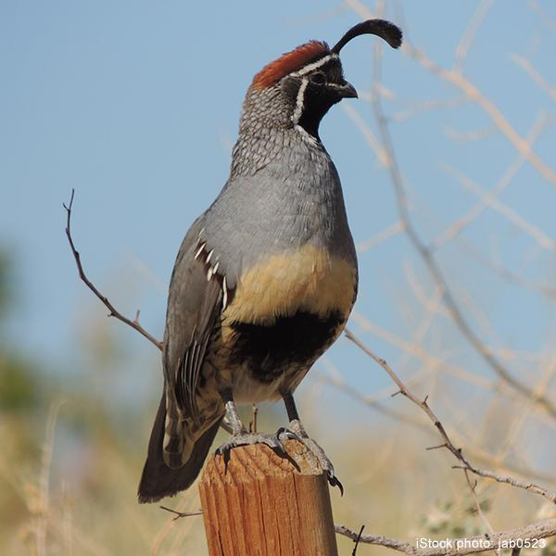
Native Texas Quail
Northern Bobwhite
Blue Scaled Quail
Montezuma Quail
Gambel Quail

Slide 3
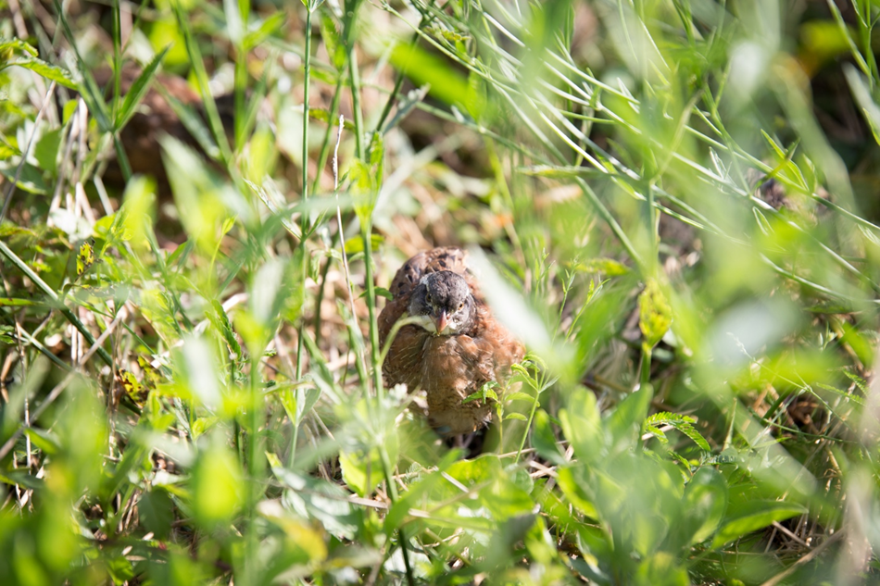
To know the bird is to know the bird
Named for their call “Bob White”
Indicator species - Canarie of the Prairie
Home Range - 40 acres (vary 10-80 acres - habitat dependant)
  ¾ time spent within 22 acres (food and cover)
  Up to 25% woody (edges)
  “Softball” Habitat
Carrying Capacity - 3 birds per acre
Life Expectancy - less than 1 year
  70%-80% population loss each year
  Can survive up to 5 years
Notes:
Height: 9-11 inches
Wingspan: 13-15 inches
Weight: 160-180 grams

Slide 4
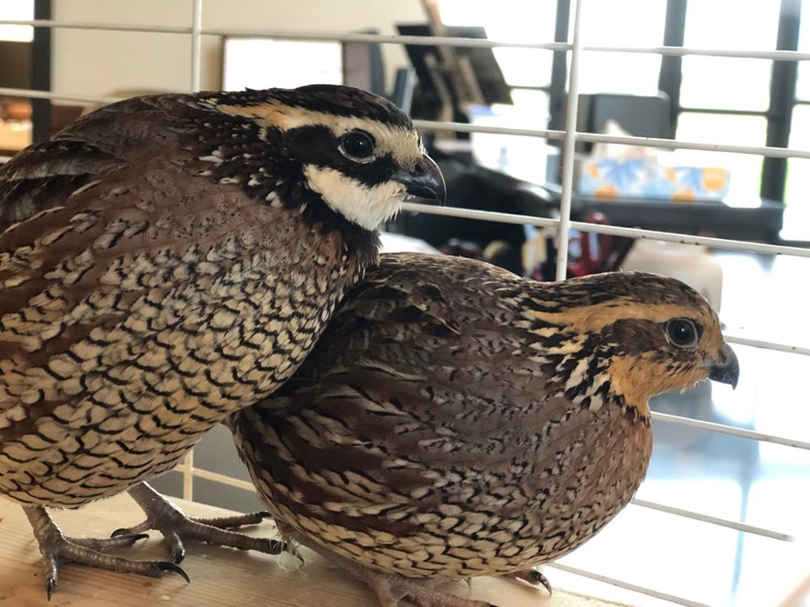
Head
Predator vs Prey
  “Eyes on the front, hunt. Eyes on the side, hide”
Male vs Female
  Sexual Dimorphism
  Male - white eye and throat patch
  Female - brown eye and throat patch

Slide 5
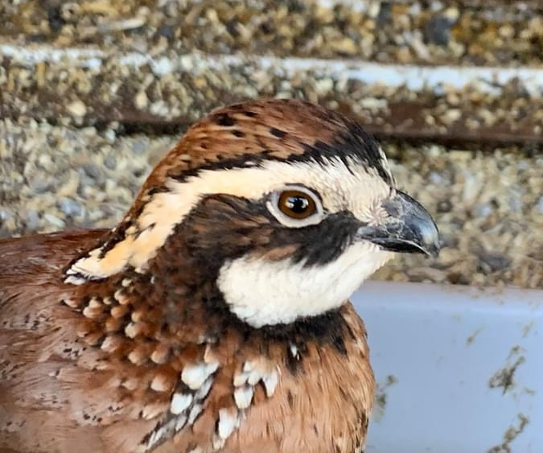
Beak
Small and Curved
How many teeth can you count?
Seeds, insects, and fruit
  Vegetation when preferred food source fun low

Slide 6
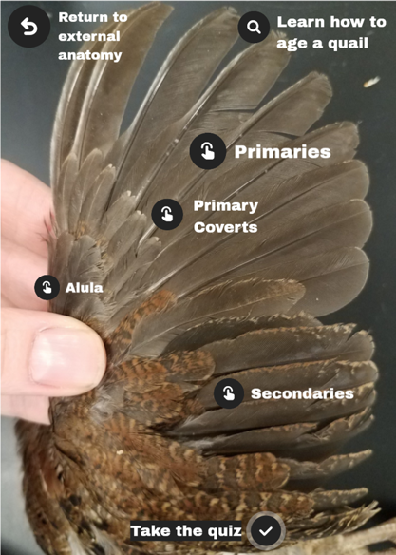
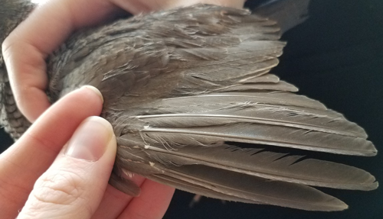
Wings
Short and round
  Flush - 40 yards
Flight feathers

Slide 7
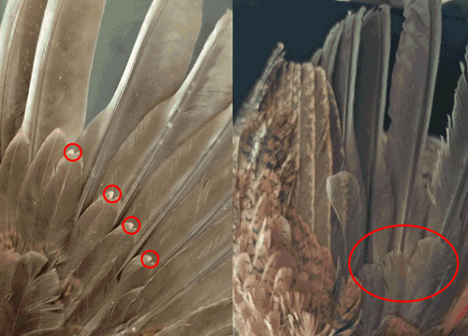
Aging N. Bobwhites
Juvenile vs Adult
Adulthood at 15 weeks
Juvenile
Adult

Slide 8
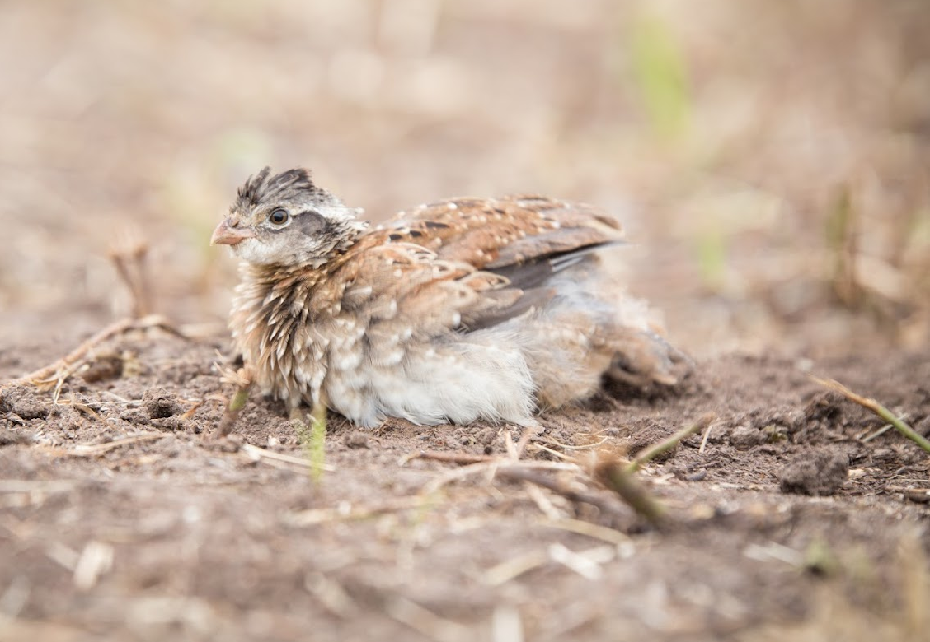
Feathers
Camouflage
  Cryptic
Flight
  Streamline and provide lift
Thermoregulation
  Fluffed or flattened

Slide 9
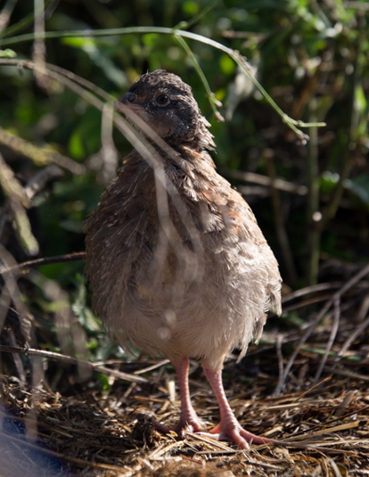
Feet
Chicken like feet
  Three toes/claws forward for scratching ground
Rasorial - running/scratching ground birds

Slide 10
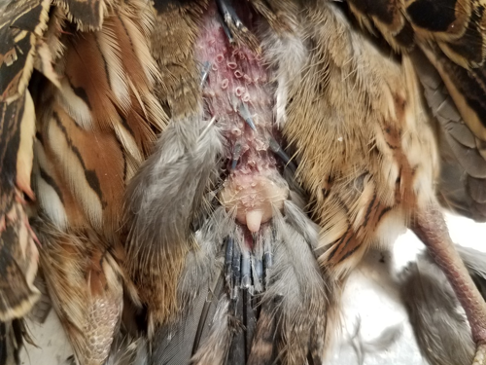
Uropygial Gland
Oil gland for waterproofing feathers

Slide 11
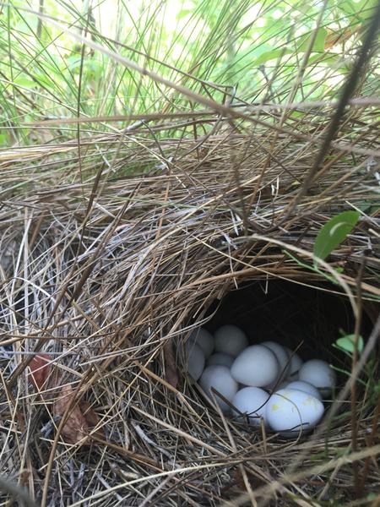
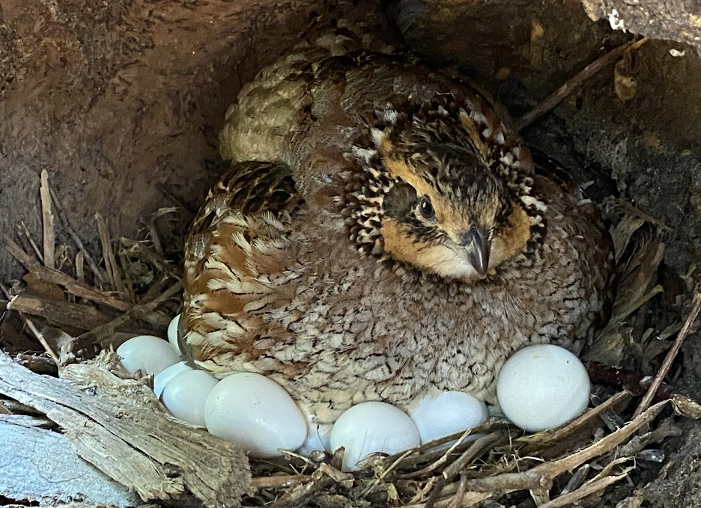
Reproduction
Nest site
  Adequate ground cover - dense native grasses and forbs with scattered shrubs and brush present
Breeding season - June to August (weather dependent: May - September)
  Clutch size - 10 - 16 eggs
  Incubation - 23 days @ 99.5F
  M and F will incubate
  F broods for 4 weeks
    Chicks fly at 2 weeks
Variety of mating strategies
  social monogamy, simultaneous polyandry, sequential polyandry, and sequential polygamy

Slide 12
Quail Decline
Free Bird by Lynyrd Skynyrd - “And this bird you cannot change”
80% N. Bobwhite decline in the last 30 years
Over 90% of grasslands in central and eastern North America have been lost over time

Slide 13
Quail Decline
No clear cut answer why, BUT…
Habitat loss - Farming, Ranching, Fragmentation, etc.
Chemical use - Pesticide and Herbicide
Weather - drought and flood
Small mammals - more food = less predation on one species
Predators - everything wants to eat quail
Hunting - conservation vs. overhunting

Slide 14
To know the bird is to know the bird
Canarie of the Prairie
Habitat is important
Landowners are key

