Slide 1
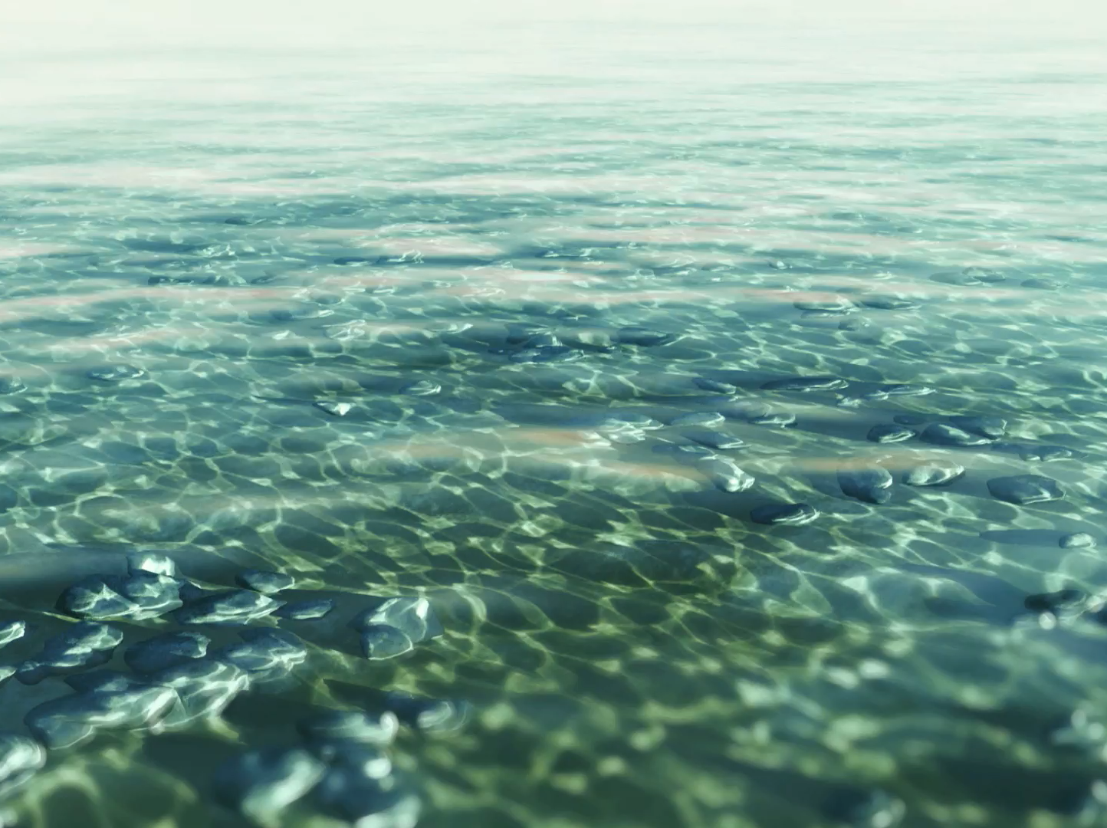
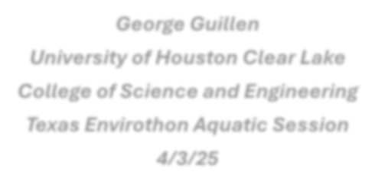
Climate Change and Aquatic
Ecosystems
George Guillen
University of Houston-Clear Lake
College of Science and Engineering
Texas Envirothon Teacher Training Session
2/15/25

Slide 2
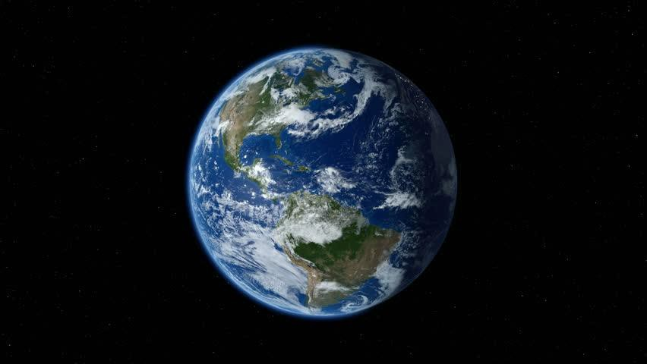
Our Blue Planet

Slide 3
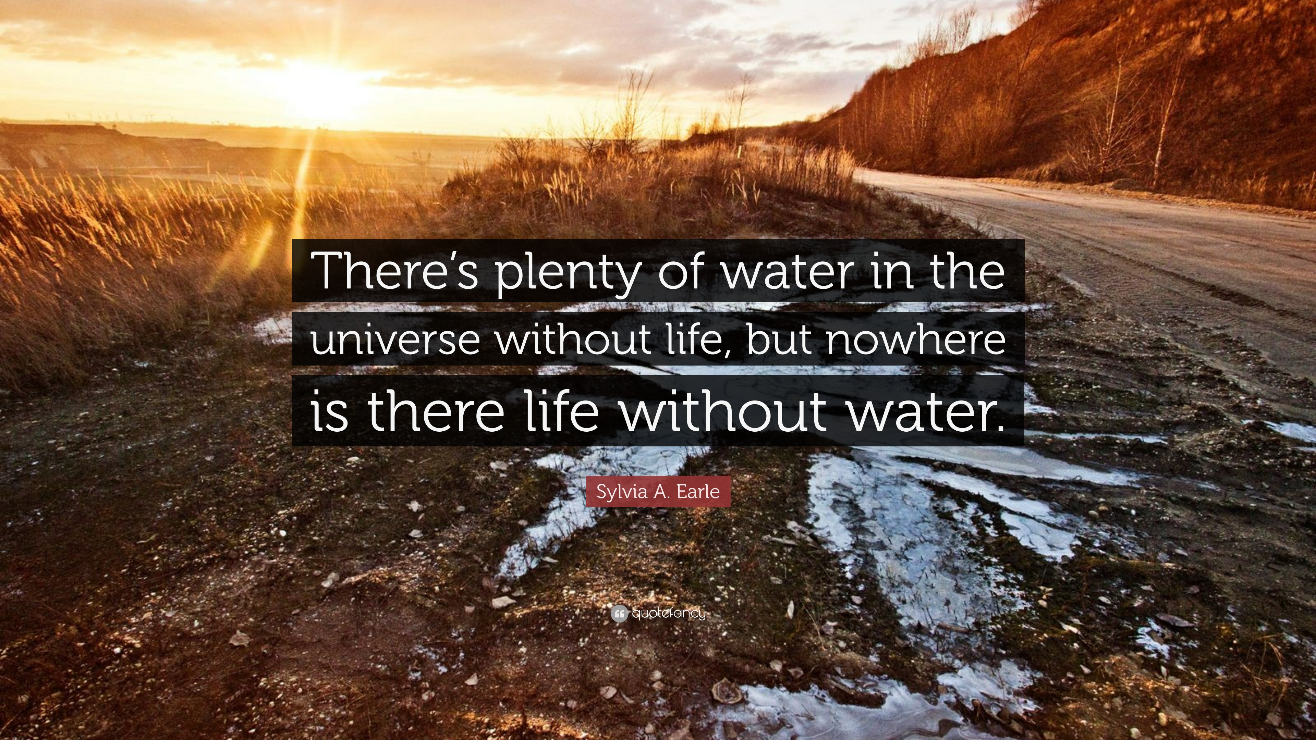

Slide 4
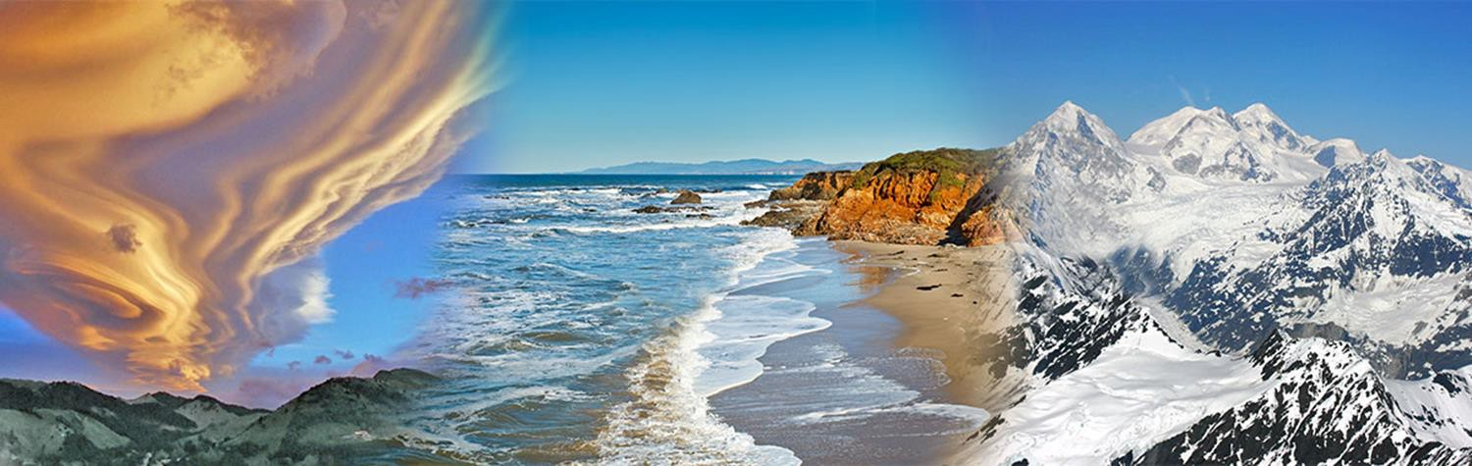
Water – 3 primary forms
Solid – frozen ice
Liquid – flowing or not; underground and above surface, precipitation
Gas – water vapor; evaporation
Gas – transpiration

Slide 5
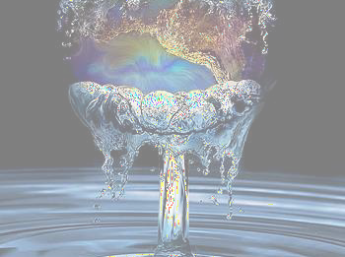
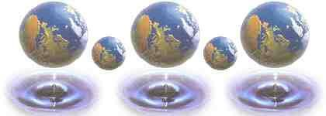
Physical Properties of Water
Life = Water. Why?
Life as we know it could not have evolved without water
Physical properties primarily responsible for this relationship

Slide 6
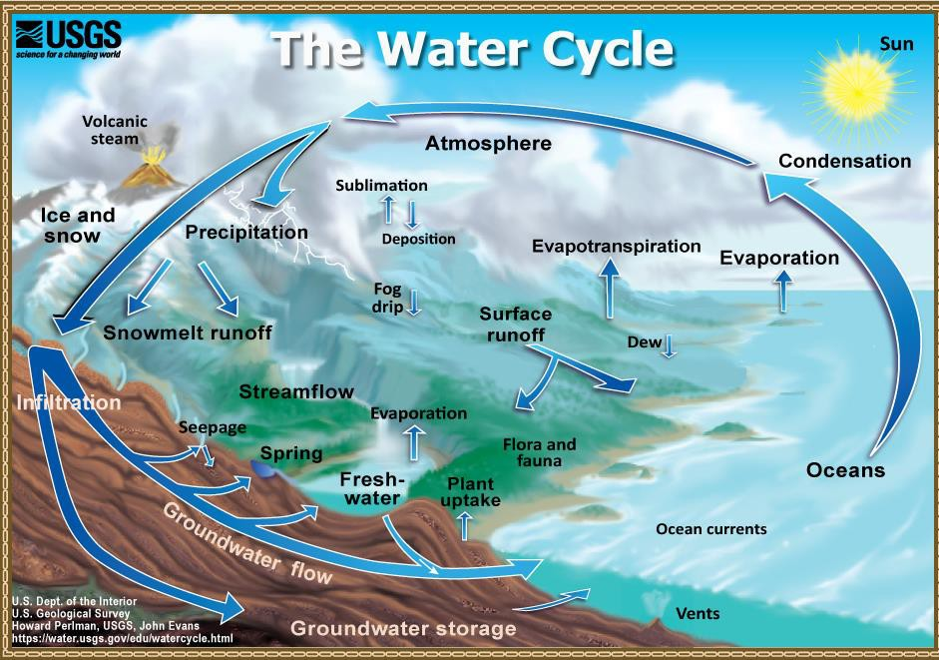

Slide 7

Flow – “the master variable”
Controlling factor in riverine physical, biological and geochemical processes
e.g.: water temperature, dissolved oxygen, available habitat, spawning cues, channel shape, substrate type

Slide 8
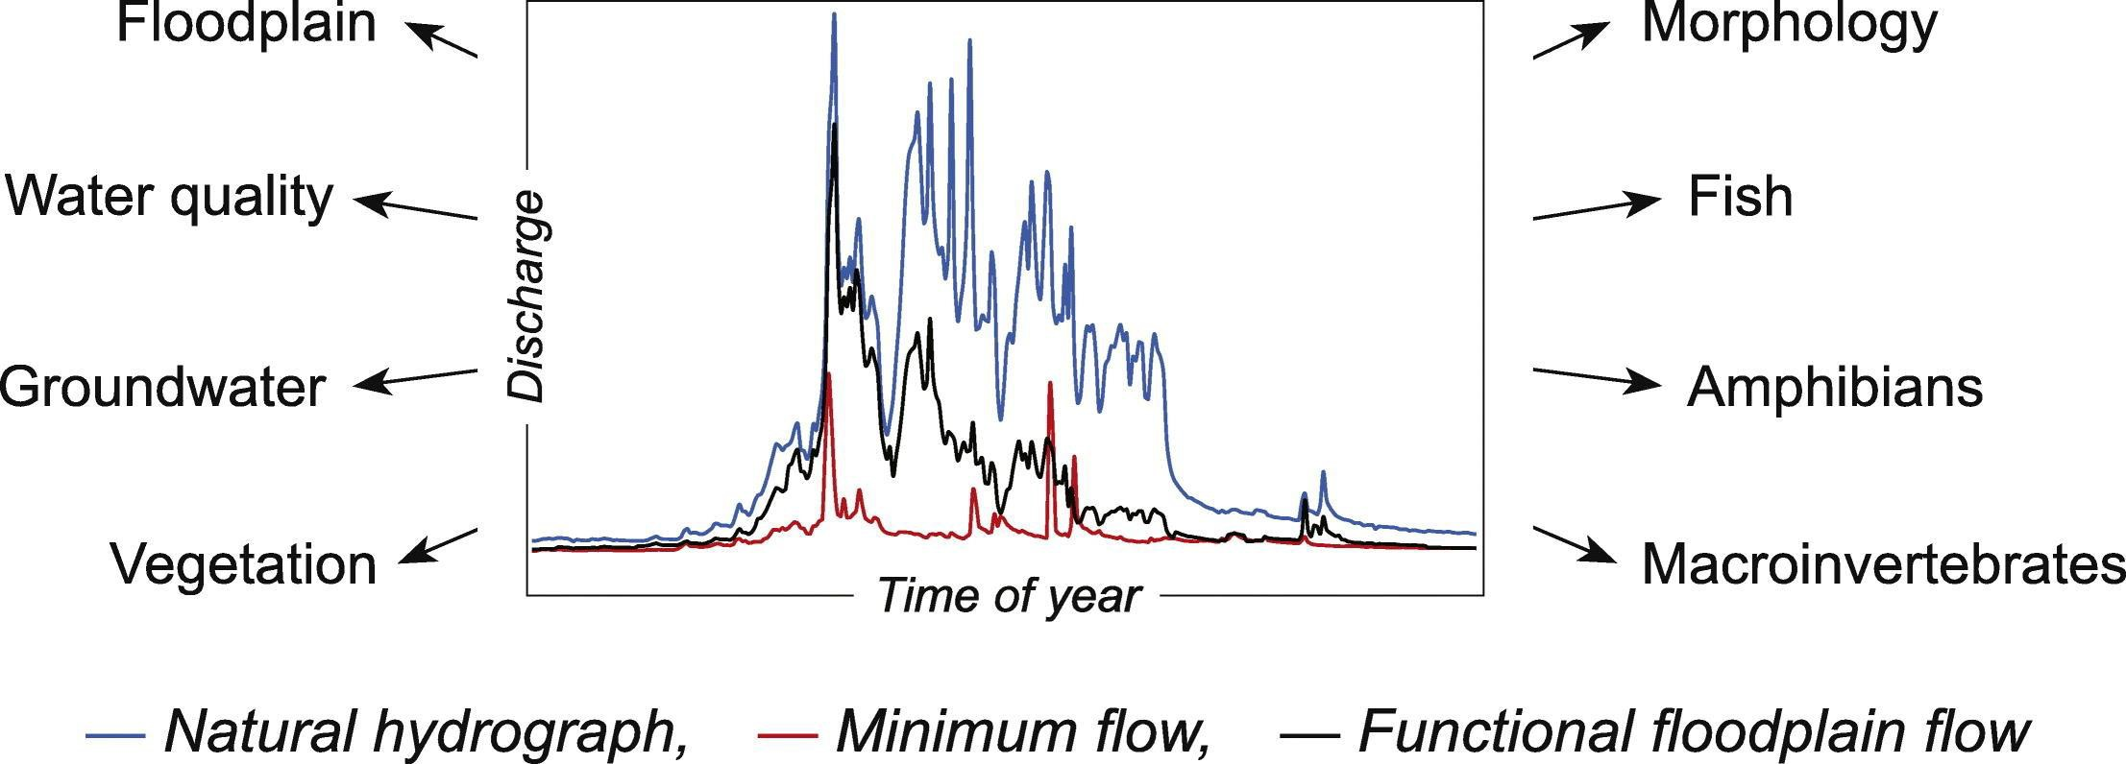
Flow = master variable in flowing
freshwater

Slide 9
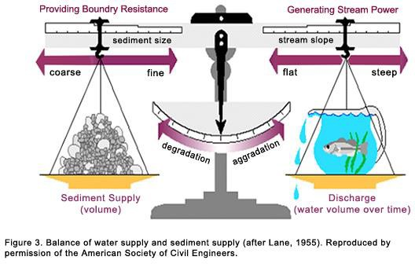
Flow Affects multiple variables and organisms

Slide 10
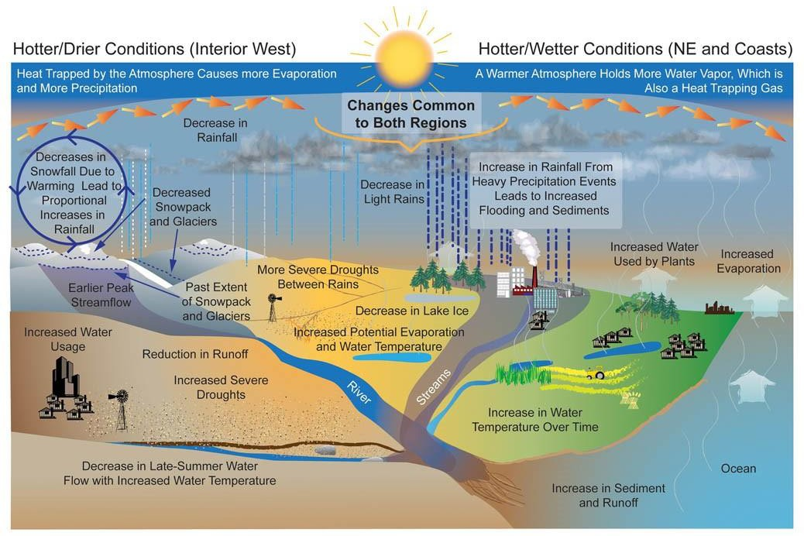

Slide 11
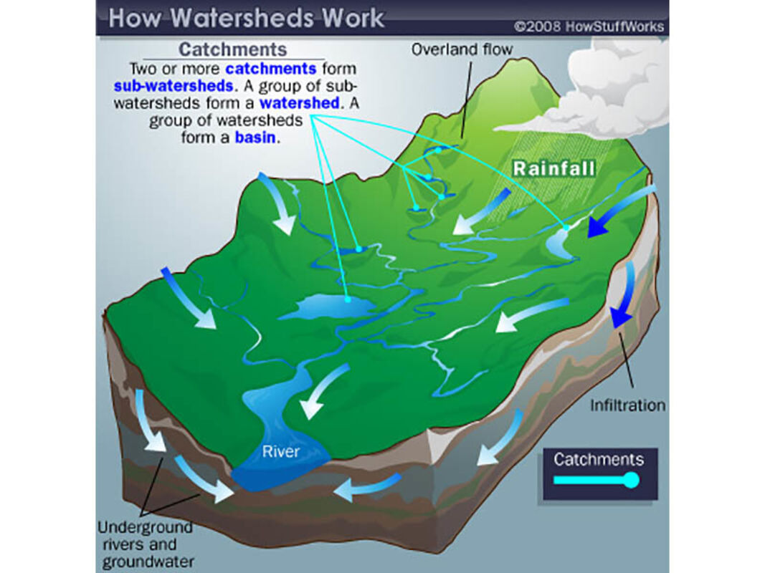

Slide 12
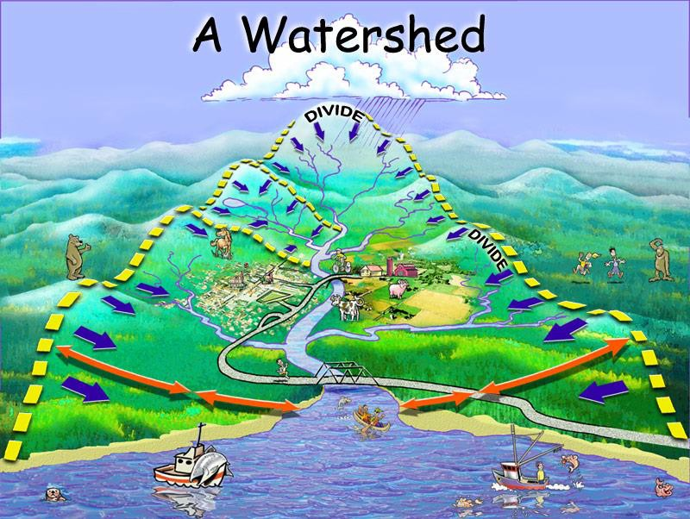

Slide 13
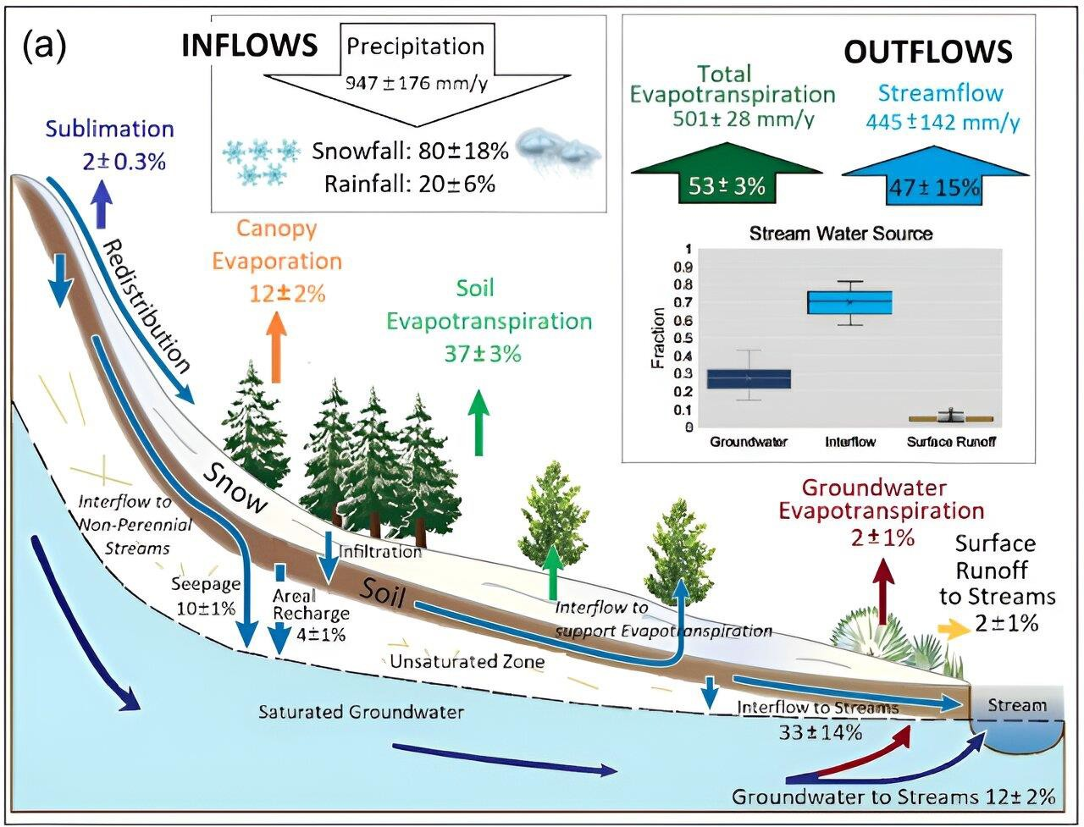

Slide 14
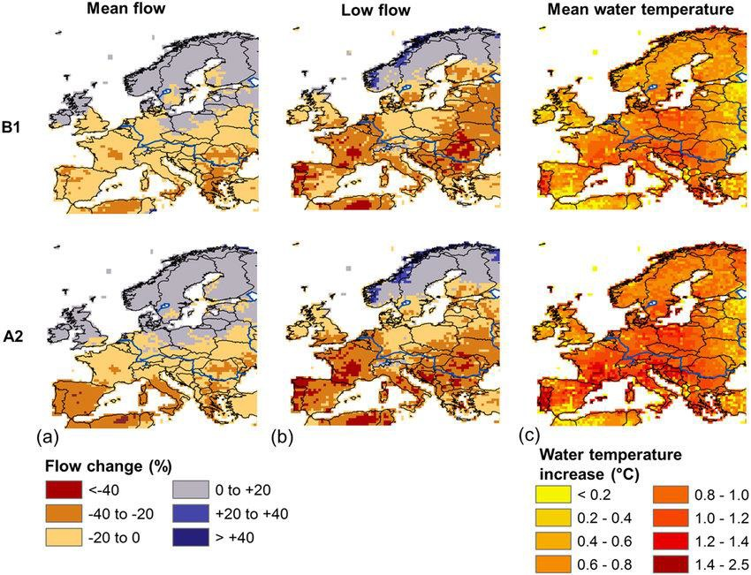

Slide 15
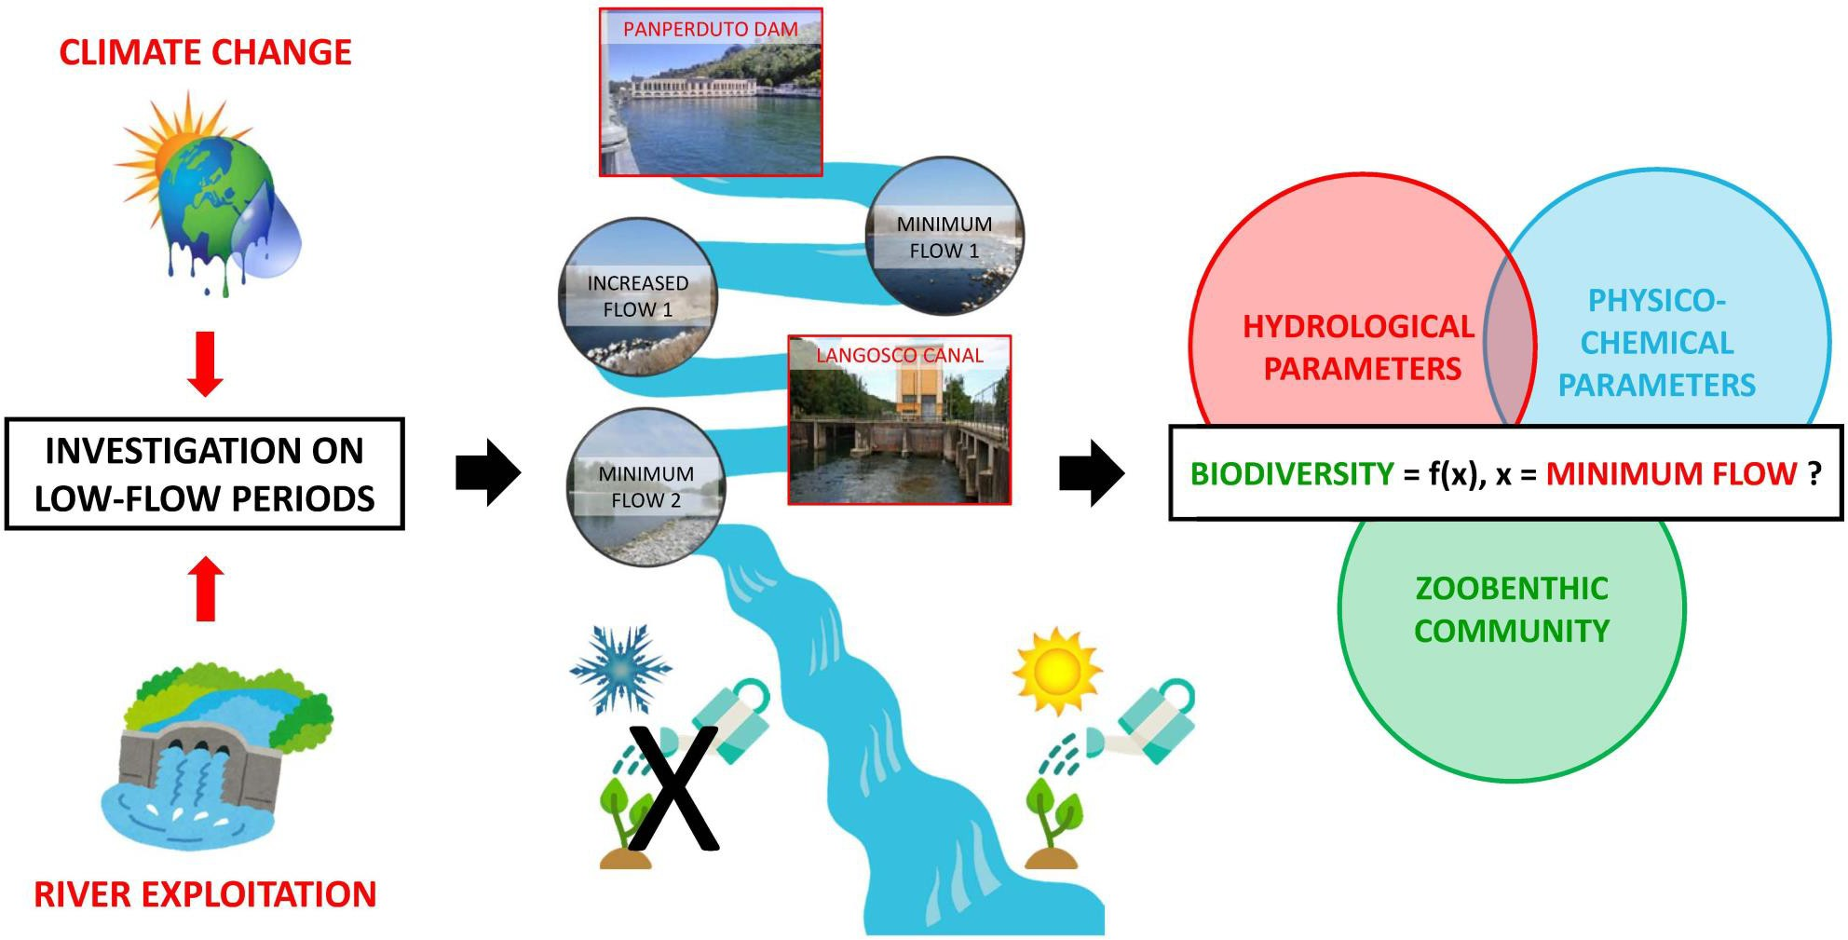

Slide 16
Stressors in Freshwater Streams
Spills
Improperly treated wastewater, septic tanks
Urbanization
Invasive organisms
Non-point runoff from land
Increased volumes and velocity of water due to more impervious surfaces.
Large numbers and sources of pathogenic bacteria

Slide 17
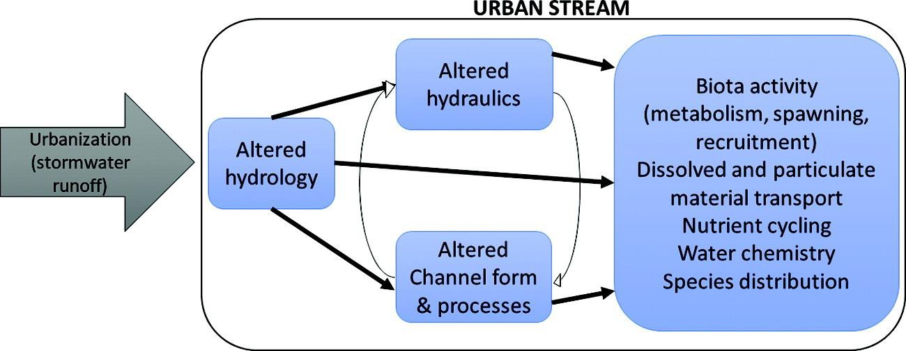

Slide 18
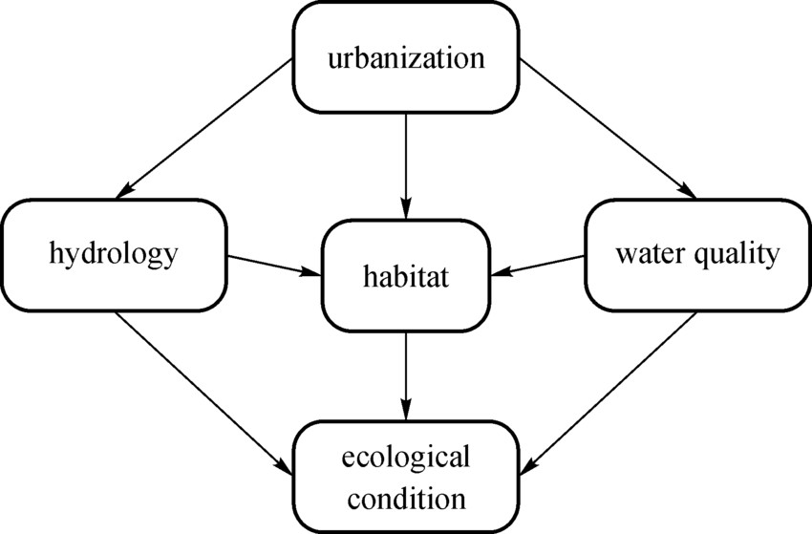

Slide 19
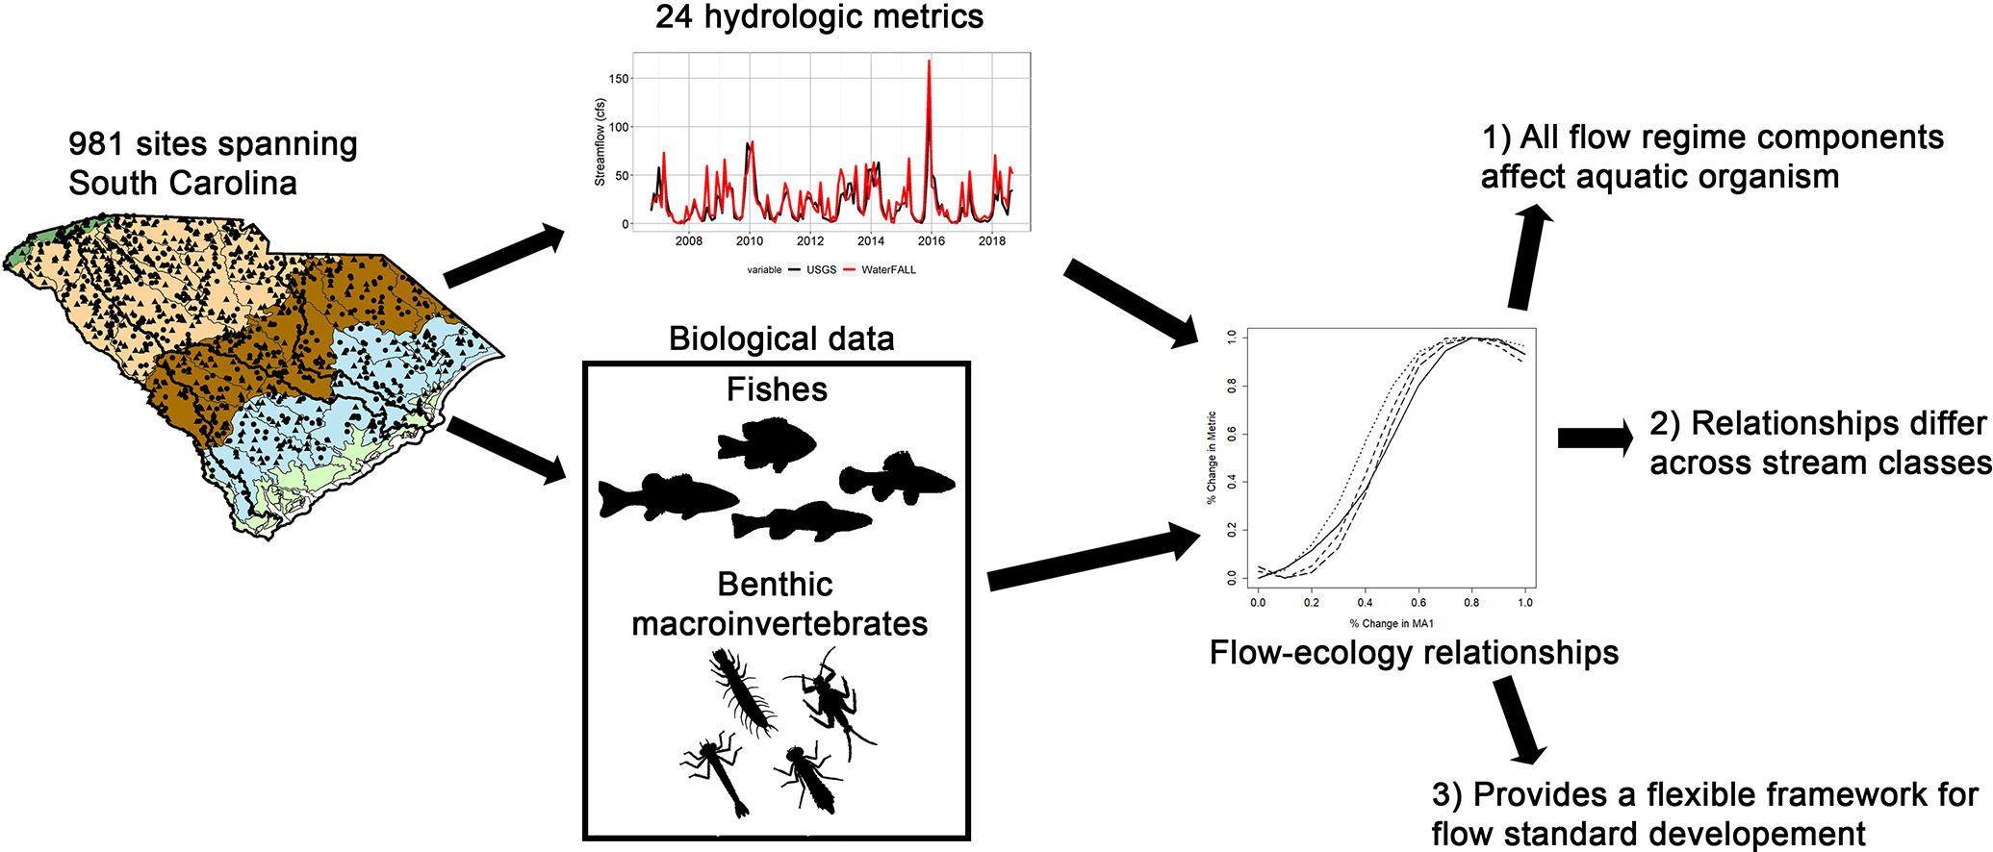

Slide 20
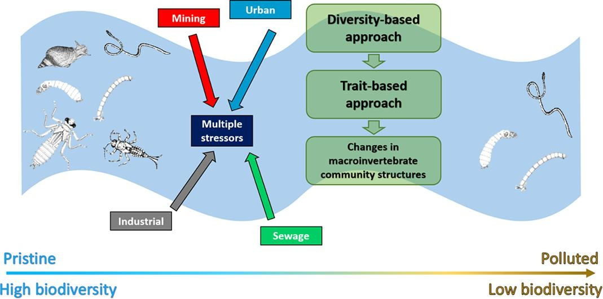

Slide 21
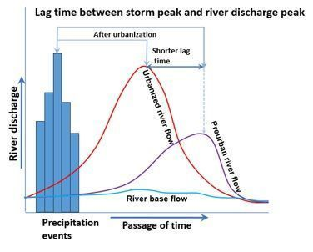

Slide 22
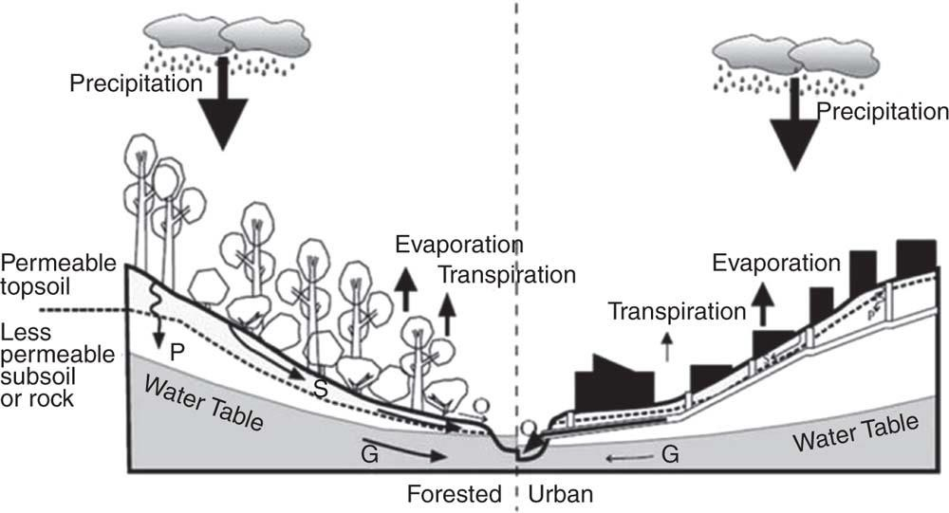

Slide 23
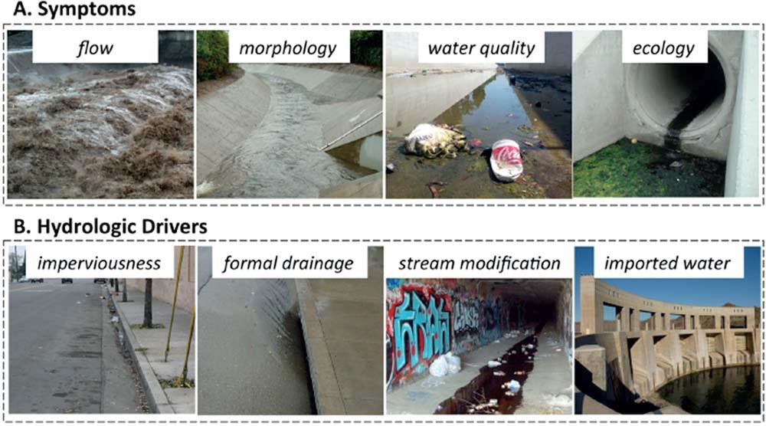

Slide 24
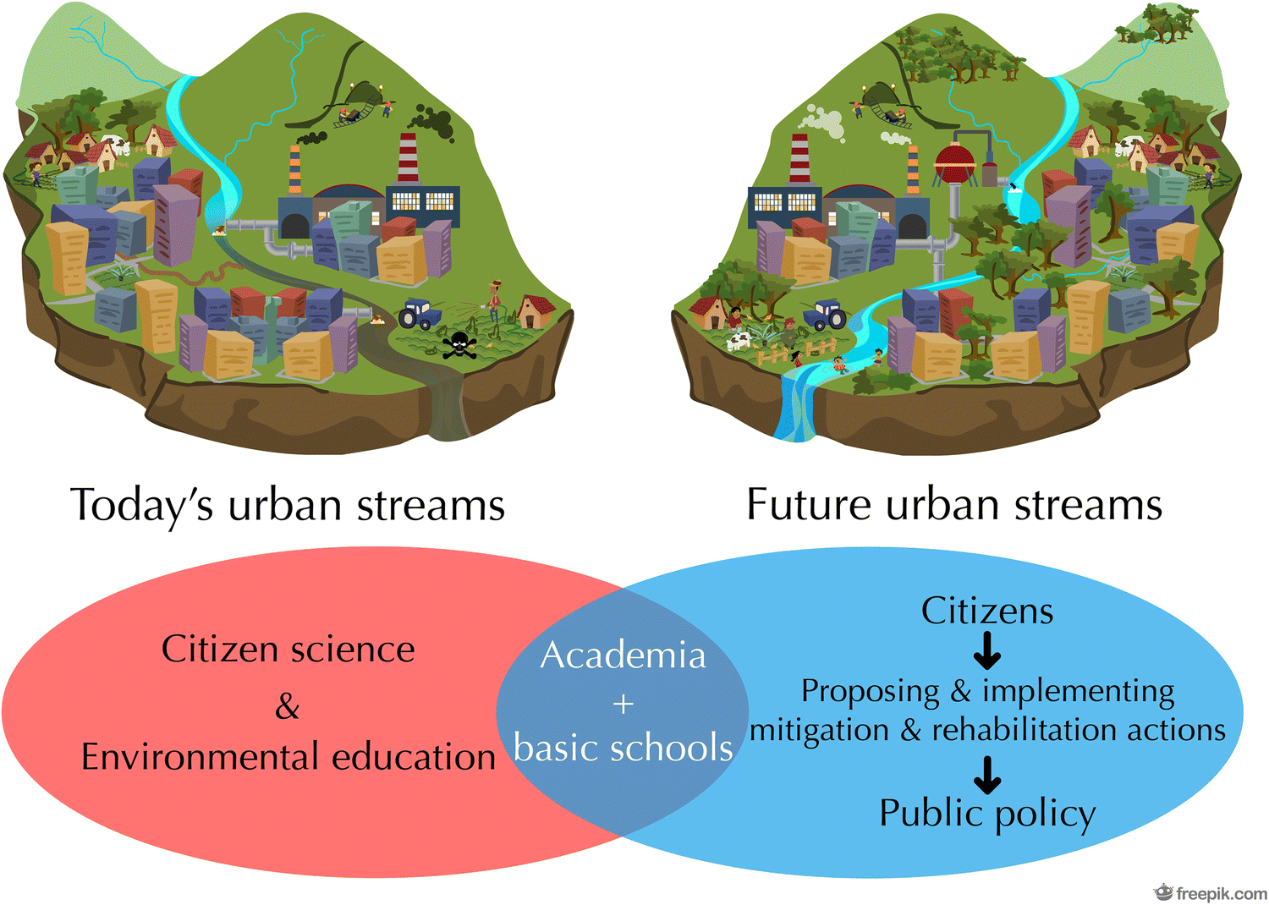

Slide 25
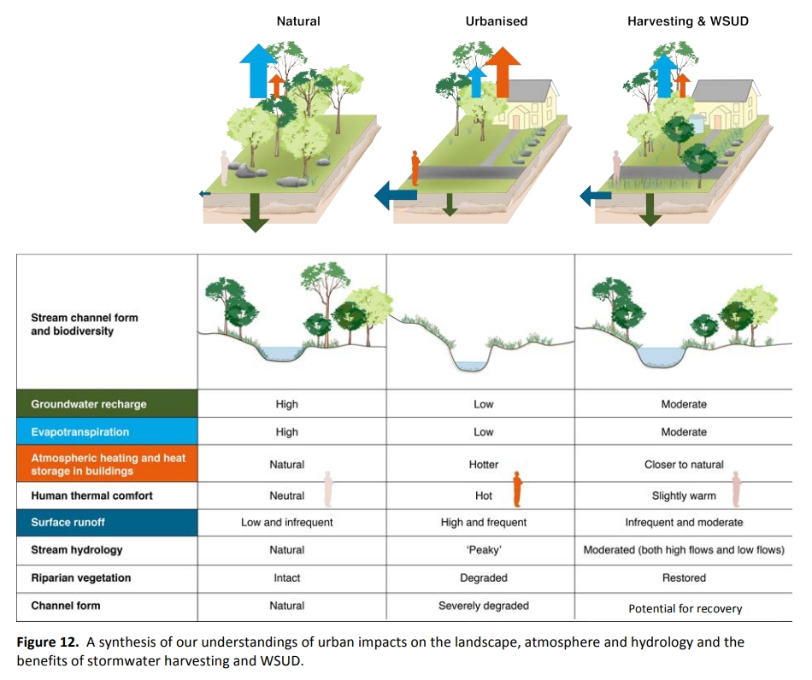

Slide 26
Stressors in Freshwater Streams
Spills
Improperly treated wastewater, septic tanks
Urbanization
Invasive organisms
Non-point runoff from land
Increased volumes and velocity of water due to more impervious surfaces.
Large numbers and sources of pathogenic bacteria

Slide 27
Coastal Systems

Slide 28
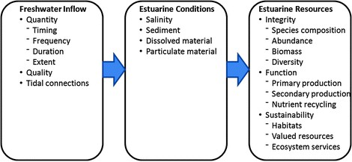

Slide 29
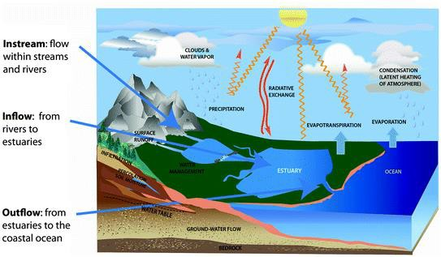

Slide 30
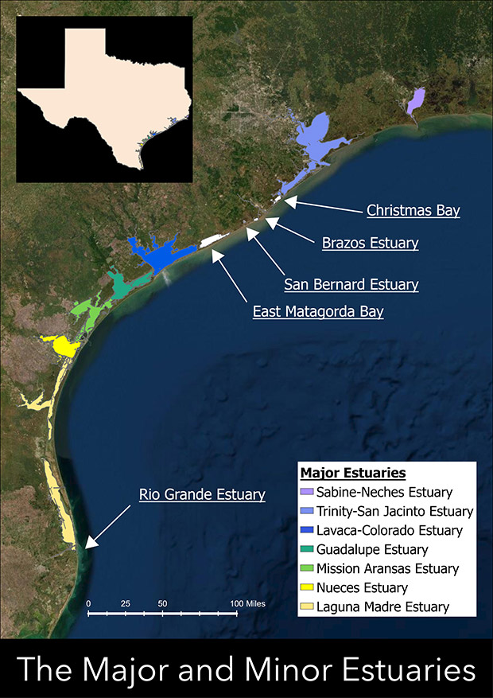

Slide 31
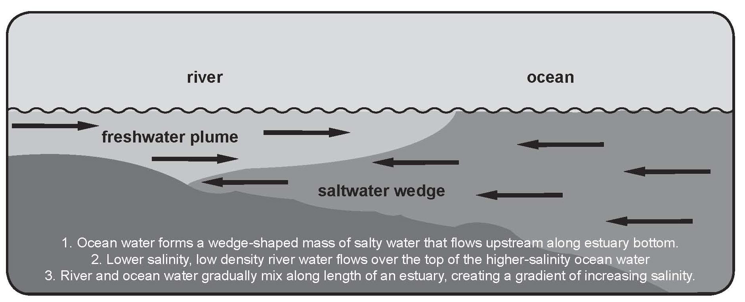

Slide 32
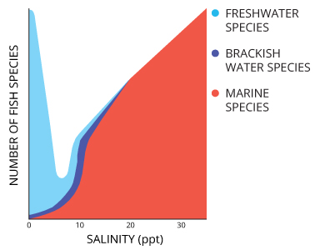

Slide 33
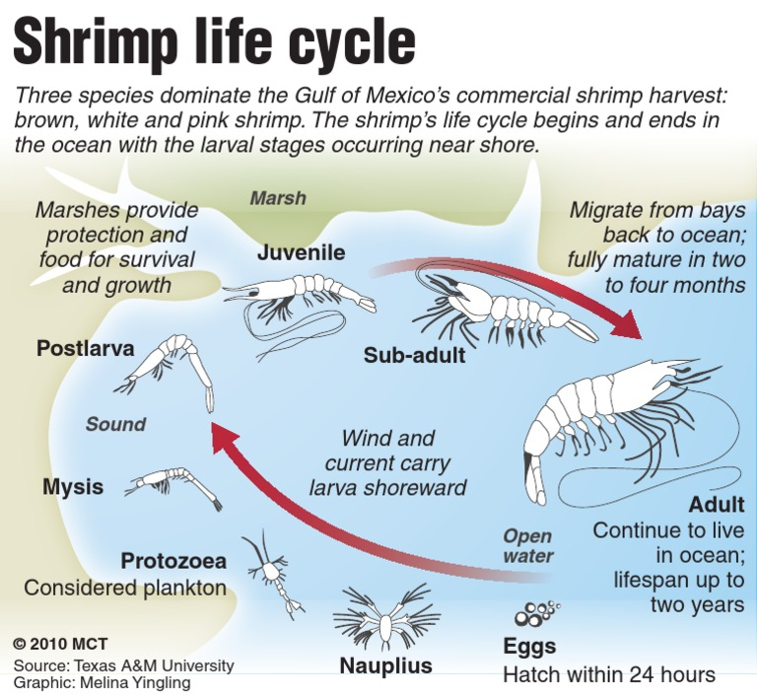

Slide 34
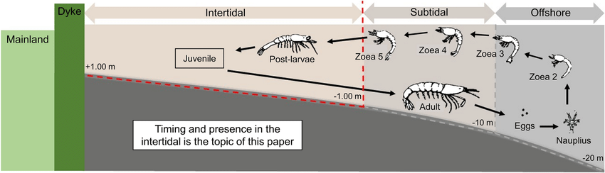

Slide 35
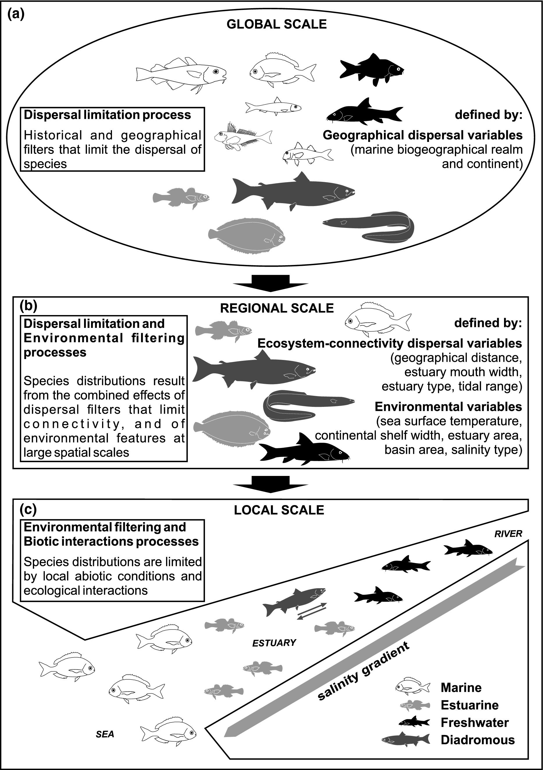

Slide 36
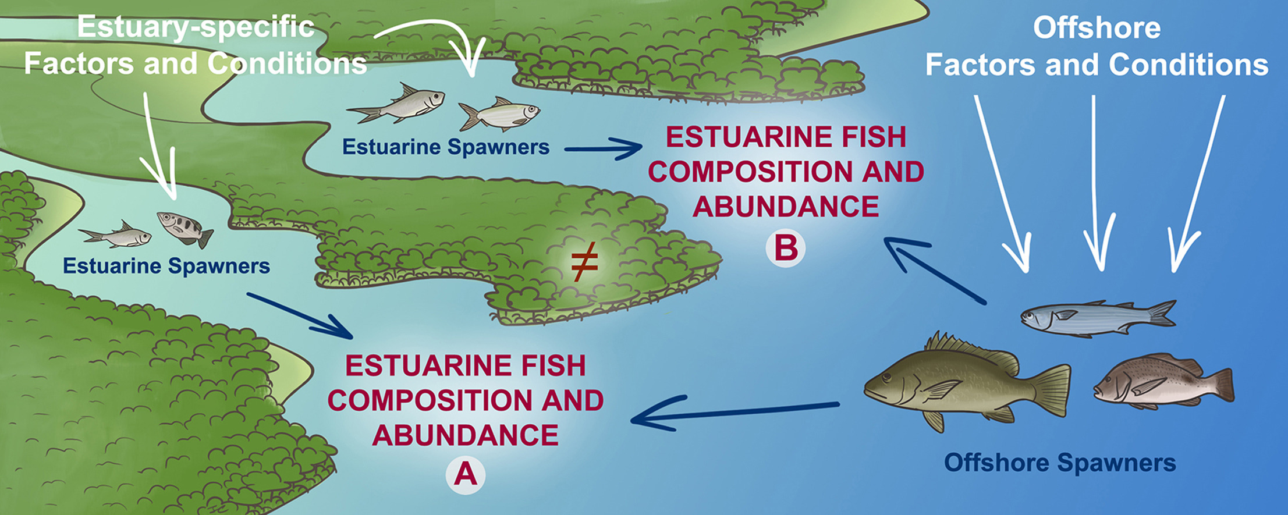

Slide 37
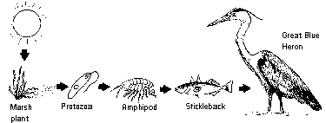

Slide 38


Effects of Climate Change

Slide 39
Climate Change Impacts
Not just heating, actually more variable
More storms – coastal
Flooding storm surge and rainfall
More storms – inland - rainfall
More erosion and loss of habitat
More pollutant loading

Slide 40
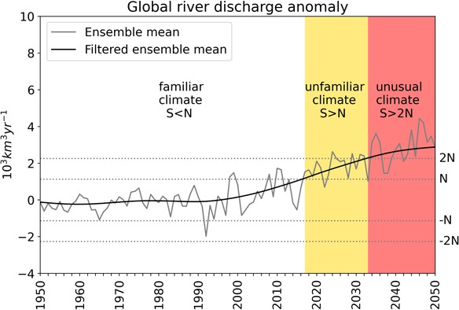

Slide 41
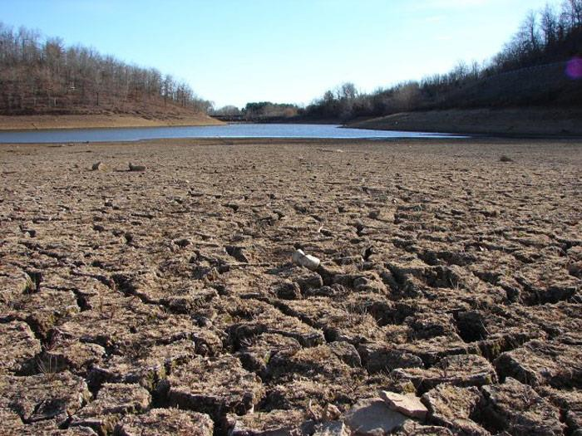

Slide 42
