Slide 1
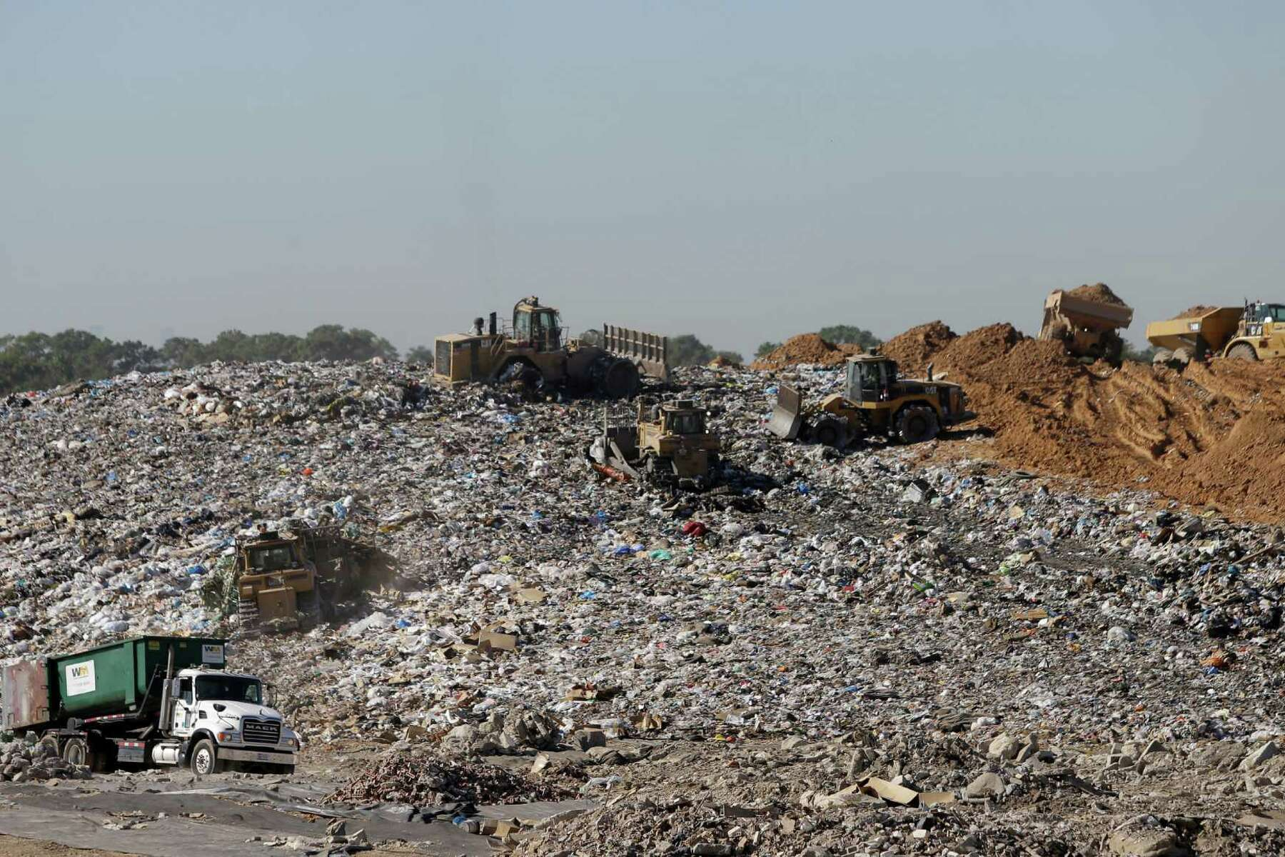
Landfills and Hazardous Materials
Texas Envirothon 2022
Rowena McDermid

Slide 2
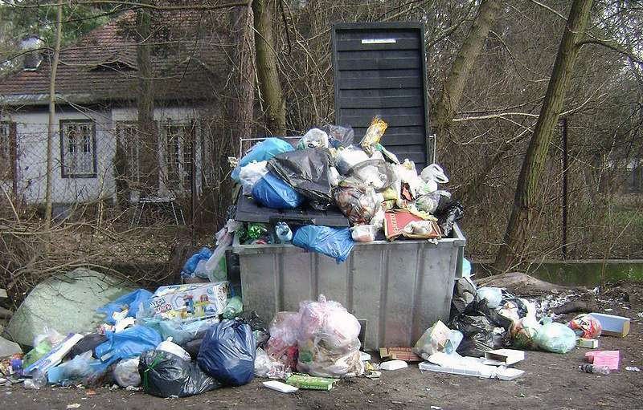
How Much?
4.9lbs/person/day
21.6% wasted food
5.83% wasted textiles
12.2% wasted plastics
4% of world population but 12% of municipal solid waste
Photo credit: Albertyanks Albert Jankowski

Slide 3
Does recycling help?
Globally 2.1bn metric tons – only 16% is recycled
Not always energy efficient.
Plastics recycling rate under 10%
For most of the country most plastics are not recyclable – mostly plastic bottles.
“Wish cycling” – not prioritizing reducing waste,
Photo credit: Shutterstock

Slide 4
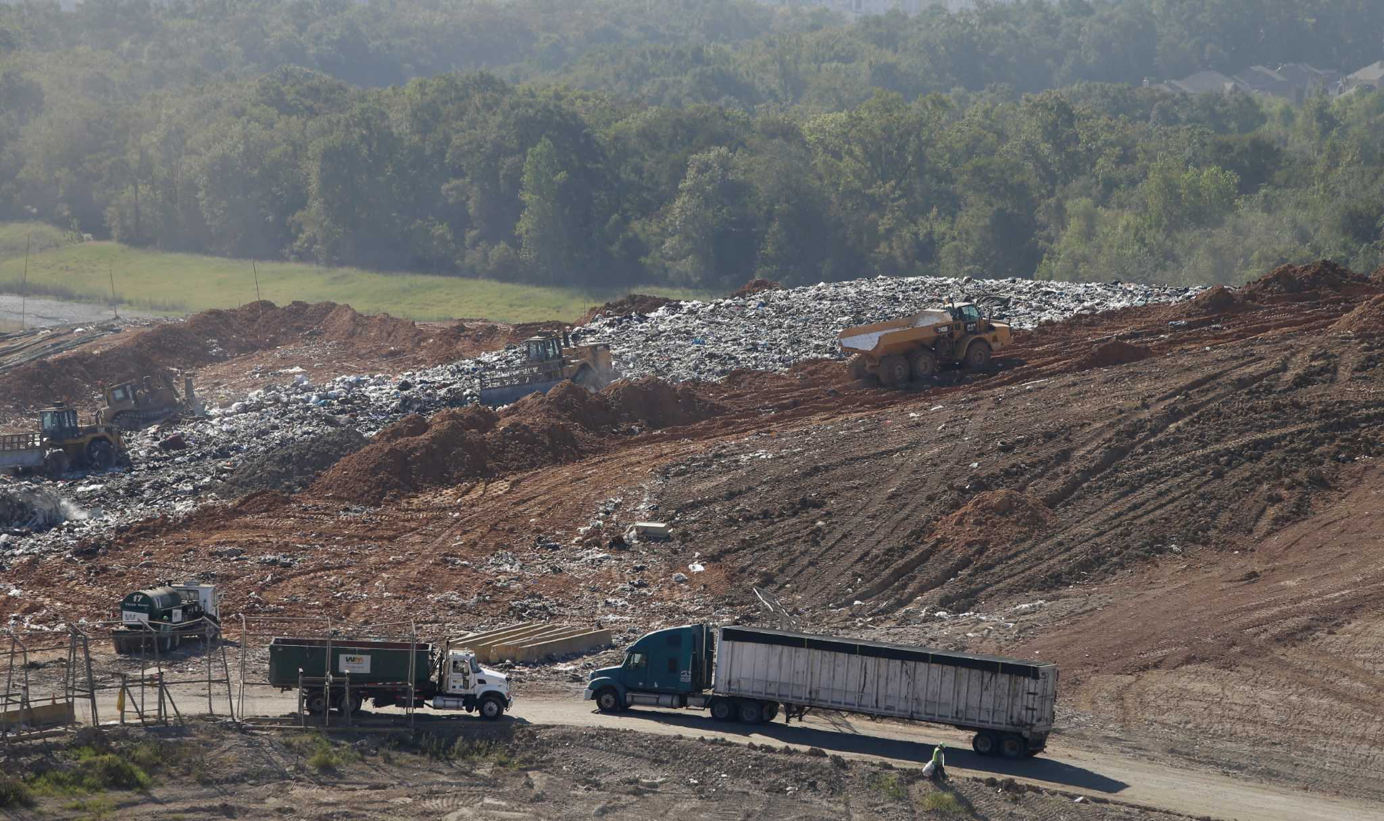
Regulation of Landfills
Federal, State and Tribal regulations.
Federal regulations:
Resource Conservation and Recovery Act (RCRA)
Subtitle D (solid waste)
Subtitle C (hazardous waste)
Toxic Substances Control Act (TCSA)
Stringent design and operation requirements
Photo credit: Houston Chronicle

Slide 5
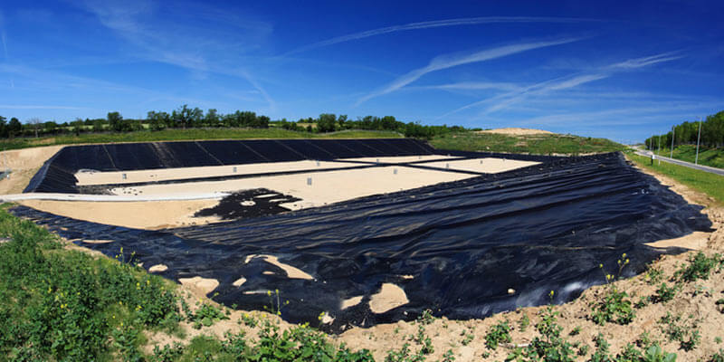
Types of Landfills
Subtitle D includes:
Municipal Solid Waste Landfills (MSWLFs)
→Bioreactor landfills
Industrial Waste Landfills
→Construction and Demolition (C&D) Debris Landfill
Subtitle C:
→Hazardous Waste Landfills
TSCA:
→Polychlorinated Biphenols (PCB) landfills
Photo credit: Dumpster.com

Slide 6
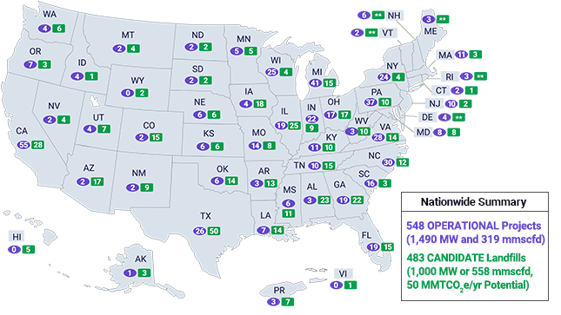
Number of Landfills
Many privately owned
Strict licensing laws
Big Business
Image Credit: US Environmental Protection Agency, September 2021

Slide 7
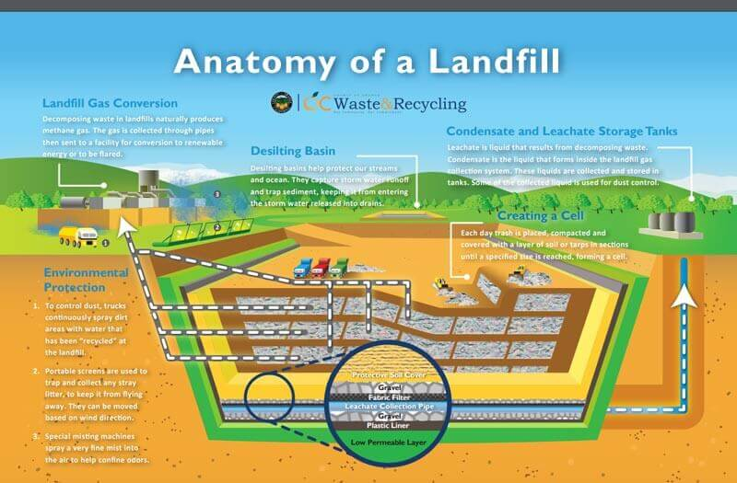
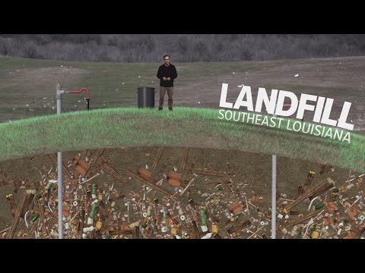
How Landfills work
Image credit: OC Waste and Recycling

Slide 8
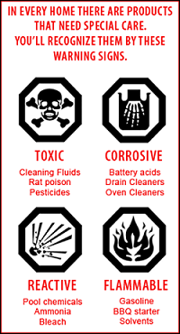
Types of Hazardous Waste
Industrial – toxic ash or sludge
Household:
Asbestos laden insulation
Paint
Old car batteries
Antifreeze
Used oil
Fluorescent lights
etc

Slide 9
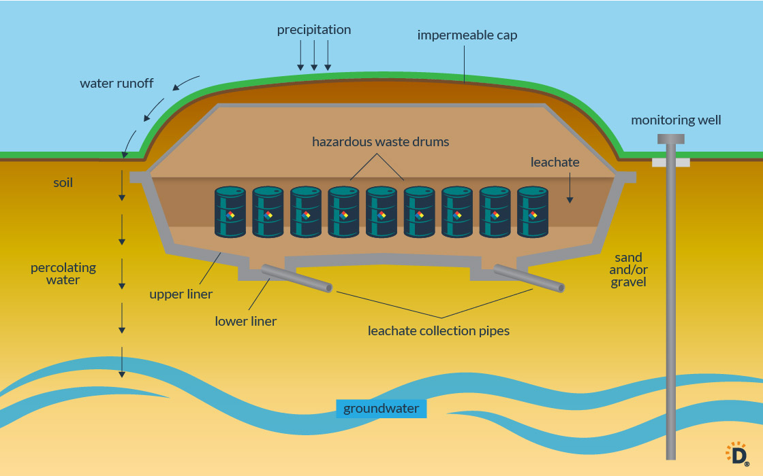
Disposal of Hazardous Waste
Improper disposal:
Drain, ground or storm drain, regular trash.
Some items should be recycled:
Oil and petroleum – re refined
Batteries: https://www.epa.gov/recycle/used-household-batteries#single
Proper disposal e.g. incineration
Pharmaceuticals
Image credit: Dumpster.com

Slide 10
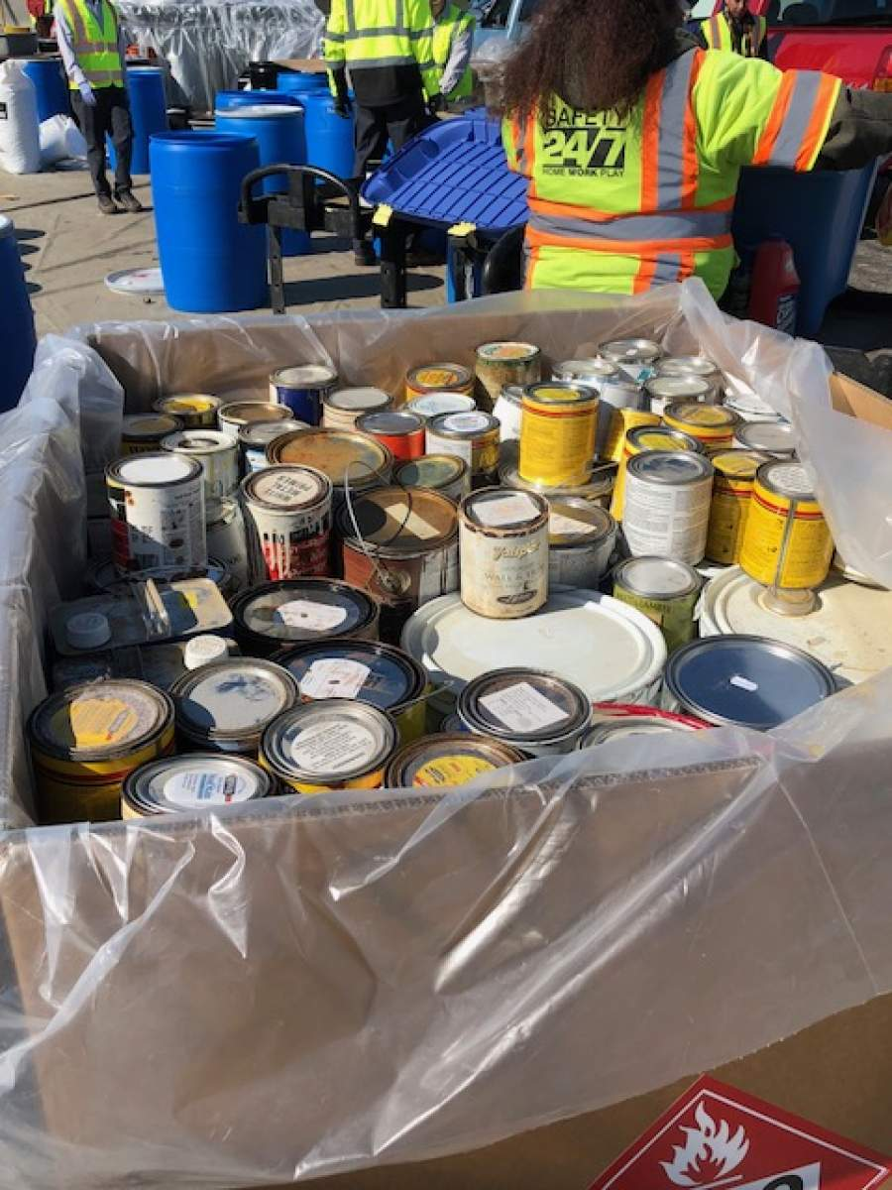
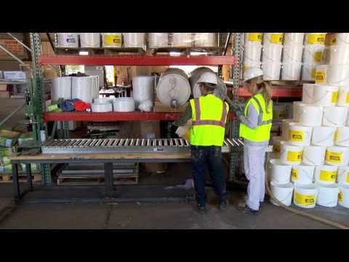
How to dispose of Hazardous Waste:
Drop off facilities
Collection events
Original container – closed & not leaking
Ensure labels are readable
Store and transport upright
Don’t mix
Photo credit: City of Rapid City

Slide 11
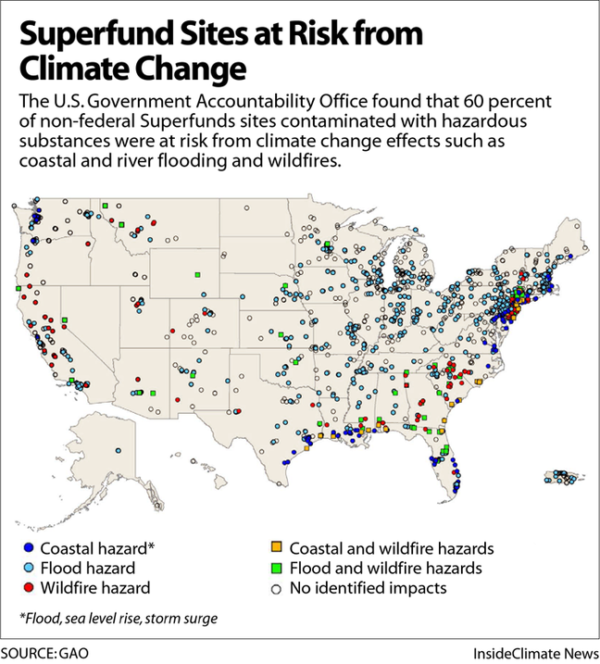
Superfund Sites
Comprehensive Environmental Response, Compensation, and Liability Act.
Polluted locations in the United States requiring a long term response to clean up hazardous material contaminations.
EPA cleans up orphan sites when responsible parties cannot be identified or located.

Slide 12
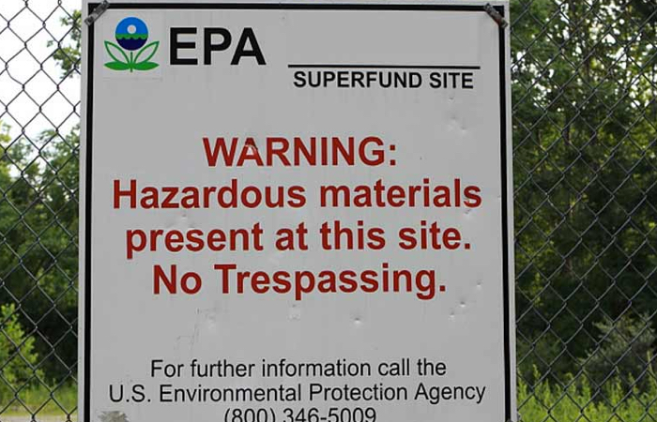
Superfund Sites
San Jacinto River Waste Pits – used for the disposal of paper mill sludge – river has eroded into the waste pits. Chlorinated dioxins used for paper bleaching very toxic to aquatic life.
Sikes Disposal Pits – illegal dumping site. Primarily chemical wastes e.g. benzene, phenols, and organic solvents most likely from petrochemical companies in the surrounding area.
Federated Metals – used as a disposal site for magnesium dross and sludge, asbestos, contaminated concrete, gasket rubber rings, breakout material from electrolytic chlorine cells…
Patrick Bayou – contaminated sediments: pesticides, polynuclear aromatic carbons (PAHs), metals and polychlorinated biphenyls. Sediment contamination in adjacent wetlands poses a threat to downstream fisheries.

Slide 13

Social Unfairness – NIMBY effect
Burden of pollution falls on non-white and low income communities.
Lack resources to be a NIMBY neighborhood.
Appeals to close sites that are actively polluting are often ignored.
The Sunday Times, Nov 11 2021

Slide 14
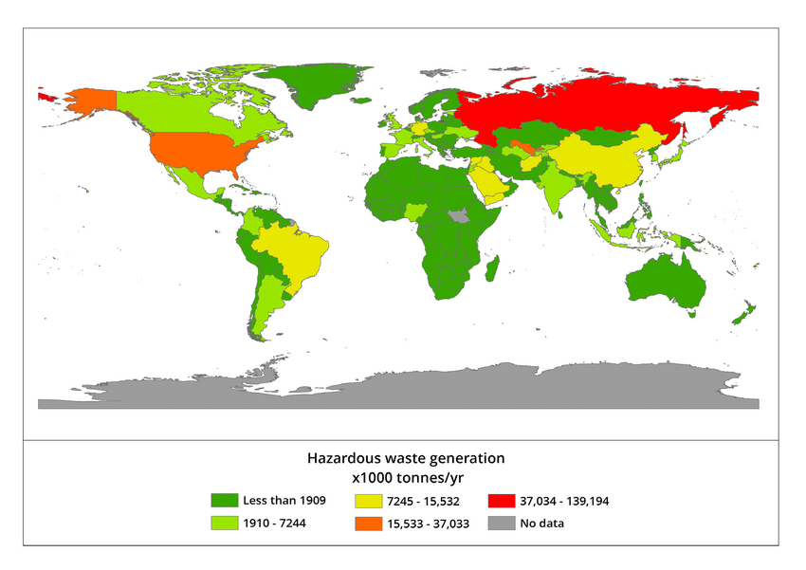
Global Issue
“Toxic Colonialism”
Higher costs of legal disposal due to increased regulations.
Cheap global transport.
Flag of convenience.
Less than scrupulous operators
Examples:
Thor Chemicals transported Mercury waste to South Africa for incineration.
Koko, Nigeria – 18,000 barrels of leaking toxic waste including PCB to be stored in exchange for $100/month.
Image credit: ResearchGate

Slide 15
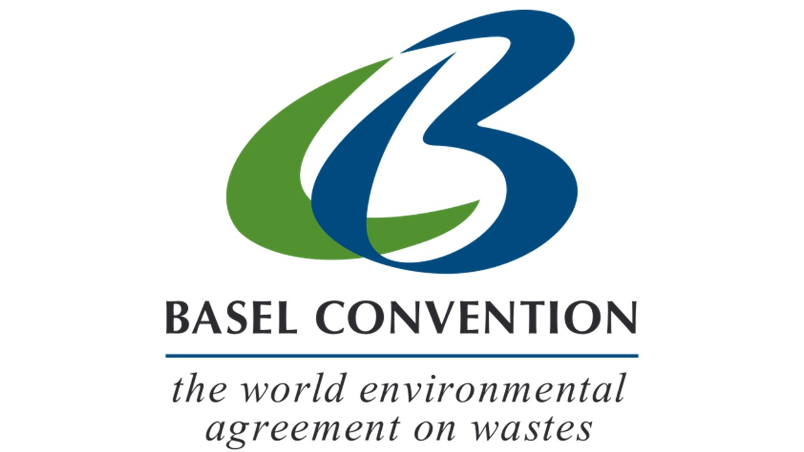
International Treaties
Developed countries dumping waste on undeveloped countries without providing information on hazards or how to manage them.
Hazardous wastes - Prior informed consent (PIC)
Annex: Household waste, incinerator ash, and plastics – first set of global rules on plastic litter.
Ban Ammendment – adopted 1994.
Ratified 2019
Prohibits developed countries from exporting hazardous waste to developing countries

Slide 16
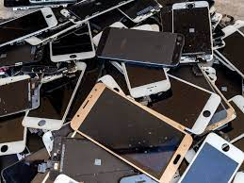
Upcoming Issues?
Electronic waste
Unwanted clothing
Lithium and Cobalt
Older wind turbines
Can we anticipate future problems?
Image credit: PC Mag.com

