Slide 1
Brownfields and the Restoration of Degraded Lands
A presentation for Texas Envirothon 2022
Garland March 5, 2022

Slide 2
Brownfields: the case for urban redevelopment
Garland march 5, 2022

Slide 3
Urban blight and Superfund
CERCLA: Superfund: requires cleanup of historic contamination that threatens human and environmental health
threat has to be imminent
ex. San Jacinto River Pits: Dioxin-laden waste pits that are IN the San Jacinto River just north of the I-10 bridge—actively releasing highly toxic material to river, wildlife, and people
But what about old industrial sites where the contamination is unknown?
Many such sites are in urban areas
Site got abandoned, or reused for something else for a while, but eventually was empty
Abandoned lots and buildings: problems for city: crack houses, homeless encampments, rats, weeds, criminal activity
Nobody wanted to buy this real estate for fear of CERCLA Liability
Garland March 5, 2022

Slide 4
Owner/Operator Definition under CERCLA
Reworded: an entity who owned or owns the facility, or who operates it now or did so in the past, even if they didn’t contribute to the contamination—they are liable for cleanup and for exposures and consequences of them
2001: An amendment to CERCLA was passed to relieve potential developers from fear of CERCLA liability and encourage redevelopment of city properties
Small Business Liability Relief and Brownfields Redevelopment Act (Brownfields Amendment)
Provided some relief to the definition of owner/operator for the purpose of redeveloping previously contaminated properties in cities
Cities asked for this to happen
Minute Maid Park, the Aquarium Restaurant, Hobby Center—all Houston Brownfields redevelopment projects funded under this Act
Garland March 5, 2022

Slide 5
Brownfields Amendment
Brownfield definition: real property, the expansion, redevelopment, or reuse of which may be complicated by the presence of or potential presence of a hazardous substance, pollutant, or contaminant
Excluded properties: NPL sites (National Priorities List: aka Superfund sites); Administrative Order on Consent (AOC); court ordered cleanup under another statutes
Created grants/loans/technical assistance for redevelopment projects
Objective: to encourage and supported redevelopment of industrial and commercial properties and to DISCOURAGE use of “Greenfields” for industrial development

Slide 6
Defenses against CERCLA Liability
Brownfields Amendment specifies three defenses again CERCLA liability
Innocent Landowner Defense: I inherited from my uncle and I didn’t cause any contamination on this site
Contiguous Property Owner Defense: I have adjacent property and contamination migrated onto my site from another property.
The Bona Fide Purchaser Exemption: I am buying this land for redevelopment and I never operated or owned any facility this parcel in the past
Brownfields says: in order to qualify for any of these defenses, you need to conduct “ALL APPROPRIATE INQUIRIES” into the history of this site (AAI)
How do we do All Appropriate Inquiries? We conduct a Phase I Environmental Site Assessment according to ASTM 1527.

Slide 7
Federal Brownfields Programs
Administered by the EPA
Grants
Site assessment
Site Cleanup
Loans
Multipurpose grants
Job Training Grants
https://www.epa.gov/brownfields

Slide 8
State Brownfields Program
In Texas: administered under two agencies
TCEQ: which houses Brownfields in the Voluntary Cleanup Program (VCP)
TO REDEVELOP A BROWFIELD IN TEXAS, YOU MUST ENROLL YOUR SITE IN THE VCP AND WORK WITH A STATE PROJECT MANAGER THROUGHOUT THIS PROCESS!!!
https://www.tceq.texas.gov/remediation/bsa
Brownfields Assessment services: has contractors who will do these assessments for you
Innocent owner/operator certificates which go with the landowner or facility operator (AAI under CERCLA/Brownfields Amendment goes with the Property (good for one year))
Texas Railroad Commission: which deals specifically with oil/gas related Brownfields

Slide 9
Who is eligible for Brownfields Grants and Loans?
Municipalities (cities, counties, villages, incorporated towns…)
Non-profit economic development entities
For-profit entities that PARTNER with one of the above organizations
Legal agreement to work together on the redevelopment
Cost-sharing; specifies who oversees the project and who pays the rest of costs
Brownfields Grants and Loans have caps:
up to $250,000 to do site assessment
Up to $1 million for cleanup
For-profit partner often covers additional costs above the grant

Slide 10
Brownfields Redevelopment Process
Assess the site: complete All Appropriate Inquiries by doing a Phase I Environmental Site Assessment
Investigate the site: Phase II Environmental Site Assessment—Sampling and Analysis Plan
Risk Assessment: based on SAP data, what are the risks at my site?
Complete Exposure Scenario: Source(s) + Migration Pathways + Receptors for the proposed END USE
Site Cleanup: develop and implement a remediation strategy to reduce the site risk to the level appropriate for the end use
TRRP: Texas Risk Reduction Program

Slide 11
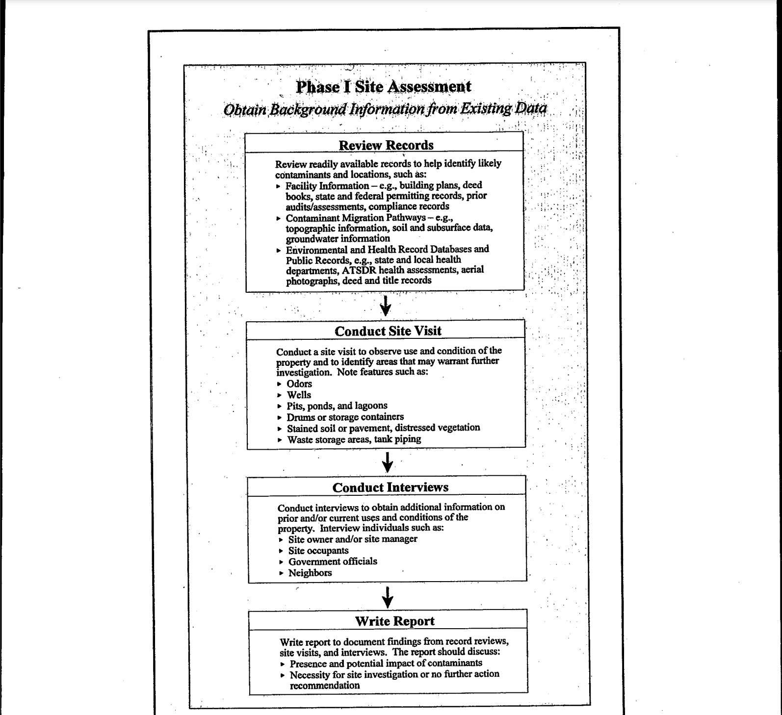

Slide 12
Site Investigation
Phase II Environmental Site Assessment
EPA Technical Approaches to Redeveloping Brownfields (PDF on our Envirothon Resources Page)

Slide 13
Clean up the Site
https://www.epa.gov/greenercleanups

Slide 14
Roadmap to Brownfields Redevelopment
This interactive document is a great resource for understanding how we go about using the Brownfield programs to redevelop and revitalize a brownfield site.
https://www.epa.gov/sites/default/files/2017-11/documents/brownfieldsroadmapepa542-r-12-001.pdf

