Slide 1
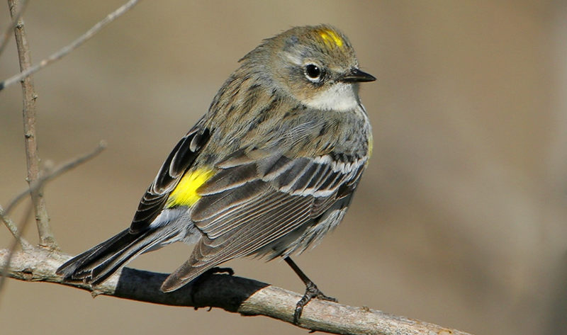
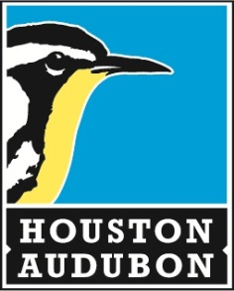
Creating Bird-Friendly Habitats
Anna Vallery
Conservation Specialist
Houston Audubon
Notes:
Yellow-rumped warbler

Slide 2
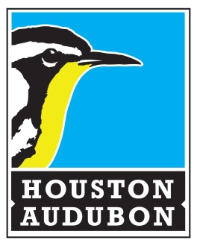
Promoting the conservation of birds and other wildlife since 1969.

Slide 3
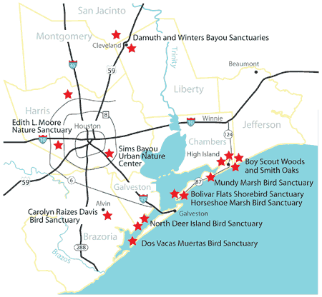
Notes:
17 bird sanctuaries ranging from fire escapes such as High Island to urban sanctuaries like Edith L Moore and Sims Bayou

Slide 4
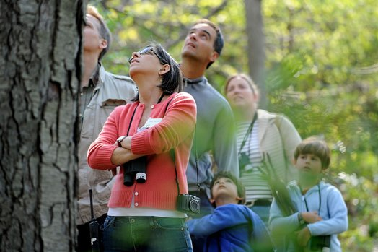
Bird Friendly Communities
“Birds make any place a chance for discovery, they make a garden seem wild, they are a little bit of wilderness coming into a city park…”—David Sibley, Author
Notes:
Birds are a wonderful entry point to nature appreciation and ultimately stewardship. BFC hopes to create bird lovers and those who care about their health. Improving life for birds improves life for all wildlife and for people, too. Get a Field Guide!

Slide 5
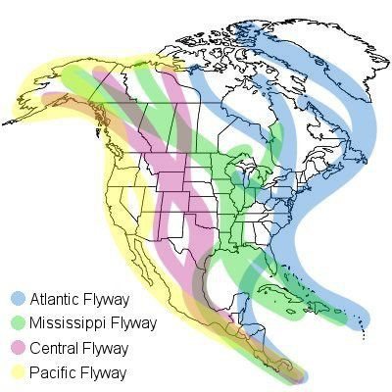
Importance of the Houston Community
600+ species of bird in Texas
2.5 million spring migrants through the Greater Gulf Coast
Notes:
Birds are a wonderful entrypoint to nature appreciation and ultimately stewardship. BFC hopes to create bird lovers and those who care about their health. Improving life for birds improves life for all wildlife and for people, too. Get a Field Guide!

Slide 6
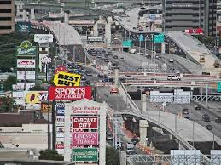
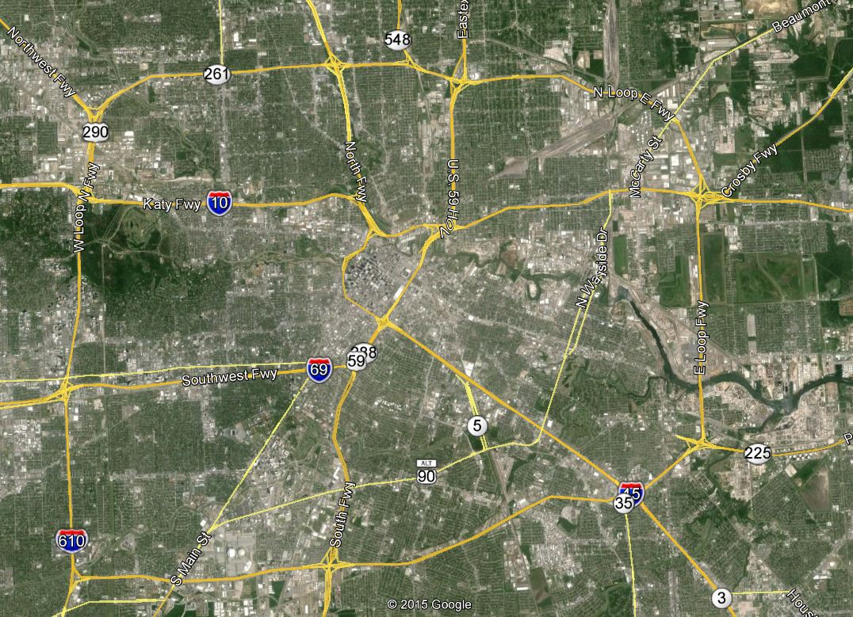
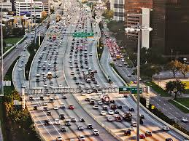
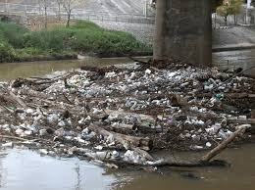
Challenges for Houston Birds
Notes:
This is what you see, this is where you have to land for food and water, congestion, concrete, water pollution.

Slide 7
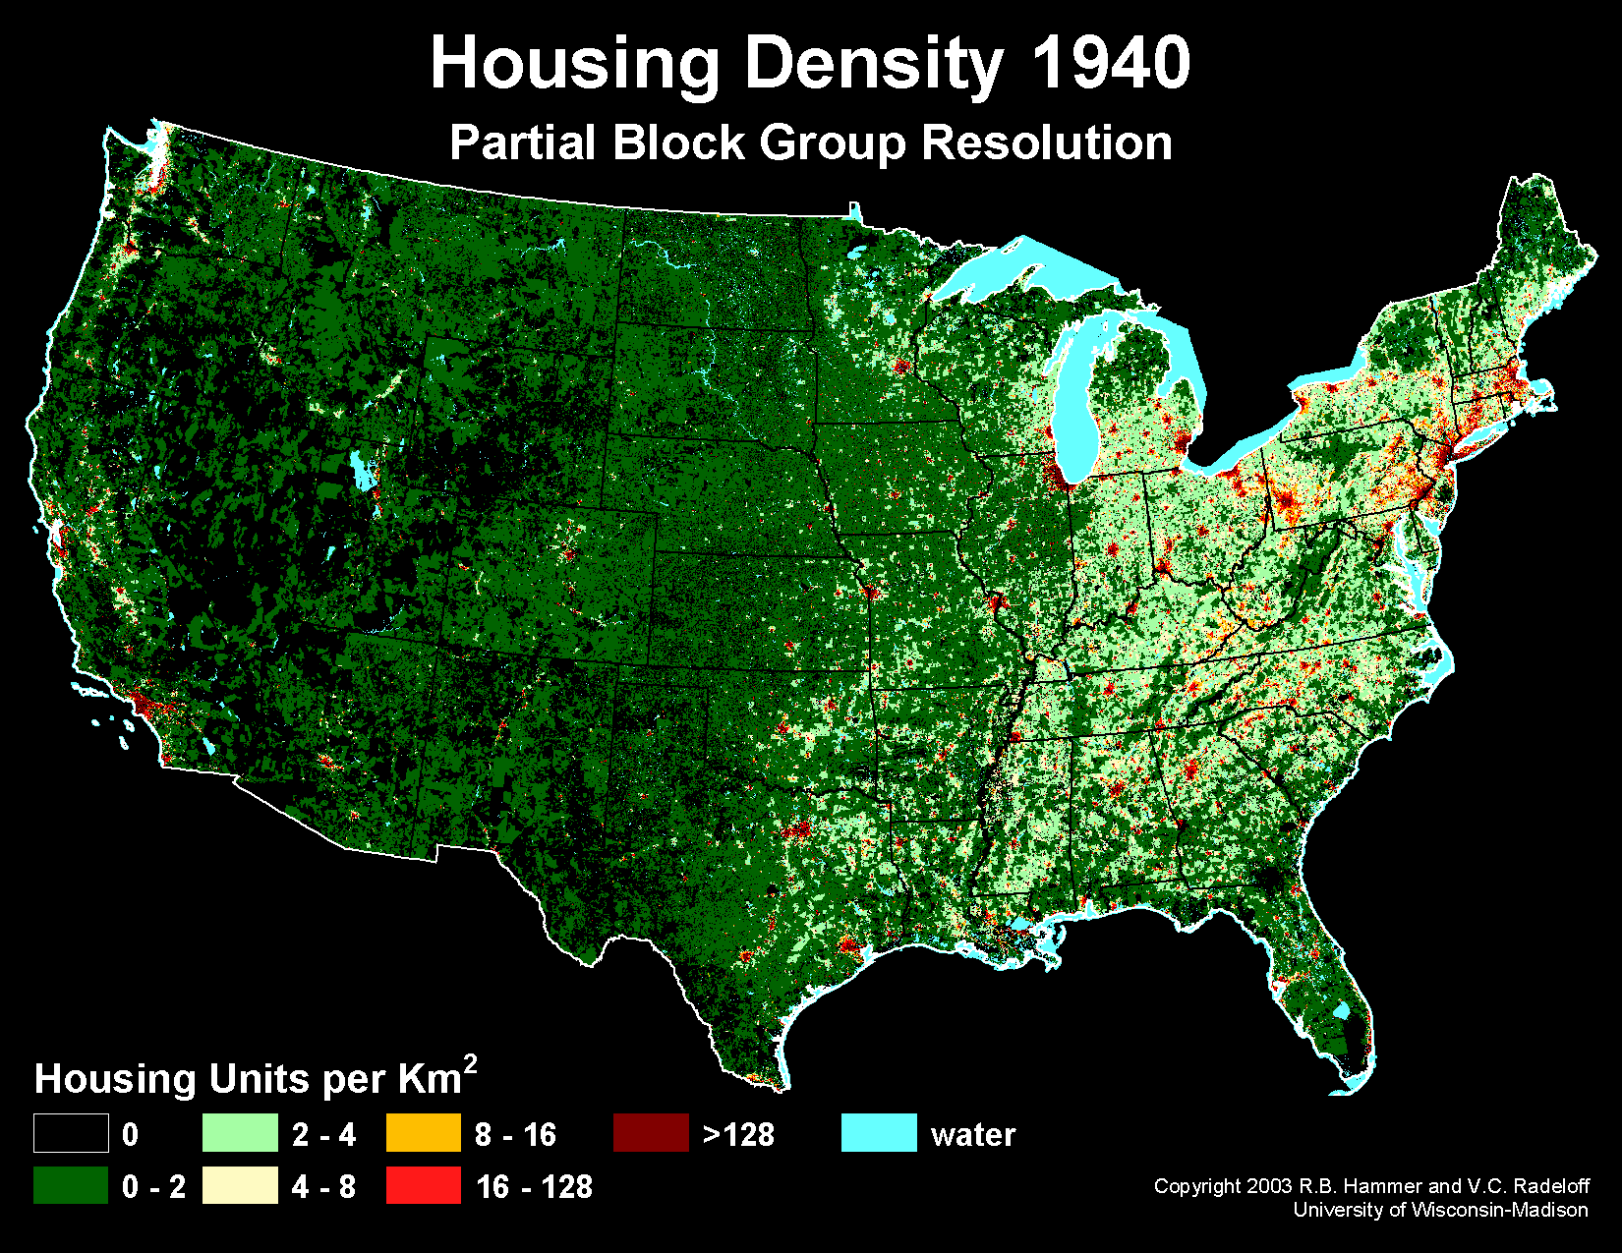
Notes:
The vital role of restoring habitat in urban, suburban and rural communities is growing.
Back in the 1940’s our country looked like this. Urban centers (especially in the eastern US) were essentially isolated cores surrounded by small farms and open land.
But just within the span of one lifetime, within the last 75 years, housing densities have exploded.

Slide 8
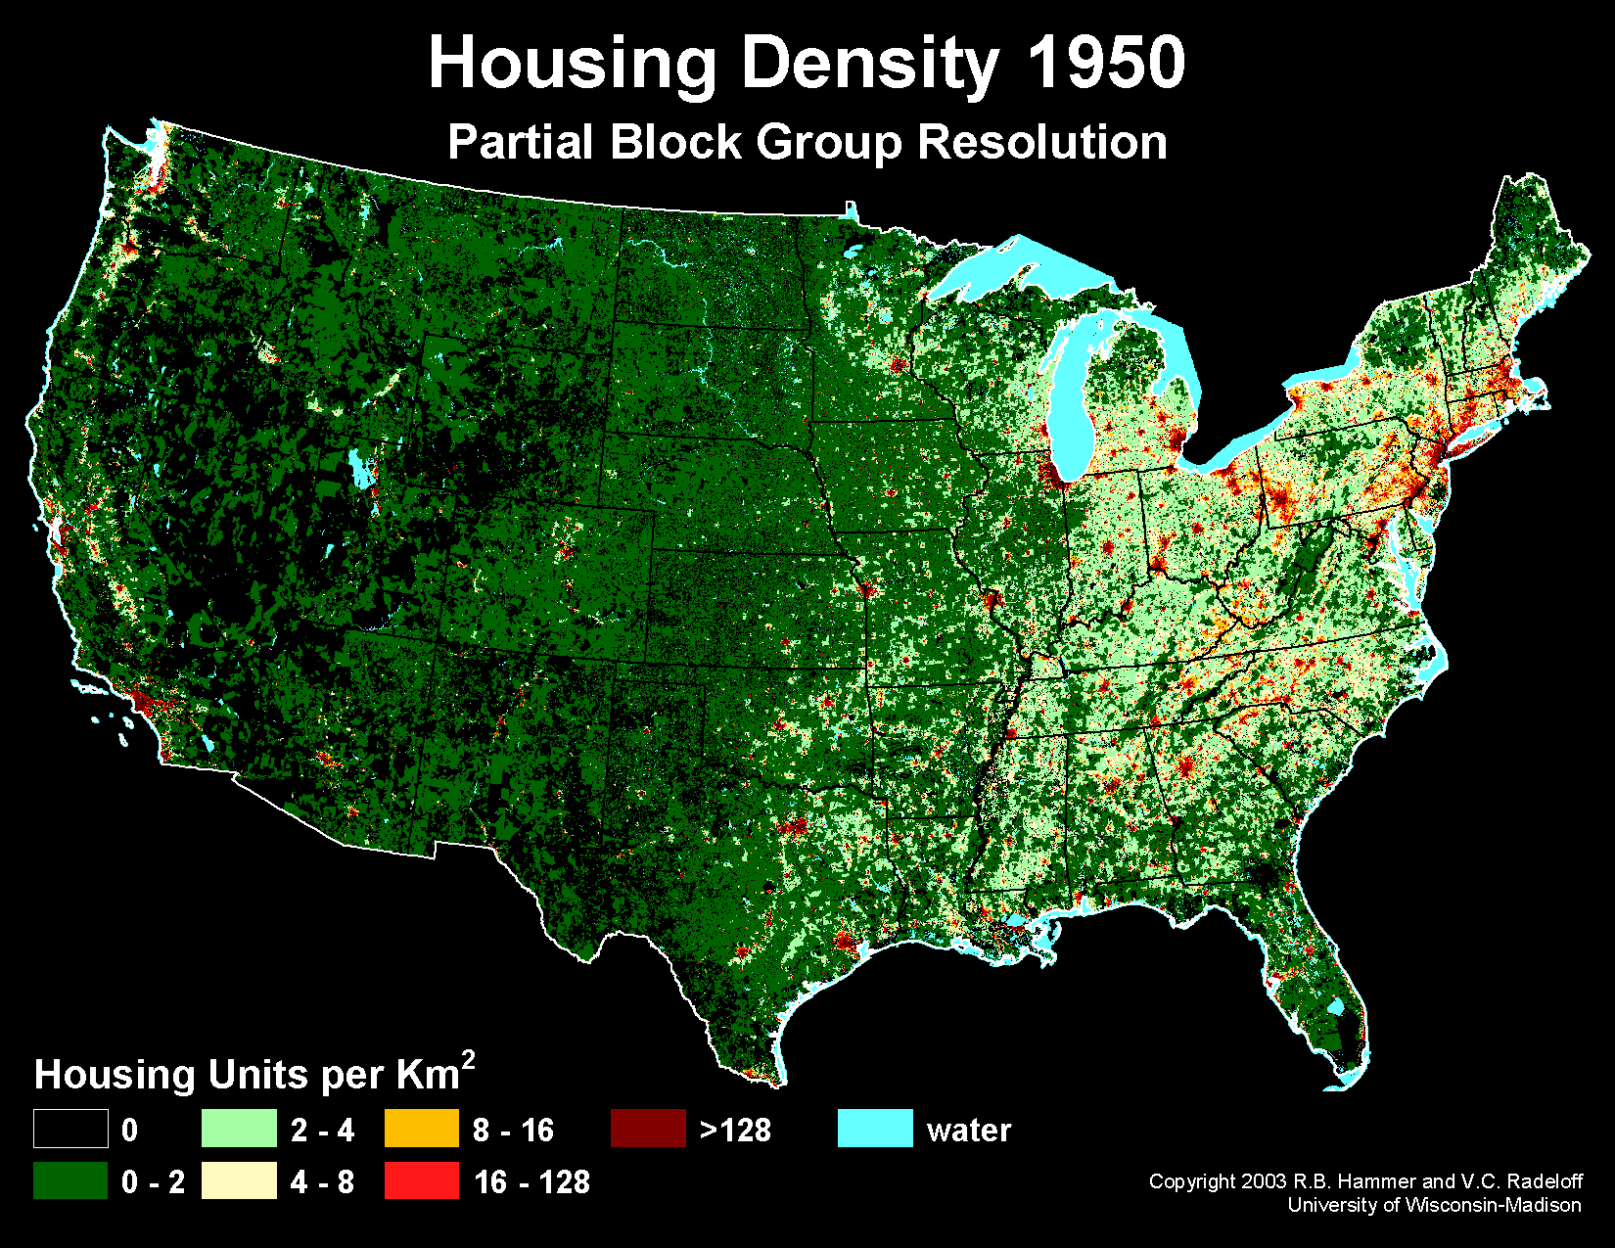
Notes:
Decade by decade, relatively consolidated urban areas . . .

Slide 9

Notes:
have spilled out into the surrounding landscape.

Slide 10

Notes:
Mowing down more and more of the essential habitat.

Slide 11
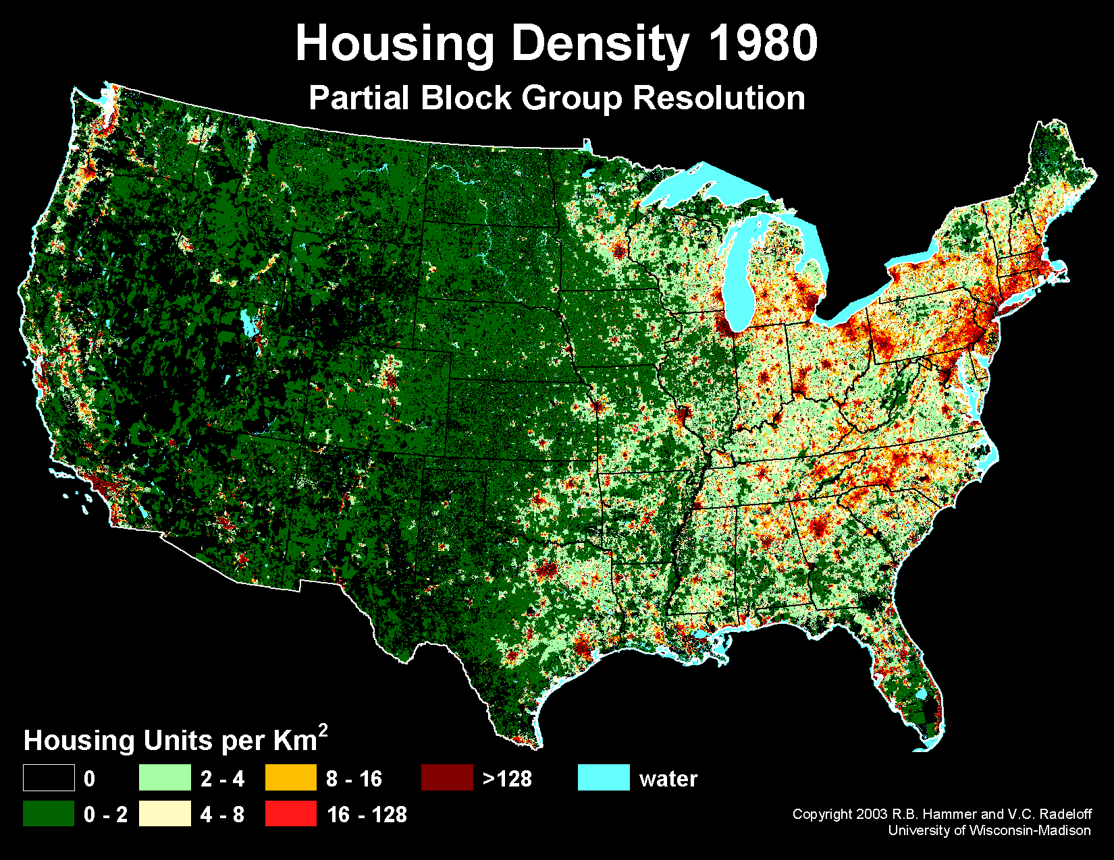
Notes:
Converting millions of acres

Slide 12
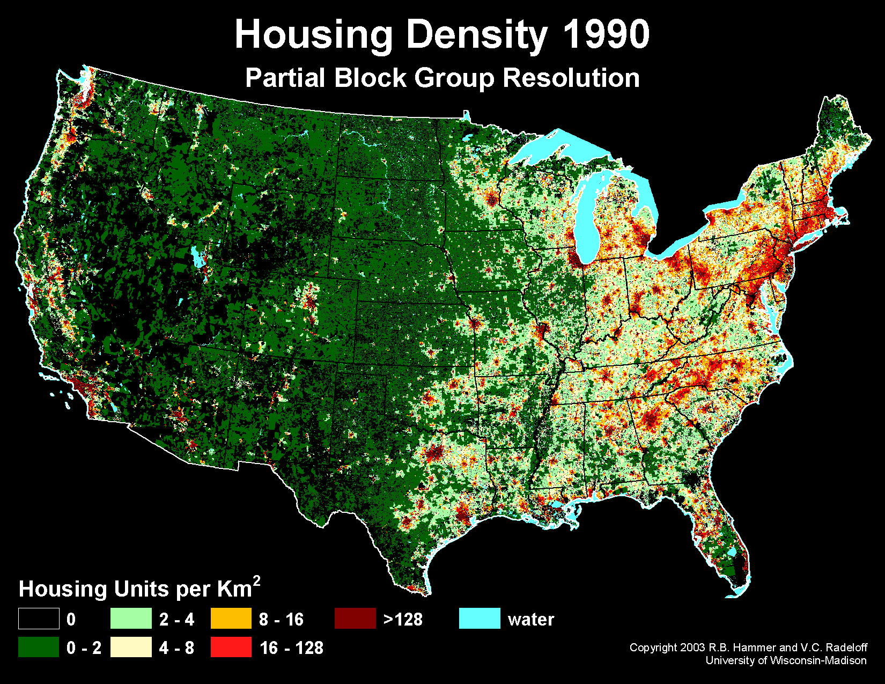
Notes:
Into housing developments

Slide 13
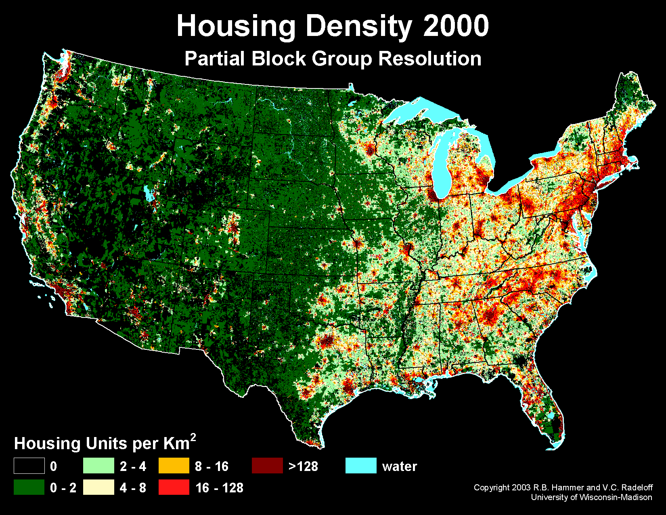
Notes:
and urban sprawl.

Slide 14
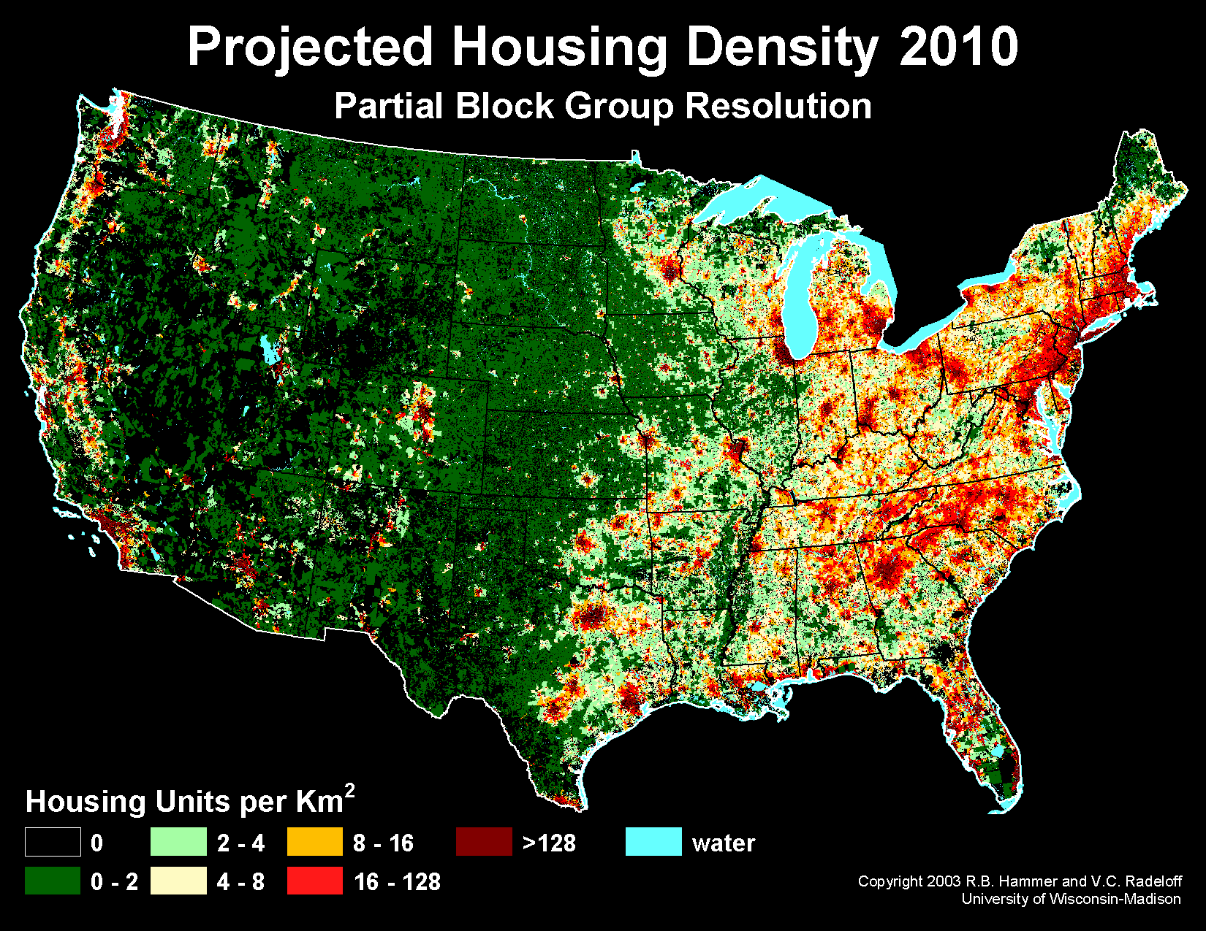
Notes:
You can see that now, within this decade, the eastern half of our country has seen tremendous increase in housing densities.

Slide 15
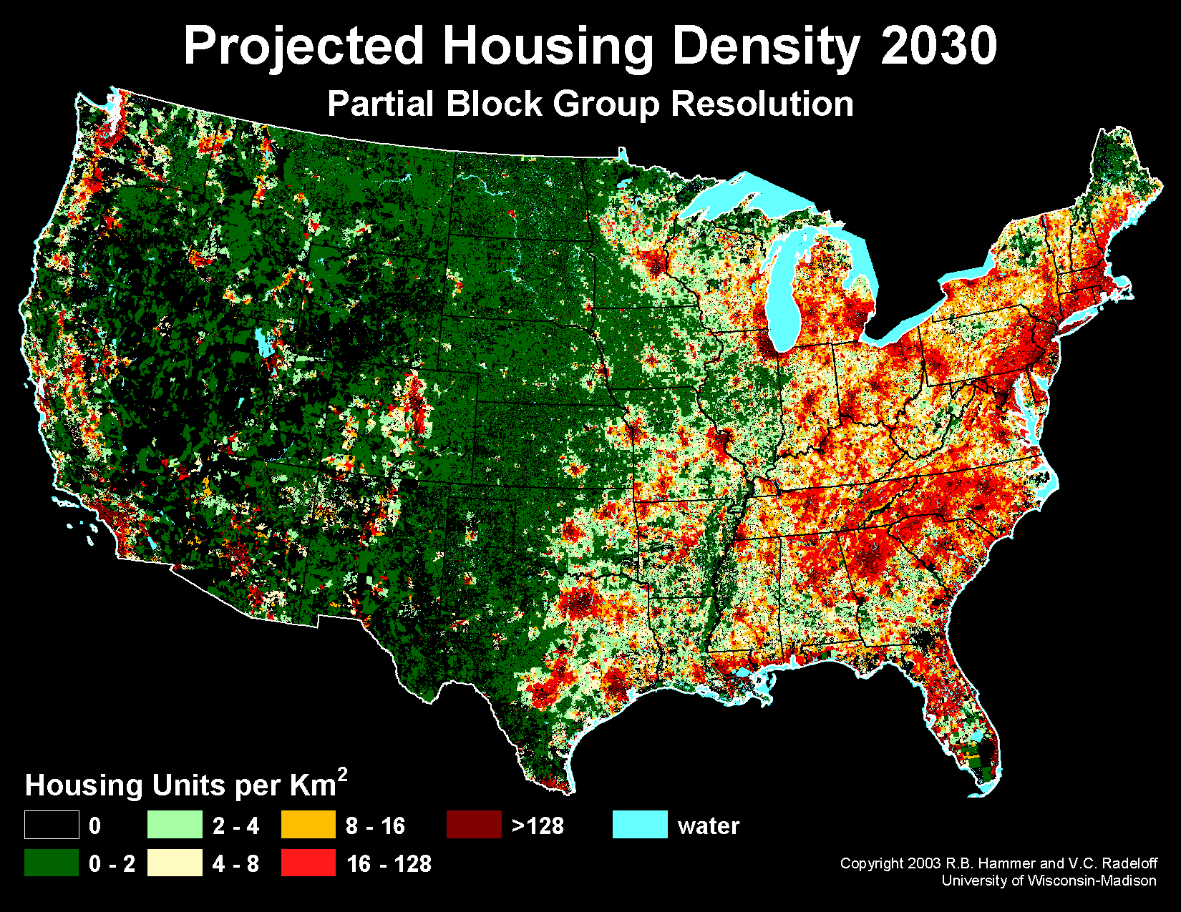
Notes:
And it is only going to get worse.
This is the projected density of housing by the year 2030, a mere 15 years from now.
Already we have lost a staggering 150 million acres of ecologically productive land to urban sprawl.

Slide 16
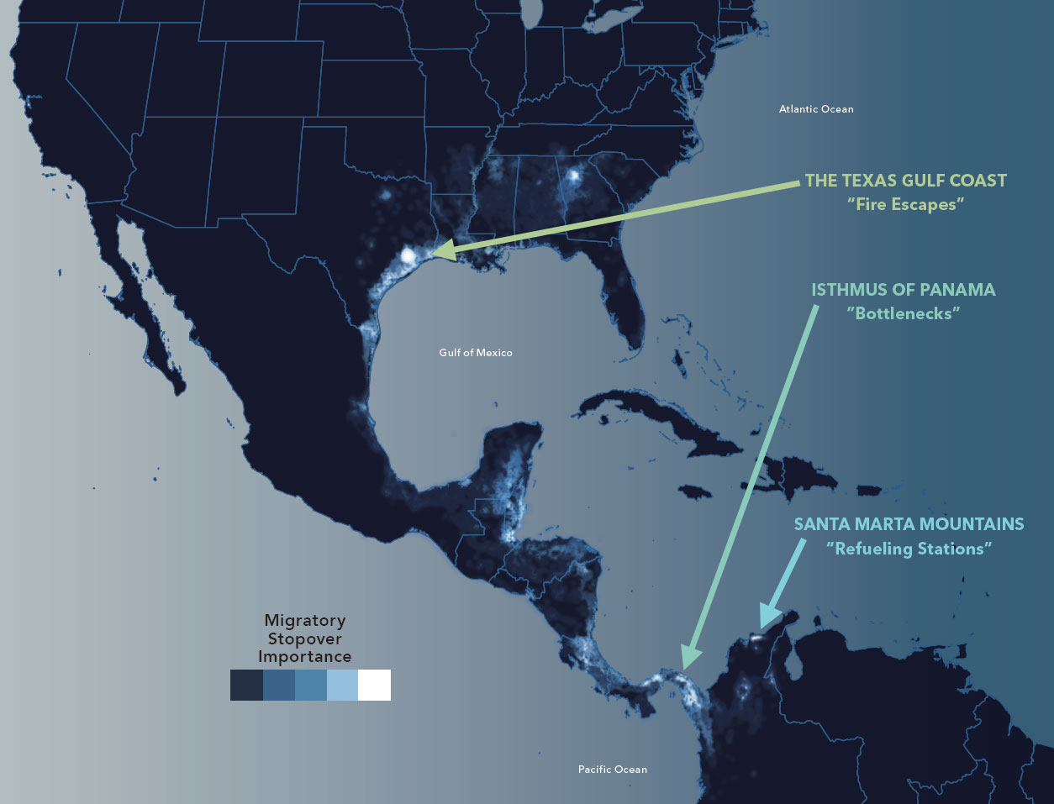
Notes:
Resting and refueling station - Fire escape – Areas that don’t necessarily provide high amounts of food and resources, but are vital for high stress situations. Ex. Fallouts from bad weather.

Slide 17
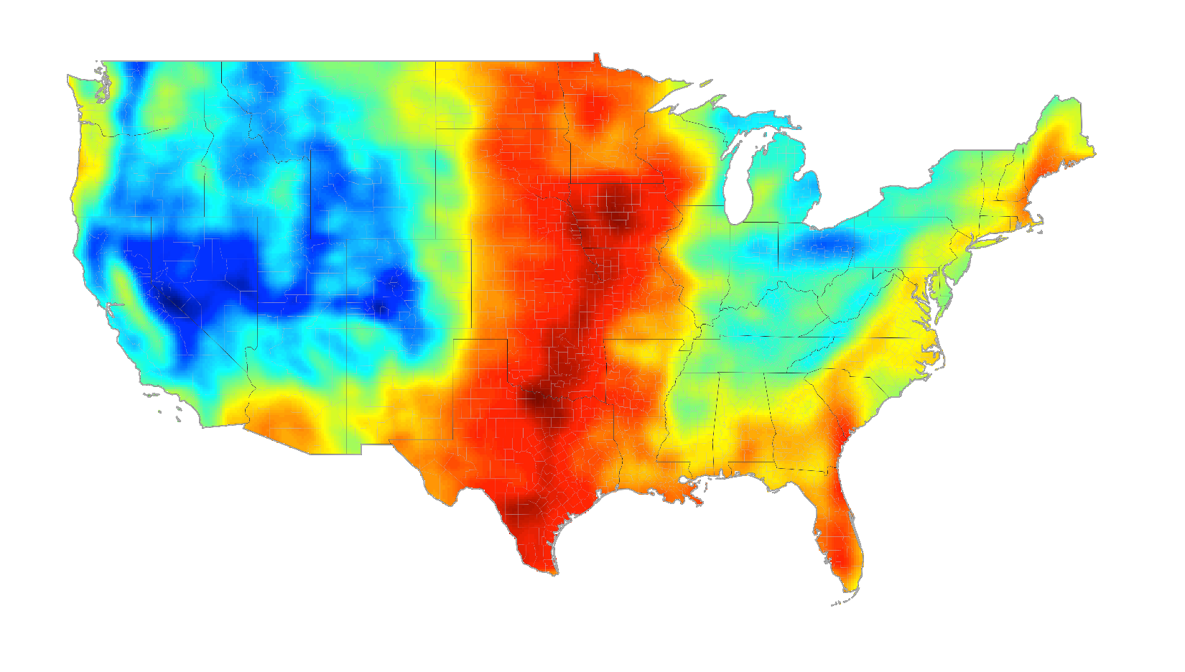

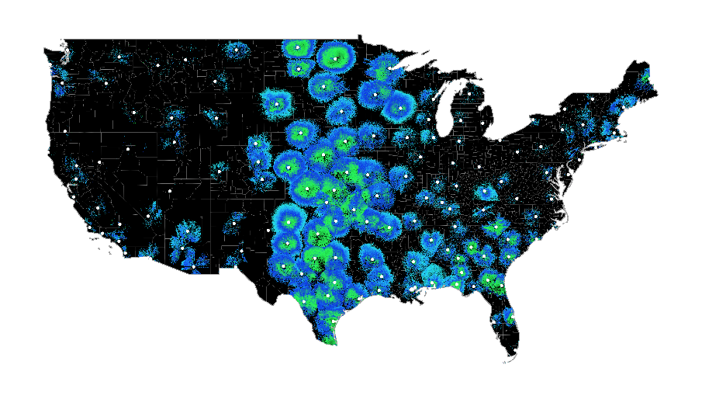
Migration forecast
April 23, 2017
112 to 178
million birds
Notes:
Example of forecast and magnitude

Slide 18
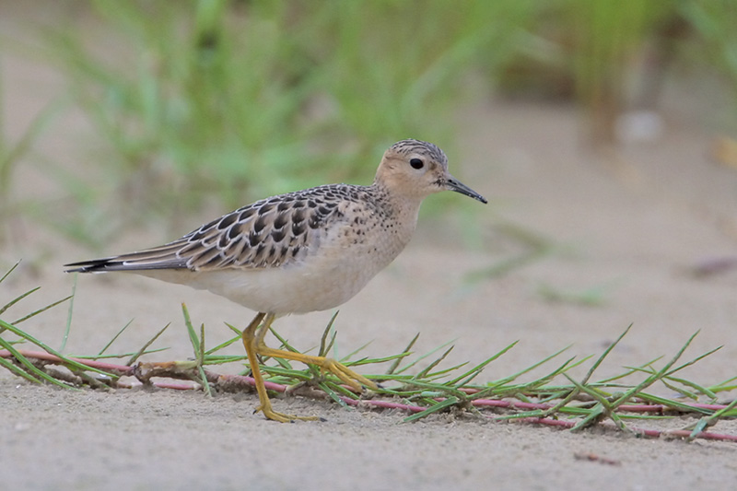
Photo by Greg Lavaty
Notes:
Buff-breasted Sandpiper

Slide 19
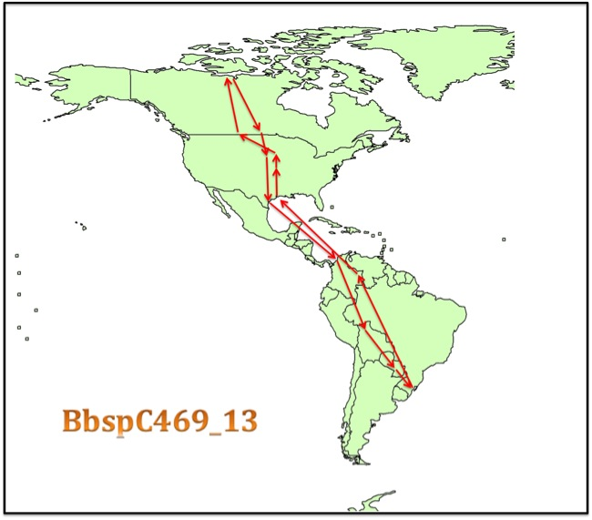
Notes:
http://www.waderstudygroup.org/projects/geolocator-project/maps-library-introduction/calidris-subruficollis-bbsp-buff-breasted-sandpiper/
Migration of a female BBSP in 2013

Slide 20
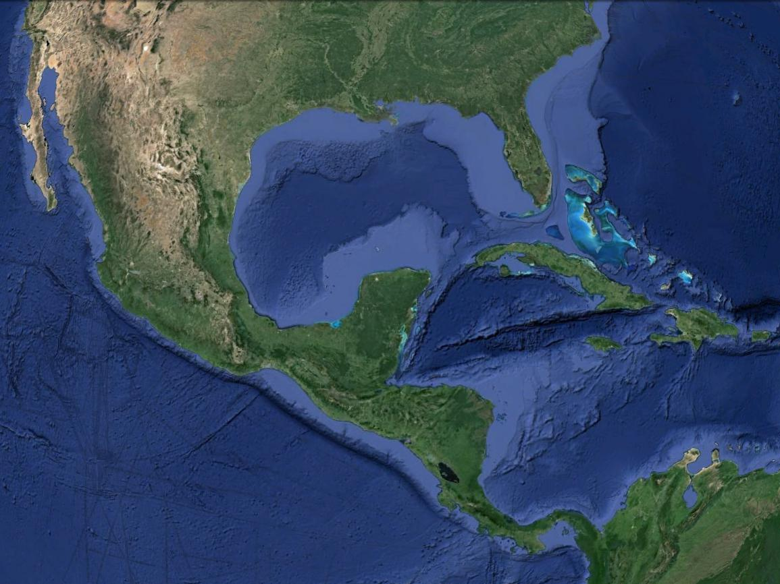
Gulf of Mexico
600+ miles
1800 miles
Notes:
As migratory birds work there way north, they are confronted with a major obstacle, Earth’s largest Gulf, more than 900 miles wide and 600 miles across. Migration routes were shaped by various evolutionary selection pressures. Timing is very important for breeding. If birds arrive too early on the breeding grounds, there may be freezing temperatures and little to eat. If birds arrive too late, the prime territories may be occupied by earlier arriving males. These counter selection pressures have shaped many adaptations and migration routes and made the spring migration more punctuated than the fall retreat.

Slide 21
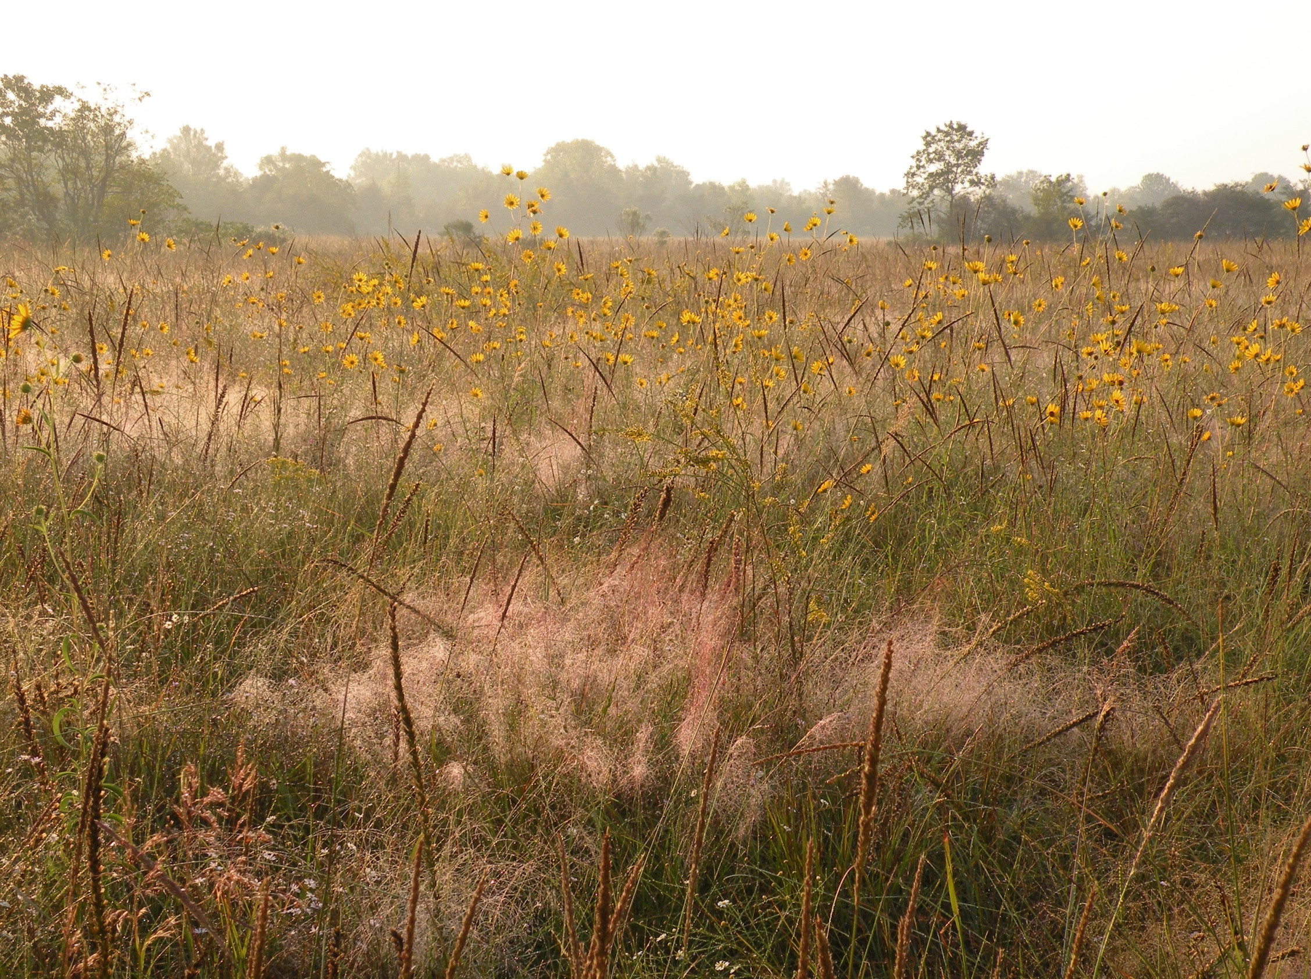
Notes:
Places you once visited looked like this: This is Saums Road Prairie, west side, before. Wonderful for plant study and for humans to appreciate our natural heritage, too.

Slide 22
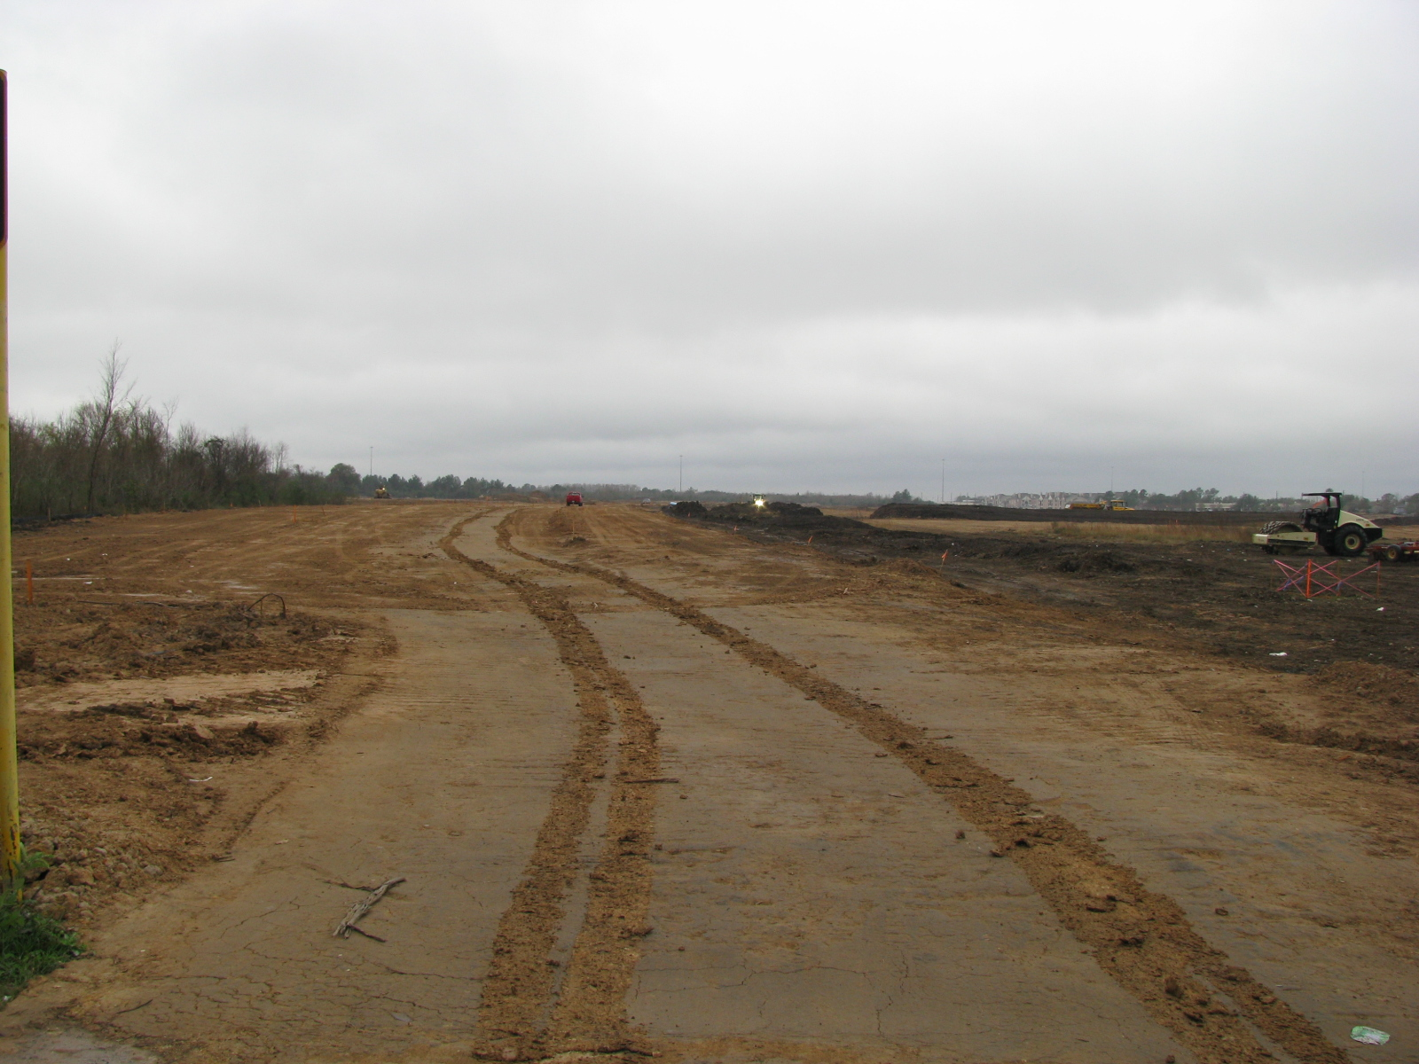
Notes:
Now look like this: Saums Prairie, After—road development

Slide 23
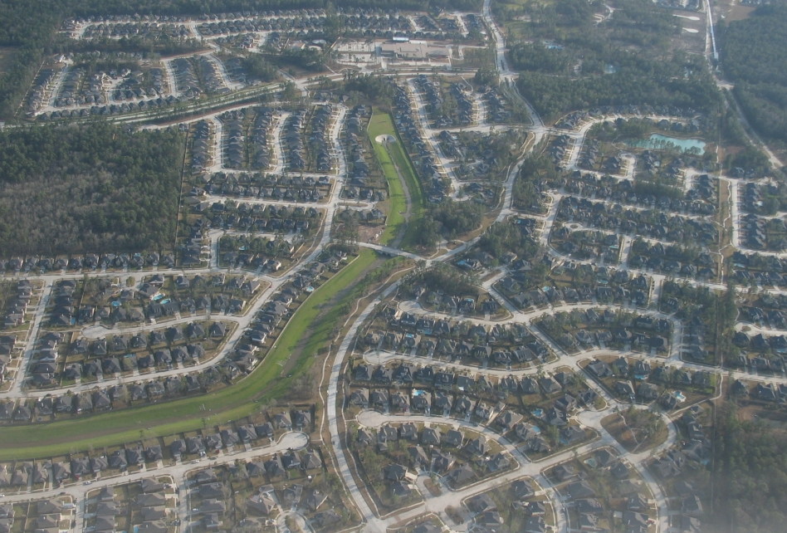

Slide 24
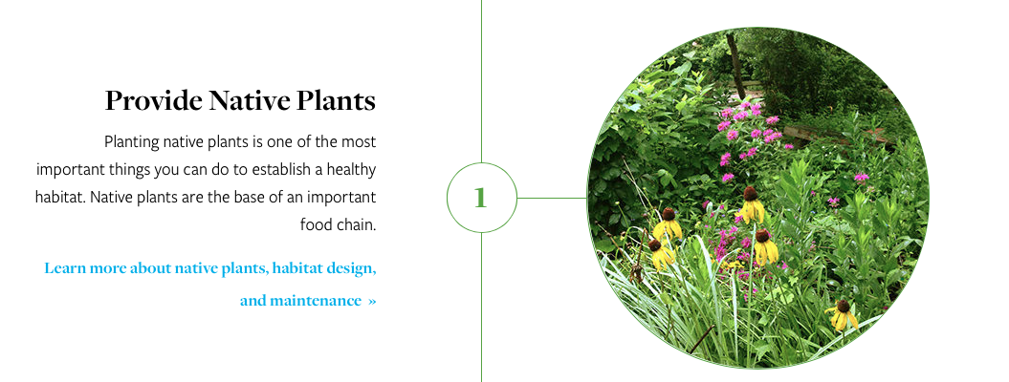
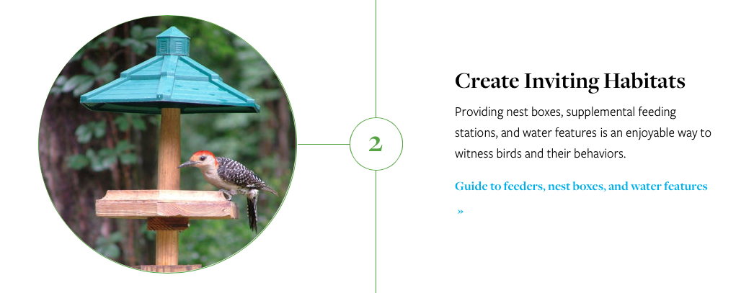
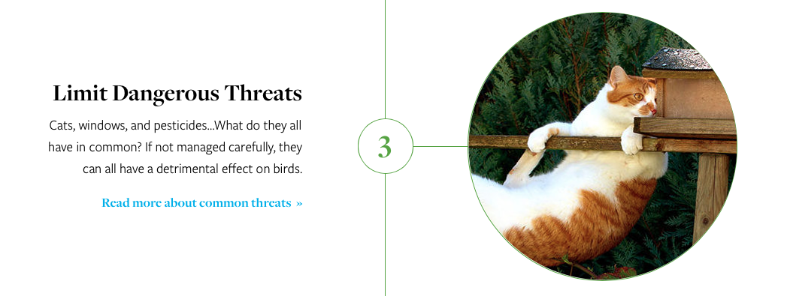
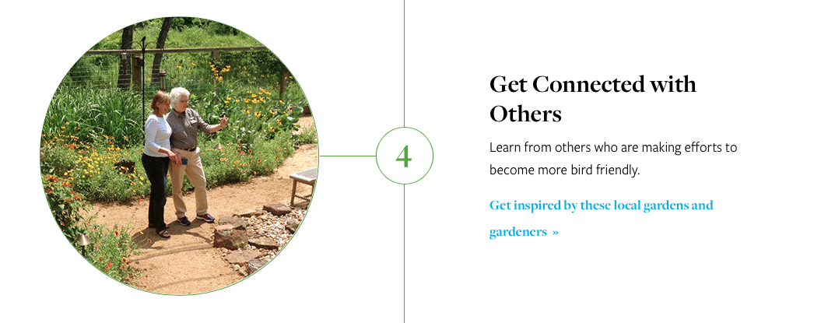
Bird-Friendly Communities steps can be implemented at any scale.

Slide 25
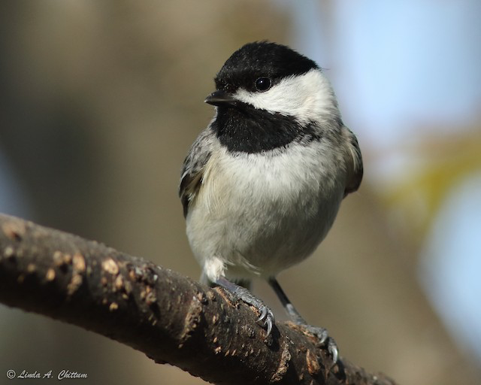
Warm Up Quiz Question: What do Chickadees feed their young?
A) Seeds
B) Fruits
C) Nuts
D) Nectar
E) Insects

Slide 26
Warm Up: What do Chickadees feed their young?
A) Seeds
B) Fruits
C) Nuts
D) Nectar
✔Insects
98% of all landbirds feed protein-rich insects to their young.

Slide 27
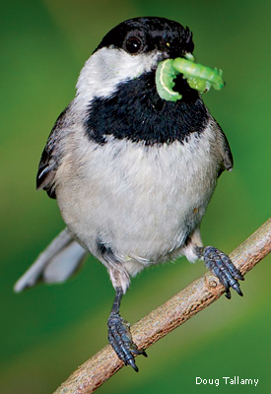
SECTION 1: Plants for Birds
Quiz: How many caterpillars will a Chickadee feed its young until the clutch fledges?
A) 85
B) 500
C) 2000
D) 9000

Slide 28
Section 1: Plants for Birds
Quiz: How many caterpillars will a Chickadee feed its young until the clutch fledges?
A) 85
B) 500
C) 2000
✔9000
Native plants host insects, and insects are bird food. No Native plants=No birds.

Slide 29
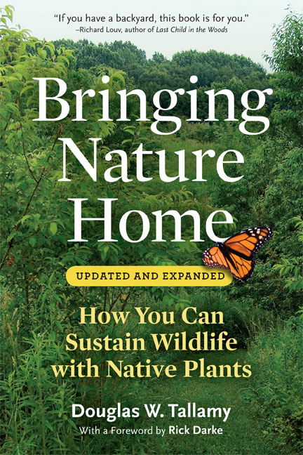
Bird-Friendly Tree List for Houston
WOODY PLANTS RANKED BY ABILITY TO SUPPORT LEPIDOPTERA SPECIES
Common Name
Genus
origin
Species Supported
Oak
Quercus
native
532
Cherry, plum
Prunus
native
456
Willow
Salix
native
455
Maple, boxelder
Acer
native
297
GREAT BOOK!
Hickory, pecan
Carya
native
235
Elm
Ulmus
native
215
Hawthorn
Crataegus
native
168
Ash
Fraxinus
native
149
Basswod
Tilia
native
149
Dogwood
Cornus
native
118
Arrowwood
Viburnum
native
104
American hornbeam
Carpinus
native
68
Sycamore
Platanus
native
45
Sugarberry
Celtis
native
43
Redbud
Cercis
native
19
Crapemyrtle
Lagerstroemia
alien
3
Chinaberrytree
Melia
alien
2
Bamboo
Bambusa
alien
1
Butterfly bush
Buddleja
alien
1
Boxwood
Buxus
alien
1
Golden raintree
Koelreuteria
alien
1
Golden bamboo
Phyllostachys
alien
1
Chastetree
Vitex
alien
0
Nandina
Nandina
alien
0
Notes:
If you want butterflies and bird food, choose native. You won’t see the eaten leaves! I think eaten leave are a sign of a healthy garden!

Slide 30
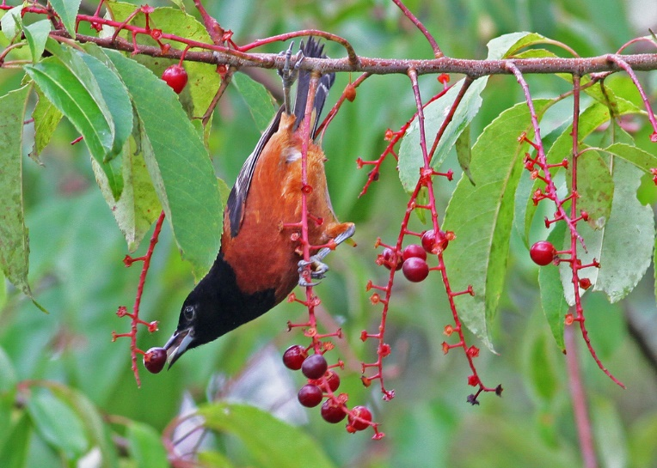
Notes:
Orchard Oriole on black cherry

Slide 31
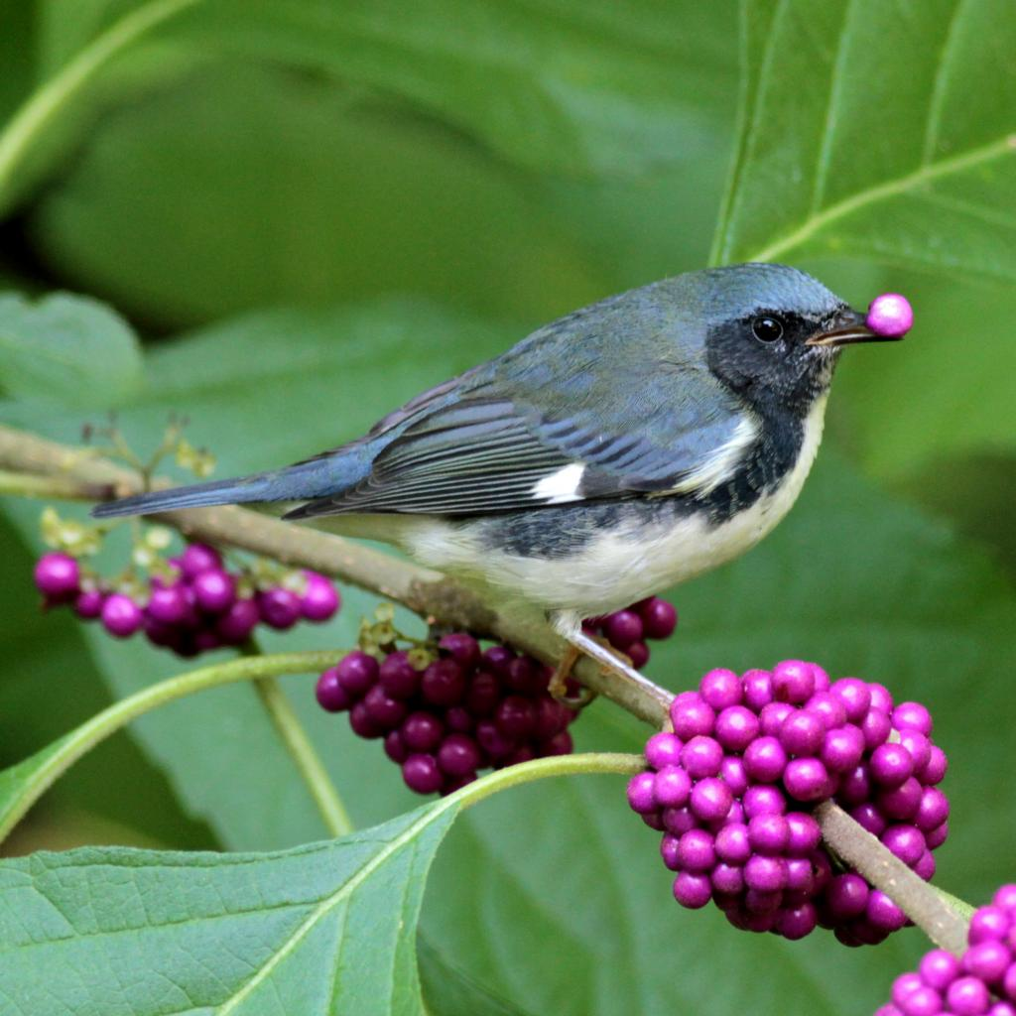
Notes:
Black-throated Blue Warbler on American Beautyberry

Slide 32
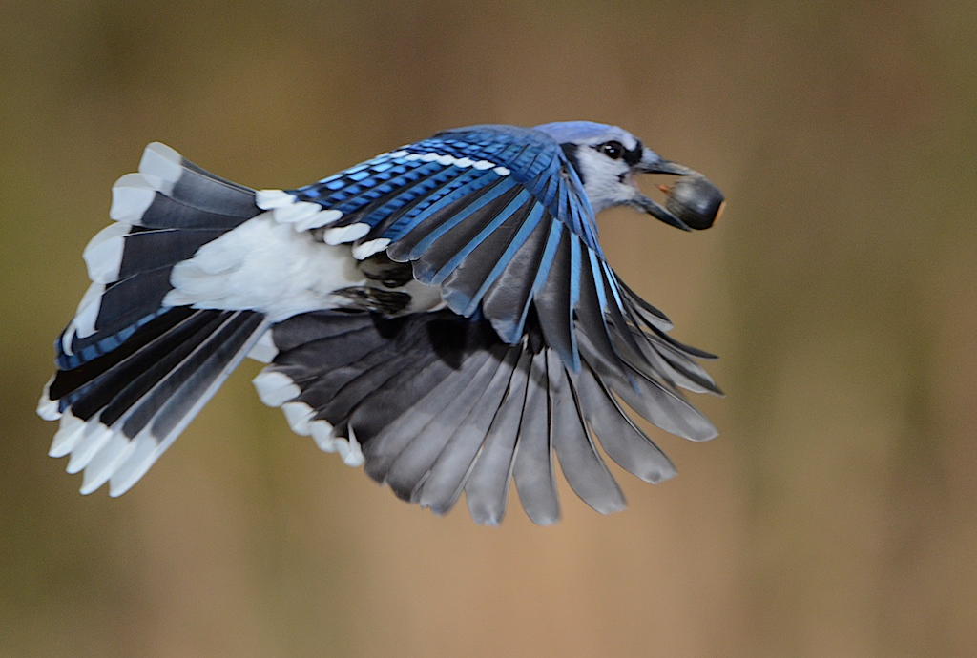

Slide 33
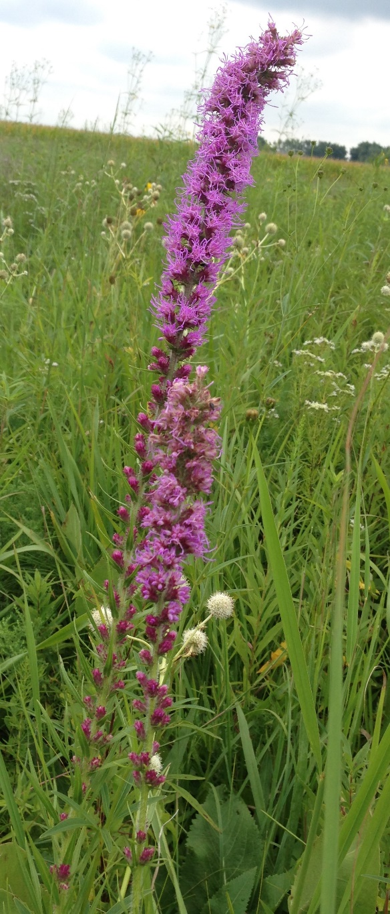
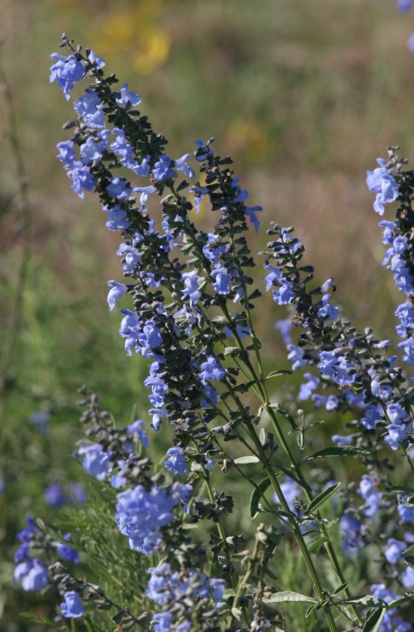
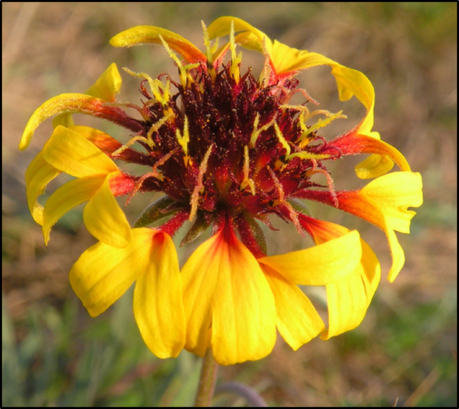
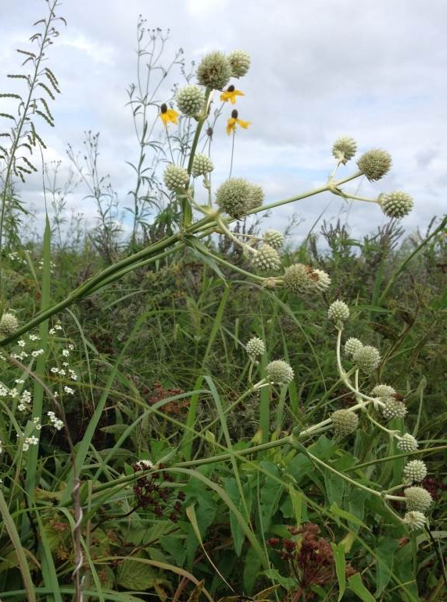
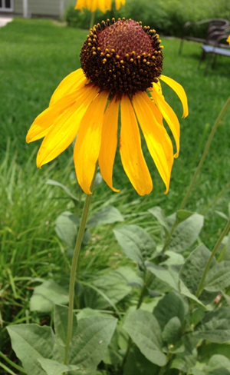
Wildflowers
Blue sage
Lanceleaf blanketflower
Kansas blazing star
Rattlesnake master
Rough coneflower

Slide 34
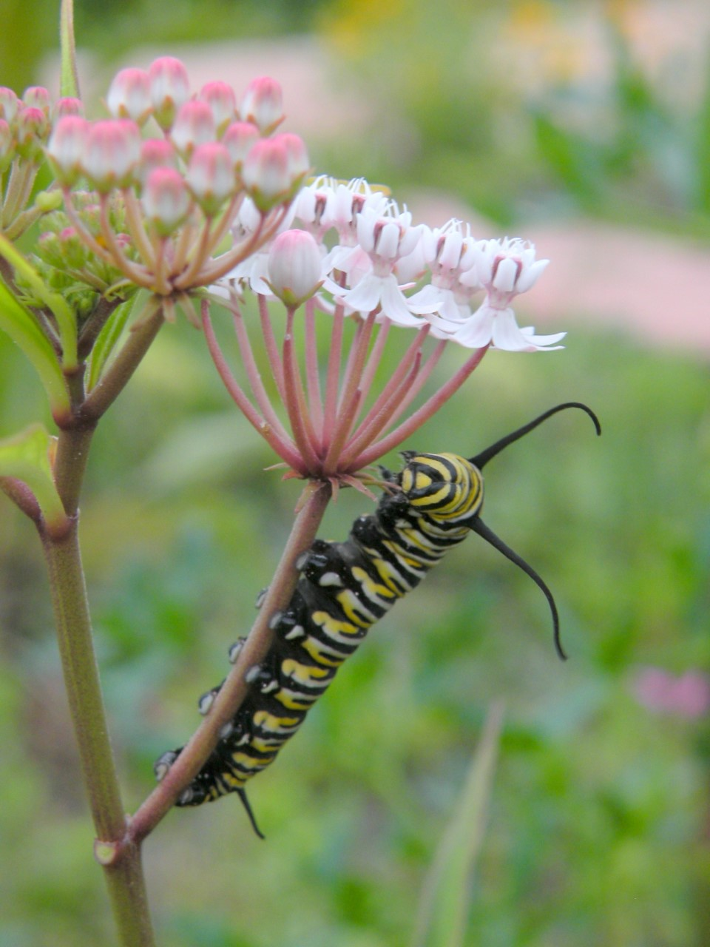
Notes:
Not just birds

Slide 35
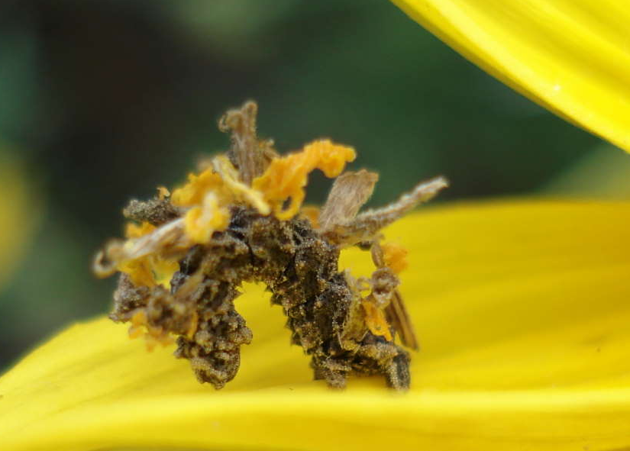
Don Verser
Camouflaged Looper, Bidens aristosa

Slide 36
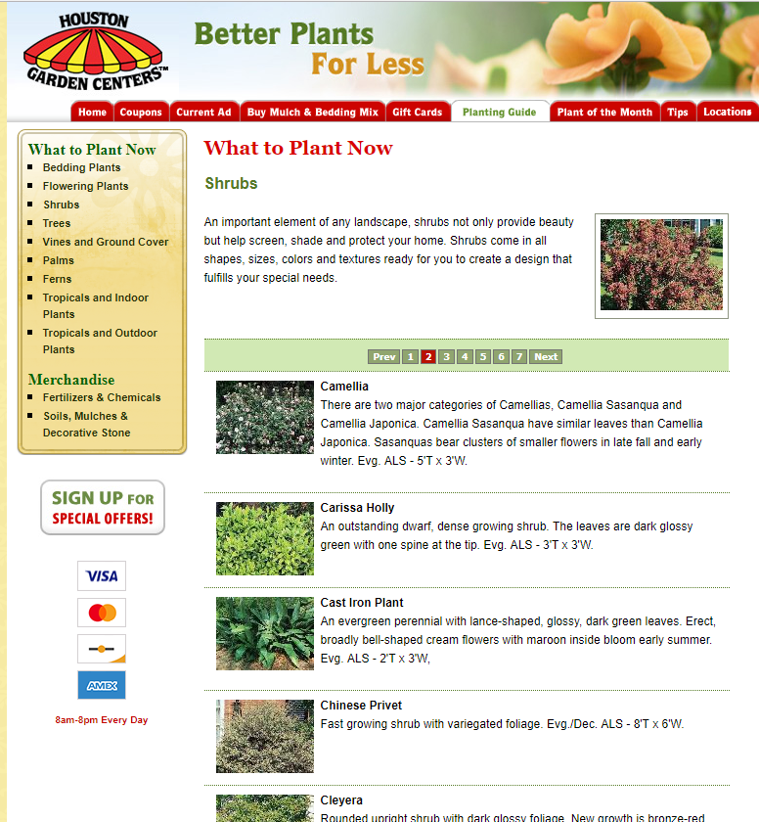
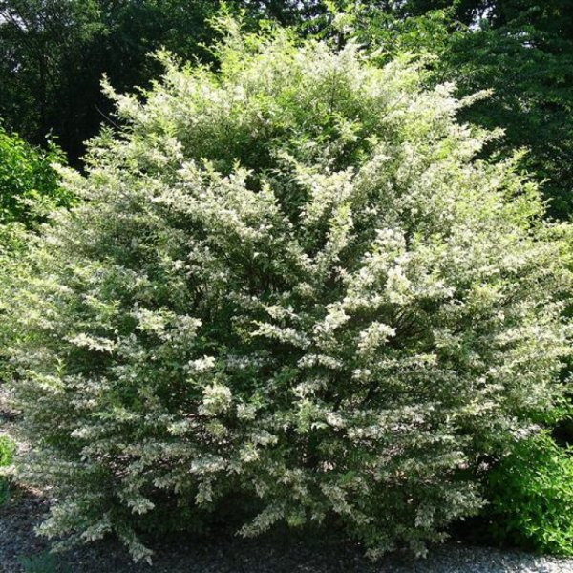
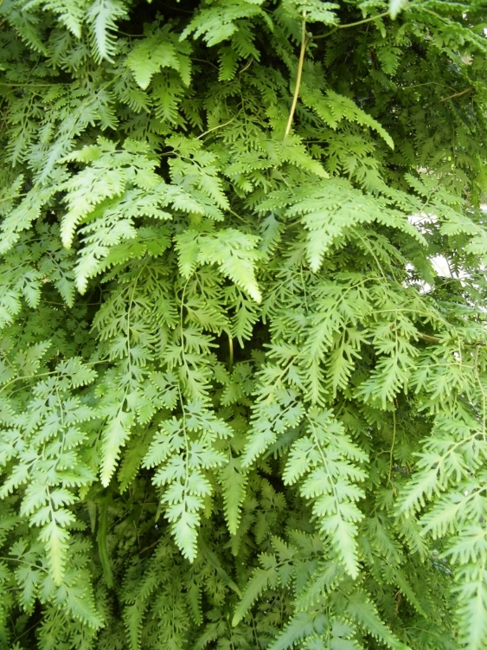
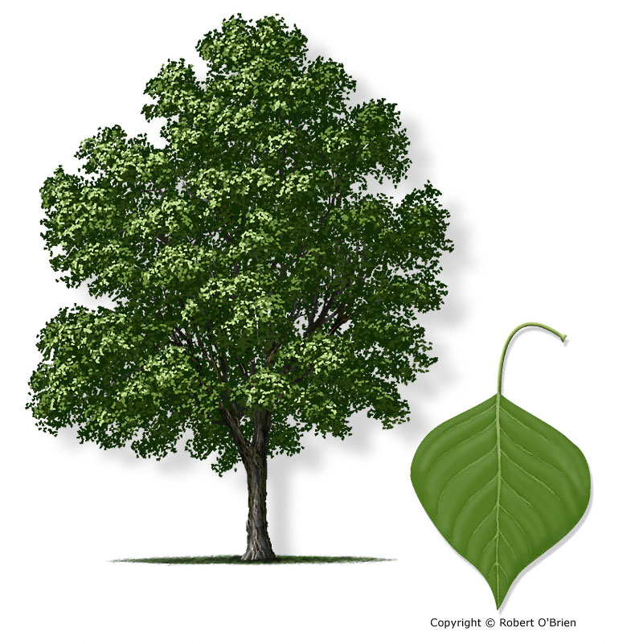
Invasive Plants
Ligustrum sinense – Chinese privet
Lygodium japonicum – Japanese climbing fern
Triadica sebifera – Chinese tallow

Slide 37
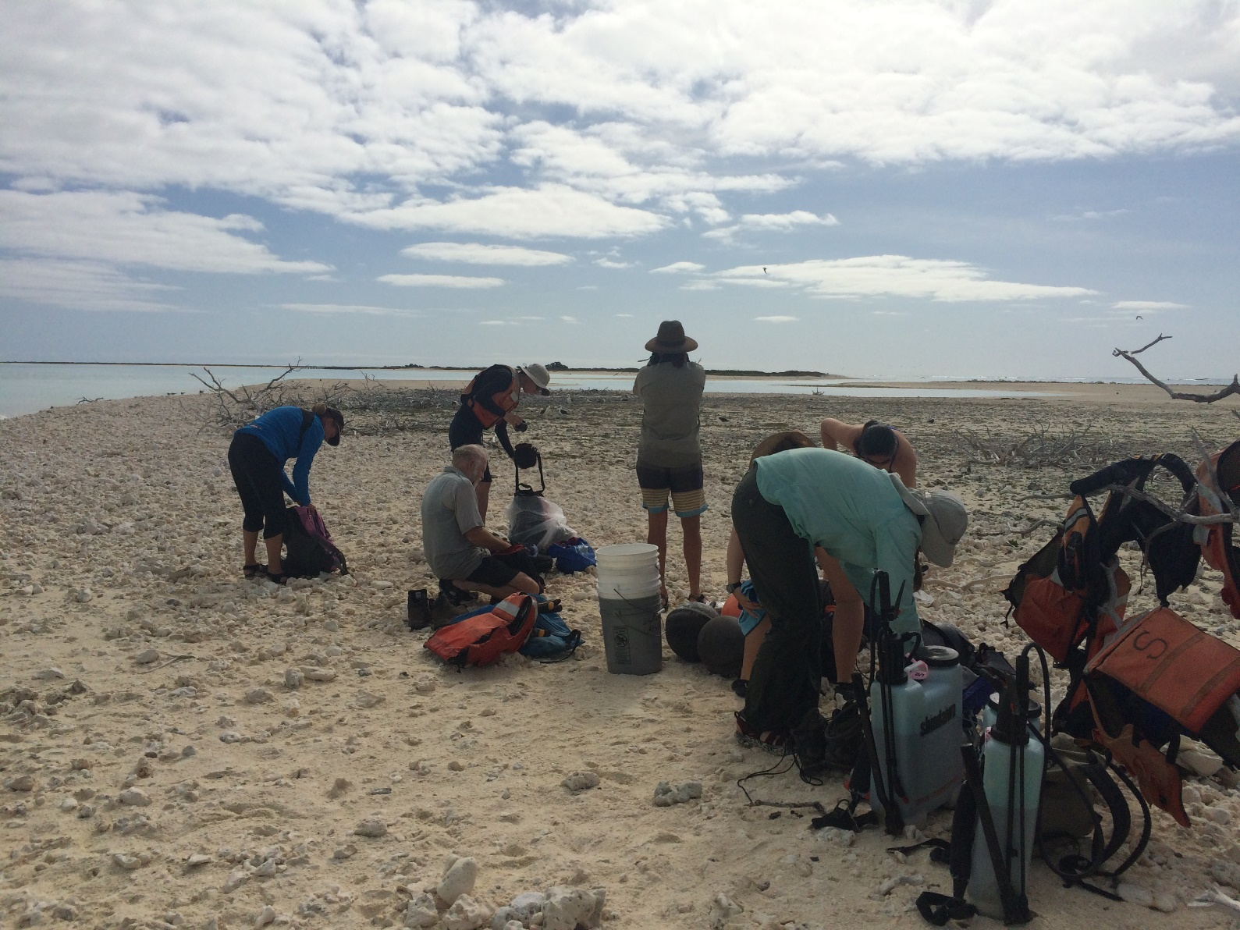
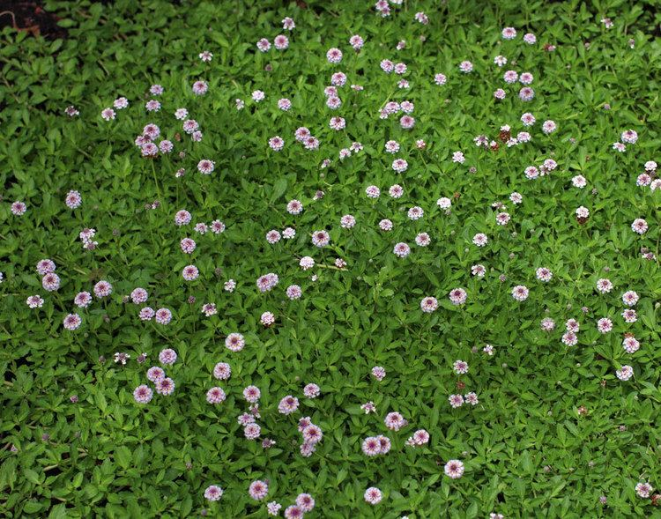
Not always bad…

Slide 38
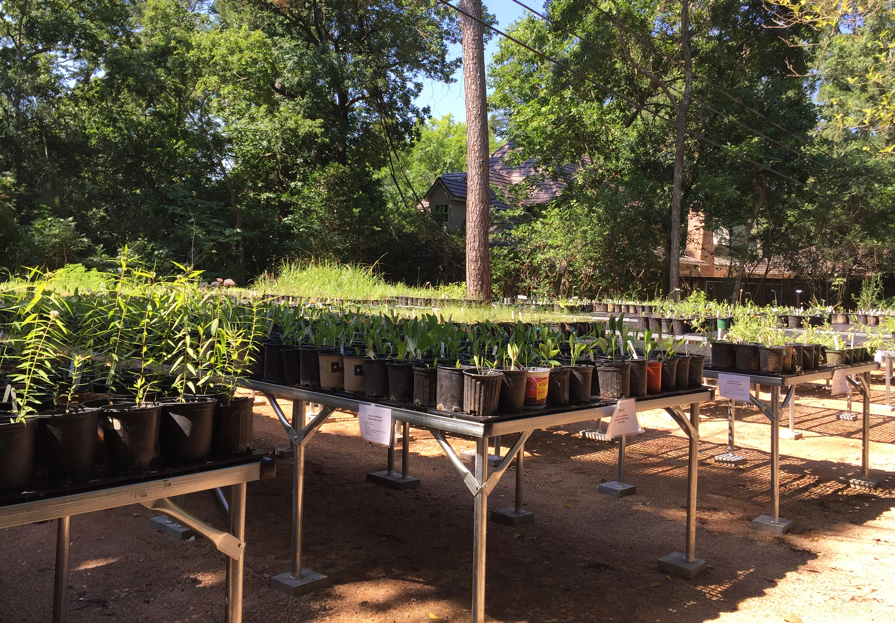
Notes:
Last November, the Houston Audubon Natives Nursery underwent a large expansion that included the addition of tables, irrigation, and increased the capacity. We now carry over 60 species of native plants that are sold for restoration and for our Bird-Friendly Yards program.
Any volunteers from the Natives Nursery?

Slide 40


Section 2: Inviting Habitats
Quiz: Which landscape better supports birds?
A.
B.

Slide 41
Section 2: Inviting Habitats
Which landscape best supports birds?
☑
Layers provide diversity. Different birds require different habitats.

Slide 42

Structural Diversity
Over-story
Mid-story
Understory
Photo by Robert Petty
Notes:
Scientists call it structural diversity. Birds call it home. Think of it in terms of different layers or stories: trees provide the canopy layer or over-story. The mid-story layers are created by small trees and shrubs. And the understory is provided by the ground cover of grasses and broad-leaved herbaceous plants. By creating a habitat with multiple layers, you will increase the variety of birds.

Slide 43


Notes:
Blue-winged Warbler
In addition to the food and habitat provided by native plants, the most important thing to provide for birds in your sanctuary is water. Clear, fresh water for drinking and bathing.
SHALLOW WATER, MOVING, AUDITORY

Slide 44



Notes:
Providing the material for refueling is important as well. This can happen as a result of your native plants, or through the use of bird feeders

Slide 45



Notes:
NESTING AND ROOSTING: Tree snaps or OWL BOXES like for the Eastern Screech Owl
Common year round, whinny sound, cavity nesters, can build own boxes

Slide 46


Notes:
Houston Audubon has been partnering with various parks to install chimney swift towers. Woodland Park (Friends of Woodland Park). Swifts over Houston in partnership HPARD, Houston Parks Board, and TPWD. Swifts Nights Out

Slide 47


Slide 49

Section 3: Threats to Birds
How many birds do free-roaming cats kill in the US each year?
A) 350,000- 500,000
B) 1.2 million-2 million
C) 10 million-20 million
D) 2 billion-4 billion

Slide 50
Section 3: Threats to Birds
How many birds do free-roaming cats kill in the US each year?
A) 350,000- 500,000
B) 1.2 million-2 million
C) 10 million-20 million
✔ 2 billion-4 billion
According to the Smithsonian and U.S. Fish and Wildlife Service. Cats Indoors!

Slide 51

Window Collisions
Between 365 and 988 Million bird deaths per year
  About half from residential buildings
Notes:
Galveston American National Building – Spring Migration 2017 – 400 birds dead in one night

Slide 52

Lights Out Action Alerts

Slide 53


Pesticides
Areas with higher than 19.43 ng/L of imidacloprid concentrations, the average rate of decline of birds was 3.5 percent annually (Hallman et al., 2014)
  A 30 percent decline over 10 years
  The higher the pesticide concentration the more severely the bird populations dropped.
Notes:
“A single corn kernel coated with a neonicotinoid can kill a songbird,” Palmer said. “Even a tiny grain of wheat or canola treated with the oldest neonicotinoid — called imidacloprid — can fatally poison a bird. And as little as 1/10th of a neonicotinoid-coated corn seed per day during egg-laying season is all that is needed to affect reproduction.” American Bird Conservancy
https://www.smithsonianmag.com/science-nature/popular-pesticides-linked-drops-bird-population-180951971/

Slide 54


Plastic
Nearly every seabird has been recorded ingesting plastic
A recent study observed plastic in dead American Oystercatchers

Slide 56
How can I be part of the Bird-Friendly Communities movement?
✔Enjoy birds
✔Volunteer at the Natives Nursery
✔Join the Bird-Friendly Yard Program
✔Visit birdfriendlyhouston.org
✔Become a member of Houston Audubon
✔Talk to your neighbors
✔Ask questions at your local plant nurseries

Slide 57

DESIGNING PLANT COMMUNITIES FOR RESILIENT LANDSCAPES
“For too long, planting design has treated plants as individual objects placed in the garden for decoration. ….. In contrast to the spirited spontaneity of wild vegetation, the landscapes of our yards, office parks, and cities are plastic assemblies of overused evergreens sheared into meatballs and vast seas of mown lawns.”
Principle 5: Management, Not Maintenance

Slide 58

Notes:
Be inspired by nature

Slide 59


Slide 60

Urban Gardening
Pathways, feeders, Coreopsis, Texas coneflower, Eastern gamagrass, Indianblanket and wildlife everywhere.
Notes:
Be inspired by others doing the same thing

Slide 61


Garden in Small Spaces
native plant garden
ELMNS

Slide 62


Slide 63

Notes:
Layers—ground, grasses, shrubs, canopy. Not all natives, “transitional” to natives. Avoids lawn, diverse native trees,

Slide 64


Slide 65
Focal
point
Decorative
value
Anchor
Screens
Past criteria for our landscapes
Doug Tallamy
Notes:
The landscaping industry and our own views of a “beautiful lawn” has been dominated by things such as decorative value.

Slide 66
Wildlife
appreciation
Mental
health
Screens
weather
moderation
Decorative
value
soil
restoration
Focal
point
Food web
value
watershed
value
Anchor
carbon
sequestration
Future criteria for for our landscapes
Doug Tallamy
Notes:
But we must balance this by adding back the values that nature already provided for free—food webs, soil retention, carbon sequestration, and frankly, in my opinion, a beauty unrivaled by any manicured lawn.

Slide 67

The Bird-Friendly Yard
  Native plant for food
  Layers of habitat
  Water
  Shelter & nest sites
  Limit threats
  Connect with others
Notes:
Do everything I have mentioned, and you'll end up with a yard like this: high diversity of plant species, and LAYERS of vegetation to meet birds' different needs: Tree canopy, shrub layer, ground cover and leaf litter.
In summary...
Plan for birds throughout their annual cycle
FOOD: native plant foods for all seasons
LAYERS: plant in layers to provide structural diversity in your habitat
WATER: Provide a source of clean, fresh water
SHELTER: Provide shelter for roosting and nesting sites.

Slide 68
What’s Happening at Houston Audubon?
Birdathon!
  Kick-off Workshop on March 8
Summer Camp registration open!
  Spring break camp at ELMNS
  Summer camp at ELMNS, HAREC, and Yorkshire academy
Speaker Event: Birding in Madagascar – March 12 at the United Way
Monthly Urban Bird Surveys
  13 across Houston
Notes:
Plant lists, upcoming details, volunteer opportunities and details, all BFY materials/application

Slide 69
Volunteer with Houston Audubon
Application form can be found at www.houstonaudubon.org
Monthly volunteer work days at ELMNS, High Island, Dos Vacas, and HAREC
Natives Nursery volunteers
Office/admin volunteers needed!

Slide 70


Thank you!
Anna Vallery
avallery@houstonaudubon.org
Notes:
Larkspur

