Slide 1
Current ISSUE 2020: Water Resources Management
Envirothon Teacher Training
January 25, 2020

Slide 2
Water Resource Management is an Economics exercise
Supplies:
Surface Water
Groundwater
Reuse Water
Rainwater Harvest
Seawater Desal
Users:
Industry
Agriculture (70%)
Muncipal
Residential
Commercial
Ecosystems

Slide 3
You can’t manage what you don’t have…
Supply: there is a hazy upper limit to this, affected by many factors
Somewhat Fixed sources
Surface water
Groundwater
Flexible but expensive sources
reuse water
Seawater Desalination

Slide 4
You can’t manage what you don’t have
Demand: We seem to think this side can grow without limits
Growth Users
Industry
Municipal
Stable or Declining
Agriculture
Ecosystems

Slide 5
Externalities*
Climate Change
Drought
Higher evaporation rates
Changing precipitation patterns
Pollution
Reduced water quality = reduced water quantity for certain uses
Degraded infrastructure
Results in loss of already developed water resources
*None of these actually removes water from the system. They just move water away from the source or distribution
system, or make it more expensive to treat the water before use.

Slide 6
Water Resources Management is Local!
Look at data taken from Texas Water Development Board on water use at the state level and by county

Slide 7
Water Sources are local, TOO
Look at Texas Water Development Board data on Aquifers: how much water is available and where is it?

Slide 8
Surface Water Sources
Look at TWDB information on the San Jacinto and Trinity Rivers
http://www.twdb.texas.gov/surfacewater/rivers/river_basins/index.asp
These are average annual flows, so they will change with climatic changes

Slide 9
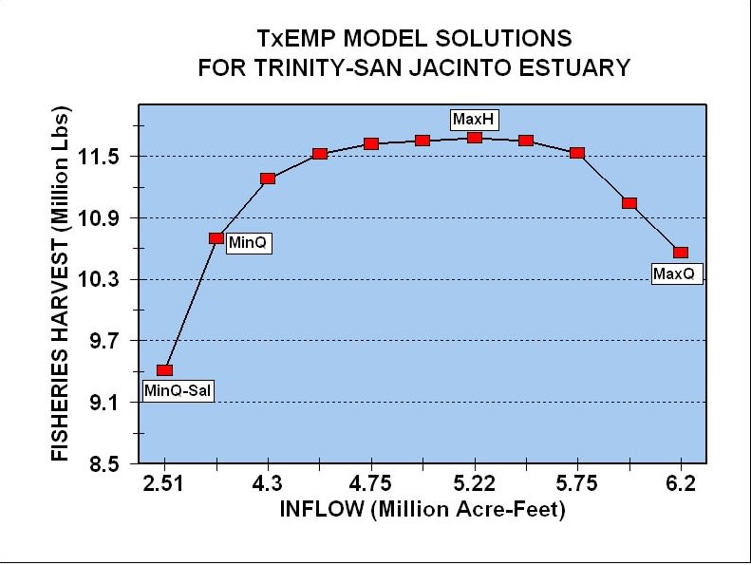
Surface water and Environmental Flows
Environmental flows are the amount of water needed to maintain healthy instream and downstream ecosystems
Graphic from TWDB

Slide 10
But Surface and Groundwater Supplies are Connected…
We cannot replace directly surface water supplies with groundwater
Doing this affects
in-stream flows
Ecosystem health in wetlands and other hydrologically connected ecosystem
And May cause locality-specific impacts

Slide 11
Subsidence in the Houston Area
https://hgsubsidence.org/science-research/what-is-subsidence/
All the bullseye contours correspond to areas of large, industrial groundwater withdrawals
If you substitute groundwater for surface water, the aquifer compacts and will no longer hold water as it did before.

Slide 12
To manage Water resources…
We must manage supply (Quantity)
Water law for surface water: Riparian Doctrine and Prior Appropriation
If your land borders a surface water body, you may use water from it
If you were the earliest to take water from a surface water body, you have seniority in using it
In texas, you have to apply for a permit to use riparian rights OR prior appropriation
Water “law” for Groundwater
A certain acreage allows you to pump a certain volume annually
In TX: The law of the biggest pump: you have the right to pump as much as you want from a well on your property, even if it makes your neighbor’s well go dry

Slide 13
To Manage Water Resources…
We must manage water Quality (supply)
Regulatory programs
NPDES permits
Stream Standards
Non-regulatory programs
Stormwater management
Nonpoint source pollution reduction (urban areas and agriculture)

Slide 14
To manage water resources…
We must develop innovative methods…
To reuse municipal wastewater
To harvest and use rainwater (note that this reduces instream flows!)
To recycle industrial wastewater
To use less water in industrial processes
To cool power plants in new ways
To detect and repair water infrastructure

Slide 15
To Manage Water Resources…
We must manage Demand (users)
Financial incentives to reduce water consumption for industrial and municipal users
Restrict development in water-poor areas
Establish conservation plans for droughts
Use water-saving technology in buildings
Teach water conservation in school

Slide 16
To manage water resources…
We must address climate change!

Slide 17
OR…
The END…

