Slide 1
Aquatics
2019 Envirothon Workshop
Presented by: Krystyn Krafka

Slide 2
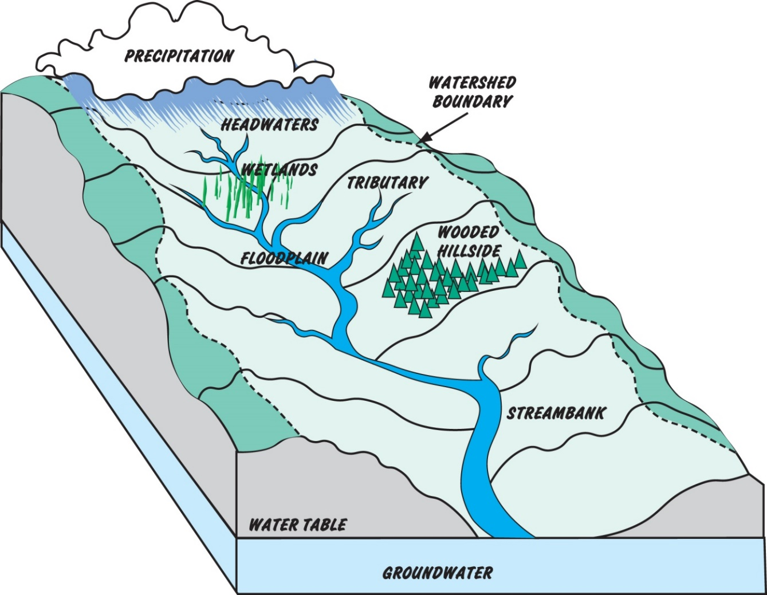
What is a Watershed?
  “A watershed is an area of land that drains all the streams and rainfall to a common outlet such as the outflow of a reservoir, mouth of a bay, or any point along a stream channel. The word watershed is sometimes used interchangeably with drainage basin or catchment….The watershed consists of surface water--lakes, streams, reservoirs, and wetlands--and all the underlying ground water.” - USGS
Notes:
https://www.google.com/url?sa=i&source=images&cd=&ved=2ahUKEwiboPPm7PXfAhVCPawKHbL4A24Qjhx6BAgBEAM&url=http%3A%2F%2Faccdpa.org%2Fwp-content%2Fuploads%2F2014%2F03%2F%3FC%3DD%3BO%3DD&psig=AOvVaw0ieS506G02qmWeYAm6KBgZ&ust=1547849985066439

Slide 3
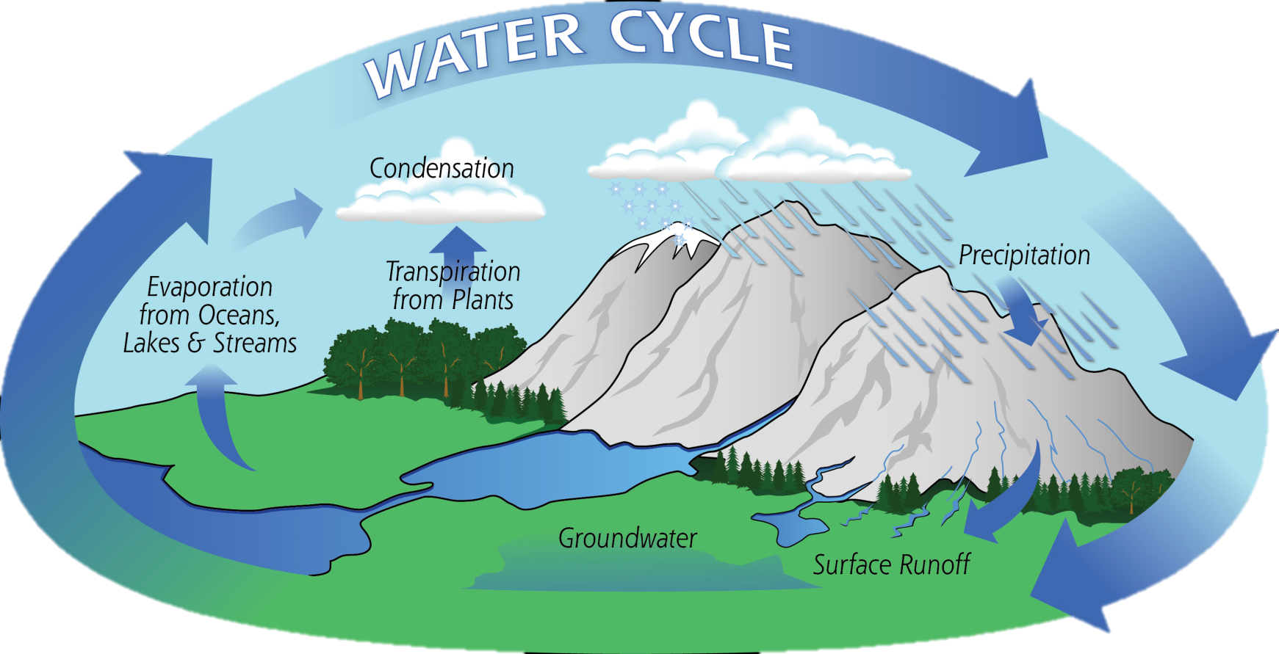
Water Budget
ΔS = P – E – ET ± SRO ± GF
Notes:
Image source: https://pmm.nasa.gov/education/water-cycle

Slide 4
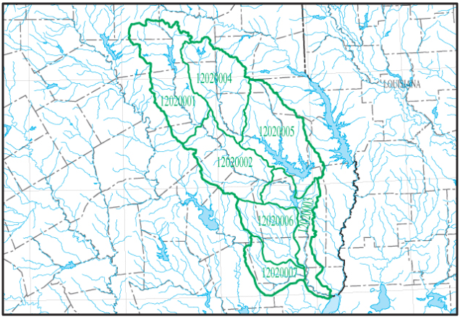
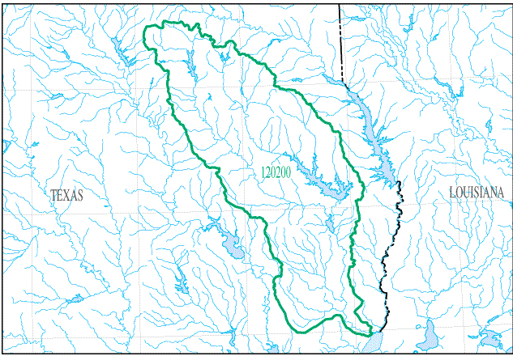
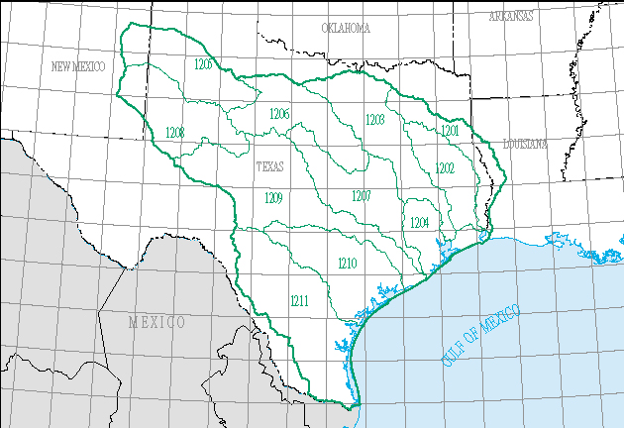
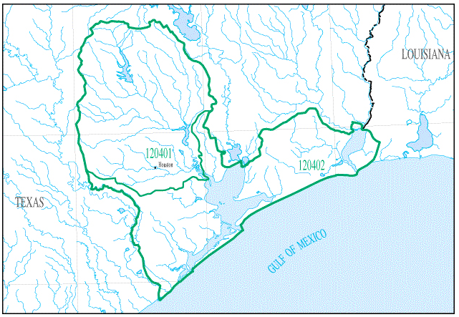
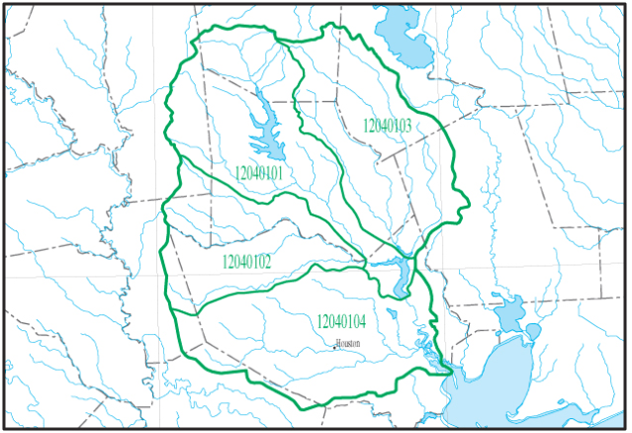
Find Your Watershed
Go To: https://water.usgs.gov/wsc/reg/12.html

Slide 5
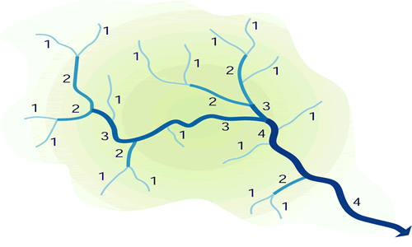
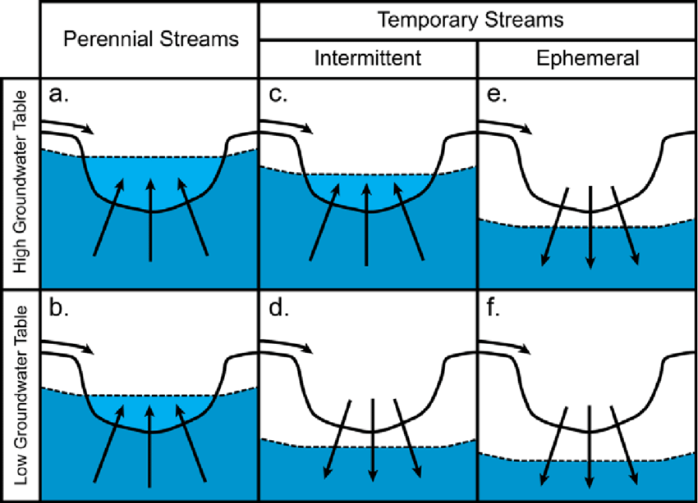
Stream Order vs.
Stream Type
Jacob D. Hosen
Notes:
https://www.researchgate.net/publication/263473320_Temporary_streams_the_hydrology_geography_and_ecology_of_non-perennially_flowing_waters

Slide 6
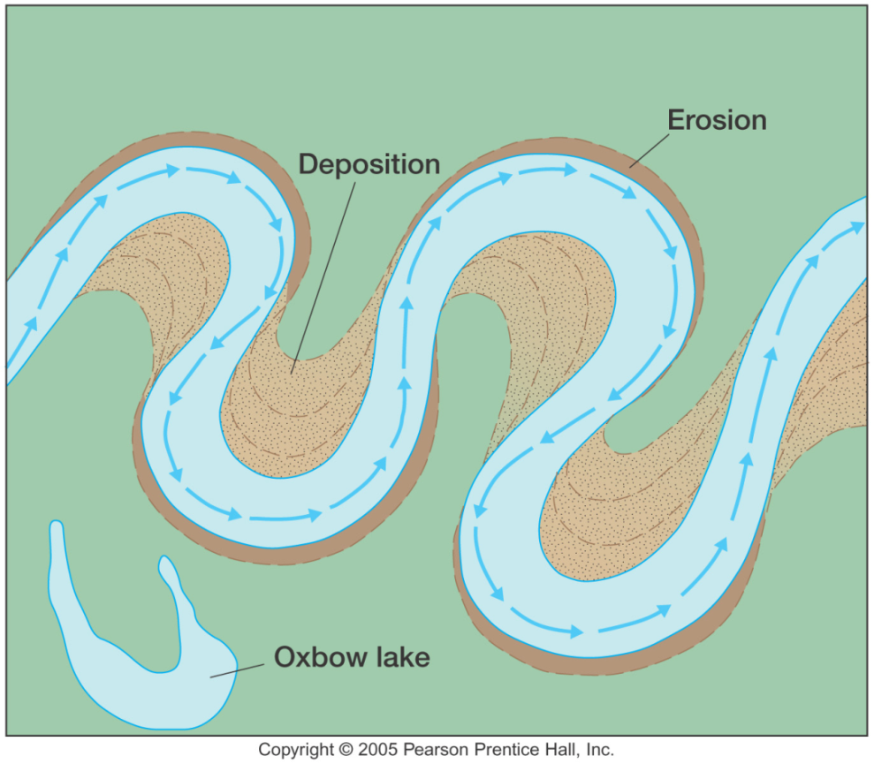
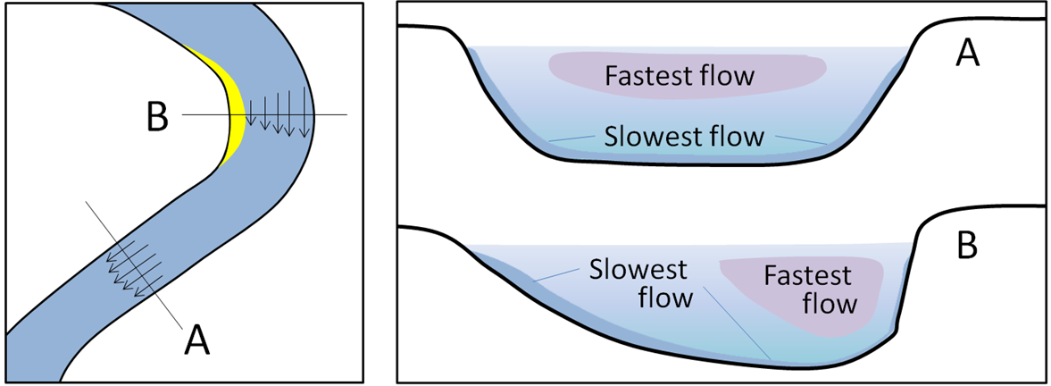
Healthy vs. Unhealthy Streams
Notes:
http://web.gccaz.edu/~lnewman/gph111/topic_units/fluvial/fluvial2.html
https://opentextbc.ca/geology/chapter/13-3-stream-erosion-and-deposition/

Slide 7
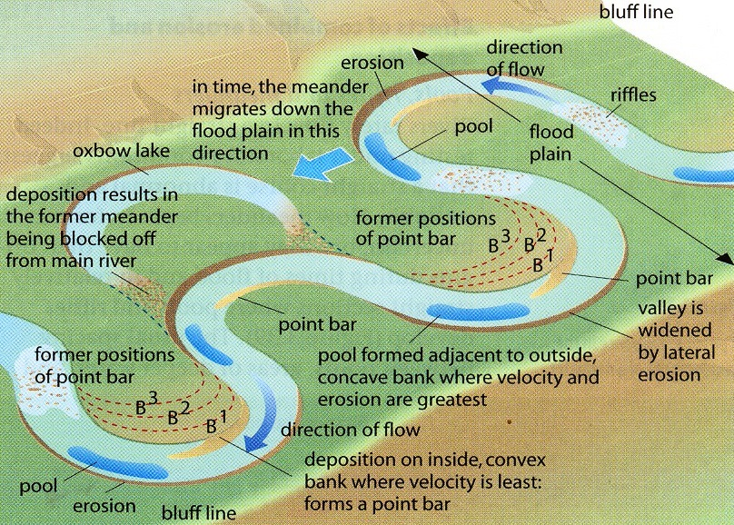
Oxbow Lakes
Notes:
https://geographyiseasy.wordpress.com/2013/11/04/as-formation-of-meanders-and-ox-bow-lakes/

Slide 8
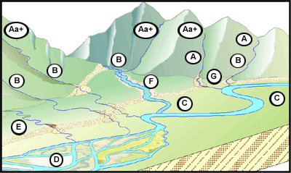
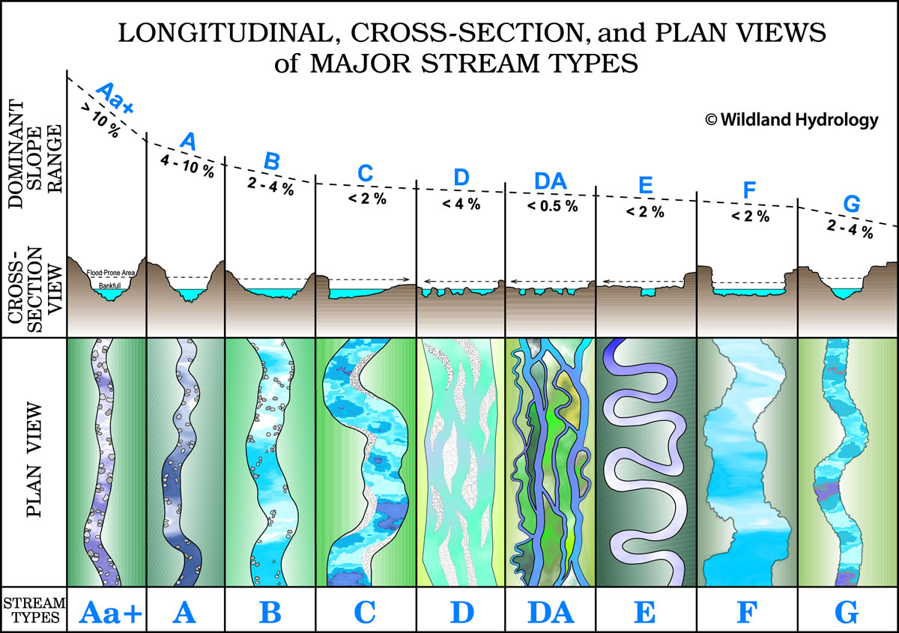
Types of Streams
Notes:
https://wildlandhydrology.com/resources/docs/River%20Restoration%20and%20Natural%20Channel%20Design/Rosgen_2011_Natural_Channel_Design.pdf

Slide 9
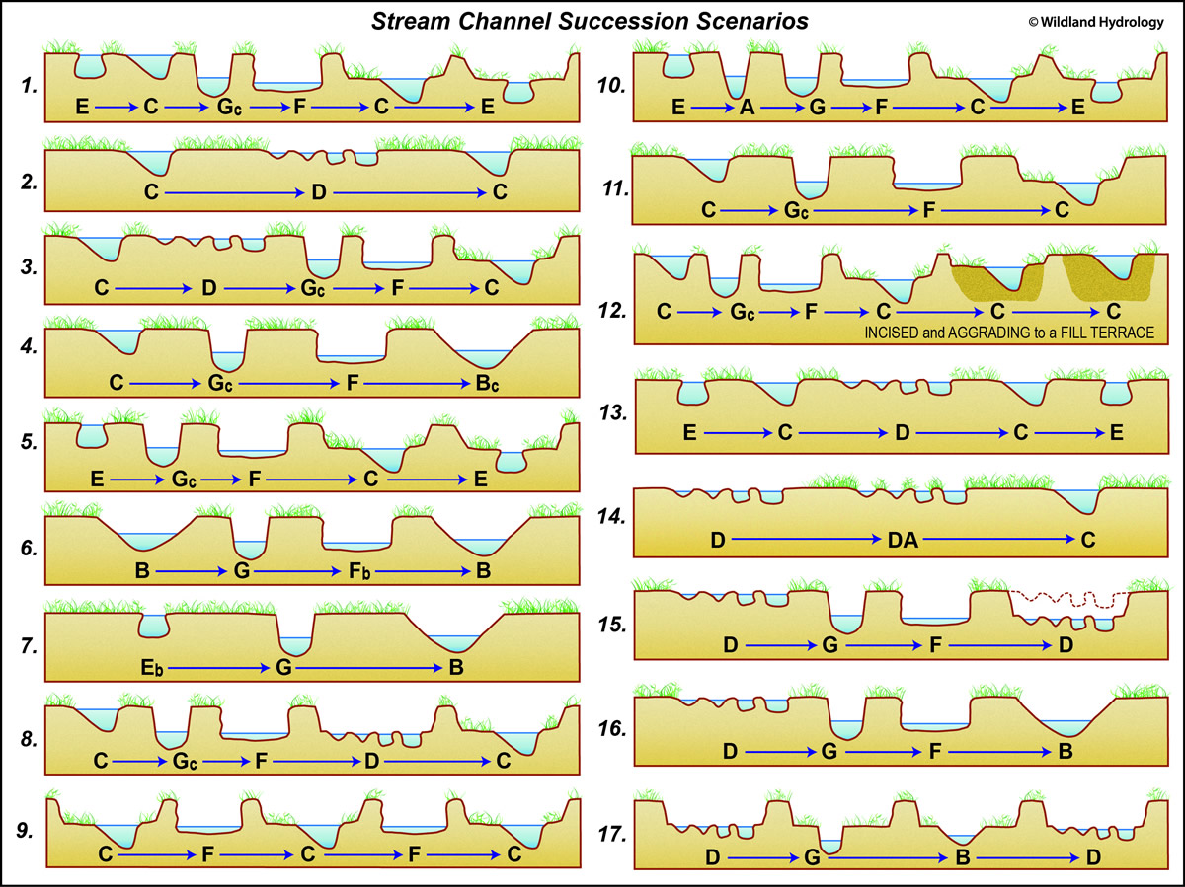
Stream Channel Succession
Scenarios
Notes:
https://wildlandhydrology.com/resources/docs/River%20Restoration%20and%20Natural%20Channel%20Design/Rosgen_2011_Natural_Channel_Design.pdf

Slide 10
What is a Wetland?
Depressional areas found primarily in the floodplains of rivers and streams
  Can be either flood or rainfall driven
  Can be forested or herbaceous
  Requires hydrology, hydric soils, hydric vegetation
Wetland Delineation (1987 Manual)
  Atlantic and Gulf Coastal Plain Region
Also called swamps, bogs, potholes, marshes
Notes:
Highlights

Slide 11
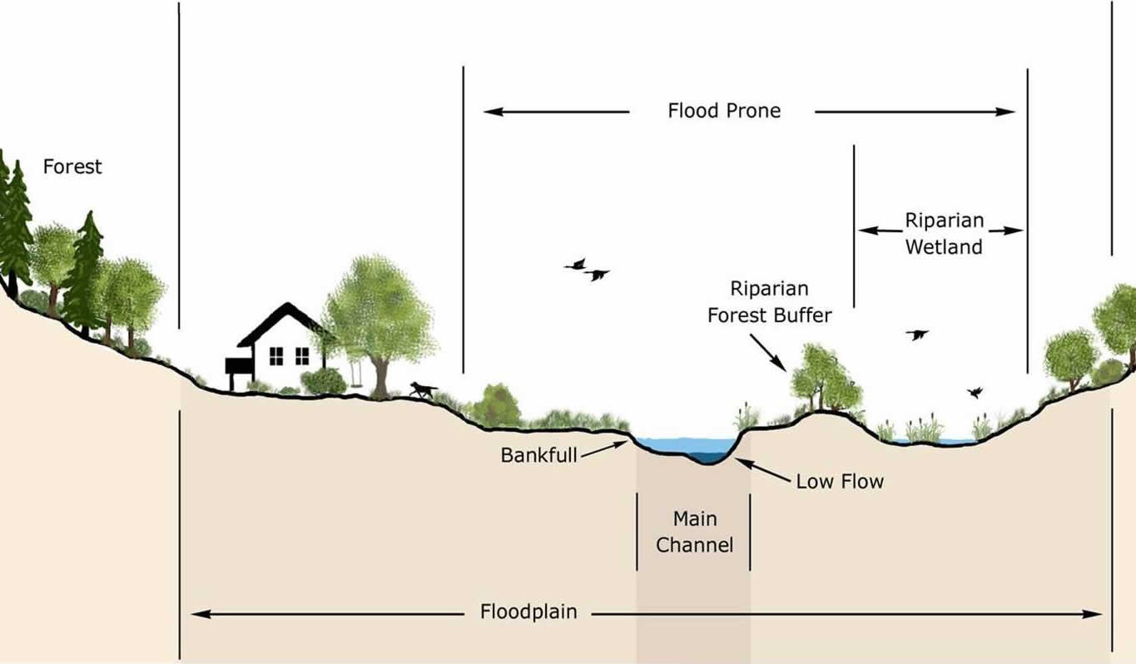
How Do We Get Wetlands?

Slide 12
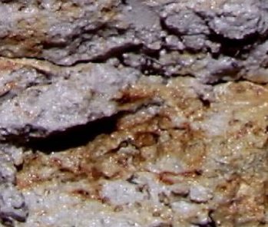
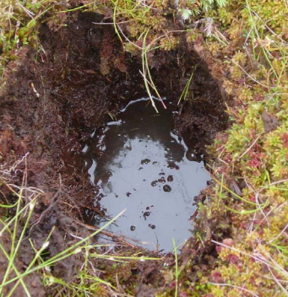
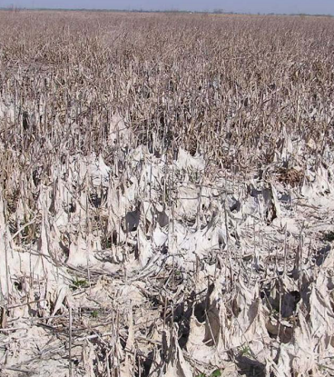
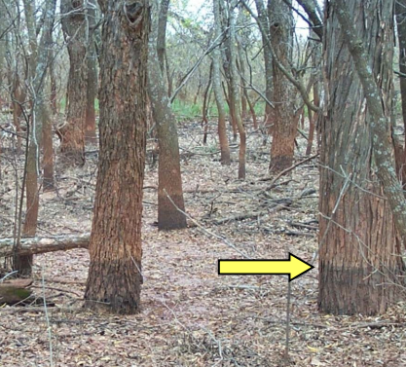
Hydrology Indicators
Surface Water/Saturation (per the growing season)
High Water Table
Water Marks
Drift Deposits
Algal Mats or Water-stained leaves
Notes:
All images: https://www.sas.usace.army.mil/Portals/61/docs/regulatory/Workshop_Hydrology_Fall2011.pdf

Slide 13
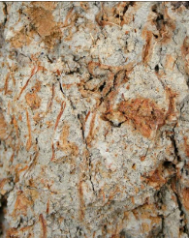
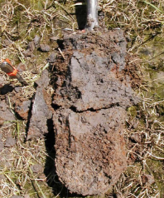
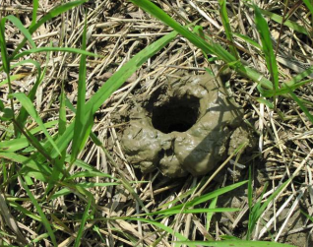
Hydric Soils
Oxidized Rhizospheres along living roots
Redox Features (mottled soils)
Soil Color (10YR, 3/2 or less)
Soil Texture (Shrink Swell)
Organic matter accumulation
Crawfish burrows

Slide 14
Hydrophytes
“Water-loving”
More so water resistant or water tolerant
Obligates and Facultative Wet (FACW)
Fringe wetlands will be a mix of FACW and FAC, maybe a few FACUpland.

Slide 15
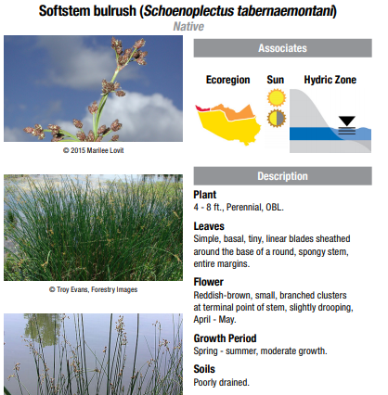
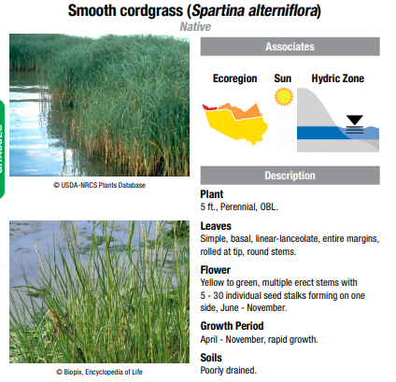
Native Vegetation
Notes:
https://www.hcfcd.org/media/1974/wetland-guide-final.pdf

Slide 16
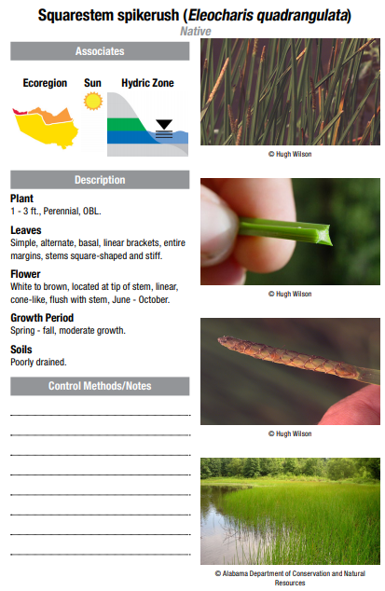
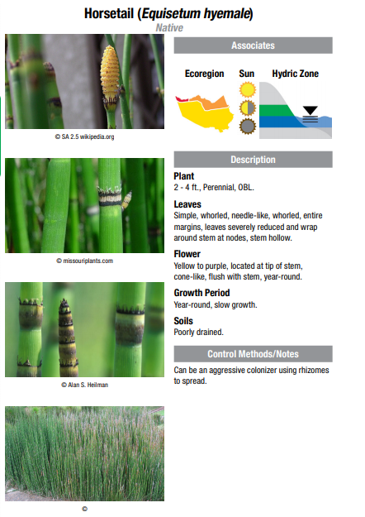
Native Vegetation
Notes:
https://www.hcfcd.org/media/1974/wetland-guide-final.pdf

Slide 17
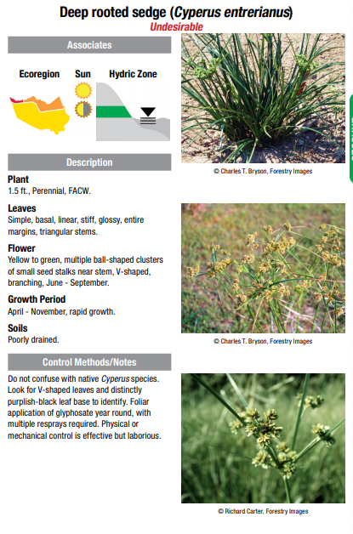
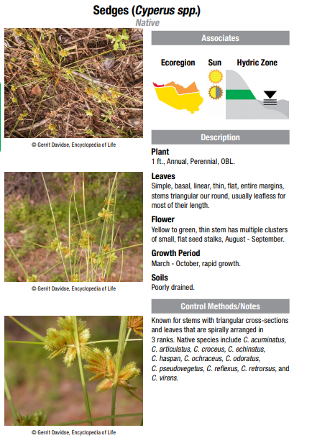
Native Vegetation
Notes:
https://www.hcfcd.org/media/1974/wetland-guide-final.pdf

Slide 18
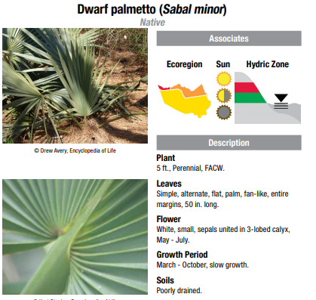
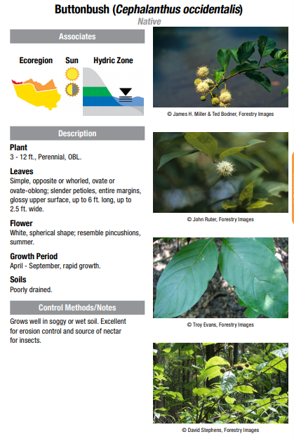
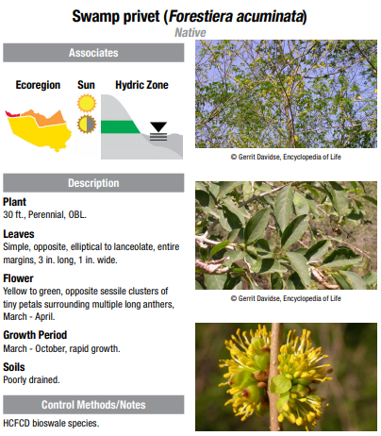
Native Vegetation
Notes:
https://www.hcfcd.org/media/1974/wetland-guide-final.pdf

Slide 19
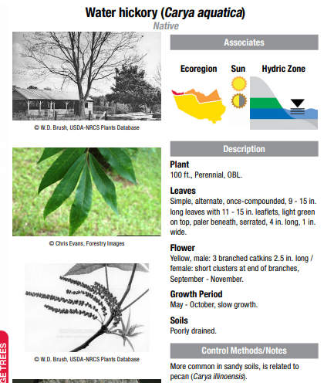
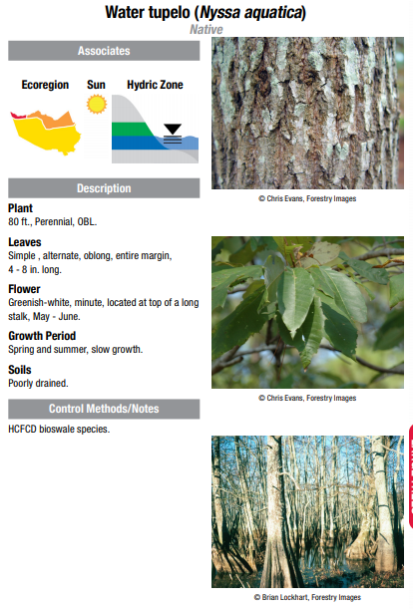
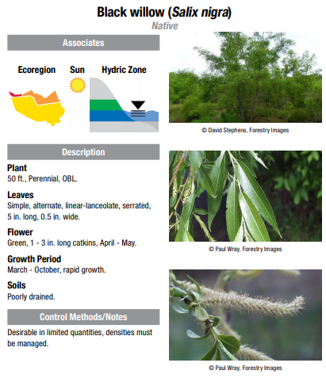
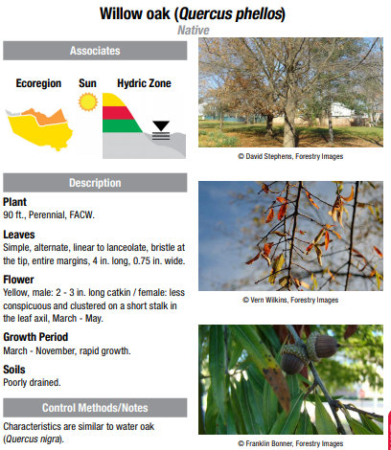
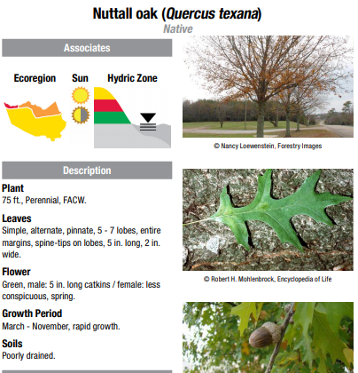
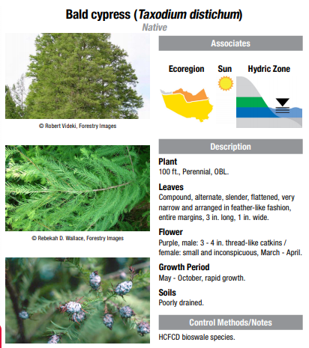
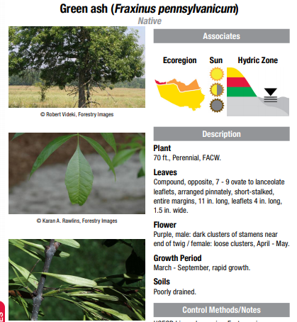
Native Vegetation
Notes:
https://www.hcfcd.org/media/1974/wetland-guide-final.pdf

Slide 20
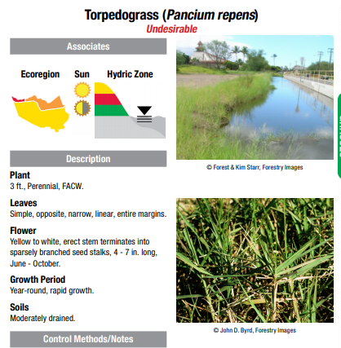
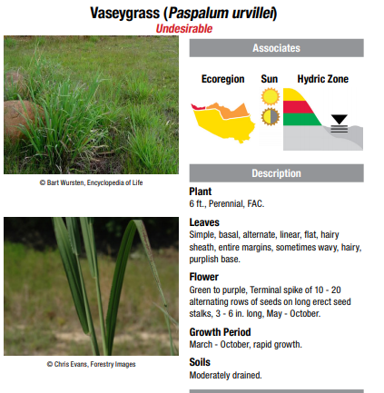
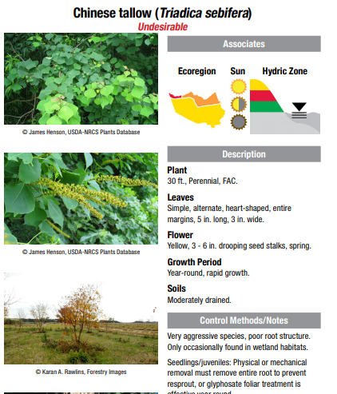
Wetland Invasives
Notes:
https://www.hcfcd.org/media/1974/wetland-guide-final.pdf

Slide 21
Benefits of
Wetlands
Filters Water
Slows storm surge (tidal)
Flood control
  reduces inland flooding
  Increases percolation/reduces run-off
Recharges our aquifers
Migratory species habitat
Home to critical flora and fauna
Recreation and Aesthetics

Slide 22
Threats to Wetlands
Agriculture(historically)
Development
Pollution

Slide 23
History of Wetland
Protection
Swamp Lands Act (1849, 1850, 1860)
Rivers and Harbors Act (1899)
Panama Canal
NEPA (1970), requirements for EA and EIS
Clean Water Act 1972 and 1977
1985 FSA defined “wetland”
Bush Administration “No Net Loss” (1989)
Wetland mitigation pops up in 1990
40 CFR 230.98 Newest Mitigation Guidance (2008)
Notes:
Environmental Assessments (EA) and Environmental Impact Statements (EIS)
https://history.state.gov/milestones/1899-1913/panama-canal
http://www.thebeatnews.org/BeatTeam/history-federal-wetland-protection/

Slide 24
What is Mitigation
Banking
In according to the regulations, compensatory mitigation means the restoration (re-establishment or rehabilitation), establishment (creation), enhancement, and/or in certain circumstances preservation of wetlands, streams, and other aquatic resources for the purposes of offsetting unavoidable adverse impacts which remain after all appropriate and practicable avoidance and minimization has been achieved.
Site where aquatic resources are established, restored, enhanced, or preserved to offset losses of aquatic resources
A wetland is given a functional score; restoration provides an uplift, and we receive credits based on the functional uplift
Operates like a financial institution
The USACE deposits credits into bank ledger
HCFCD sells those credits as mitigation for permitted impacts to aquatic resources
Notes:
You could imagine how difficult this could be- you impact 1 acre of wetland, and now you have to go find an acre suitable for a wetland, restore it, monitor it for years, turn in reports to USACE- all because you needed to build a power substation. Those people are not in the line of work for wetland restoration.

Slide 25
How Mitigation Credits
Works
Every wetland must be delineated and it’s function must be calculated.
USACE currently accepts iHGM method

Slide 26
Interim Hydrogeomorphic
Model
Measuring the function and value of a wetland
Takes into account:
  Vdur: The % of the WAA that is flooded and/or ponded due to the hydrology (i.e. flooding overbank flow) of the adjacent waterway
  Vfreq: The frequency that the WAA is flooded and/or ponded by nearby waterway.
  Vtopo: The roughness associated with the WAA
  Vcwd: Coarse Woody Debris within the WAA
  Vwood: Percentage of the WAA that is covered by woody vegetation
  Vtree: Percentage of the trees in the WAA that are mast producers
  Vrich: The diversity of the species within the WAA (To be considered the species must comprise at least 5% of the stand)
  Vbasal: The average/mean basal area of the trees in the WAA per acre
  Vdensity: The average density of the WAA stand (Tree is woody with over 3” dbh)
  Vmid: The average/mean coverage of the midstory (shrub/sapling) layer in the WAA
  Vherb: The average/mean coverage of the WAA by the herbaceous layer
  Vdetritus: The amount of the detritus on the WAA (A horizon has to have a value of 4 or less)
  Vredox: The amount of the WAA that exhibits redox features an indication of the chemical exchange
  Vsorpt: The absorptive properties of the soils in the WAA (At least 50% of the WAA must be present to be a 1.0)
  Vconnect: the number of habitat types within a 600’ of the parameter of the WAA (Habitat to be counted has to be at a minimum 5% of the size of the WAA)
Notes:
https://www.swg.usace.army.mil/Portals/26/docs/regulatory/functional%20Assessment/SWGRiverineForestediHGM.pdf

Slide 27
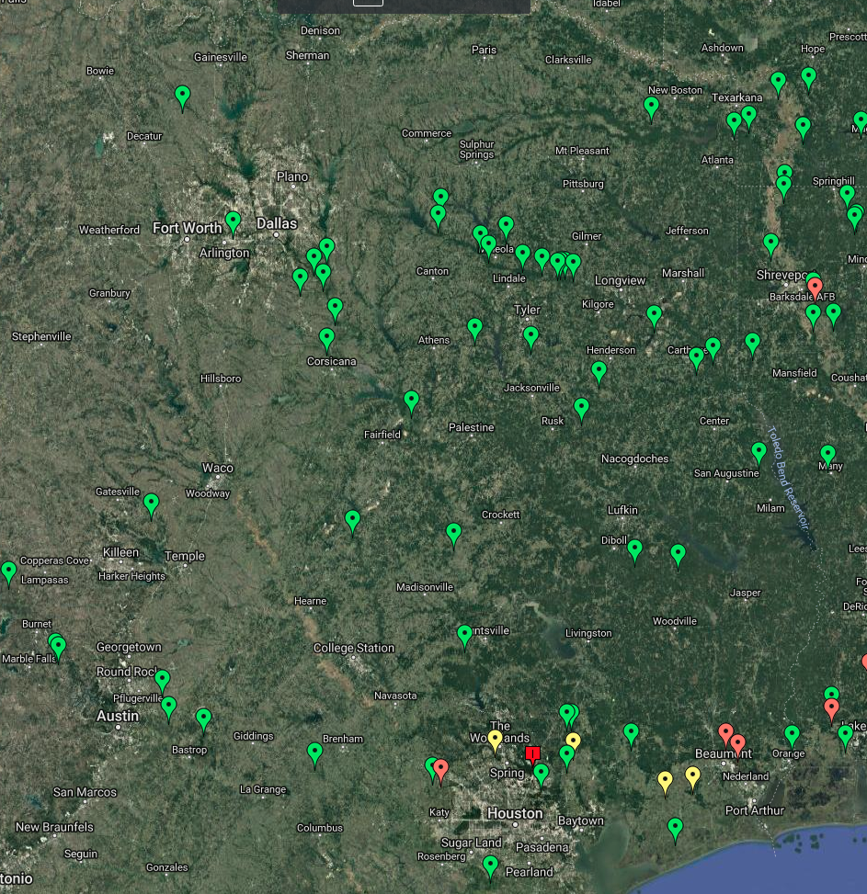
Notes:
Amount of mitigation banks in East Texas
You can see them along rivers (floodplains)
Need for mitigation in respect to development
Screenshot taken from ribits.mil

Slide 28
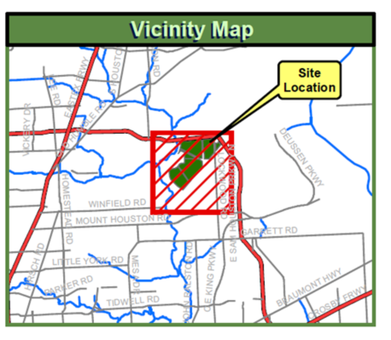
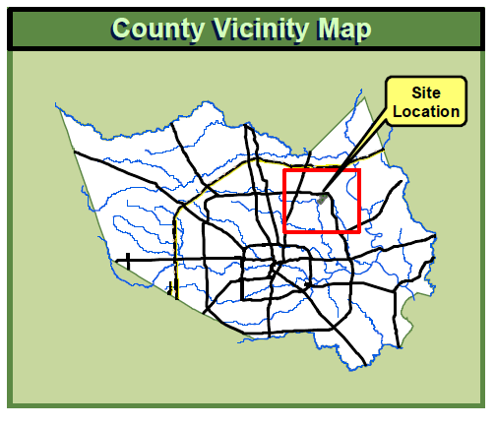
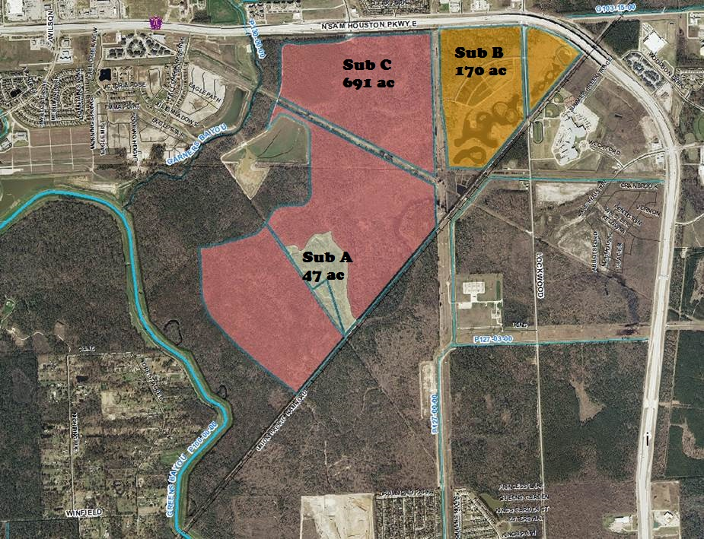
Greens Bayou Wetlands
Mitigation Bank
1000 acres of protected and restored wetlands both forested and emergent- Inside the beltway
Notes:
Location: Bounded by Greens & Garners Bayous
1st Bank in Galveston District, 1995
Property about 1200 acres, includes 3 subdivisions of BANK & P500-03
A: 47 acres: 1997 & 32 credits
B: 170 acres (Two Phases) 1999
I: 100 credits
II: 24 credits (2008)
C: 691 acres – Construction starting in 2014, 200 credits
Three wetland mitigation subdivisions have been constructed and host a wide variety of habitats including:
bottomland hardwoods including depressions and old channel meanders
pine flatwoods and wet pine savannahs
deep water emergent marsh
Wet Cajun prairies
Mixed pine/hardwood forest
Remnant saline prairies

Slide 29
GBWMB Site Background
Site purchased with intent of mitigating for unavoidable wetland impacts for Harris County projects.
Three wetland mitigation subdivisions have been constructed and host a wide variety of habitats including:
  bottomland hardwoods including depressions and old channel meanders
  pine flatwoods and wet pine savannahs
  deep water emergent marsh
  Wet Cajun prairies
  Mixed pine/hardwood forest
  Remnant saline prairies

Slide 30
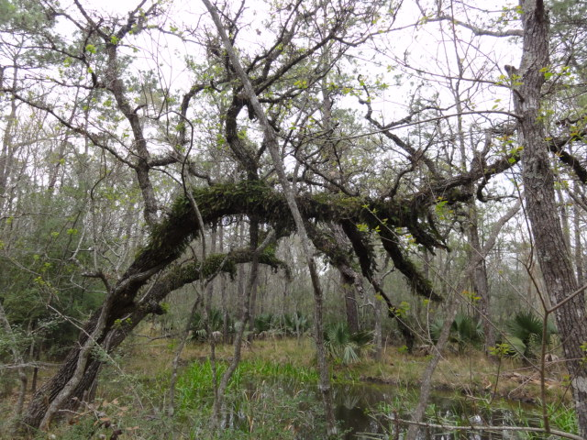
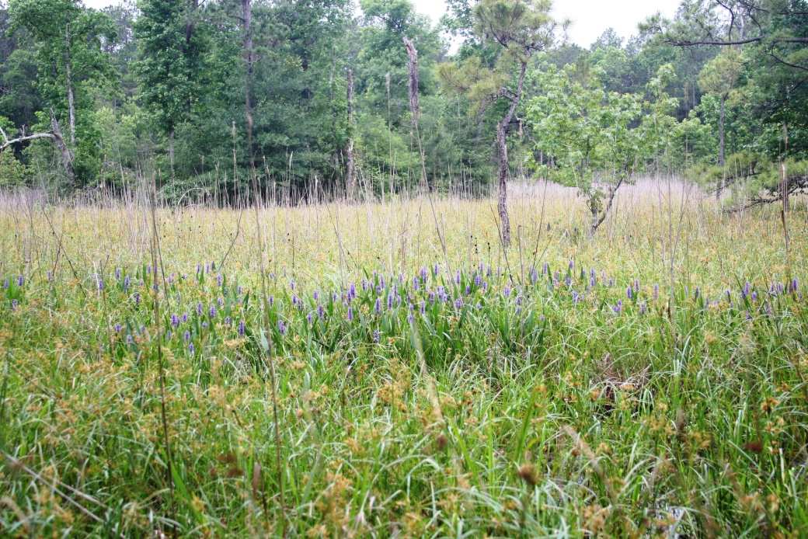
Greens Bayou Wetlands Mitigation Bank
Forested Wetlands
Emergent Wetlands
Notes:
Insert Photographs

Slide 31
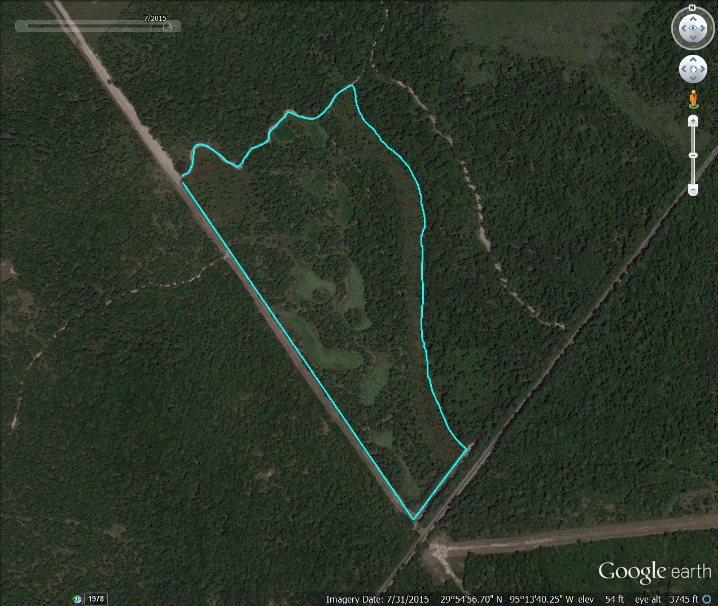
Subdivision A - 1997
Notes:
Sub A

Slide 32
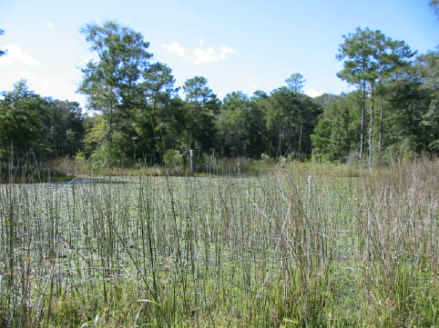


Subdivision A - Photos

Slide 33

Subdivision B - 1999
Notes:
Sub B

Slide 34




Subdivision B - Photos

Slide 35

Subdivision C - 2015
Notes:
Sub C

Slide 36

Subdivision C - Plan
Notes:
Sub C

Slide 37
GBWMB Prairies

Slide 38
Re-established Wet Prairie
Prairie visible on 1930-1940 aerials.
Area had reverted to loblolly pine, sweetgum, and Chinese tallow forest with dense yaupon understory.
Low berm constructed on west/south side of area.
Trees and brush hand/mechanically cleared in 2015
Additional native warm season grass seeding in Spring 2016.

Slide 39


Slide 40



Subdivision C - Construction

Slide 41


Winter 2015

Slide 42


Slide 43


Summer 2016

Slide 44


Spring 2017

Slide 45



Subdivision C - Photos

Slide 46




GBWMB: Operations & Maintenance
Credit Maintenance
  Annual site monitoring
  Invasive Species Control
  Property Management
  Ledgers/Financial Records
Notes:
Everything was constructed to create wetlands mitigation credits. It has to be maintained to keep those credits.
Credit maintenance: Ensure that wetlands maintain function. Monitoring for appropriate water levels & vegetation
Property management: trespassers, routine vegetation work, repairs to site structures (fences, roads, etc).

