Slide 1
TX Envirothon Teacher Training Agriculture and Climate Change
Kathleen A. Garland, PhD
UHCL
January 26, 2019

Slide 2
What is Agriculture?
Definition: The science or practice of Farming, including the Cultivation of Soil for the growing of crops and rearing of animals for food, Wool, and other products (https://www.google.com/search?client=firefox-b-1-ab&q=Definition+of+Agriculture)
Types of Farms
Industrial Ag: large-scale production, often of monocultures, by corporations
usually either crops or animals, but rarely both
Global market
Independent Farmers: large-scale production, often of monocultures, by family businesses
May involve both crops and animals
National to global market
Small farmers: Small-scale production, multiple Cultures
Regional to local market
Small holdings: very small-scale production, multiple Cultures
Supplies family and limited Local markets

Slide 3
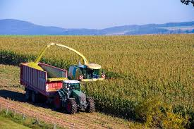
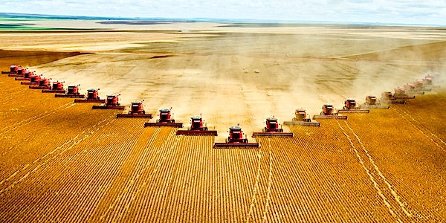
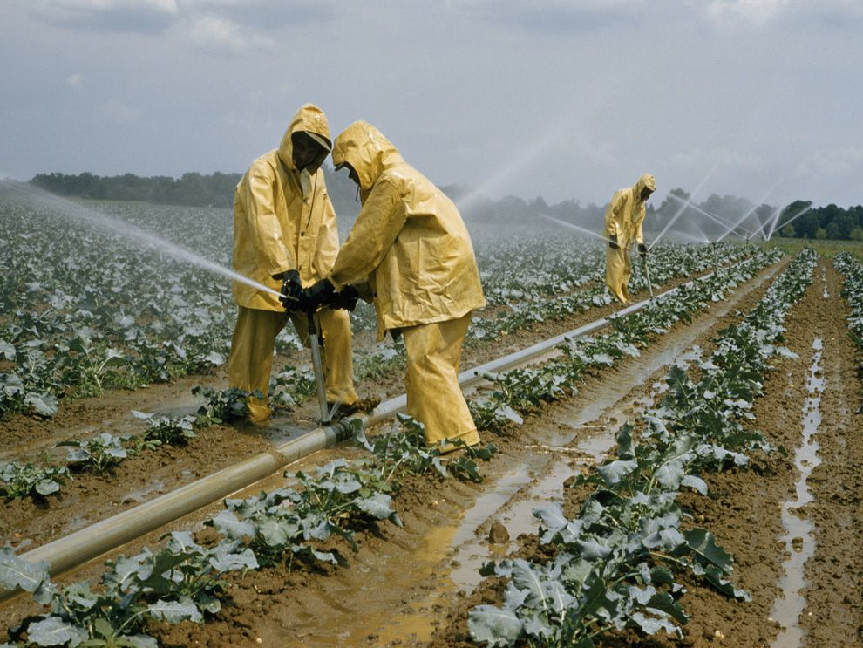
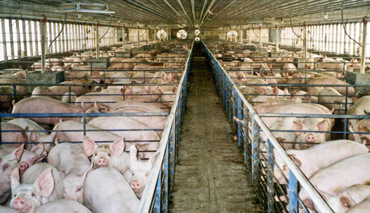
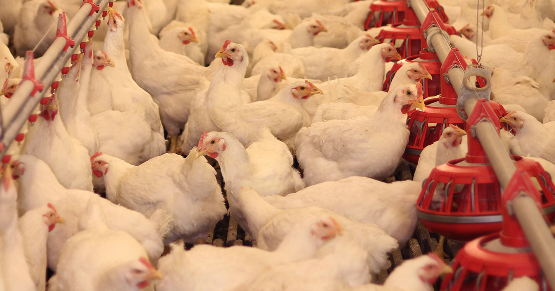
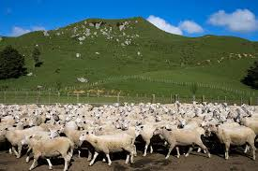
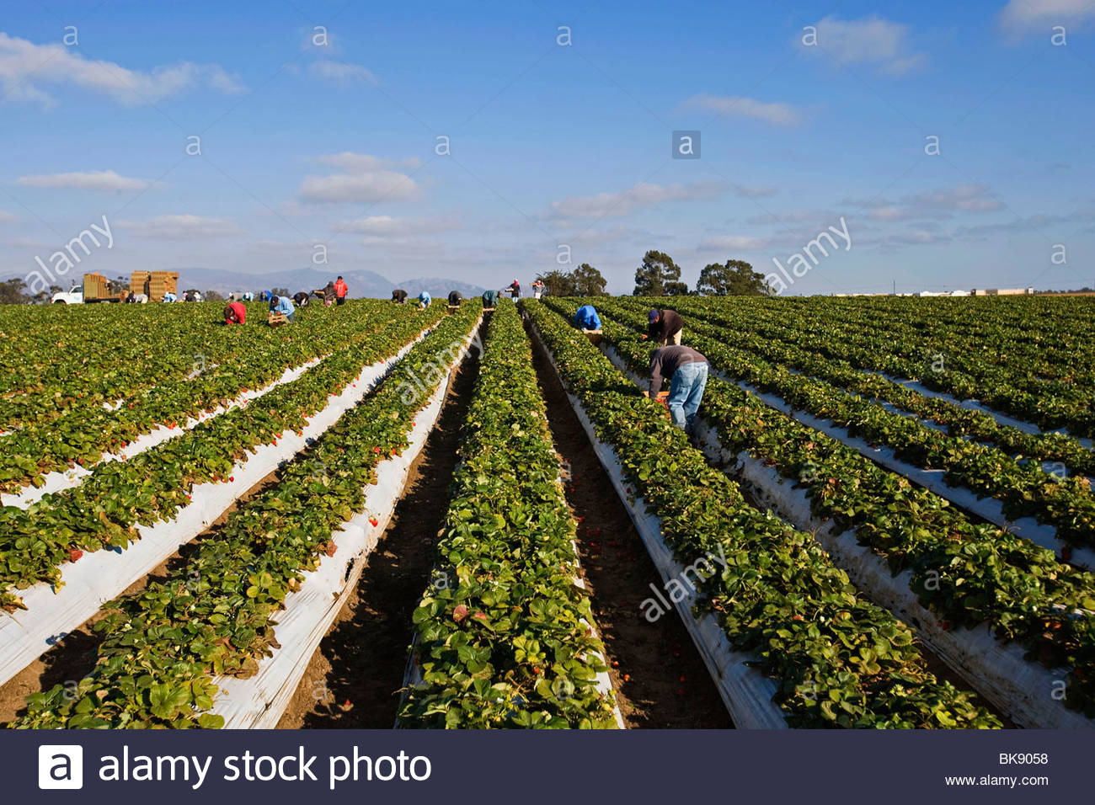
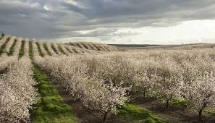
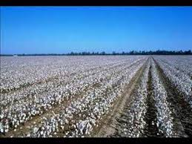

Slide 4
Similarities and variables
Similarities
Require Land—they are Place-based—but acreage varies
Require Availability of Water—rainfall and/or groundwater dependent
Require soil (plant-based ag)
Variables
Annual or perennial growth patterns for products
Self-replicating or external seed source (plants and animals)
Dry Land or irrigated
Confined or free range
Mechanized or manual labor

Slide 5
Opportunities and Threats of each type
Monocultures: enable large-scale, mechanized planting, husbandry, and harvest
Seed drills and other mechanized planting technologies
Aerial spraying of fertilizers and pesticides
Mechanized irrigation
Combines and other mechanized harvesters possible
Threats
Single-species production reduces resilience
Susceptible to large-scale pest infestation and destruction—insects, blights, etc.
Annuals: crop rotation possible; perennials: crop rotation difficult to impossible
Requires external source of pollination
Destroys soil structure over time

Slide 6
Opportunities and Threats of each type
Small Farms: ability to relocate farm products to different areas of farm
Enables rotational planting and grazing; allows no-till methods
Combined annual and perennial production
multiple products restricts pest threats to certain areas of farm
Supports local pollinators and seed sources
Threats
labor intensive
Water, nutrients, and pesticides must be customized across holding
Failure of annual crops threatens economics of perennials

Slide 7
Opportunities and Threats of each type
Small holdings: Most vulnerable and most adaptable
Allows customized production of crops and animals on acreage
Low-cost, frequently unpaid manual labor for planting, husbandry, harvest
Threats: high-stakes operation
May not be self-sustaining without success of all production
Pests and diseases threaten family physical and economic survival
Requires external seed and pollinator source

Slide 8
Climate: Elements that Affect AGriculture
Temperature: affects rate of photosynthesis and respiration
Avg. daytime; avg. nighttime; diurnal range; annual range, esp. max and min
all factors affect crop growth, esp. avg. nighttime temps
Precipitation: water availability, irrigation demands and schedule, recharge, soil moisture, erosion rates
annual avg; max and min for individual events; frequency and distribution of events across growing season; intensity and duration of individual events
Wind: evapotranspiration rates; physical effects; position and timing of weather systems
Max speed; prevalent direction; position of jet streams; distribution of wind speed and direction across growing season
Climate cycles: El Nino and La nina, Atmospheric Gyres, long-term circulation patterns, ocean currents

Slide 9
Determining Factors of Climate Impacts: Generalities
Time frame: climate changes slowly, so perennial crops are generally affected more than annual crops, as annual crop choice can be varied
Location: farms have set locations: as climate changes, farming practice must change, including crop choice, husbandry methods, and water supply
Animal husbandry is affected less than crops
Pest and diseases move with atmospheric conditions—warmer, wetter conditions foster more pest development

Slide 10
Determining Factors of Climate Impacts: Specifics
Tipping points on soil stability: soils are stable in the climate where they developed. Increased wind, decreased humidity, increased rainfall intensity and duration can increase rates of soil loss
Dry Land ag more susceptible than irrigated, as it depends on consistent local rainfall
Some crops cannot withstand increased storm frequency and intensity or changes in timing of events within the growing season

Slide 12
Climate-resilient agricultural methods
Hydroponics: climate-controlled environment
Free-range animal husbandry: reduces greenhouse gas emissions
Polyculture
Regenerative Farming and Grazing
Biodiversity in seed sources
Hybridization for optimization of crop to climate
GMOs?

Slide 13
https://www.patagoniaprovisions.com/pages/unbroken-ground-1
https://www.patagoniaprovisions.com/pages/regenerative-organic-agriculture

