Slide 1
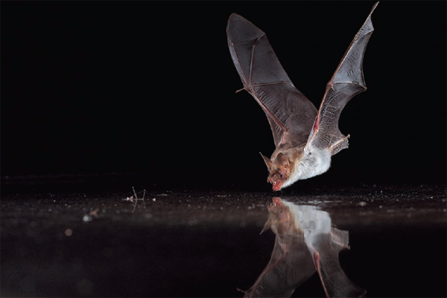
TEXAS ENVIROTHON
WILDLIFE
Diana Foss
TPWD Wildlife Biologist
Diana.foss@tpwd.texas.gov

Slide 2
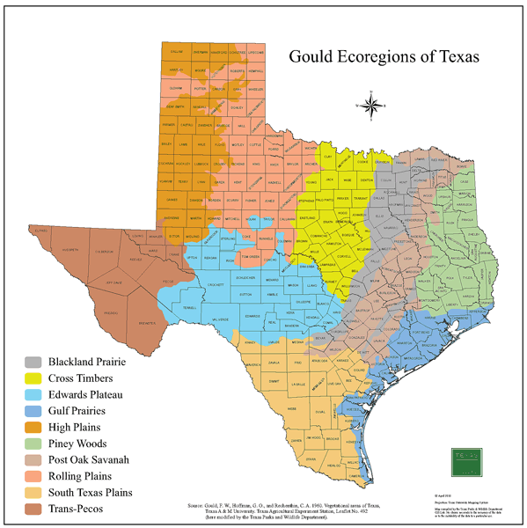
Hill Country
Edwards Plateau
Based on:
soils & geology
Precipitation
vegetation

Slide 3
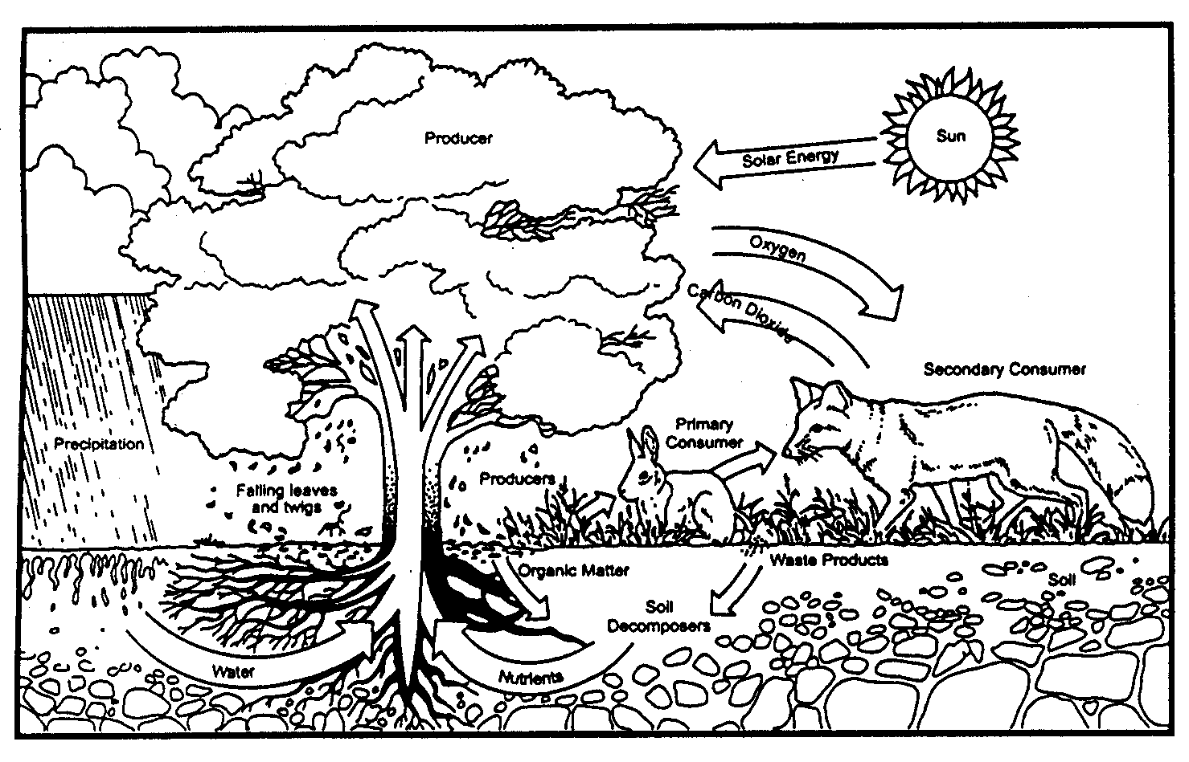
ECOSYSTEMS
Understand How the Pieces Fit Together

Slide 4
Ecosystem Characteristics
Trophic Relationships
Producers (Autotrophs) Those organisms capable of producing their own food, primarily via photosynthesis.
Herbivores (Primary Consumers) Organisms obtain their energy directly from plants.
Primary Carnivores (Secondary consumers) Those organisms obtaining their energy from herbivores.
Secondary Carnivores (Tertiary consumers) Those organisms obtaining their energy from other carnivores.
Detritivores (Decomposers) Those organisms obtaining their energy from dead plants and animals

Slide 5
Food Web
Red Shouldered
Hawk
Coachwhip
(snake)
Whiptail
(lizard)
Mockingbird
Tertiary consumer
Common Toad
Praying Mantis
Scorpion
Secondary consumer
Field Mouse
Cricket
Grasshopper
Prey to Predator
Primary consumer
Plants
Producers

Slide 6
Ecological Concepts
Carrying capacity of an ecosystem or habitat
Limiting factors on a population
Successional stages
Overgrazing w/Browse Line
Young, regrowth – at or below carrying capacity

Slide 7
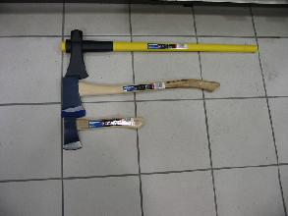
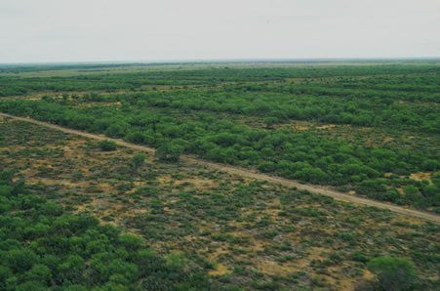
Habitat/Wildlife Management Tools
(Aldo Leopold)
axe
plow
cow
fire
gun

Slide 8

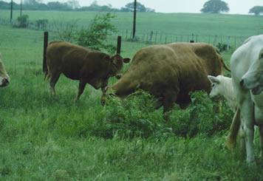
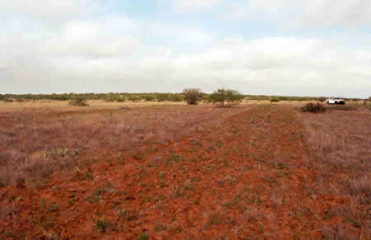
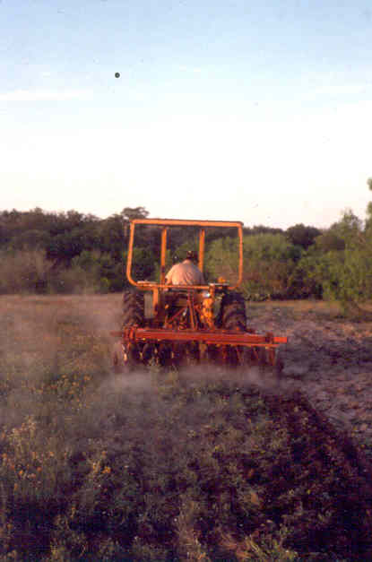
Cow
Maintains ecosystem at a successional stage
Hoof Action – creates bare soil, softens hard surfaces for water inflow
Open space – allows ground nesting bird hatchlings space to roam
Reduce old grass - mimics bison herds roaming through, creating new sprouts
Rotational Grazing
Plow
Encourage forbs ”weeds”
Establishing foodplots

Slide 9
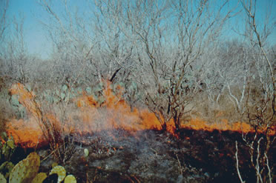
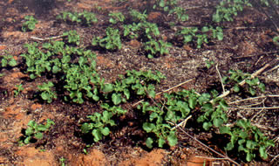
Maintains ecosystem at specific successional stage
Increases light and moisture
Controls invasives and undesirable trees/shrubs
Cycles nutrients between soil & vegetation
Increases vegetative diversity
Fire

Slide 10
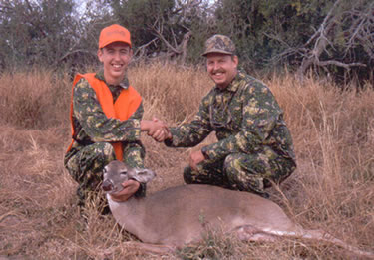
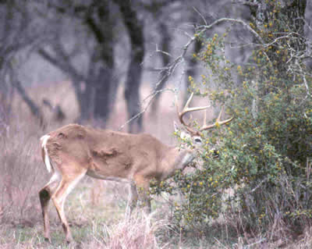
Gun
Population control
Disease control
Includes any lethal removal methods

Slide 11
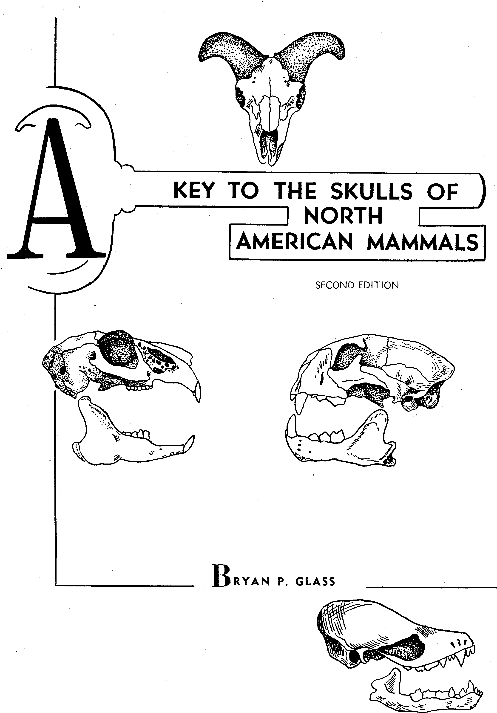
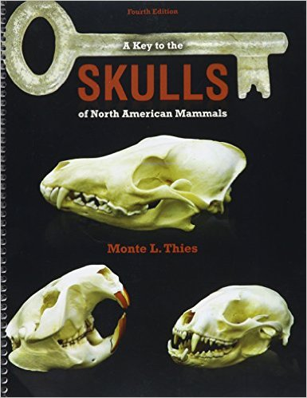
Using A Dichotomous Key

Slide 12
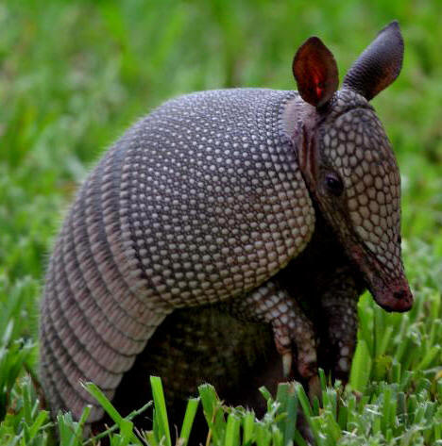
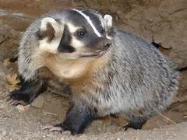
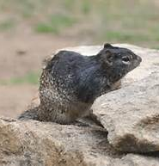
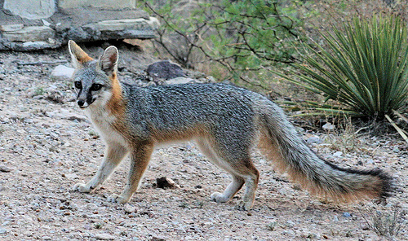
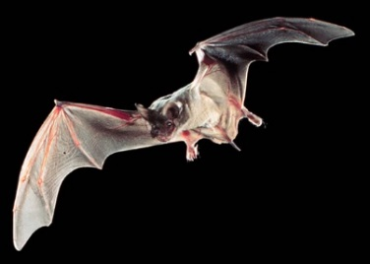
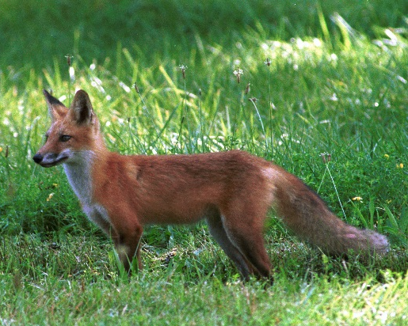
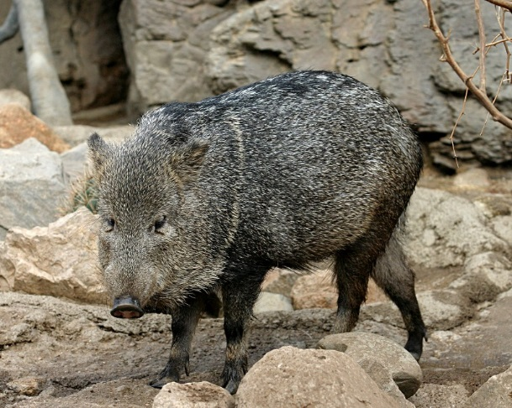
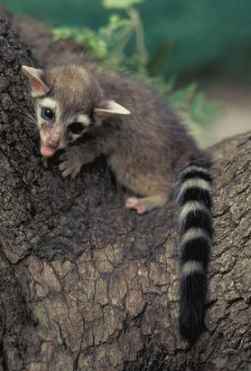
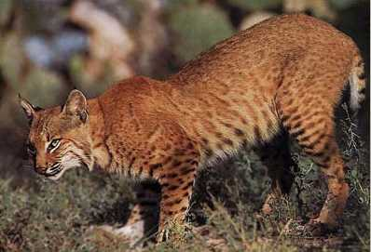
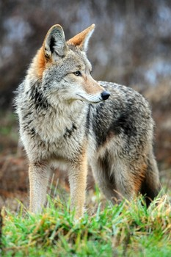
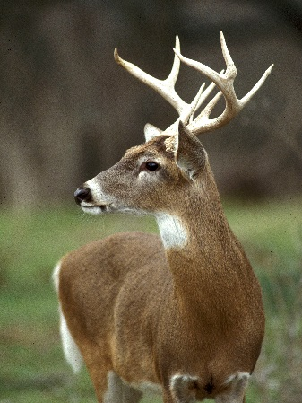
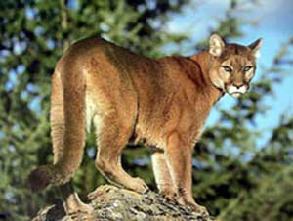
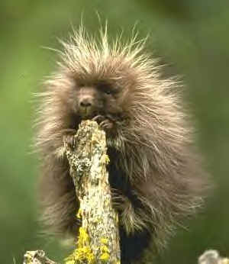
Nine-banded armadillo
Rock squirrel
Gray fox
American badger
Red fox
Collared peccary
Bobcat
Coyote
White-tailed deer
Ringtail
Mountain lion
Porcupine

Slide 13
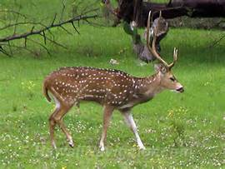
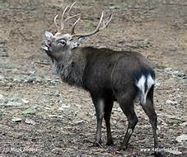
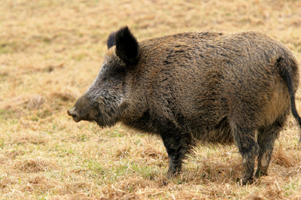
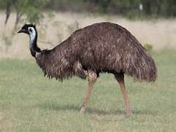
Introduced Animals
Axis deer
Sika deer
Fallow deer
Red deer
Scimitar-horned Oryx
Eland
Aoudad/Barbary Sheep
Blackbuck antelope
Nilgai
Greater kudu
Sable antelope
Thompson’s gazelle
Emu
Feral hog

Slide 14
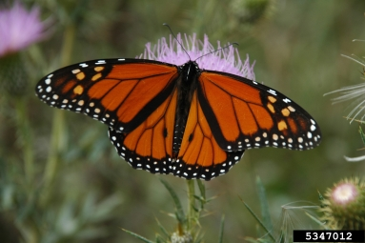
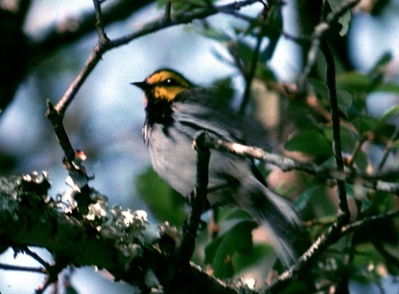
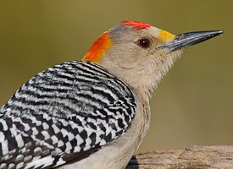
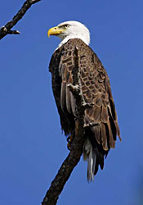
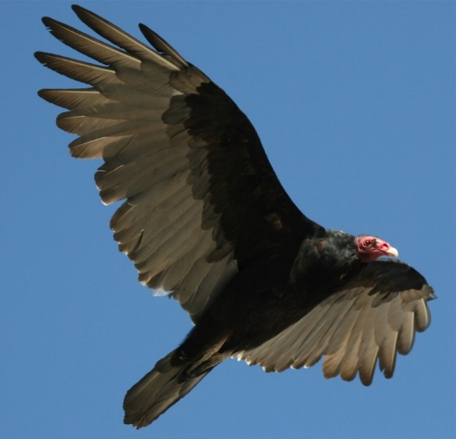
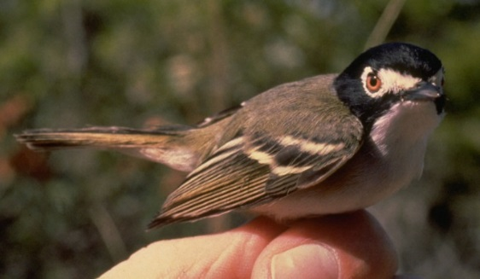
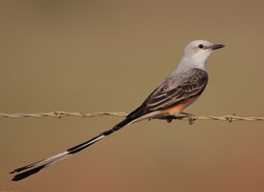
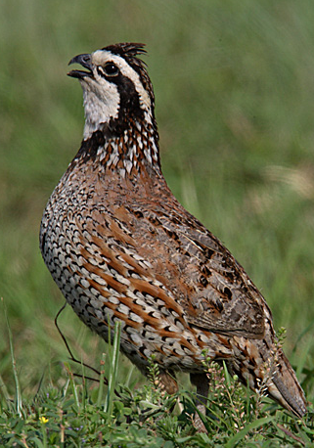
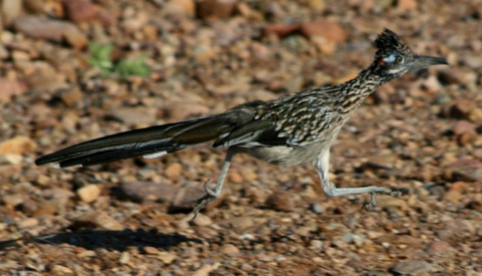
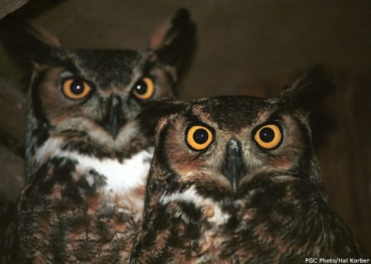
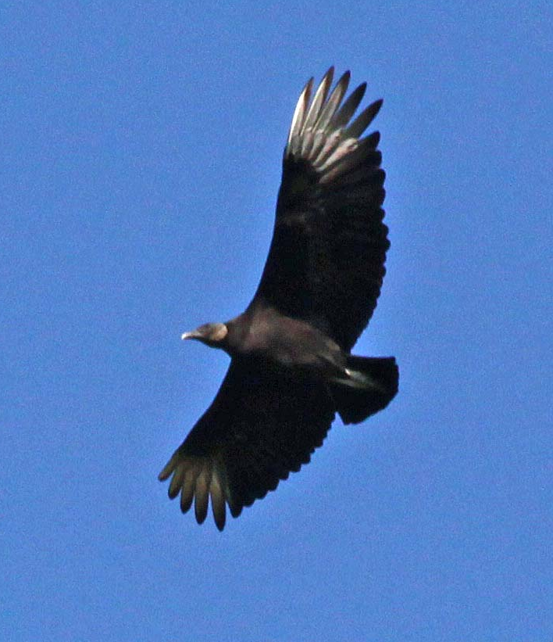
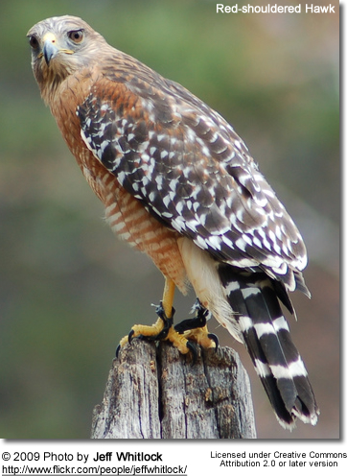
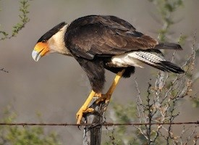
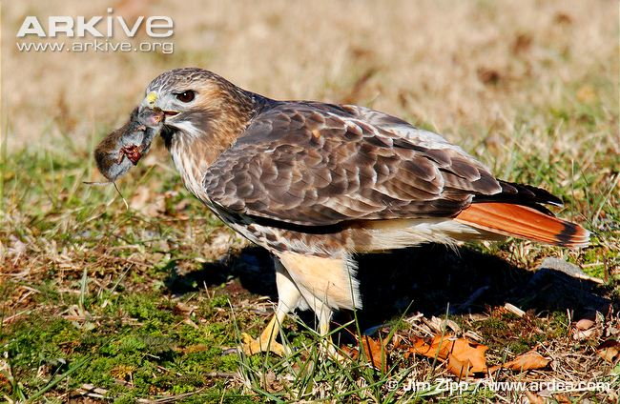
Golden-fronted woodpecker
Monarch
Golden-cheeked warbler
Turkey vulture
Black-capped vireo
Scissor-tailed flycatcher
Bald eagle
Northern bobwhite quail
Roadrunner
Great-horned owl
Black vulture
Red-tailed hawk
Crested caracara

Slide 15
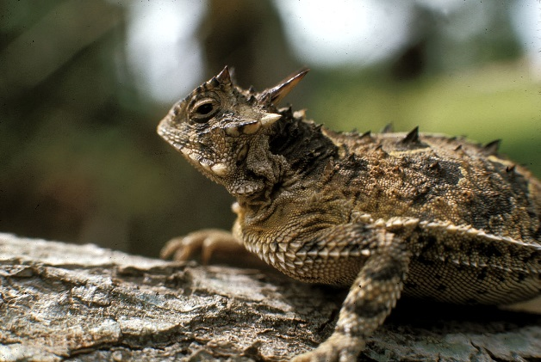
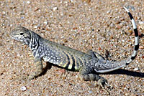
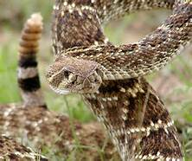
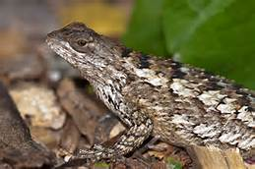
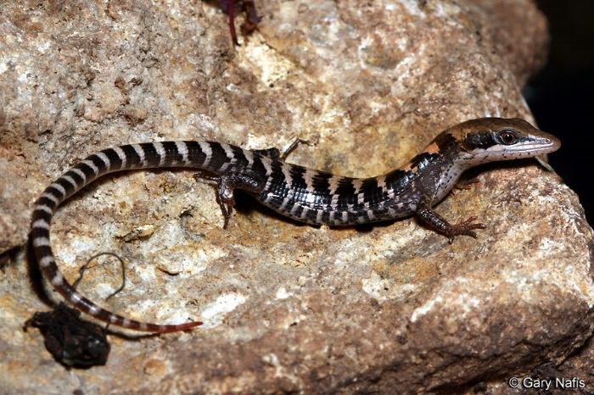




Texas horned lizard
Texas earless lizard
Western diamondback rattlesnake
Texas spiny lizard
Desert kingsnake
Texas alligator lizard (hatchling)
Lang Elliot
Woodhouse’s Toad
Texas alligator lizard (adult)
Desert/Western massasauga

Slide 16



Identification Techniques
Sightings
Sound
Tracks
Hairs
Bones/Skull
Scat

Slide 17
Classification
Kingdom Animalia
  Phylum Chordata
    Subphylum Vertebrata
      Class _______ (mammals, reptiles, birds, etc.)
        Order ______
          Family ______
          Genus
          Species

Slide 18

Skull Characteristics
Teeth – types & numbers of each
  Incisors
  Canines
  Premolars
  Molars
Eye Sockets
  monocular vision (180 degree view)
  binocular vision (almost 360 degree view)
  large eye sockets = better eyesight
Nasal Cavity - larger = better sense of smell
Auditory Bullae – larger = better hearing
Size of Skull and Brain cavity
Sagittal crest and other identifiers

Slide 19
Diet/ Dentition
HERBIVORE
  Granivore
  Frugivore
  Nectarivore
OMNIVORE
CARNIVORE
  Insectivore
  Piscivore
  Sanguinivore

Slide 20


Herbivores
Eat vegetation
Are prey animals, usually
Monocular vision, usually
Tall, flat-surfaced molar teeth
Long front incisors,
often “ever-growing”

Slide 21

White-tailed Deer - herbivore

Slide 22

American Beaver
- Herbivore
Note the upward-facing eyes

Slide 23


Prairie Dog

Slide 24



Carnivores
predators
binocular vision, usually
sharp canine teeth for holding prey
sharp molars with scissor action
Sharp claws

Slide 25

Nine-banded armadillo
- insectivore

Slide 26




mountain lion
River otter

Slide 27




Omnivores
can be either prey or predator
wide molar teeth, like human, usually
generalists, very adaptable
very successful

Slide 28

Raccoon

Slide 29


Coyote
- omnivore, lean toward meat
Red Fox
Gray Fox

Slide 30
DENTITION & DENTAL FORMULAS
Based on the 4 types of teeth
Count the upper and lower teeth on ONE side of skull only
Then multiply by 2 for Total # Teeth
Examples:
I 3/3, C 1/1, Pm 4/4, M 2/3 X 2 = 42

Slide 31





Roseate spoonbill
Cardinal
Woodpecker
White ibis

Slide 32





Great blue heron
Peregrine falcon top & side
Barred owl

Slide 33




Non-venomous snake
Western diamondback rattlesnake
Venomous snake (see fangs)

