Slide 1
Yearlong Residency Pilot

Slide 2

Welcome & Introductions
Please use the chat feature to introduce yourself and share what you are looking forward to learning in this session!
Notes:
Facilitator:
Welcome and Introductions - invite all participants to use the chat feature to introduce themselves and maybe something unique they would like to share with the group.
Introduce facilitators and their role at UHCL
Kent
Neelu

Slide 3
Welcome!
Insert picture
Insert picture
Name
Contact Info
Role
Name
Contact Info
Role

Slide 4
Agenda
UHCL Residency Model
Benefits of Residency
Application Next Steps
Notes:
Facilitator:
Set the stage for the information that will be covered in the time together.
Also let them know there will be time for questions.

Slide 5

Overview
of the
UHCL Residency Model

Slide 6
UHCL Yearlong Residency
For the 2025-2026 school year, a select group of UHCL students will participate in a paid, yearlong residency in Goose Creek CISD. Residents follow the GCCISD calendar and co-teach with their host teacher 3 days per week in Semester 1 and 5 days per week in Semester 2.

Slide 7
Program Schedule: Goose Creek
One-Year Model | Monday | Tuesday | Wednesday | Thursday | Friday
Semester I (Fall 2025) | Co-Teaching in Goose Creek | Co-Teaching in Goose Creek | Co-Teaching in Goose Creek
Semester II (Spring 2026) | Co-Teaching in Goose Creek | Co-Teaching in Goose Creek | Co-Teaching in Goose Creek* | Co-Teaching in Goose Creek | Co-Teaching in Goose Creek
Notes:
What might a typical week look like for residents at Goose Creek?
Residents will report to the Goose Creek campus Monday, Tuesday and Wednesday in the first semester.
On Thursday and Friday, they won’t report to Goose Creek. Instead, they’ll use those days to take classes at UHCL and work on their coursework. They’ll also have a seminar course every other week to meet as a cohort and learn strategies specific to their placement.
In the second semester, residents will report to Goose Creek Monday - Friday. Every other week they will have a half-day so they can continue to meet with their site coordinator. UHCL and Goose Creek are working to find the right day and location to minimize travel for residents.

Slide 8
UHCL Resident Responsibilities
Co-teach with Host Teacher | Lead small group instruction | Participation in PLCs and school-based PD
Co-plan with Host Teacher | Lead whole group instruction with increasing responsibility throughout the year | Work the calendar days and hours of the assigned school and Host Teacher
Notes:
Residency offers so much more than traditional student teaching. Residents start the school year with their mentor teacher so they can be a part of setting up the classroom, attending back to school events, and being a co-teacher in the classroom from day 1.
Since residents work with the same host teacher for the entire school year, you’ll have the chance to really learn your students and see them grow. You’ll also be a regular member of the school community, attending PLCs and professional learning for teachers. From the beginning, you and your mentor will work together to plan lessons and identify how you can best support students in the classroom.
As the year progresses you’ll take on more and more responsibility for running the classroom. You’ll be the lead teacher more often and even have to opportunity to try out different grade levels by providing coverage for other teachers occasionally. This helps ensure that when you have your own class, you’ve gotten to experience all the ins and outs of a school year with your mentor first, answering questions and coaching you along the way.

Slide 9


About Goose Creek CISD
Lorenzo De Zavala Elementary
K-5 Campus
Principal Leah Abbate
A great place to learn,
a great place to work!
*Competitive starting teacher pay
*Employee Wellness Center
*October and February Breaks
Stephen F. Austin Elementary
K-5 Campus
Principal Amy Henderson
Notes:
Goose Creek ISD is the district where all residents will be placed in 25-26. We’ve selected Goose Creek because of their commitment to working closely with UHCL to ensure our residents have an experience that sets them up for success.
This means that Goose Creek school leaders have already been working with us to plan for next year’s residents. We’ve identified two schools, DeZavala and Stephen F. Austin where principals will work with UHCL faculty to select mentor teachers who are committed to support residents for the full school year.
In addition to being a great place to learn, Goose Creek is a great place to start your career if you decide to stay after residency. They offer a competitive starting teacher pay rate and have district benefits that prioritize employee’s well being like a wellness center and additional district breaks in October and February for teachers.

Slide 10
Benefits of
UHCL Residency

Slide 11
Why join a teacher residency?
Teachers from residency programs:
  Gain valuable on-the-job training
  Perform better as first year teachers
  Stay in the profession longer
  Report higher job satisfaction
Teacher Candidates receive:
  Paid employment during the residency year (three days+ C1 and 5 days C2)
  1 year of Texas Retirement System credit and salary schedule
  Preferential hiring in Goose Creek ISD
  Gym membership and medical center access
  Free test prep
  NEW - Texas Enhanced Teacher Residency Certification
Notes:
Long and Short Term gains.

Slide 12

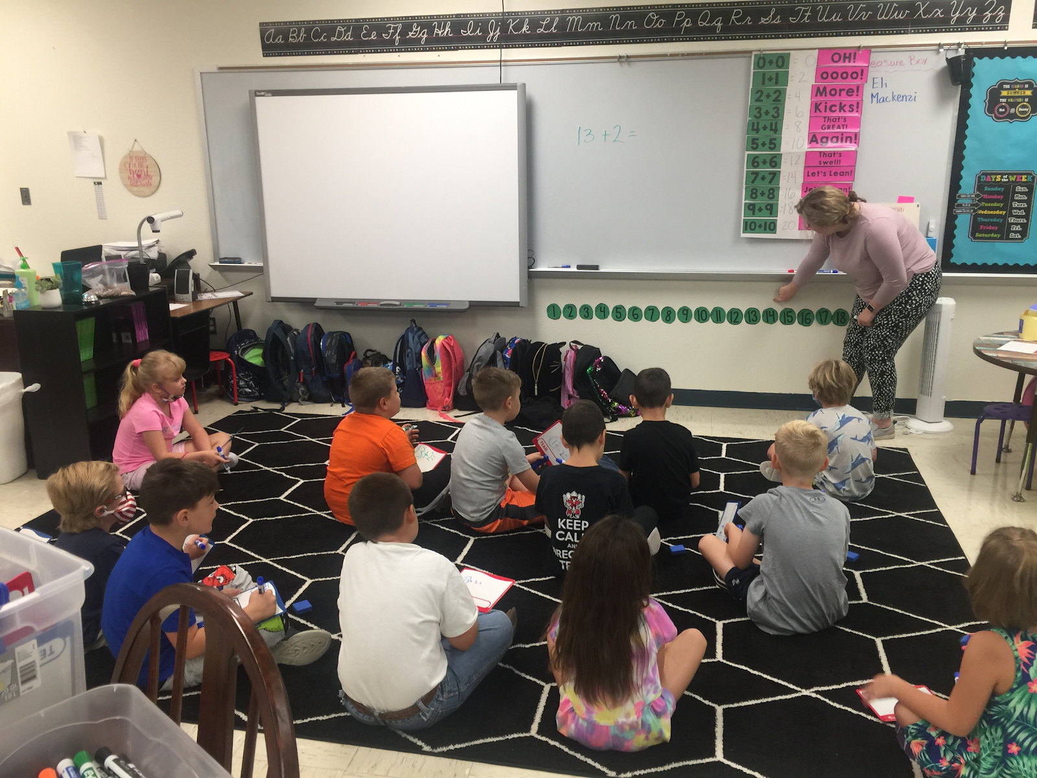
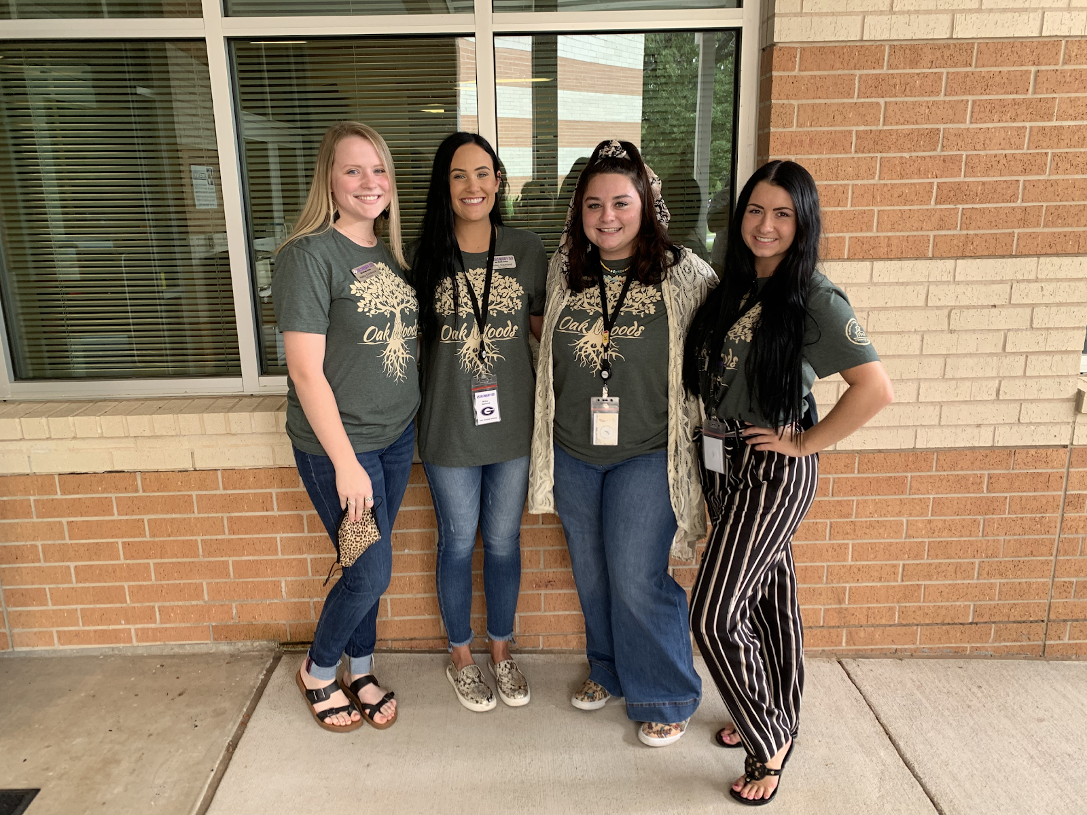
What does the Residency Offer?
A full-year residency that provides hands-on clinical experience in a partner district classroom.
Professional connections to the partner school and district.
Selected highly qualified and trained Mentor Teachers who provide coaching and mentoring support.

Slide 13
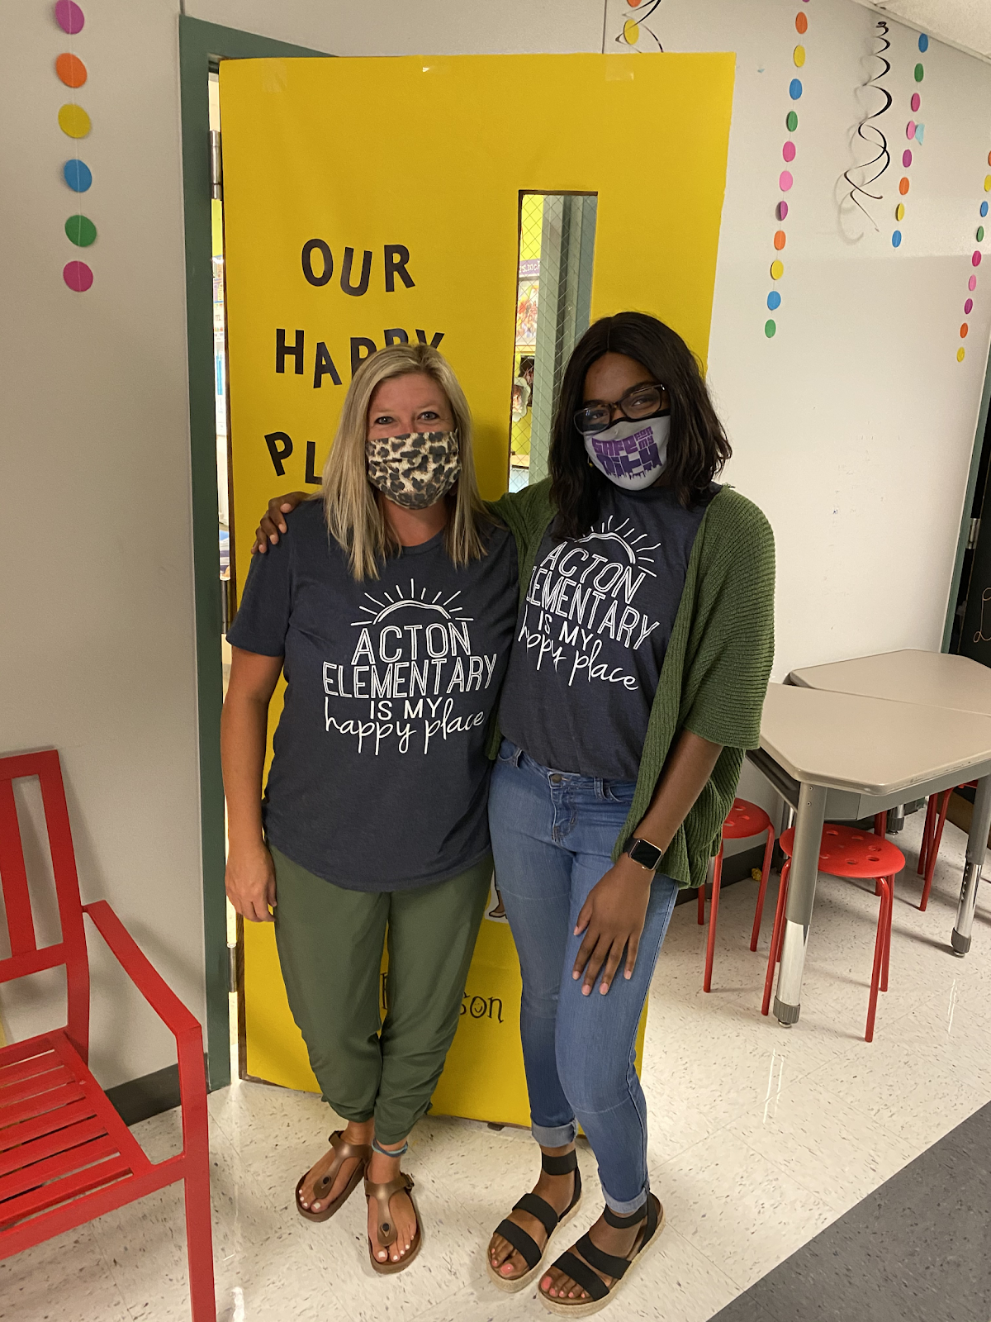
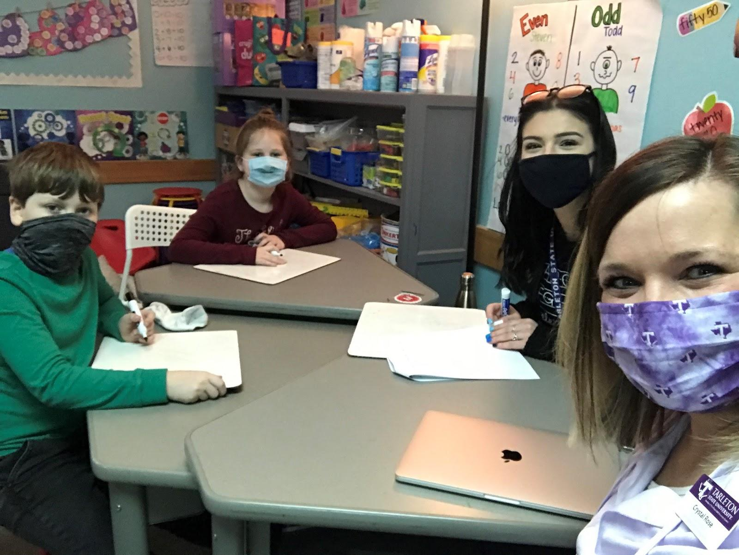
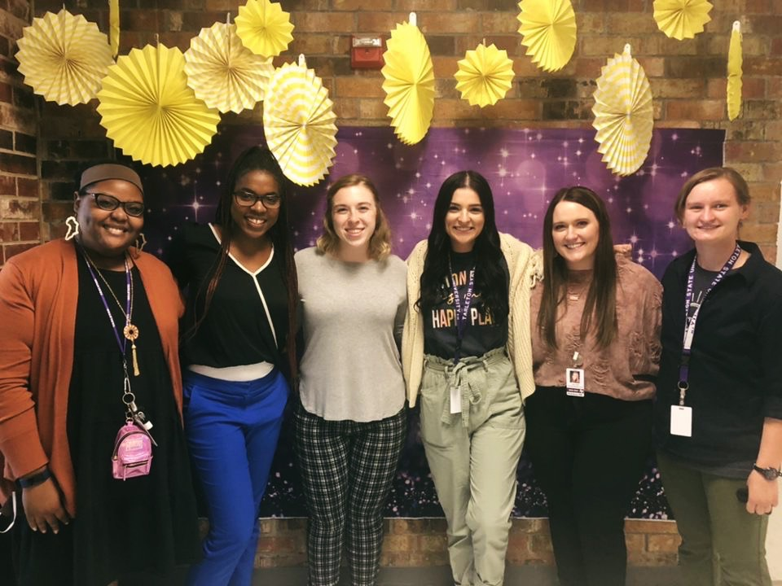
What does the Residency Offer?
A UHCL Site Coordinator who serves as a coach, mentor, and instructor.
Continuous learning alongside a cohort of teacher candidate peers.
Engaging in a co-teaching model for more engagement in your class placement.

Slide 14
Application
Next Steps

Slide 15
Who Should Apply?
Must be enrolled in one of the following Elementary Education programs:
    Bilingual
    ESL
    Literacy
    Early Childhood
    Special Education
Ready to take the Clinical 1 in Fall 25 with 1-2 methods courses
Willing to complete their yearlong residency in Goose Creek CISD.
Those who want to get paid!

Slide 16
Application Timeline
Now - March 3rd: Apply for Clinical 1
March 5th - Applications for EC-6 Residency will be sent to all eligible students
March 28th - Application for EC-6 Residency closes
April - Residents informed of their selection

Slide 17
Questions?
divoll@uhcl.edu

