Slide 1
Constructed Response Example & Practice
Twitter: @UHCLLITERACY
Science of Teaching Reading TExES #293
Training provided by UHCL Literacy Faculty, December 2020

Slide 2
Welcome
This power point is meant to be self-paced. The Science of Teaching Reading Test is comprised of the following:
90 Selected Response Items (SRIs)
Single question items
Clustered question items (including a stimulus item)
1 Constructed Response Item (CRI)-The 90 selected-response items (SRIs) are followed by the constructed-response items (CRI), but candidates can navigate freely throughout the exam at all times. Candidates can respond to the CRI first if they choose.
5-hour seat time (4:45 testing time)

Slide 3
The STR exam will be required for the issuance of five certification fields:
Early Childhood: EC – Grade 3
Core Subjects with Science of Teaching Reading: Early Childhood–Grade 6
Core Subjects with Science of Teaching Reading: Grades 4–8
English Language Arts and Reading with Science of Teaching Reading: Grades 4–8​
English Language Arts and Reading/Social Studies with Science of Teaching Reading: Grades 4–8​
The STR exam will be required for the issuance of intern, probationary, and standard certifications for these certification fields beginning January 1, 2021.

Slide 4
Your Coursework at UHCL….
Has prepared you for the exam
Has provided you with knowledge of instructional strategies/activities, TEKs, and assessment tools
Has prepared you for building a bridge between data and instructional strategies
Has helped you approach student’s learning from a strengths’ perspective

Slide 5
Framework and Weighting of Test
Four Domains, see list and weighting below.
13 Competencies
Topics:
Reading Pedagogy,
Reading Development/Foundational Skills,
Reading Development/Comprehension, and
Analysis and Response

Slide 6
Domains Covered

Slide 7
Sample Assignment Use the information in the exhibits to complete the assignment that follows.
This assignment focuses on a fifth-grade student named Alyssa. Her primary language is English. The assessment data in the exhibits were collected using the Developmental Reading Assessment (DRA2) during the first six weeks of the school year.
Using your knowledge of reading pedagogy and the developmental progression of foundational reading skills and reading comprehension as described in the Texas Essential Knowledge and Skills (TEKS) for English Language Arts and Reading (ELAR), analyze the information provided and write a response of approximately 400–600 words in which you:
Identify one significant need that the student demonstrates related to foundational reading skills (e.g., phonemic awareness skills, phonics skills, recognition of high-frequency words, syllabication skills, morphemic analysis skills, automaticity, reading fluency [i.e., accuracy, rate, and prosody]), citing specific evidence from the exhibits, particularly the Oral Reading Fluency Assessment, Fluency Rubric, to support your analysis;
Describe one appropriate, effective instructional strategy or activity that would address the student's need you identified related to foundational reading skills and help the student achieve relevant grade-level standards;
Identify one significant need that the student demonstrates related to reading comprehension (e.g., vocabulary knowledge; knowledge of sentence and grammatical structures; application of literal, inferential, or evaluative comprehension skills; use of comprehension strategies; application of text analysis skills to a literary or informational text), citing specific evidence from the exhibits, particularly the Comprehension Assessment, to support your analysis;
Describe one appropriate, effective instructional strategy or activity that would address the need you identified related to the student's reading comprehension and help the student achieve relevant grade-level standards; and
Explain why each of the instructional strategies or activities you described would be effective in addressing the needs you identified and in helping the student achieve grade-level reading standards as described in the TEKS for ELAR.

Slide 8
Section 5: Sample Constructed-Response Question Science of Teaching Reading (293)
General Directions
This question requires you to demonstrate your knowledge of the subject area by providing an in-depth written response. Read the question carefully before you begin to write your response to ensure that you address all components. Think about how you will organize what you plan to write.
The final version of your response should conform to the conventions of standard English. Your written response should be your original work, written in your own words, and not copied or paraphrased from some other work. You may, however, use citations when appropriate.
Exhibits for the constructed-response question will be presented in a tabbed format on the computer-administered test. You will have the ability to move between exhibits by clicking on the tab labels at the top of the screen.
An on-screen answer box will be provided on the computer-administered test. The answer box includes a white response area for typing your response, as well as tools along the top of the box for editing your response. A word counter that counts the number of words entered for the response is also provided in the lower left corner of the box. Note that the size, shape, and placement of the answer box will depend on the content of the assignment.

Slide 9
Suggested Approach
In order to not to feel overwhelmed with each of the exhibits, I suggest that you create a notetaking chart on scratch paper like below.
Go through each exhibit and complete the chart.
Once you have done this, you are ready to write.
Remember you must adhere to the following; Using your knowledge of reading pedagogy and the developmental progression of foundational reading skills and reading comprehension as described in the Texas Essential Knowledge and Skills (TEKS) for English Language Arts and Reading (ELAR), analyze the information provided and write a response of approximately 400–600 words.
Exhibit Number | Student Strengths | Student Needs | Instructional Recommendations | TEKS
1
2
3
4

Slide 10
Ways you can practice…
Using your knowledge of reading pedagogy and the developmental progression of foundational reading skills and reading comprehension as described in the Texas Essential Knowledge and Skills (TEKS) for English Language Arts and Reading (ELAR), analyze the information provided and write a response of approximately 400–600 words in which you:
identify one significant need that the student demonstrates related to foundational reading skills (e.g., phonemic awareness skills, phonics skills, recognition of high-frequency words, syllabication skills, morphemic analysis skills, automaticity, reading fluency [i.e., accuracy, rate, and prosody]), citing specific evidence from the exhibits, particularly the oral reading fluency and fluency rubric (Exhibit 1), and comprehension assessment (Exhibit 2).
describe one appropriate, effective instructional strategy or activity that would address the student's need you identified related to foundational reading skills and help the student achieve relevant grade-level standards;
identify one significant need that the student demonstrates related to reading comprehension (e.g., vocabulary knowledge; knowledge of sentence and grammatical structures; application of literal, inferential, or evaluative comprehension skills; use of comprehension strategies; application of text analysis skills to a literary or informational text), citing specific evidence from the exhibits, particularly the Comprehension Assessment (Exhibit 2), to support your analysis;
describe one appropriate, effective instructional strategy or activity that would address the need you identified related to the student's reading comprehension and help the student achieve relevant grade-level standards; and
explain why each of the instructional strategies or activities you described would be effective in addressing the needs you identified and in helping the student achieve grade-level reading standards as described in the TEKS for ELAR.
Be sure to cite evidence from all four exhibits in your response.

Slide 11
Carefully looking at the scoring criteria
In the following two slides, some of the scoring criteria is listed. Take the time to look over the criteria that will be used to score your response.

Slide 12
Rubric
Performance Characteristics
The rubric created to evaluate your response to the constructed-response question is based on the following criteria:
Completion | The degree to which the candidate completes the assignment by responding to each specific task in the assignment.
Application of Content | The degree to which the candidate applies the relevant knowledge and skills to the response accurately and effectively.
Support | The degree to which the candidate supports the response with appropriate evidence, examples, and explanations based on the relevant content knowledge and skills.

Slide 13
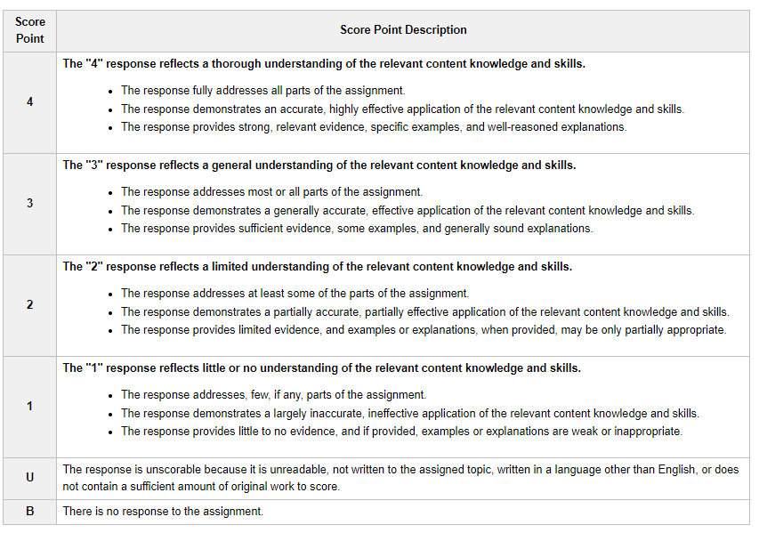
Score Scale
Score Scale
The four points of the scoring scale correspond to varying degrees of performance.

Slide 14
Materials for Practicing
Paper and pen or pencil
Exhibits 1, 2, 3, and 4
TEKS Vertical Alignment (please note, you will not have a copy of the TEKS during the test).
TEKS Strands:
1: Foundational Language Skills
2: Comprehension
3: Response Skills
4: Multiple Genres
5: Author’s Purpose and Craft
6: Composition
7: Inquiry and Research

Slide 15
Make your chart based on each of the assessments provided. You will write your response using this chart as a guide.

Slide 16
Before writing: Read the directions over several times, look back over your needs charts, and jot down notes.
Directions
Identify one significant need that the student demonstrates related to foundational reading skills (e.g., phonemic awareness skills, phonics skills, recognition of high-frequency words, syllabication skills, morphemic analysis skills, automaticity, reading fluency [i.e., accuracy, rate, and prosody]), citing specific evidence from all four exhibits.

Slide 17
Let’s Practice
Use the information in the exhibits to complete the assignment that follows.
This assignment focuses on a fifth-grade student named Alyssa. Her primary language is English. The assessment data in the exhibits were collected using the Developmental Reading Assessment (DRA2) during the first six weeks of the school year.

Slide 18
Preparing to Answer the Prompt…
“I remember in my trusty study sessions I did with my literacy professors that I need to read over the directions a few times. I’m going to underline key things I need to focus on. Okay, check, I have done that. I am going to look back at my notes, and focus in on Julia’s response to reading (Exhibit 1), her Word List (Exhibit 2), her Comprehension Assessment (Exhibit 3), and her Oral Fluency Rubric (Exhibit 4).
Create and fill out a chart for each of the exhibits. You can do this on scratch paper. You could even practice writing a response of your own. As you move through the power point, there are examples provided that respond to each of the exhibits.
The important thing is to begin thinking in the way that identifies strengths and hones in on an area that needs support.

Slide 19
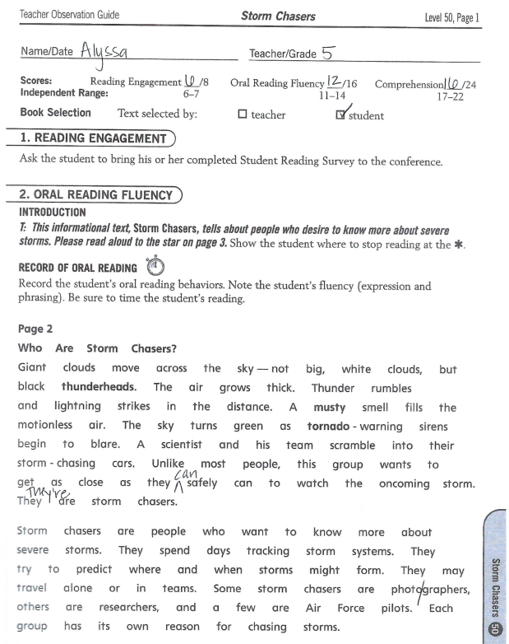
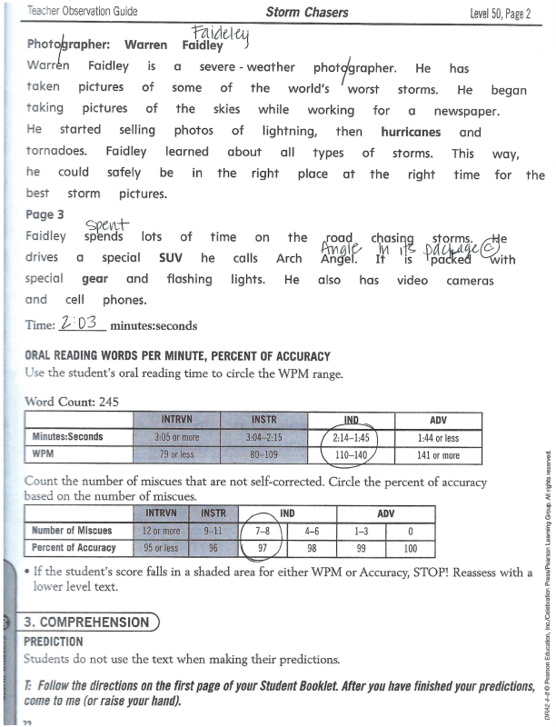
Exhibit 1: Oral Reading Fluency and Fluency Rubric
For this assessment, the teacher administered it one on one with Alyssa.
This assessment was administered the second week of school.
Alyssa chose Who Are Storm Chasers to read.
While Alyssa read, her teacher noted miscues on the passage and timed the student’s reading.
Included you will see the record of Alyssa’s oral reading behavior and oral reading fluency rubric.

Slide 20
Make your chart based on each of the assessments provided. You will write your response using this chart as a guide.

Slide 21
Exhibit 1: Oral Reading Fluency
Exhibits | Strengths | Needs | Instructional Rec. | TEKS
1 | Reads many multisyllabic words Substituted words don’t generally change the meaning of the sentence Good expression; emphasizing key words | Made several substitutions where she did not work through the word to the ending Can still work on phrasing of longer phrases | Help student look through words to monitor word choice | Using appropriate fluency when reading grade-level text

Slide 22
Exhibit 1: Reader Response
For exhibit one- the Reader Response, I might comment on the following.
Based on the Oral Reading Fluency (Exhibit 1), Alyssa read the passage with good expression and phrasing. She emphasized the correct words and phrases at the correct times. However, to better her accuracy when reading, Alyssa does need some support when it comes to miscues and self-correction. Alyssa did not always self-correct her miscues, and these many times were due to not working through to the end of the word. For example, she substituted “angle” for “Angel” and “spent” for “spends.” Alyssa could benefit from a support in reading through to the end of words to monitor her word choice. In small groups, or one-on-one, Alyssa would benefit from slowing down when reading and reading more carefully to the end of each word to self-correct her miscues. Another instructional strategy that could be used with Alyssa would be to her look through words to monitor her word choices, this could also be done in small group or during a reading conference. This connects to the fluency TEKS, because self-correction and reading to the end of words is needed for successful, fluent reading.

Slide 23
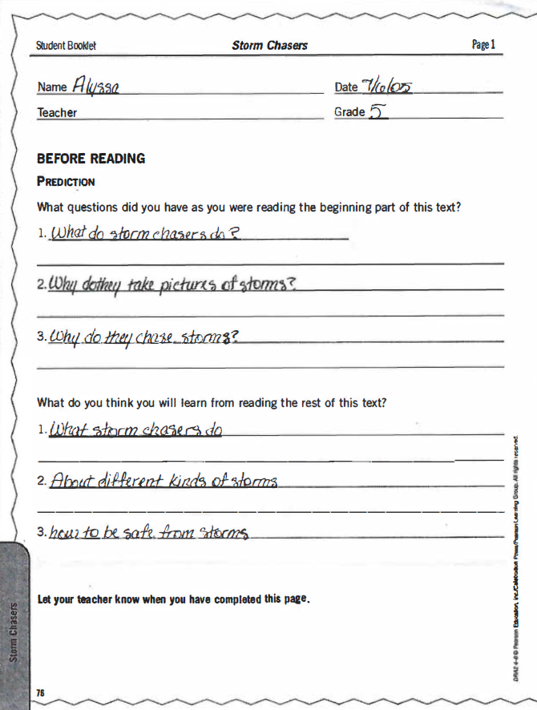
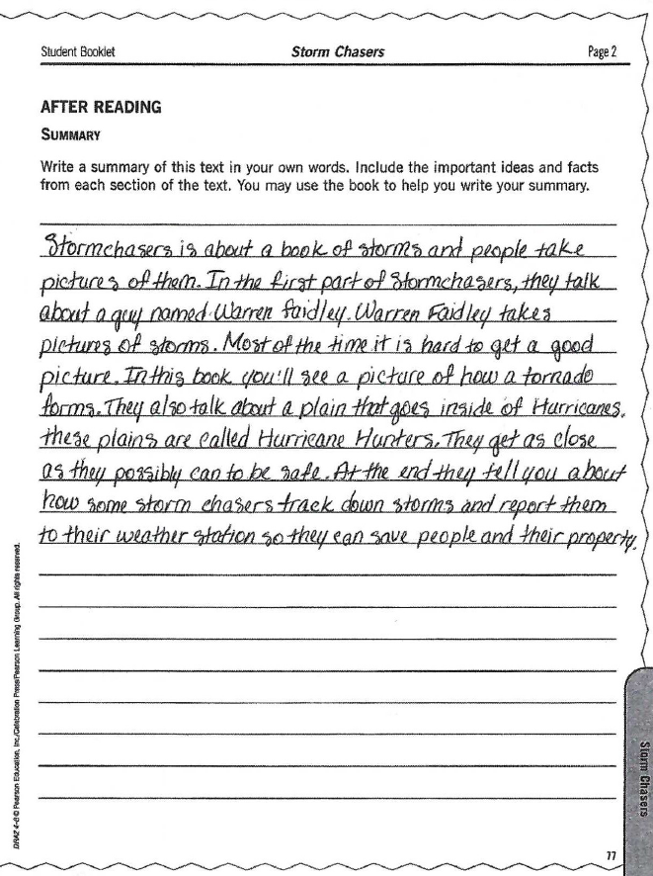
Exhibit 2- Comprehension
For this assessment, the teacher administered one-to-one.
The teacher asked Alyssa to pause and answer the prediction section after reading the beginning of the passage.
The teacher asked Alyssa to write a summary after she read the passage.

Slide 24
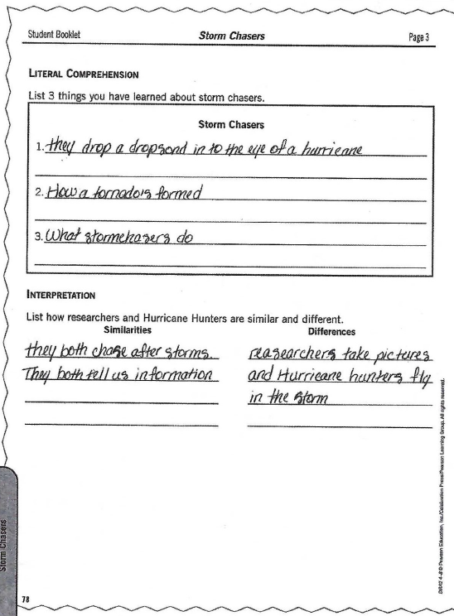
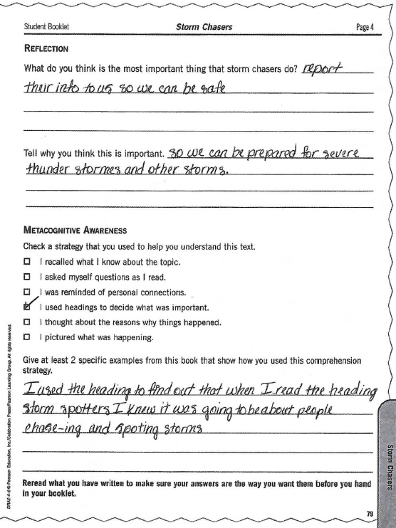
Exhibit 2- Comprehension
Alyssa answered the Literal Comprehension and Interpretation sections after reading the passage.
Then, she answered the reflection questions and metacognitive awareness section after reading.

Slide 25
Make your chart based on each of the assessments provided. You will write your response using this chart as a guide.

Slide 26
Exhibit 2: Comprehension
Exhibits | Strengths | Needs | Instructional Rec. | TEKS
2 | Alyssa has several reasonable questions before reading and she made two reasonable predictions – show purpose for reading and a basis for self-monitoring Uses her own language to construct a summary In the interpretation, Alyssa demonstrates an understanding of an important text implication Uses headings in text when reading | Summary was partial For the Literal Comprehension section, Alyssa only partially answered the prompt and her answers were very general. Reflection could have been more thoughtful | Instruction to help her grasp the overall intent of the passage and add more supporting information Instruction on how to use key words and ideas to be more specific in responses Instruction on extending ideas when writing | Identify key ideas TEKS Identify key ideas TEKS Response using newly acquired vocabulary TEKS Discuss specific ideas in the text that are important to the meaning TEKS

Slide 27
Exhibit 2: Comprehension
To address Exhibit 2, I might comment on the following:
Based on the comprehension section of the DRA2 (Exhibit 2), Alyssa was successful at using text features to comprehend the passage and know what was coming next. Alyssa also shows purpose in her reading by asking reasonable questions and making reasonable predictions before reading. When constructing a summary, Alyssa used her own language to write it. Instructionally, Alyssa would benefit from instruction that would help her grasp the overall intent of a passage and add more supporting details from each section of a text into her summaries. She would also benefit from looking at key words an details to be more specific in her thinking and writing about a passage. Both of these are connected to and support the key details TEKS in the comprehension strand. Lastly, Alyssa would then benefit from instruction in extending her ideas when writing about her reading and connecting these to the meaning of a text, in her reading responses (TEKS).

Slide 28
You’ve Got This…
Remember, you have all the tools necessary to be successful on this test.
It is our hope that going through these exercises has helped you to feel more prepared for the Constructed Response.
On the day of the exam, take a deep breath, carefully map out your possible responses, check over your work, maximize your tools of writing skills, and envision yourself setting up your first classroom.

Slide 29
Information and Practice
Please view the State Assessment Website for updated information. https://www.uhcl.edu/education/certification/state-assessments/
Preparation Manual can be found here. http://www.tx.nesinc.com/Content/StudyGuide/TX_SG_about_293.asp

