Slide 1

Constructed Response Example & Practice
Twitter: @UHCLLITERACY
Science of Teaching Reading TExES #293
Training provided by UHCL Literacy Faculty, December 2020

Slide 2
Welcome
This power point is meant to be self-paced. The Science of Teaching Reading Test is comprised of the following:
90 Selected Response Items (SRIs)
  Single question items
  Clustered question items (including a stimulus item)
1 Constructed Response Item (CRI)-The 90 selected-response items (SRIs) are followed by the constructed-response items (CRI), but candidates can navigate freely throughout the exam at all times. Candidates can respond to the CRI first if they choose.
5-hour seat time (4:45 testing time)

Slide 3
The STR exam will be required for the issuance of five certification fields:
Early Childhood: EC – Grade 3
Core Subjects with Science of Teaching Reading: Early Childhood–Grade 6
Core Subjects with Science of Teaching Reading: Grades 4–8
English Language Arts and Reading with Science of Teaching Reading: Grades 4–8​
English Language Arts and Reading/Social Studies with Science of Teaching Reading: Grades 4–8​
The STR exam will be required for the issuance of intern, probationary, and standard certifications for these certification fields beginning January 1, 2021.

Slide 4

Your Coursework at UHCL….
Has prepared you for the exam
Has provided you with knowledge of instructional strategies/activities, TEKs, and assessment tools
Has prepared you for building a bridge between data and instructional strategies
Has helped you approach student’s learning from a strengths’ perspective

Slide 5
Framework and Weighting of Test
Four Domains, see list and weighting below.
13 Competencies
Topics:
  Reading Pedagogy,
  Reading Development/Foundational Skills,
  Reading Development/Comprehension, and
  Analysis and Response

Slide 6
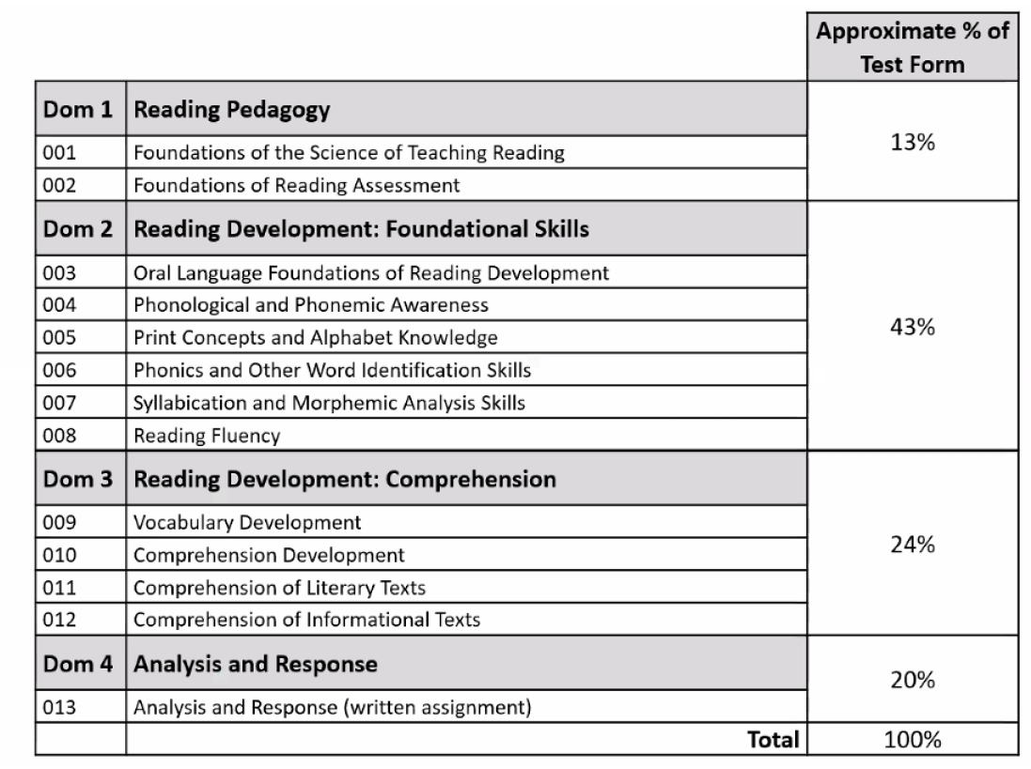
Domains Covered

Slide 7
Sample Assignment
Use the information in the exhibits to complete the assignment that follows.
This assignment focuses on a first-grade student named Julia who is six years old. Her primary language is English. The assessment data in the exhibits were collected during the first six weeks of the school year. The level of each assessment was selected based on Julia’s previous assessment results.
Using your knowledge of reading pedagogy and the developmental progression of foundational reading skills and reading comprehension as described in the Texas Essential Knowledge and Skills (TEKS) for English Language Arts and Reading (ELAR), analyze the information provided and write a response of approximately 400–600 words in which you:
Identify one significant need that the student demonstrates related to foundational reading skills (e.g., phonemic awareness skills, phonics skills, recognition of high-frequency words, syllabication skills, morphemic analysis skills, automaticity, reading fluency [i.e., accuracy, rate, and prosody]), citing specific evidence from the exhibits, particularly the Word-Reading Assessment, Passage-Reading Assessment, and Fluency Data, to support your analysis;
Describe one appropriate, effective instructional strategy or activity that would address the student's need you identified related to foundational reading skills and help the student achieve relevant grade-level standards;
Identify one significant need that the student demonstrates related to reading comprehension (e.g., vocabulary knowledge; knowledge of sentence and grammatical structures; application of literal, inferential, or evaluative comprehension skills; use of comprehension strategies; application of text analysis skills to a literary or informational text), citing specific evidence from the exhibits, particularly the Comprehension Assessment, to support your analysis;
Describe one appropriate, effective instructional strategy or activity that would address the need you identified related to the student's reading comprehension and help the student achieve relevant grade-level standards; and
Explain why each of the instructional strategies or activities you described would be effective in addressing the needs you identified and in helping the student achieve grade-level reading standards as described in the TEKS for ELAR.

Slide 8
Section 5: Sample Constructed-Response Question
Science of Teaching Reading (293)
General Directions
This question requires you to demonstrate your knowledge of the subject area by providing an in-depth written response. Read the question carefully before you begin to write your response to ensure that you address all components. Think about how you will organize what you plan to write.
The final version of your response should conform to the conventions of standard English. Your written response should be your original work, written in your own words, and not copied or paraphrased from some other work. You may, however, use citations when appropriate.
Exhibits for the constructed-response question will be presented in a tabbed format on the computer-administered test. You will have the ability to move between exhibits by clicking on the tab labels at the top of the screen.
An on-screen answer box will be provided on the computer-administered test. The answer box includes a white response area for typing your response, as well as tools along the top of the box for editing your response. A word counter that counts the number of words entered for the response is also provided in the lower left corner of the box. Note that the size, shape, and placement of the answer box will depend on the content of the assignment.

Slide 9
Suggested Approach
In order to not to feel overwhelmed with each of the exhibits, I suggest that you create a notetaking chart on scratch paper like below.
Go through each exhibit and complete the chart.
Once you have done this, you are ready to write.
  Remember you must adhere to the following; Using your knowledge of reading pedagogy and the developmental progression of foundational reading skills and reading comprehension as described in the Texas Essential Knowledge and Skills (TEKS) for English Language Arts and Reading (ELAR), analyze the information provided and write a response of approximately 400–600 words.
Exhibit Number | Student Strengths | Student Needs | Instructional Recommendations | TEKS
1
2
3
4

Slide 10
Ways you can practice…
Using your knowledge of reading pedagogy and the developmental progression of foundational reading skills and reading comprehension as described in the Texas Essential Knowledge and Skills (TEKS) for English Language Arts and Reading (ELAR), analyze the information provided and write a response of approximately 400–600 words in which you:
  identify one significant need that the student demonstrates related to foundational reading skills (e.g., phonemic awareness skills, phonics skills, recognition of high-frequency words, syllabication skills, morphemic analysis skills, automaticity, reading fluency [i.e., accuracy, rate, and prosody]), citing specific evidence from the exhibits, particularly the reader response (Exhibit 1), the word analysis (Exhibit 2), and fluency rubric (Exhibit 4)
  describe one appropriate, effective instructional strategy or activity that would address the student's need you identified related to foundational reading skills and help the student achieve relevant grade-level standards;
  identify one significant need that the student demonstrates related to reading comprehension (e.g., vocabulary knowledge; knowledge of sentence and grammatical structures; application of literal, inferential, or evaluative comprehension skills; use of comprehension strategies; application of text analysis skills to a literary or informational text), citing specific evidence from the exhibits, particularly the Comprehension Assessment (Exhibit 3), to support your analysis;
  describe one appropriate, effective instructional strategy or activity that would address the need you identified related to the student's reading comprehension and help the student achieve relevant grade-level standards; and
  explain why each of the instructional strategies or activities you described would be effective in addressing the needs you identified and in helping the student achieve grade-level reading standards as described in the TEKS for ELAR.
Be sure to cite evidence from all four exhibits in your response.

Slide 11

Carefully looking at the scoring criteria
In the following two slides, some of the scoring criteria is listed. Take the time to look over the criteria that will be used to score your response.

Slide 12
Rubric
Performance Characteristics
The rubric created to evaluate your response to the constructed-response question is based on the following criteria:
Completion | The degree to which the candidate completes the assignment by responding to each specific task in the assignment.
Application of Content | The degree to which the candidate applies the relevant knowledge and skills to the response accurately and effectively.
Support | The degree to which the candidate supports the response with appropriate evidence, examples, and explanations based on the relevant content knowledge and skills.

Slide 13
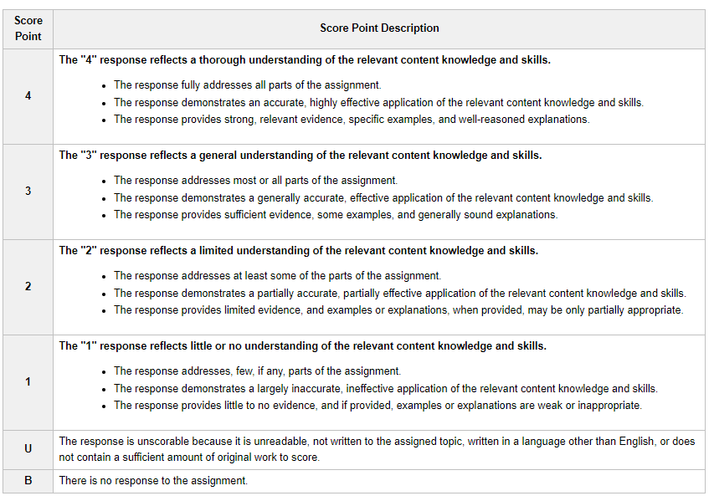
Score Scale
Score Scale
The four points of the scoring scale correspond to varying degrees of performance.

Slide 14
Materials for Practicing
Paper and pen or pencil
Exhibits 1, 2, 3, and 4
TEKS Vertical Alignment (please note, you will not have a copy of the TEKS during the test).
TEKS Strands:
  1: Foundational Language Skills
  2: Comprehension
  3: Response Skills
  4: Multiple Genres
  5: Author’s Purpose and Craft
  6: Composition
  7: Inquiry and Research

Slide 15
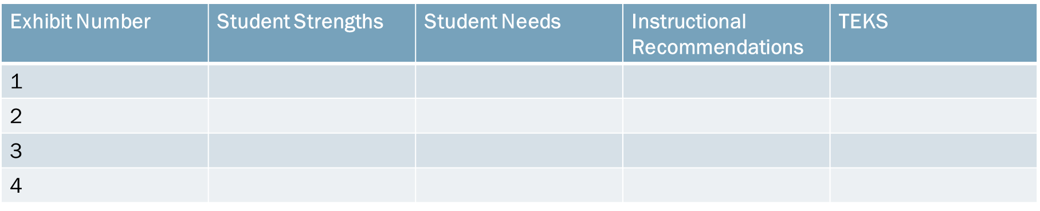
Make your chart based on each of the assessments provided. You will write your response using this chart as a guide.

Slide 16
Before writing: Read the directions over several times, look back over your needs charts, and jot down notes.
Directions
Identify one significant need that the student demonstrates related to foundational reading skills (e.g., phonemic awareness skills, phonics skills, recognition of high-frequency words, syllabication skills, morphemic analysis skills, automaticity, reading fluency [i.e., accuracy, rate, and prosody]), citing specific evidence from all four exhibits.

Slide 17
Let’s Practice
Use the information in the exhibits to complete the assignment that follows.
This assignment focuses on a first grade student, Julia, who is six years old. Her primary language is English. The assessment data in the exhibits were collected during the first six weeks of the school year. The level of each assessment was selected based on Julia’s previous assessment results.

Slide 18
Preparing to Answer the Prompt…
“I remember in my trusty study sessions I did with my literacy professors that I need to read over the directions a few times. I’m going to underline key things I need to focus on. Okay, check, I have done that. I am going to look back at my notes, and focus in on Julia’s response to reading (Exhibit 1), her Word List (Exhibit 2), her Comprehension Assessment (Exhibit 3), and her Oral Fluency Rubric (Exhibit 4).
Create and fill out a chart for each of the exhibits. You can do this on scratch paper. You could even practice writing a response of your own. As you move through the power point, there are examples provided that respond to each of the exhibits.
The important thing is to begin thinking in the way that identifies strengths and hones in on an area that needs support.

Slide 19
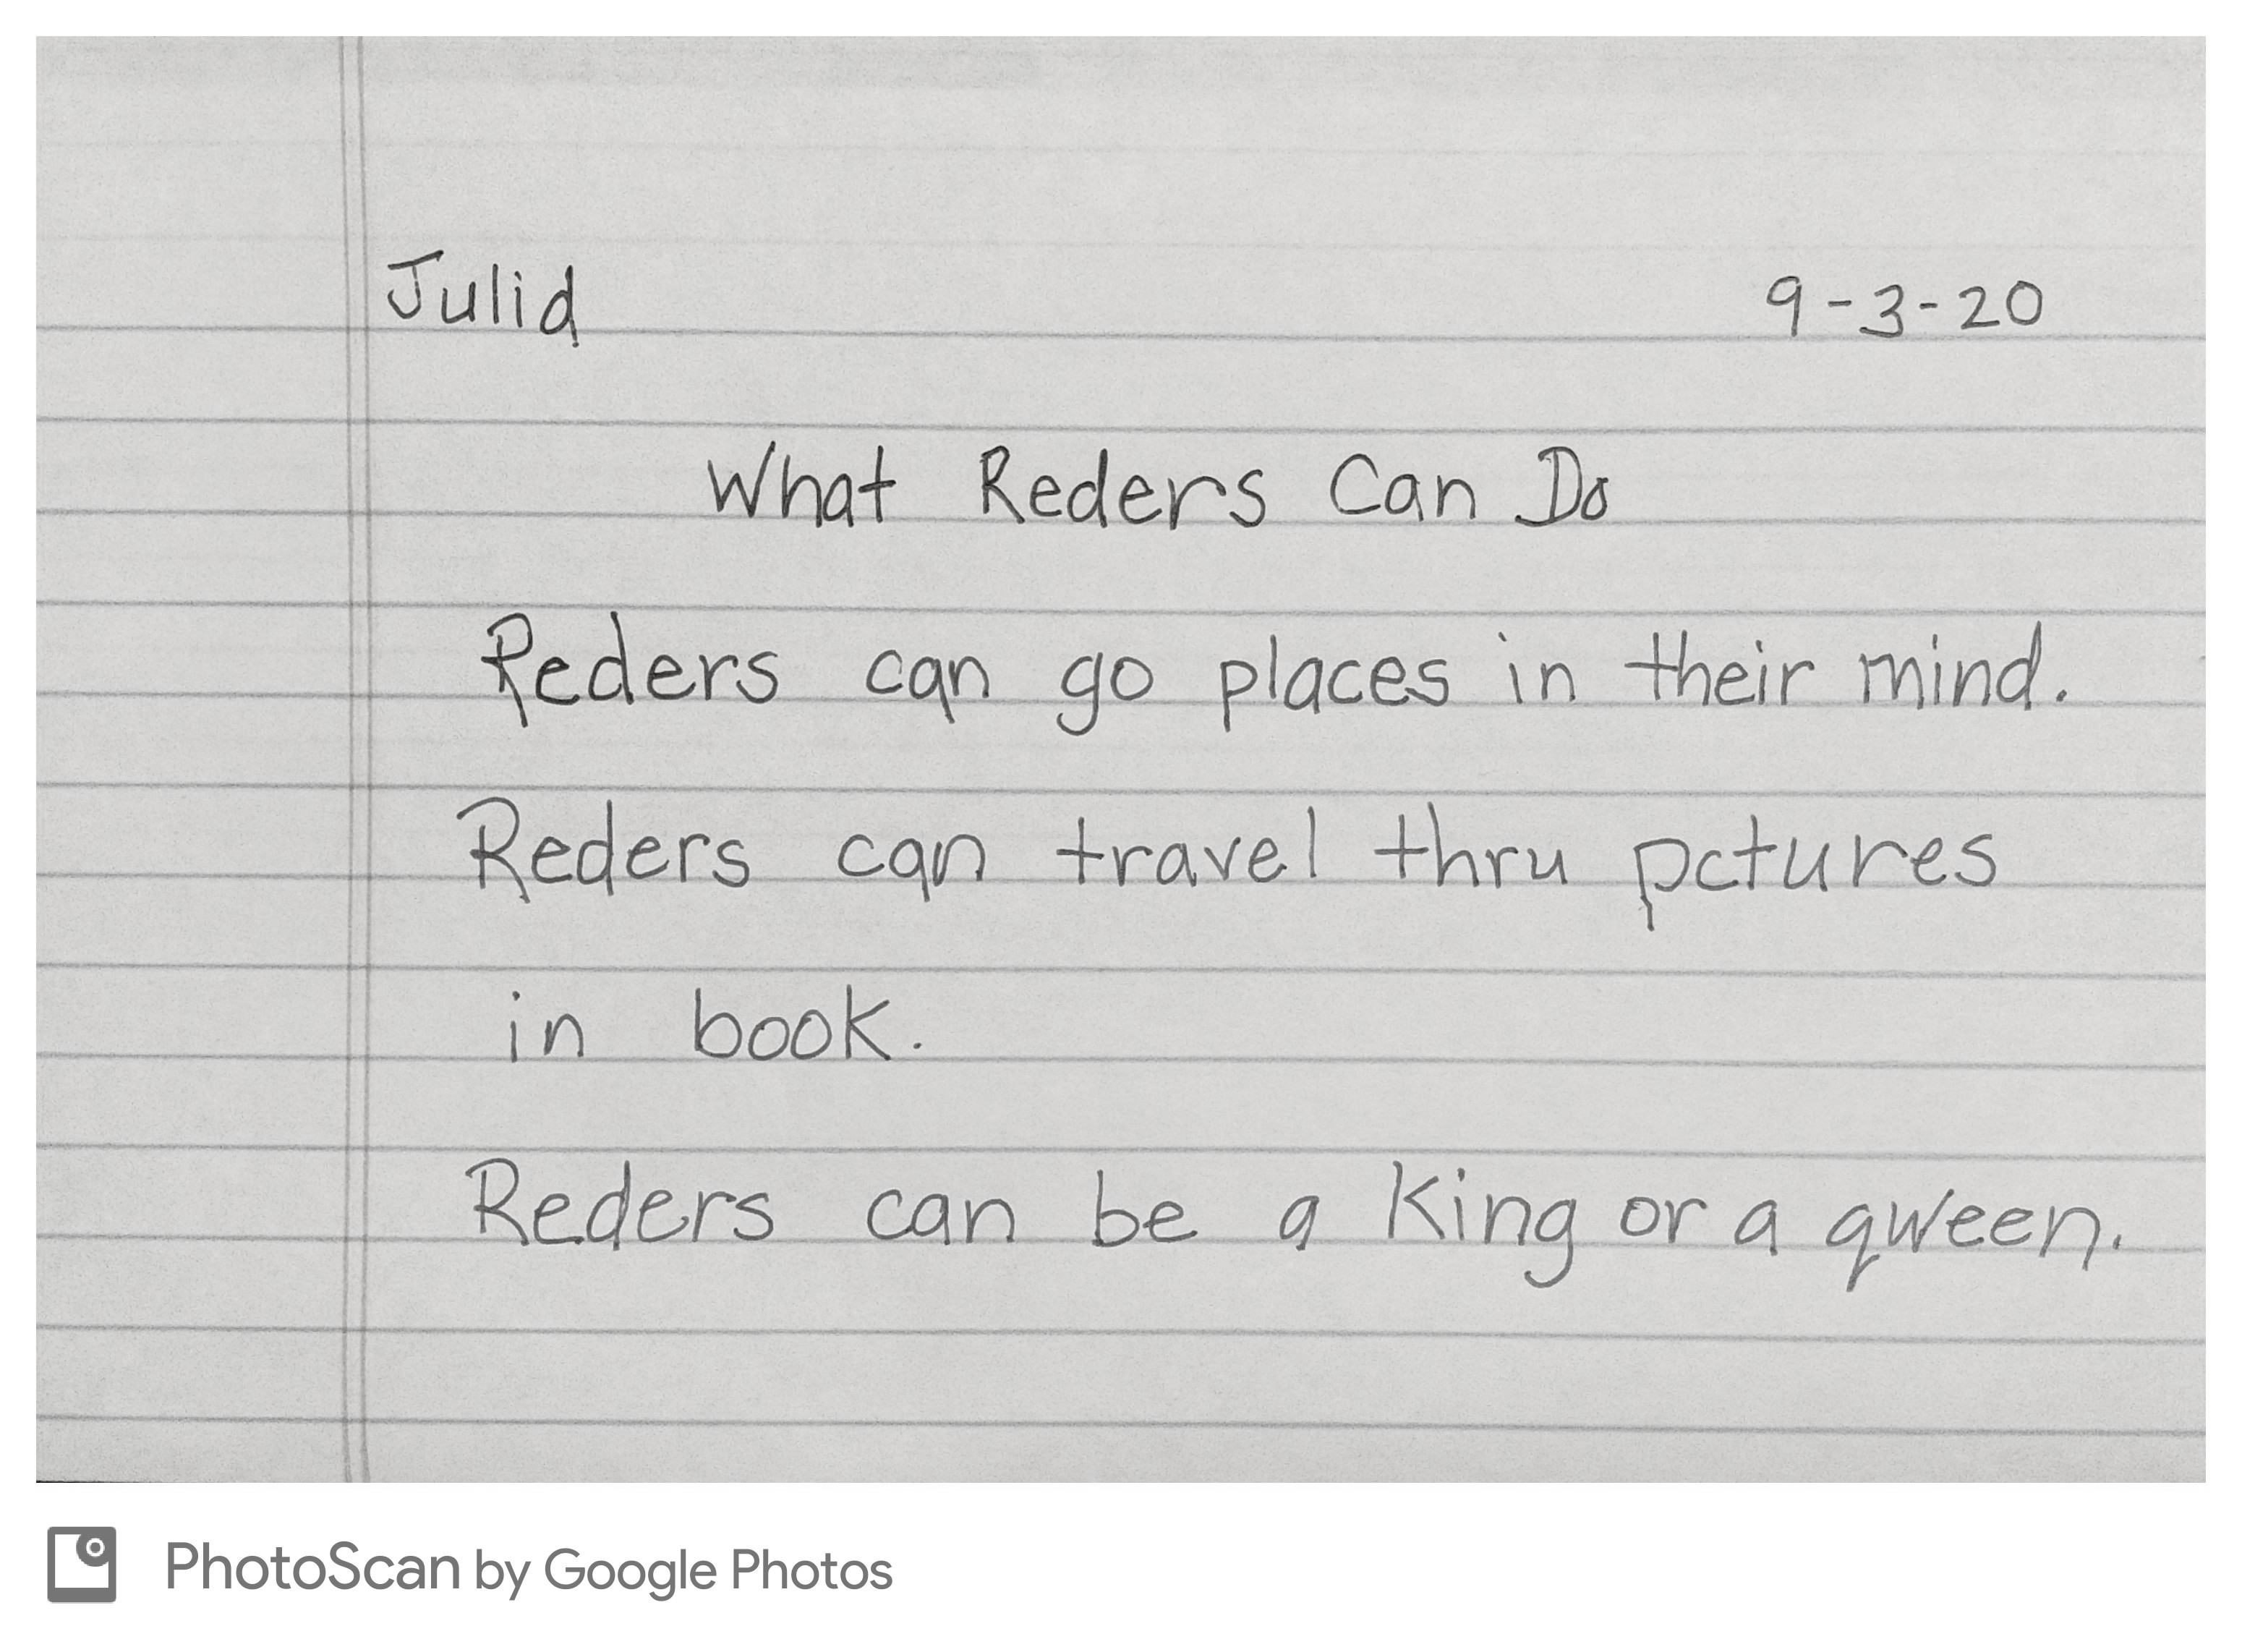

Exhibit 1: Reader Response
For this assessment, the teacher administered it whole group.
This assessment was administered the fifth day of school.
The teacher read the book What Readers Can Do aloud to the class.
At the end of the read aloud, she asked the class to write at least three things readers can do.
Included you will see Julia’s reader response from the book What Readers Can Do.
Note: Julia’s teacher asked each student to read their response aloud to the class. Julia’s reading matched her written response.

Slide 20
Make your chart based on each of the assessments provided. You will write your response using this chart as a guide.

Slide 21
Exhibit 1: Analysis
Exhibits | Strengths | Needs | Instructional Rec. | TEKS
1 | Understands capital letters Understands complete sentences Practices consistent end punctuation | Medial vowel instruction- recognizing that a vowel sound may have different spellings (e.g. the long /a/sound can be spelled a,ue, ay, ey, ai, oe ei) | Word sorts focusing on ee and ea words | Spelling words using sound-spelling patterns

Slide 22
Exhibit 1: Reader Response
For exhibit one- the Reader Response, I might comment on the following.
Based on the Reader Response (Exhibit 1), Julia has a firm knowledge of how writing should be structured. She addressed the teacher’s prompt by stating three things that readers can do. She pulled from the text using her own words to describe things readers could do. She was willing to take chances, even though she may not have been sure about how to spell certain words. She misspelled the words “readers” (spelling it as reders) consistently throughout her text which indicates she would benefit from instruction in the area of medial vowels and the different ways they can be represented in words. Also misspelled in her piece was the word “queen” (which Julia spelled as qween); this is another example of the aforementioned point about medial vowels and different ways they can be represented in words. An instructional strategy that would benefit Julia would be the use of word sorts where she sorts words with words that have representations of the long e sound in two different ways (long e spelled “ee” or “ea”). So they might be given words like “green, teeth, speed, wheel, sheet” and “read, reach, beach, bead, bean, mean” and asked to sort them under “ee” or “ea.”

Slide 23
Exhibit 2- Word List
For this assessment, the teacher administered one-to-one.
The teacher showed Julia the words one at a time and asked her to pronounce each word.
The teacher made a record of the student's performance by using check marks to indicate words that the student read accurately and automatically and using simplified phonetic transcription to record any errors.
This assessment was timed, and the student had to respond accurately within three seconds.
Included are some of the words in the assessment, followed by the teacher's record for Julia.

Slide 24
Make your chart based on each of the assessments provided. You will write your response using this chart as a guide.

Slide 25
Exhibit 2: Analysis
Exhibits | Strengths | Needs | Instructional Rec. | TEKS
2 | Beginning sounds of words she encounters in her reading Some of her miscues retain meaning | Drops off inflectional endings such as “s” | Tape Julia while she is reading a short paragraph and then have her listen to tape and point out any times where her tape recorded reading does not match the written text. | Inflectional endings

Slide 26
Exhibit 2: Word List
To address Exhibit 2, I might comment on the following:
Based on the word list (Exhibit 2), Julia was successful at identifying the beginning sound in all of the words she read out to the teacher. One of her miscues indicates that she does attempt to retain meaning as when she said “Dad” for “Daddy.” She dropped off the “dy” on “Daddy” in much the same way that she dropped off the inflectional endings of “ed” on “wanted” and the “s” on “bikes.” One activity that might be done is to have Julia audio tape her reading of a short passage (3-5 sentences) at her instructional or independent reading level and then have her point and match the words on the paper at the same time she is listening to her taped reading.

Slide 27
Exhibit 3
You Cannot Fly!
Once a boy named Sam wanted to fly.
His mother and father said, “You cannot fly.”
His sister said, “You cannot fly.”
Sam tried jumping off a box.
He tried jumping off his bed.
He fell down each time.
Sam tried hard but he still could not fly.
Then one day a letter came for Sam.
The letter said, “Come and see me, Sam, on the next airplane.”
It was from his grandfather.
Sam went to his family and read the letter.
Sam said, “Now I can fly.”
Sam and his family all laughed together.
The teacher reads Julia the following story orally.
At the end of the story, the teacher asked Julia four questions about the story.
The teacher record is included on the next slide.
Story and questions adapted from The Flynt/Cooter Comprehensive Reading Inventory-2.

Slide 28
Exhibit 3: Continued
Comprehension Questions | Type of Question | Correct | Incorrect | Student Answer
What was the name of the boy in the story? | Character-characterization/ literal |  | √ | Stan
What were two ways Sam tried to fly? | Problem resolution attempts/literal | √ |  | Jumping off his bed and a box
How was Sam’s problem finally solved? | Problem resolution/ inferential | √ |  | Sam got to ride on an airplane
What did Sam learn about being able to fly? | Theme/evaluative |  | √ | You have to just keep trying

Slide 29
Make your chart based on each of the assessments provided. You will write your response using this chart as a guide.

Slide 30
Exhibit 3: Analysis
Exhibits | Strengths | Needs | Instructional Rec. | TEKS
3 | Able to answer problem resolution questions | Identifying names of characters Inferring/identifying theme | Use of photographs of interesting events to re-teach inferring. Show student a photo of children gathered around a birthday cake. Ask, what can you infer from the picture? Do you have clues in the picture that help you with that answer? We do the same thing when we are reading. We gather clues to help us infer what is happening in the story. Show student additional photos and have them go through the same process | Make inferences and use evidence to support

Slide 31
Exhibit 3: Comprehension Assessment
Based on the comprehension questions Julia answered she did a good job of comprehending aspects related to the problem and resolution in a story. She was able to correctly identify that Sam tried different things to try to fly, such as jumping from the box and the bed to try to fly. Julia did miscue on the name in the story, calling Sam “Stan” throughout the reading. This was a literal miscue and could be due to her reading too quickly and not paying attention to the entire word as she reads. This quick pace to her reading, at times, shows up on other assessments as well, such as her fluency rubric (Exhibit 4) and the word list (Exhibit 2). The area of theme was one where Julia could benefit from additional instruction. Theme deals with inferring and is a first grade TEK. In terms of comprehension, one instructional strategy that could be used for addressing theme is to have the teacher create a graphic organizer that has a middle circle with theme written at the top and then has circles extending from the middle circle that say “Evidence from Story.” Together, the class could work through a fable that is familiar to them such as The Three Little Pigs. The teacher could write the following in the “Theme” circle- “Take the time to do things the right way.” Then the class could brainstorm the events from the story that provide evidence for this theme. Two additional fables that might be covered are listed here:
Chicken Little/Henny Penny- Don't believe everything someone says, or Think things through before jumping to conclusions.
City Mouse, Country Mouse- Home is the best place to be.
https://firstgradecentersandmore.blogspot.com/2016/05/central-message-or-theme-in-first-grade.html

Slide 32
Exhibit 4
Julia’s teacher met with individual students to assess their reading fluency.
She used the Fluency Rubric to assess four areas.
  Expression and Volume
  Phrasing
  Smoothness
  Pace
Included on the next slide is Julia’s fluency rubric.

Slide 33
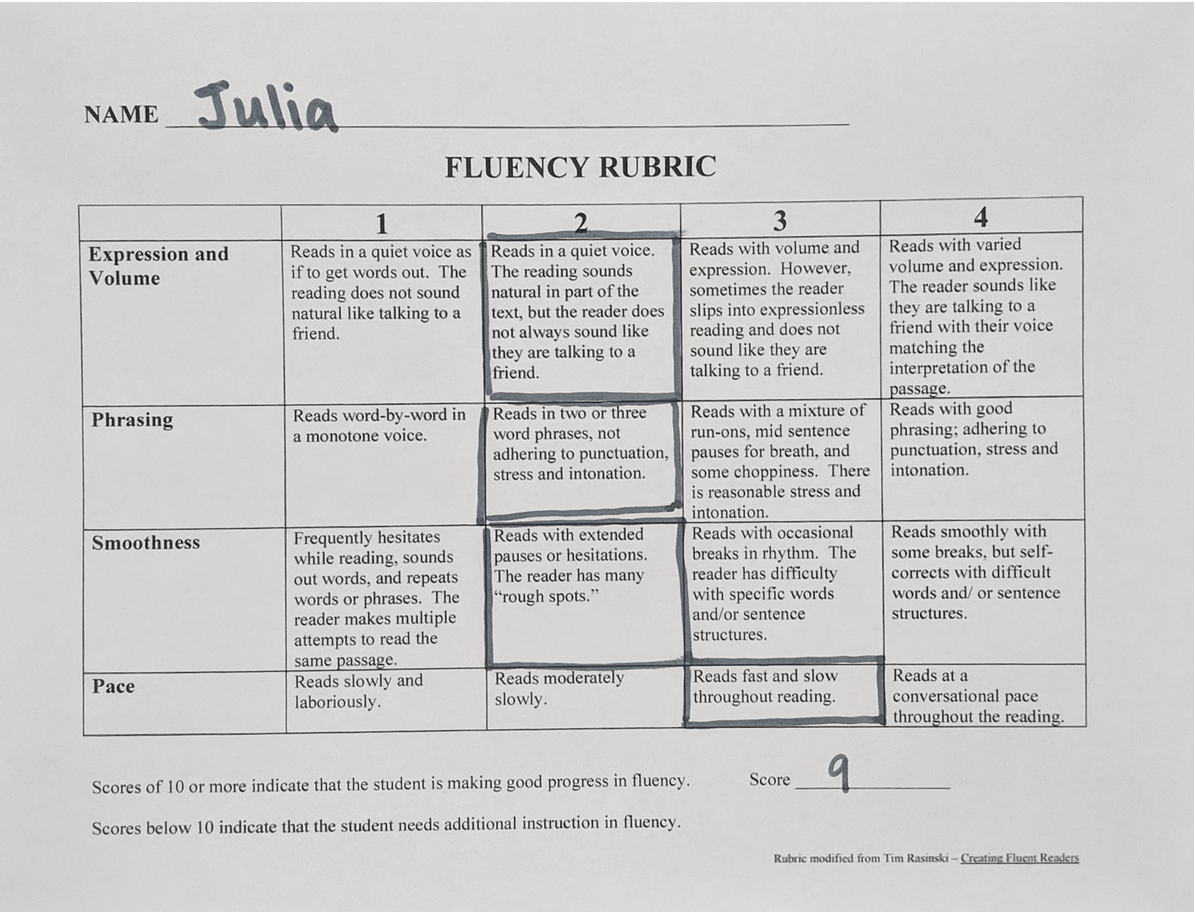

Slide 34
Make your chart based on each of the assessments provided. You will write your response using this chart as a guide.

Slide 35
Exhibit 4: Analysis
Exhibits | Strengths | Needs | Instructional Rec. | TEKS
4 | When reading common sight words, able to read like she is talking. Gains confidence as she progresses through text Pauses at times to attempt to systematically work through a difficult word | Read with volume and expression. Read with appropriate phrasing. | Choral reading of texts at her independent reading level to gain confidence and mastery | Use appropriate fluency and prosody when reading grade level texts

Slide 36
Exhibit 4: Fluency Rubric
On the Fluency Rubric, the results indicate that Julia reads in a very quiet voice and that she has spurts in her reading where she reads very quickly and then other spots in her reading where she reads very slowly. She tends to have some rough spots in her oral reading and she sometimes pauses as she moves through the text. She does not yet have a consistent flow to her reading, which when addressed will help with the smoothness and phrasing in her reading. This ties in with the TEKS which states that for grade level text students should ideally attend to rate, accuracy, expression, and appropriate phrasing. One instructional strategy that a teacher could implement is to have Julia do choral reading of independent level text. It is important that the independent level text be used so that she can be concentrating on the accuracy and expression of her reading.

Slide 37
You’ve Got This…
Remember, you have all the tools necessary to be successful on this test.
It is our hope that going through these exercises has helped you to feel more prepared for the Constructed Response.
On the day of the exam, take a deep breath, carefully map out your possible responses, check over your work, maximize your tools of writing skills, and envision yourself setting up your first classroom.

Slide 38
Information and Practice
Please view the State Assessment Website for updated information. https://www.uhcl.edu/education/certification/state-assessments/
Preparation Manual can be found here. http://www.tx.nesinc.com/Content/StudyGuide/TX_SG_about_293.asp

