Slide 1

International Student
Online Pre-Arrival Orientation

Slide 2







Meet the Office of International Admissions and Programs Team
Dr. Johna McClendon
Director, International Admissions & Student Services
Stephanie Holleran
Manager, International Admissions & Student Services
Mabel Perez
Manager, International Outreach
Livia Kidd
Senior International Student Counselor
Crystal Klyng
Global Initiative Advisor
Rebekah Gonzalez
International Admissions Advisor I
Andrew Ngo
International Admissions Advisor I

Slide 3
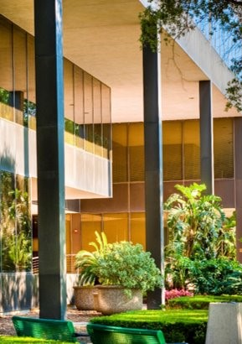
Office of International Admissions & Programs Contact Information
Physical Address
2700 Bay Area Blvd
Houston, TX 77058
Bayou Building
2nd Floor, Suite 2123
Email us at:
intladvising@uhcl.edu
Find us on:
Facebook: @uhclgls
Instagram: @uhclgls
Twitter: @uhclgls
Website: UHCL International Services

Slide 4
U.S. Immigration Documents
Passport
I-20
Visa
I-94

Slide 5
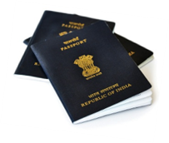
Passport
Your passport must be valid at all times
  Mark your calendars to set yourself a reminder about 8 months prior to expiration to renew your passport
  Contact your country’s consulate to inquire about the required documentation to apply for a passport renewal

Slide 6
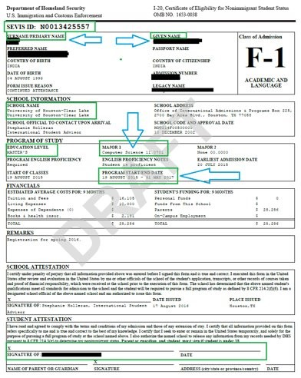
The SEVIS Form I-20
Who can study?​
Where can you study?​
What can you study?​
When can you study?​
Note your Program Completion Date!

Slide 7
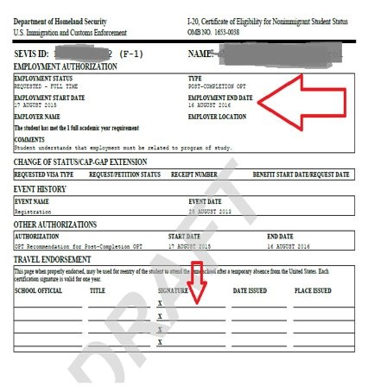
Page 2 of your Form I-20
Employment Authorization
Curricular Practical Training (CPT)
Optional Practical Training (OPT)
Travel Endorsements
Valid for one year from issue date while you are a student at UHCL​
Keep a valid travel signature at all time in case of emergencies

Slide 8
Pay the SEVIS I-901 Fee
After you have been issued your I-20, you will need to pay the I-901 fee before going to your visa appointment
What is the SEVIS I-901 fee?
U.S. Immigration and Customs Enforcement (ICE) charges a $350 SEVIS (Student and Exchange Visitor Information System) I-901 fee to new F-1 students
  This fee is IN ADDITION to the visa fees charged by the U.S. Department of State
This fee must be paid and you must print your receipt before you apply for your student visa if you are outside the U.S., or before you apply for a change of status if you are in the U.S.
SEVIS I-901 Fee Exemption: If you are transferring from another U.S. institution you do not need to pay the SEVIS fee again UNLESS you receive a new Form I-20 AND a new SEVIS ID number.

Slide 9
How do I pay the I-901 fee?
Online by credit card (http://www.fmjfee.com)
  Please save your payment confirmation
By Western Union Quick Pay​
  Please visit the ICE website for more information: https://www.ice.gov/sevis/i901/wu-instructions
  You must still fill out the form I-901 and save your confirmation
Your F-2 dependents do not need to pay a separate SEVIS fee

Slide 10

Schedule Your Visa Appointment
After paying your SEVIS fee, find the nearest U.S. Embassy or Consulate at: https://www.usembassy.gov/
Locate the website of the Embassy/Consulate in your country​ and schedule your appointment
Bring these items to your visa interview:
  Passport​
  Form I-20 (don’t forget to sign it)
  Confirmation from your visa application​
  Proof of funding ​
  Admission letter from UHCL​
  And any other required support documentation specified on the ​ embassy/consulate website

Slide 11
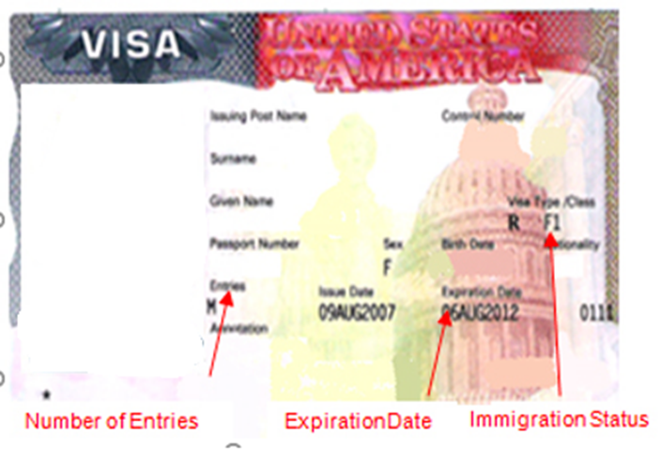
F-1 Visa
The visa is a stamp or sticker placed in your passport by a U.S. Embassy or Consulate
It is granted for entry purposes only; the visa can expire while you are inside the U.S.
Even if your visa stamp is valid, you can lose your legal F-1 status if you do not comply with the immigration laws regulating your stay in the US.
The visa does not govern how long you may stay in the U.S
It cannot be renewed in the U.S.
Think of your visa as your “key”​ to the U.S.
​
It is strongly discouraged to purchase your flight tickets before your visa is granted.

Slide 12
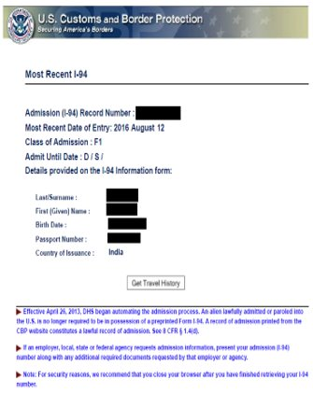
Electronic I-94
The I-94 is the DHS Arrival/Departure Record issued to non-residents who are admitted to the U.S.
To get your I-94 record go to: www.cbp.gov/I94
Review the document for accuracy
Make sure your information is correct
  Name
  Class of Admission (F-1)
  Admit Date (D/S)
For errors—please contact your International Student Advisor

Slide 13
Preparing to Travel to the U.S.
What should you do before you travel?

Slide 14
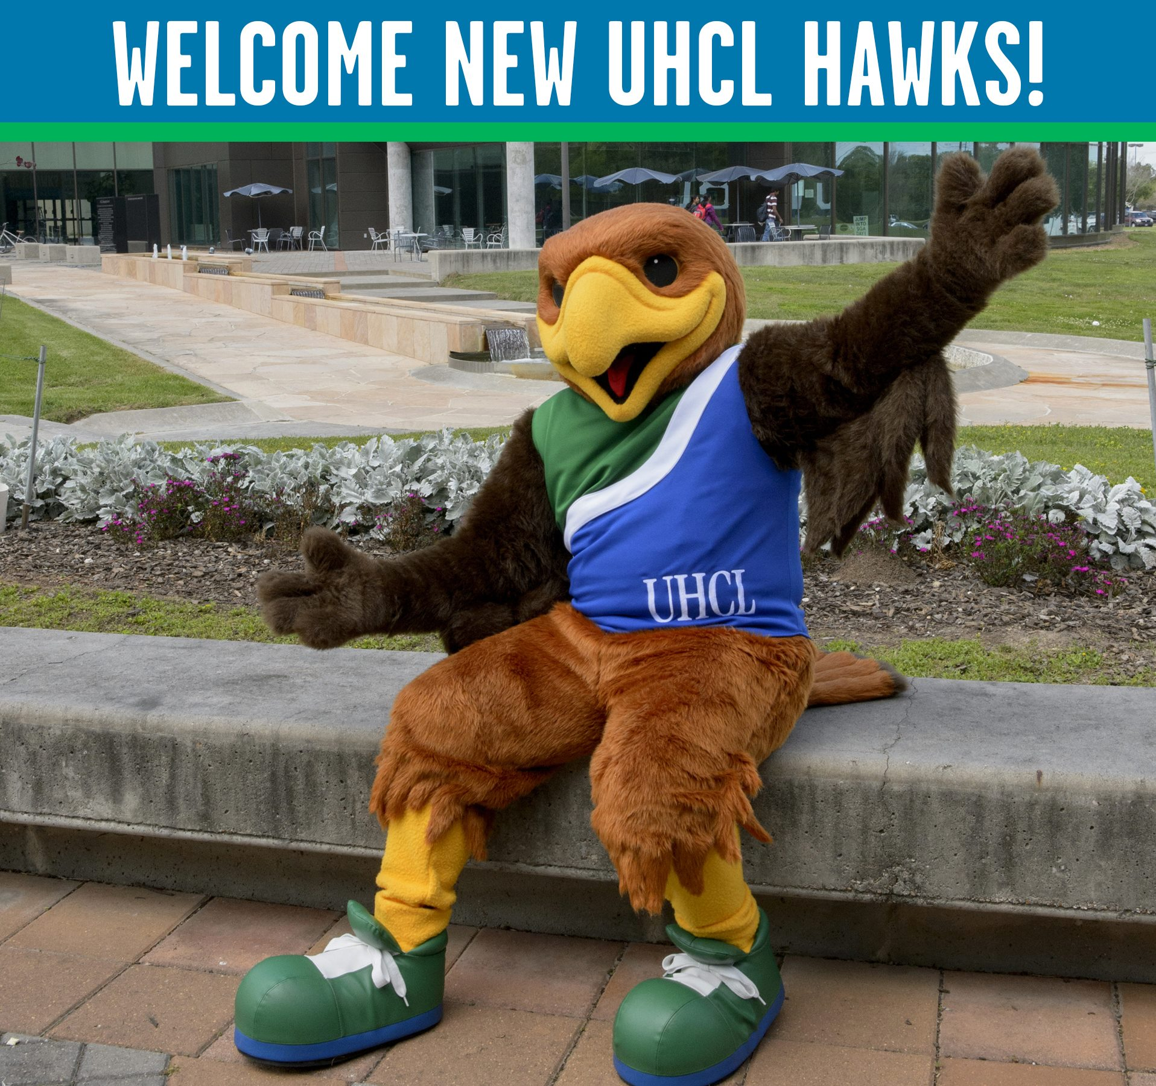
Register for Mandatory New International Student Orientation (NISO)
All international undergraduates and F-1 graduate students are required to attend New International Student Orientation.
To register, please visit the Orientation & New Student Programs webpage: https://www.uhcl.edu/student-affairs/campus-community/orientation/

Slide 15
Make Your Travel Plans
When Should You Come to the U.S.?
After you obtain your visa, you may travel to the U.S. up to 30 days before the program start date, which is indicated on your Form I-20
Plan to arrive at UHCL BEFORE the program start date (Orientation Day!)
  Contact your academic department and OIAP if you cannot arrive until your program start date
  Late arrival is available only until the first day of class
  We do not provide late arrival permission letters

Slide 16
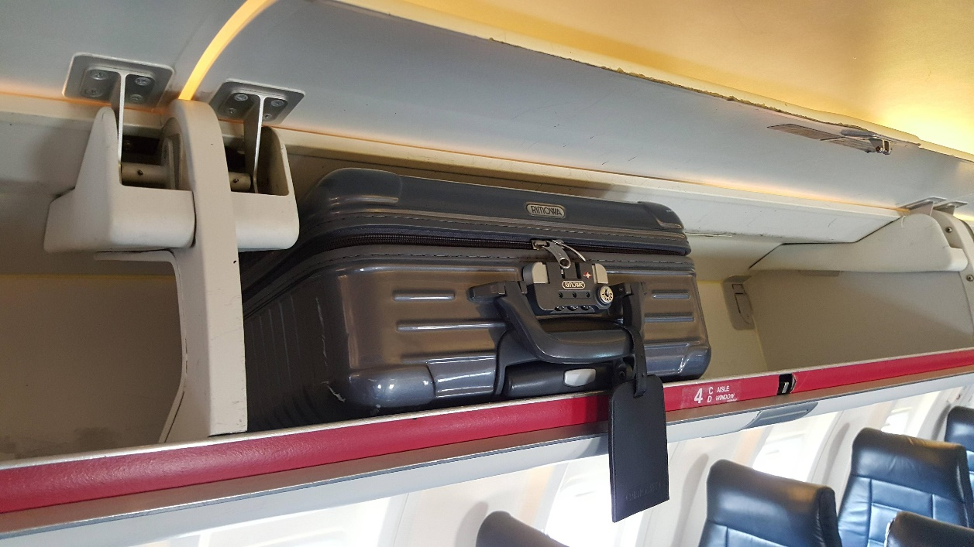
Travel Documents
Be sure to have these documents with you in a carry-on bag so they are with you when you land and not stowed away in your luggage
When you travel please carry with you:
Form I-20
Passport
Visa
I-901 SEVIS fee receipt
Admission letter
Funding documentation
OIAP contact information

Slide 17
Admissions Documents
You need to bring official admissions documents to finalize your admissions
Submit Original or Attested Copies of your Proof of Degree
Submit Original or Attested Copies of your Transcripts
Submit Official Test Scores
Submit any outstanding requirements, such as meningitis vaccination records (if under the age of 22) via E-Services. If you have not received your I-20 yet, please review your To Do List in E- Services to upload any outstanding items and ensure that your English proficiency test scores have been officially reported to UHCL.
These documents will not be returned to you, make sure you are providing a copy you do not need returned to you. Please bring these documents with you to orientation.

Slide 18
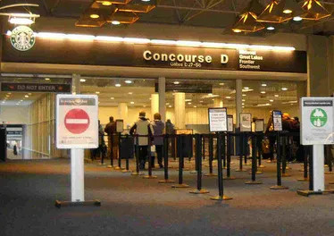
U.S. Port of Entry
Follow signs to U.S. Customs. Get in the line for non-U.S. citizens.
Present your passport and Form I-20 to the U.S. immigration officer
Be sure that the officer admits you using your F-1 visa by checking your I-94 before leaving the airport
If your I-94 states any entry other than F-1 and a specific expiration date (not D/S), please go back to have this corrected BEFORE you leave the immigration booth

Slide 19
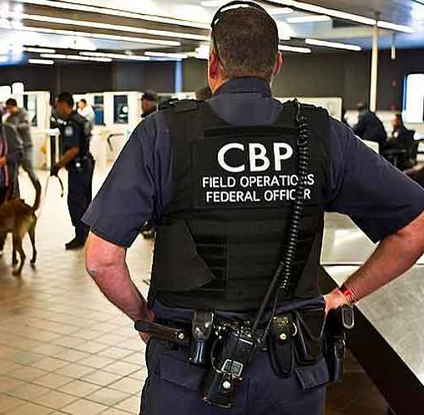
Deferred Inspection
Occasionally, when going through the port of entry, you may be sent to Deferred Inspection (sometimes called Secondary Inspection.) This may happen if additional information is required by the officer. It is normal but could delay you for a bit.

Slide 20
Welcome to the U.S.
What to do now that you have made it

Slide 21
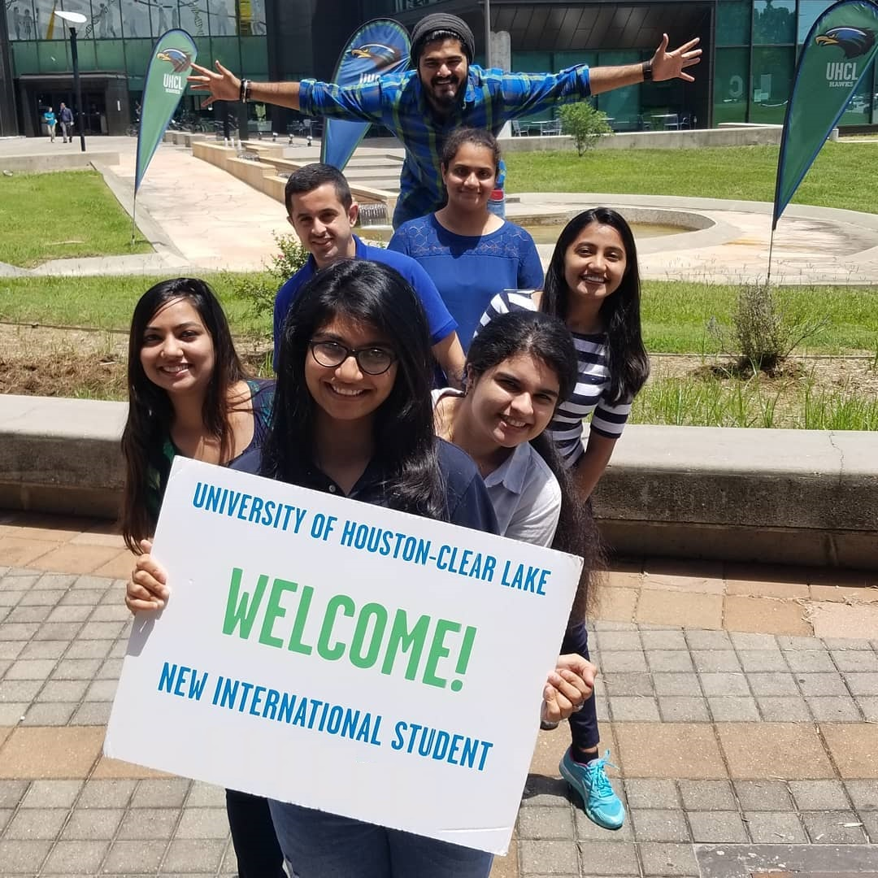
Complete Your F-1 Check-In
Upon arrival to Houston
Report to the Office of International Admissions & Programs (OIAP) by uploading your documents to the ISD Portal: https://apps.uhcl.edu/isd
Upload the following:
Form I-20 with your signature on it
Passport
F-1 Visa
Most recent I-94 arrival record. You can obtain this on the U.S. Customs and Border Patrol website: https://i94.cbp.dhs.gov/I94/#/home

Slide 22
Class Enrollment
You can enroll for classes through E-Services
Start here: https://www.uhcl.edu/registrar/enrollment/
You may need assistance from your academic advisor (this is not the same as your international advisor)
  Academic advising for undergrad and transfer students can happen virtually prior to arrival. You will need to schedule an appointment with them
  For graduate advising please contact your academic or faculty advisor via email if you have questions
It is possible to register for classes prior to arriving in the U.S. but be aware of payment deadlines and if you do not come, you are responsible for dropping your classes before the payment deadline
After you have registered for classes you will need to secure your payment for tuition and print your schedule

Slide 23
F-1 Full Course Study Requirements
Minimum Requirements:
Summer Enrollment
Not required unless it will be your first or last semester at UHCL​. Must have at least 1 F2F class
Academic Level​ | Spring/Fall​ | Minimum # F2F​ | Allowed Online​
Undergraduate (UG)​ | 12 credits​ | 9 credits​ | 3 credits​
Graduate (GR)​ | 9 credits​ | 6 credits​ | 3 credits​
***DO NOT drop or withdraw from a course without consulting your International Advisor
Concurrent Enrollment
Allows you to enroll at another institution to take credits that count towards UHCL degree completion
Online Course
Courses labeled 100% or > 50% OR = to 50% online are an ONLINE course
Only 3 credits of online coursework count towards full-time enrollment per semester.

Slide 24
Withdrawal from a Class
“W” = withdrawal of a class
It is either initiated by you or the instructor and is NOT considered completion of course
May lead to status violation if it results in an unauthorized drop below full course of study
If for some reason you withdraw or are withdrawn from any class or classes, it is your responsibility to register for additional courses to maintain your status
If you believe that you need to drop a course and it will result in a below full-time enrollment status, ​contact your International Advisor BEFORE YOU DROP THE COURSE!

Slide 25
International Student Services
How can our office assist you?

Slide 26
Your International Advisor/DSO
Your International Advisor is also your Designated School Official (DSO) that is responsible for making sure you are compliant with U.S. regulations related to your F-1 Visa status
The DSO maintains your SEVIS (immigration) record while you are in F-1 status
The DSO is responsible for educating the student and the institution about rights and obligations under F-1 regulation and approves or recommends benefits for the F-1 student
Your International Advisor does not assist with class enrollment. You will need to contact your Academic Advisor for class support
DSO Advisor​ | Academic/Faculty Advisor​ | Who is Your Academic Advisor
Supports with I-20​ | Registration For Class​ | College of Science and Engineering
Maintain Status​ | Academic Support​ | College of Business
Immigration Advising​ | Course Inquiries​ | College of Human Sciences & Humanities
 |  | College of Education

Slide 27
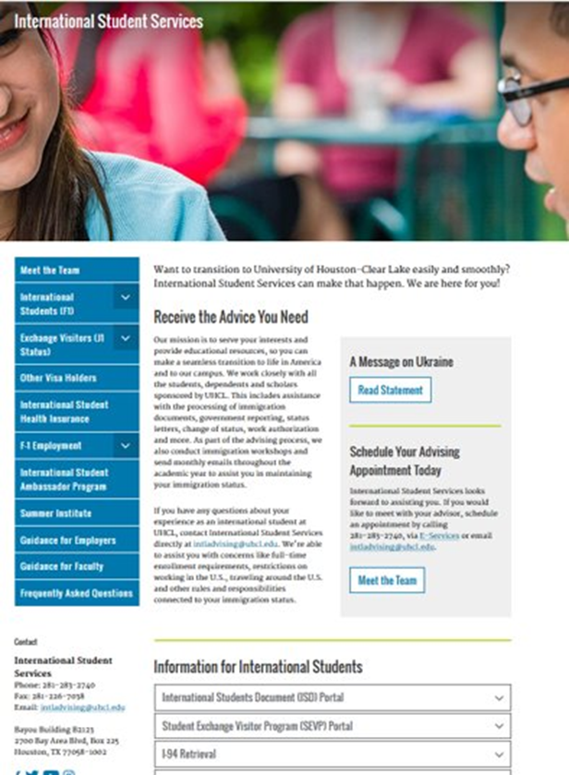
ISD Portal
The International Student Document (ISD) Portal is how you will communicate with our office and make requests
Common Requests Include:
Reduced Course Load (RCL)
Reporting a Change of Address
Requesting Concurrent Enrollment
Applying for and reporting Employment
Status Letters

Slide 28
Keep All I-20s Issued to You
The Form I-20 is an important document that should be kept safe.
F-1 students need their Form I-20 for benefits:
Driver’s license
Social Security Number
Employment
Change of Status
Source: https://studyinthestates.dhs.gov/what-is-the-form-i-20

Slide 29
Reporting Requirements
Please report within ten (10) days of the change:
  Address​
  Telephone​
  Name changes: marriage or spelling has changed on passport​
  Financials or sponsorship​
  Status changes from F-1 visa to a different visa- H1B, B-2, etc.​
  Passport/F-1 visa renewals
There is a penalty for not reporting changes in a timely fashion
Note – Your passport needs to be valid for six (6) months or more at all times​

Slide 30
F-1 Students and Employment
Types of Employment
On-Campus Employment
  On school premises - student positions such as peer tutors, servers with dining services, graduate assistants, etc.
  May work up to 20 hours per week while school is in session (full time during summer and official University breaks (spring break, winter break, etc.)
Curricular Practical Training (CPT)
  Written approval from DSO is needed before an F-1 student can start working at an internship
  The student must enrolled in an internship course to be eligible for CPT
  CPT is not allowed until a student has completed one full academic year
Optional Practical Training (OPT)
  Adjudicated by U.S. Citizenship and Immigration Services (USCIS)
Any other employment in the U.S. is considered Unauthorized Employment. F-1 student status will be terminated if a student is found working outside of their visa requirements​

Slide 31
Student Tax Return
Every international student and their dependents are required to file a tax return if they were in the US during the previous calendar year
Source: https://www.internationalstudent.com/tax/
You might get a refund - Some international students will qualify for a refund due to tax treaties and a lack of serious income if they’ve earned income in the US
You fulfill your visa obligations - All international students must file at least the Form 8843, even if you didn’t earn any money in the US

Slide 32
Adjusting to Life in the U.S
Health Insurance
Housing
Transportation
Phone Service
Banking

Slide 33

Health Insurance
Insurance is essential and required for F-1 international students
Healthcare can be very expensive but life saving!
Health Insurance will help save money in the long-term
Visit the UHCL Health Insurance Page for additional information: https://www.uhcl.edu/student-affairs/health-wellness/health-services/insurance-student

Slide 34
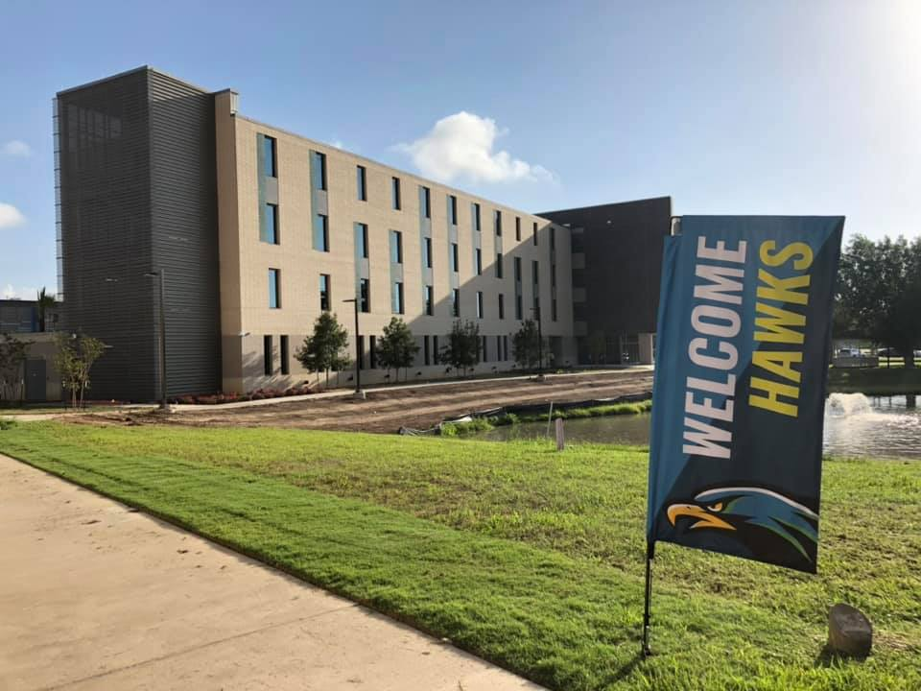
Housing
On-Campus Housing
  Hunter Hall: https://www.uhcl.edu/student-affairs/campus-community/housing/hunter-hall/
Off-Campus Housing
  Many options close to campus
    University Forest
  Search local apartment finders
    ApartmentFinder.com
    Apartments. com

Slide 35

Transportation
Shuttles
The University of Houston-Clear Lake provides a shuttle around campus and between nearby apartment complexes. To review the shuttle schedule, please visit the Parking and Transportation webpage: https://www.uhcl.edu/maps/parking/shuttle-service/
Buses
Houston Metro: https://www.ridemetro.org
  The Bay Area Blvd and El Dorado Blvd Park and Rides are the closest transportation hubs to UHCL that can take you into Houston and beyond! The Hawk Express Shuttle does stop at the Bay Area Park & Ride at various time throughout the day. Check the schedule on the Parking and Transportation website
  Explore the Metro website to learn how you can get around the city of Houston by public transportation
Ride-Share
Uber
Lyft
Bicycles
Some students invest in a bicycle for their time at UHCL. Don’t forget to purchase
a helmet!

Slide 36

Cellphone Providers
UHCL does not endorse any specific cell phone provider and cannot make specific recommendations to you about which to use. There are several options:
  Verizon
  T-Mobile
  AT&T
  Boost Mobile
  Cricket

Slide 37
Banking
UHCL does not endorse any specific bank and cannot make specific recommendations to you about which banking institution to use. There are several with branches near the University of Houston-Clear Lake.
Banks located Near Campus
PNC
Bank of America
Chase
Wells Fargo

Slide 38
Campus Resources
Tools for success while you are studying at UHCL

Slide 39
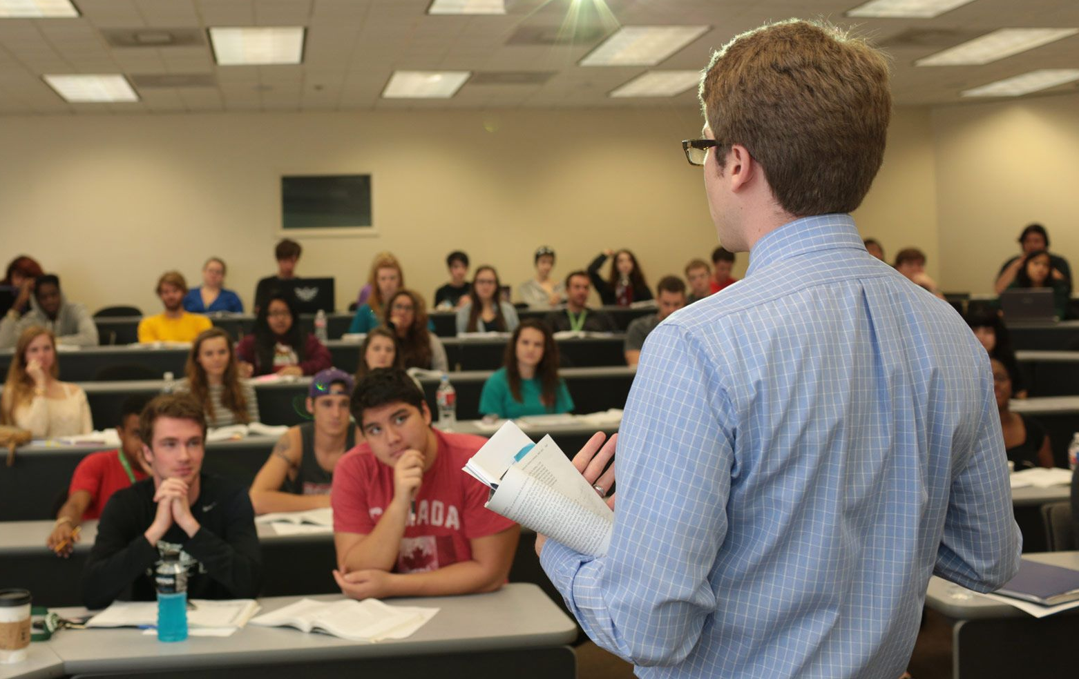
Preparing for Class
Find your classrooms before the first day of class
Make sure you have your professor’s contact information
Review your course syllabus:
  Assess your course learning outcomes
  Purchase required textbooks
  Make sure you understand the course structure
  Review the course grading criteria
Review all assignments and schedule time to prepare all work
Know your deadlines
Ask your instructors clarifying questions

Slide 40
Academic Services
Feel free to use the services offered at UHCL
Academic Advising​: https://www.uhcl.edu/academics/advising/
Academic Tutoring​: https://www.uhcl.edu/student-success-center/tutoring
Career Services: https://www.uhcl.edu/career-services/
Technical Support​: https://www.uhcl.edu/computing/
Counseling Services: ​https://www.uhcl.edu/counseling-services/
Writing Center​: https://www.uhcl.edu/writing-center/
University Library: https://www.uhcl.edu/library/
Accessibility Support Center: https://www.uhcl.edu/accessibility-support-center/
Hawk Pantry: https://www.uhcl.edu/student-affairs/advocacy/uhcl-food-pantry

Slide 41
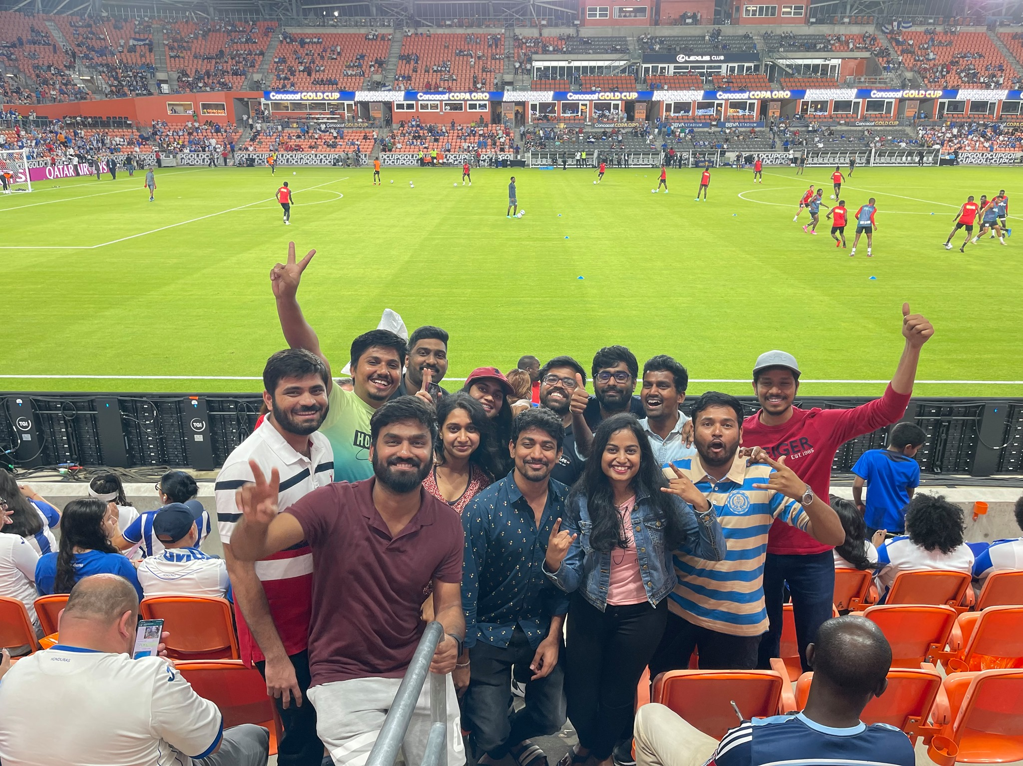
Get Involved – Student Life
Find Your Community
UHCL has over 100 student organizations
Attend Campus Events
There’s always something happening at UHCL
Develop Leadership Skills
Fine tune your experience at UHCL by being an active leader on campus
https://www.uhcl.edu/student-affairs/

Slide 42

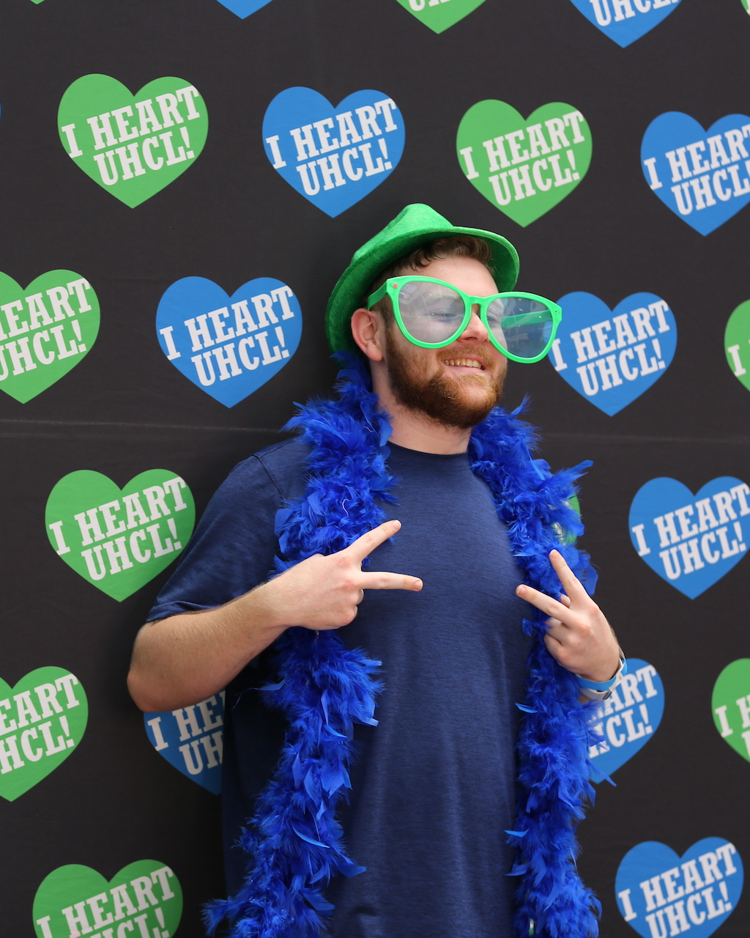
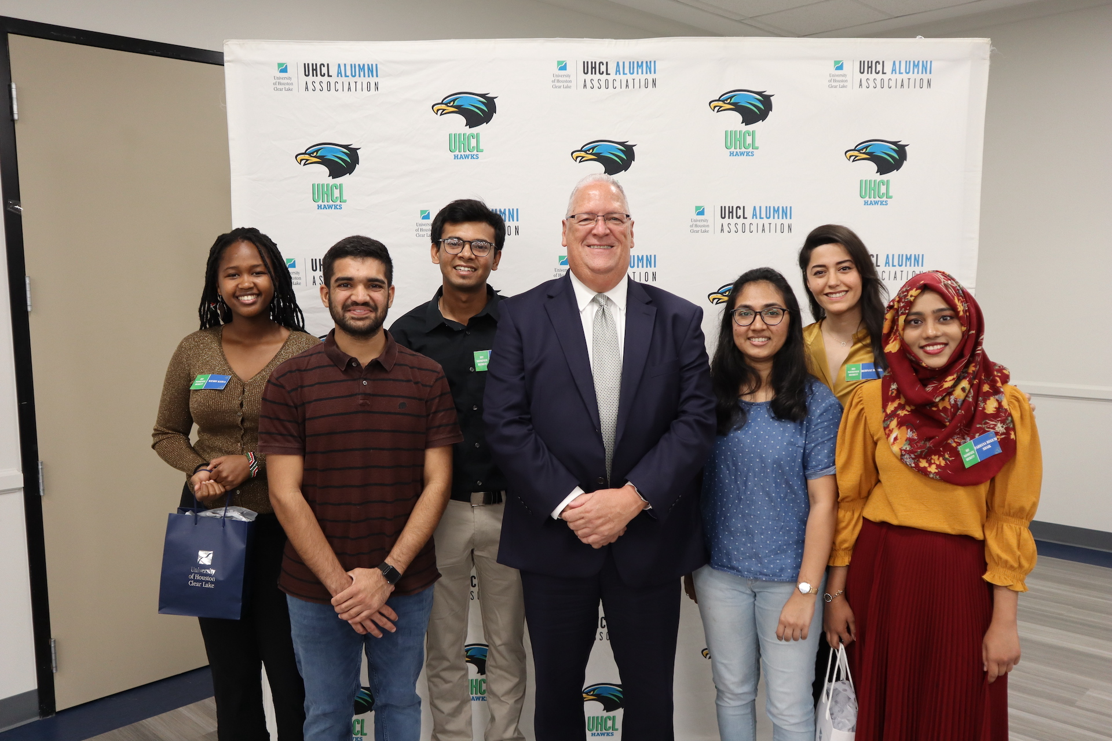
International Student Pre-Arrival Guide
Please review our online pre-arrival guide for more information and tips for international students at UHCL:
International Pre-Arrival Guide

Slide 43
Mandatory Acknowledgement Completion Form
Click Here: International Student Online Acknowledgement Form

Slide 44
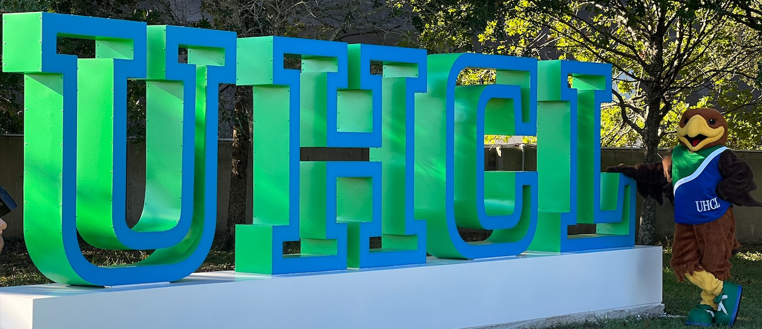
Welcome to the UHCL
HAWK FAMILY

