Slide 1
Faculty Research and Support Funds
Preparing a Competitive Proposal

Slide 2
OVERVIEW
Purpose and Eligibility

Slide 3

FACULTY RESEARCH AND SUPPORT FUNDS
Internal funding
Research, creative, and scholarly activities
Small projects
This Photo by Unknown Author is licensed under CC BY-NC

Slide 4
ALLOWABLE USES OF FUNDS
Equipment, supplies, and materials
Salary and fringe for student assistants
Travel necessary to conduct research
Copyright permission
Training or coursework to develop new research skills
Preparation of monographs
  Textual and biographical research
  Annotation
  Indexing
This Photo by Unknown Author is licensed under CC BY-NC

Slide 5

ELIGIBILITY
Full-time faculty
Tenure-track or tenured
No current FRSF awards
No overdue FRSF final reports
This Photo by Unknown Author is licensed under CC BY

Slide 6
APPLICATION PROCESS
Five steps to done

Slide 7

STEP 1: Read the Guidelines
This Photo by Unknown Author is licensed under CC BY-SA-NC

Slide 8

STEP 2: Write the Proposal
This Photo by Unknown Author is licensed under CC BY

Slide 9

STEP 3: Send to Dean
Request support from your College Dean
Include proposal and current CV
Allow sufficient time for review
Copy Dean’s Administrative Assistant
Copy SponsoredPrograms@UHCL.edu
This Photo by Unknown Author is licensed under CC BY-ND

Slide 10

STEP 4: Dean’s Support
Dean reviews proposal
Dean sends email supporting proposal to OSP
Must be received by application deadline
This Photo by Unknown Author is licensed under CC BY-NC-ND

Slide 11

STEP 5: OSP Confirmation
OSP acknowledges receipt of proposal and Dean’s support
Submission process is complete
This Photo by Unknown Author is licensed under CC BY

Slide 12
PROPOSAL ELEMENTS
All the parts and pieces to make your proposal whole

Slide 13

REQUIRED ELEMENTS
Cover Page
10-Page Project Narrative
Budget and Budget Justification
Cost Share Support (if applicable)
Appended Material
  Curriculum Vitae for Project Personnel
This Photo by Unknown Author is licensed under CC BY-SA-NC

Slide 14
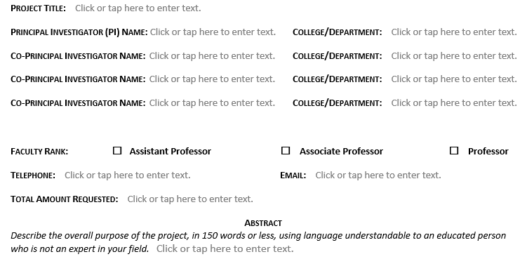

Slide 15
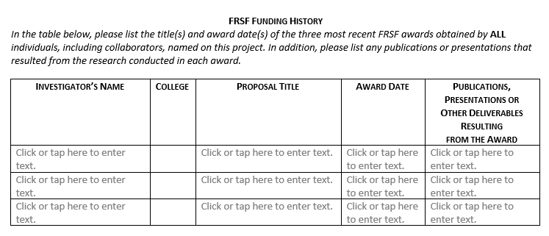

Slide 16

PROJECT NARRATIVE
Purpose and Objectives
Background and Hypothesis
Significance of Request
Procedures/Work Plan/Methodology
Duration of Request/Time Frame
Equipment/Facilities
Dissemination/Use of Results/Project Sustainability
This Photo by Unknown Author is licensed under CC BY

Slide 17
BUDGET SUMMARY
Category | Item Description | Cost
Salary | Student Research Assistant ($400 per month for 6 months) | $2,400
Fringe | Calculated at 6.2% of salary | $149
Equipment
Travel | Local mileage to collect samples calculated at 62.5 cents per mile (200 miles) | $125
Supplies | Sample collection supplies | $500
Other | Transcription service (20 hours at $25 per hour) | $500
Total |  | $3,674

Slide 18

BUDGET JUSTIFICATION
Describe each budget item
Estimate the cost of each item
Explain why it is important to the project
This Photo by Unknown Author is licensed under CC BY-SA-NC

Slide 19

COST SHARE SUPPORT
Itemize expenses to be paid for by program or college
Provide documentation of program or college’s commitment to support the cost of items

Slide 20
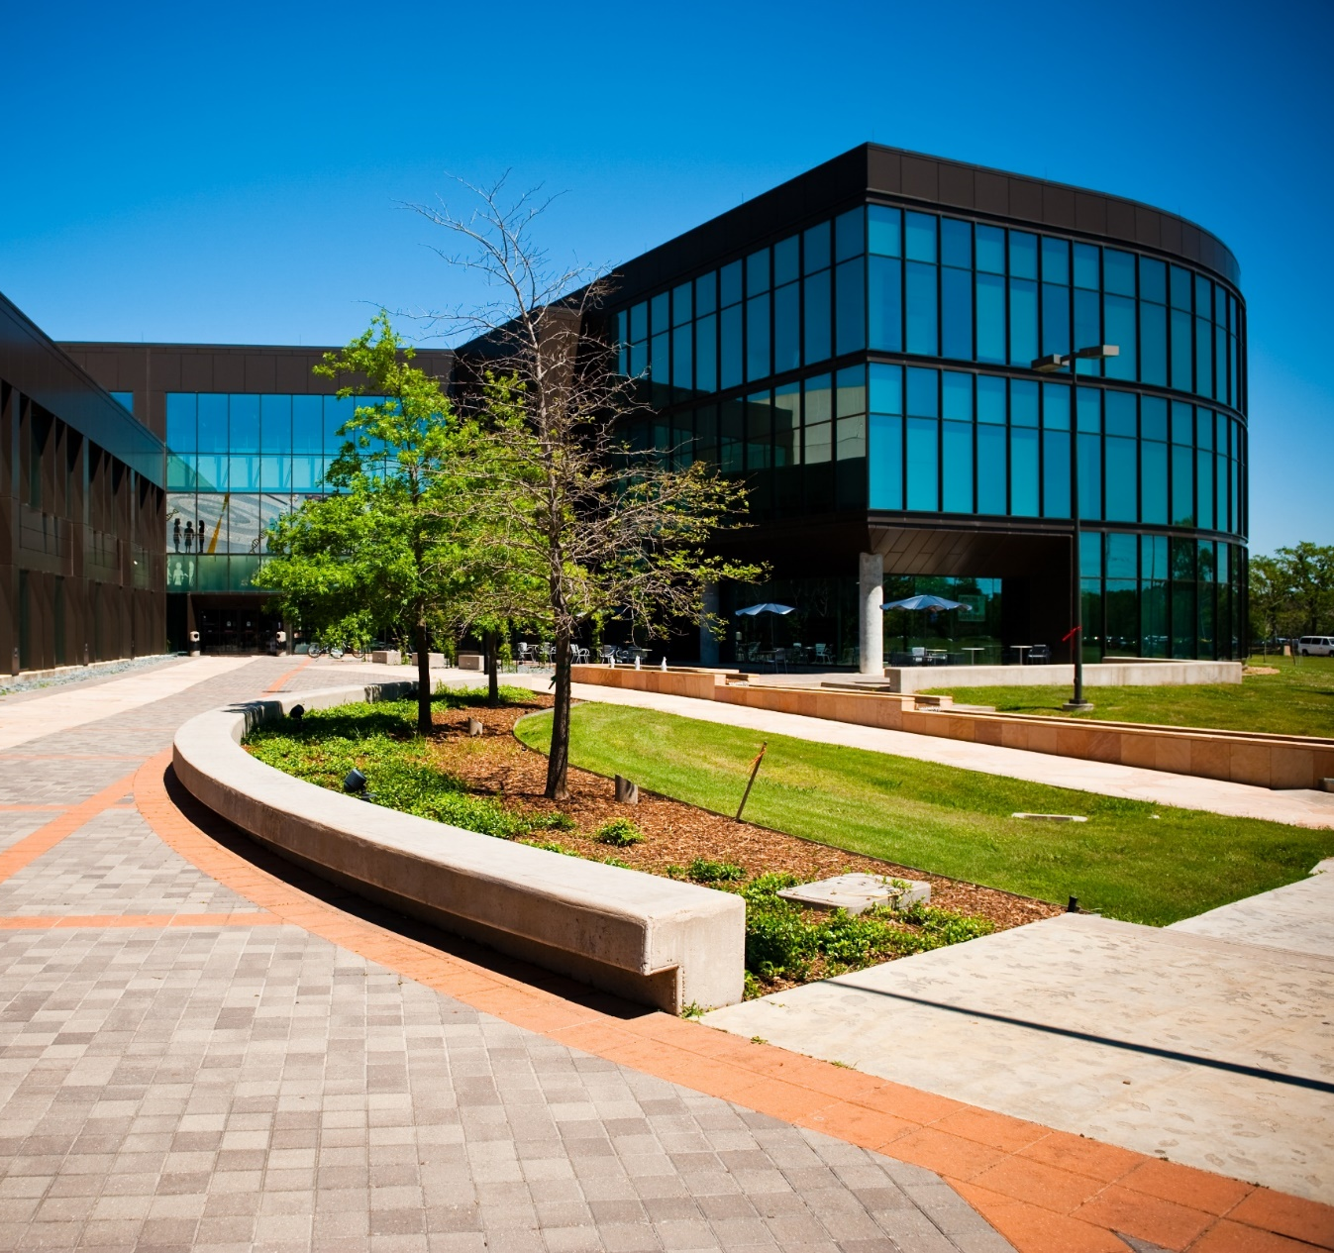
APPENDED MATERIALS
Include Curriculum Vitae for all professional personnel
Provide supplemental information supporting the project, such as:
  Letters documenting external partnerships or other commitments to support project
  Sample instruments to be used in project
  Documentation to support costs of budget items

Slide 21
REVIEW PROCESS

Slide 22

REVIEW CRITERIA
Purpose
Significance and Timeliness
Advancement of the discipline
Clarity of hypothesis, methodology, and project plan
Impactful Dissemination Plan
Realistic plan for future external funding
This Photo by Unknown Author is licensed under CC BY-SA

Slide 23

COMMITTEE PROCESS
Points are assigned to each criterion
Two criteria may be excluded if not applicable
Points are averaged for all reviewers
Points are converted to a final score (percentage based on number of criteria scored)
Committee reviews scores and makes recommendations for funding
Provost reviews and approves committee recommendations
This Photo by Unknown Author is licensed under CC BY-SA

Slide 24
COMPETITIVE PROPOSALS

Slide 25

TIP 1: Write to the Reviewers
At least one reviewer will not be from your discipline
Use clear language someone outside of your field can understand
Write concisely
Address what you plan to do, how and why, and what resources are needed
This Photo by Unknown Author is licensed under CC BY-SA-NC

Slide 26

TIP 2: Use a Scholarly Approach
Support assertions with recent citations
Tailor a concise literature review to the project
Include citations within the 10-page narrative

Slide 27

TIP 3: Sell Your Idea
State why the project is important
Explain how it benefits UHCL
Explain how it advances your discipline
Provide a realistic dissemination plan
This Photo by Unknown Author is licensed under CC BY

Slide 28

TIP 4: Pay Attention to Details
Follow formatting requirements
Use current cover page form
Assemble components in correct order
Check budget calculations and align with budget justification
This Photo by Unknown Author is licensed under CC BY

Slide 29
TIP 5: Seek and Use Reviewers’ Advice
College | Committee Members
Business | Timothy Michael, Ivelina Pavlova-Stout
Education | Renée Lastrapes, Sheila Baker
Human Sciences and Humanities | Steven Sutherland, Christine Kovic
Science and Engineering | Yi Su, Kazi Billah

Slide 30
WRITING CENTER ASSISTANCE

Slide 31




UHCL Writing Center
The Writing Center's mission is to support students, faculty, staff, and alumni in reading, writing, and researching a wide variety of texts.
Our Services
One-on-One Consultations
Group consultations
Workshops & Writing Circles
Tip Sheets & Writing Guides
Visit Our Website: https://www.uhcl.edu/writing-center/
Contact Us
281-283-2910
writingcenter@uhcl.edu
SSCB 2.101

Slide 32
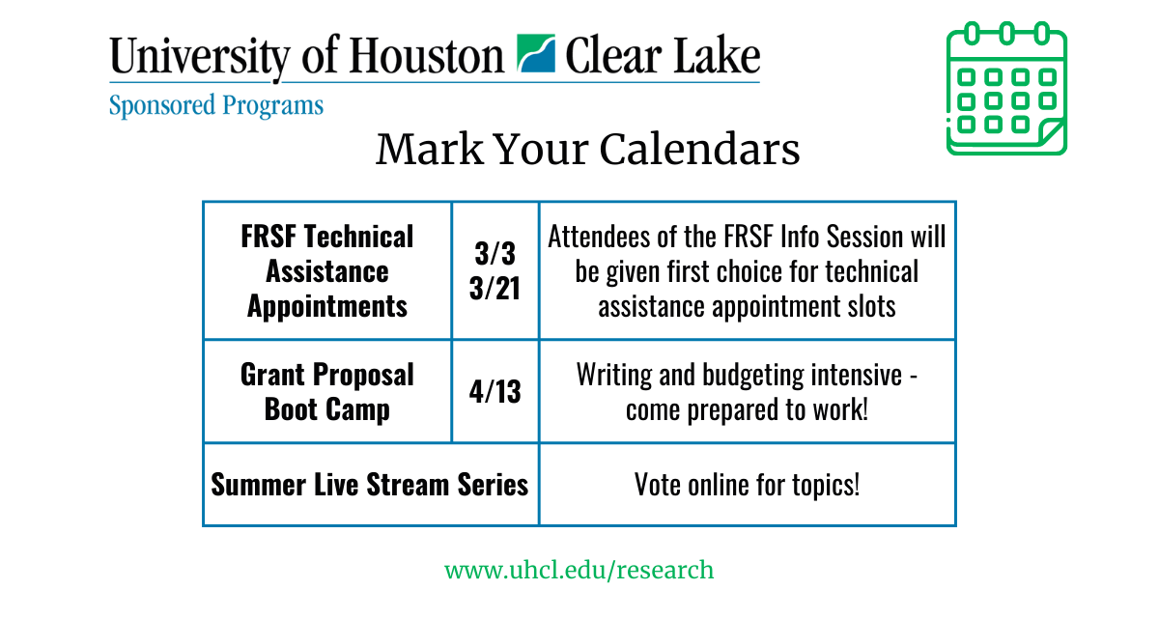

Slide 33
Q & A

Slide 34

This Photo by Unknown Author is licensed under CC BY-SA-NC

