Slide 1
PARTNERSHIPS
Office of Sponsored Programs
Summer Live Stream Series
June 29, 2023

Slide 2
Office of Sponsored Programs
Our mission is to assist faculty, staff, and students in seeking out and applying for external funding for research, academic, and community activities.
Proposal Development Services
Generating a proposal outline from solicitation
Generating a timeline of tasks for proposal completion
Assisting in developing research and management plans
Providing general university or community information or statistics already on file
Verifying compliance with agency solicitation and guidelines
Proofreading and editing
Completing forms and submitting proposal to agency

Slide 3
OFFICE OF STRATEGIC PARTNERSHIPS

Slide 4
Who We Are
Our mission is to cultivate strategic connections that build lasting and mutually beneficial relationships with business, industry, government agencies, community organizations, educational entities, and nonprofit partners.
  Serve as a primary interface for external partners and specializes in connecting opportunities to meet company or organization objectives.
  Form partnerships where the university provides a pipeline of skilled interns and businesses provide valuable and paid learning experiences for students.

Slide 5
Who We Are
Internship Initiatives
  Boeing Student Development Program
  Funded Internships
  Intern Scholarships
External Outreach
  Hawk Ventures
  Lunch & Learns and Employer Roundtables
  Internship Information Sessions

Slide 6
Experiential Learning
Internships, Capstones, Practicums
Internships for academic credit
  Administered by each college
  Affiliation Agreement available through Procurement & Contracts
  Strategic Partnerships can provide guidance on recruitment and internship process
  Internships as part of a grant
  Work with Sponsored Programs for guidelines on administering internships
  Strategic Partnerships may support recruitment and internship process

Slide 7
How We Can Support
Whether you have existing relationships with industry or would like to establish new mutually beneficial relationships, Strategic Partnerships can help faculty and staff in engaging with external partners.
  Help to identify prospective companies and organizations.
  Connect to industry representatives.
  Provide guidance on partner engagement.
  Search the university partnership database.

Slide 8
Community Partnerships Dashboard
A great starting point!
Searchable database of university partnerships
Partnerships are self-reported by colleges and divisions
University point of contact listed for each partner

Slide 9
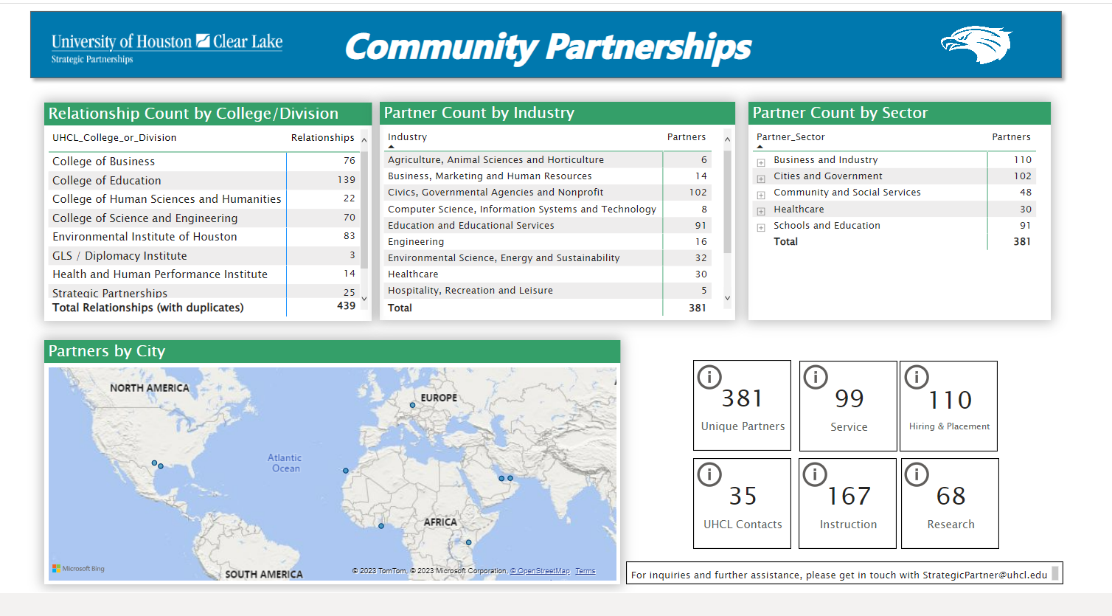
ACCESS INSTITUTIONAL RESEARCH DATA PORTAL

Slide 10
TYPES OF PARTNERSHIPS
Office of Sponsored Programs

Slide 11
Universities
You reach out to colleagues or are invited to join colleagues’ project
Best Practices
Connect UHCL OSP to partner’s OSP as soon as possible
Decide structure: subaward or collaborative
  Review agency guidelines
Research Institutions (R1, R2) may become project lead
  For programs not specifically for MSI/HSI/PUI
  Depends on your relationship with PI

Slide 12
Community Colleges
Current Strong Relationships
San Jac
  Central (Pasadena)
  South
Lee College
Houston Community
Alvin Community
College of the Mainland
Best Practices
Connect UHCL OSP to partner’s OSP as soon as possible
Decide structure: subaward or collaborative
  Review agency guidelines

Slide 13
Local School Districts
We have standing relationships with 22 districts
Best Practices
Reach out to UHCL College of Education
  Executive Assistant in Dean’s Office; or
  Ask OSP for assistance

Slide 14
Non-profit Organizations
Usually either a subaward or a passthrough
Subaward
Establish clear scope of work
Request signed letter of commitment
Finalize subaward budget early
Passthrough
UHCL is not eligible entity, so non-profit submits on our behalf
OR
Non-profit is not eligible entity, so UHCL submits on their behalf
Submitting agency acts as passthrough for funds, while subgrantee performs work

Slide 15
Small Businesses
Best Practices: Do Your Research!
Are they registered with the Small Business Administration?
  Link to SBA search
Have they been debarred from federal contracts?
  Need a free account with SAM.gov
  Log in and search for entity with exact name
UHCL will only contract with businesses that are registered with the SBA and that have not been debarred.

Slide 16
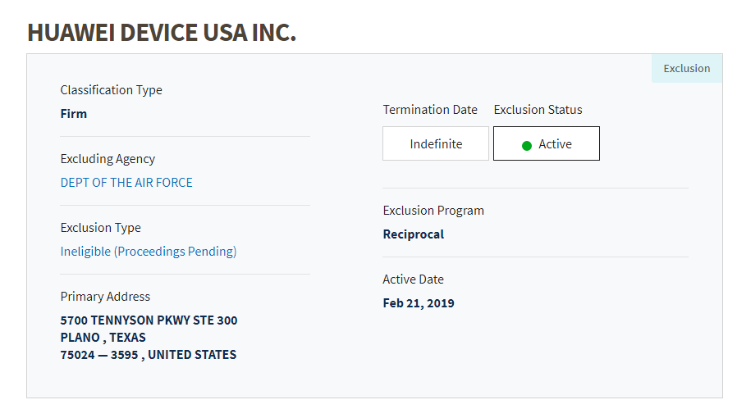
Debarment Example

Slide 17
Thank you!
Contact us:
strategicpartner@uhcl.edu
sponsoredprograms@uhcl.edu

