Slide 1
IRB Applications

Slide 2
When you Receive the Application
Double check that the info on the first page has been completed
Make sure students list themselves as student researcher
If a student researcher is listed, there must be a faculty sponsor name

Slide 3
Page 2
Data collection dates should make logical sense
Double check that the start of data collection has not passed
Make sure the number of participants listed here matches what is described later in the application
The Background/Significance and Specific Aims sections should be completed
The quality of research questions, doability of the study, etc. are outside of our scope unless they impact the protection of participants.

Slide 4
Research Design
This section should include a thorough explanation of what the researcher will do over the course of the study.
What we need to see:
Step-by-step description of data collection, analysis
What we don’t need to worry about:
Quality of the research, unless it affects the protection of participants

Slide 5
Instruments
The researcher should attach copies of all instruments used for data collection
If he/she sends a link to their survey, we need to request a PDF of the survey
Interview/focus group protocols need to be included here as well, even though they aren’t usually considered instruments
Exceptions:
Some assessments, like the STAAR tests, aren’t available because the items are not released.

Slide 6
Recruitment & Selection
The researcher should be specific here. If you read this section and are unclear about how he/she will recruit participants, ask for more detail
Pay close attention to studies where the researcher is in a power position over potential participants (i.e. a professor researching their students)
Should describe how he/she will address the power issue in a way that would protect the students and that students would see as non-coercive

Slide 7
Informed Consent
Make sure consent forms for every type of participant are attached (as needed)
Consent for adults
Parental consent
Student assent
Survey cover letter instead of consent
This often is confusing for students, surveys get cover letters, interviews require the informed consent forms
These should be written in language that participants can understand, not research-speak
Should clearly explain what participants will do (and only what they will do—no lit, no research questions, etc.)
Need to consider risks from the participants’ perspectives, not from the researcher’s.

Slide 8
Confidentiality
Make sure the researcher is clear about how he/she will protect identities.
May use numeric identifiers, pseudonyms, etc.
Need to say that data will be stored for (at least) 3 years and will then be destroyed.
Describe how data will be kept secured
locked in a filing cabinet
stored on a password-protected laptop
There should be a sentence about who has access to the list connecting actual names with identifiers (unless data were anonymous)

Slide 9
Research Benefits
Often, there is no direct benefit to participants
This should be clearly stated
The researcher needs to include a sentence or two on expected general results.
Example:
There are no expected direct benefits to participants. The results of this research are expected to increase understanding of the factors that contribute to doctoral students’ positive experiences in research courses.

Slide 10
Risks
Should be addressed from the perspective of the participant, not the researcher
If there are risks, the researcher should provide contact info for treatment (counselors, clinics, etc.)
Make sure the researcher is adequately considering any possible risks and minimizing them

Slide 11
Site Letter
This is a letter granting permission to do research at a site, usually a school district.
Must be attached to the application
Need a letter for each site
Should be a PDF, signed, on letterhead
If data is not collected at a particular site, this may not be needed
Interviews with teachers conducted off-campus
Observations conducted in a public setting

Slide 12
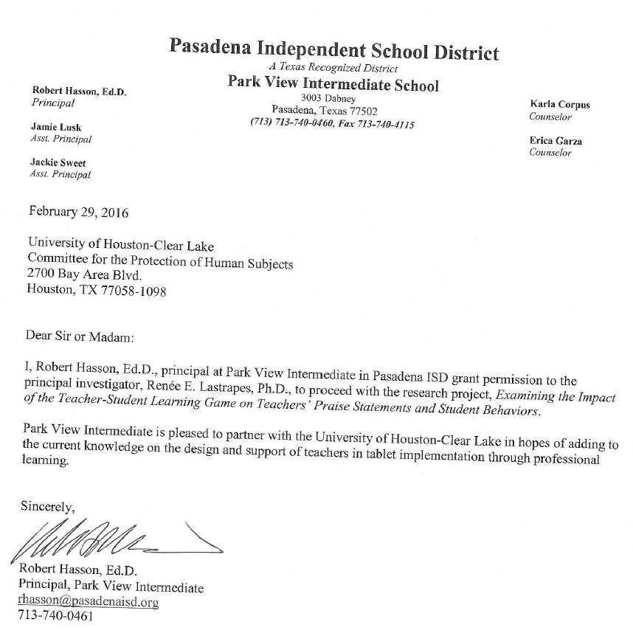
Example Site Letter

Slide 13
Approval Form
Fill out the top part using the application
In Section A, indicate whether the research qualifies as exempt and indicate the category.
If non-exempt, in Section B, select the type of risk & add the category #
Minimum Risk, Allowable
Minimum Risk, Not Allowable (not on the category list)
Above Minimum Risk
Also check that the requirements have been met or explain in Section C.
Select a recommendation in Section C
Approved
Conditional approval
Call a full CPHS meeting

Slide 14
When it is not Research
Not all applications are for research activities.
If you get an application that does not seem as if it is research, ask the PI to fill out the Determination of Research Worksheet

