Slide 1
Administration & Finance
Finance is a division of the Administration and Finance component. The finance division encompasses the units of Procurement and Contract Administration, Accounts Payable, Travel, Student Business Services, General Support Services, General Accounting, Asset Management, and Financial Compliance and Reporting.
Mission Statement
In the spirit of providing quality service, the Finance Division of UHCL strives to excel in delivering business solutions through collaborative partnerships that foster a culture of integrity, creativity and innovation.
Vision Statement
The UHCL Finance Division aspires to be a team of professionals committed to the delivery of effective and efficient customer service while maintaining fiscal integrity.

Slide 2
It always begins with a TEAM!

Slide 3
Training Objectives
Requisition training
Purchase Order
Contract

Slide 4
Requisition Pertinent Information
Request for goods or services
Purchasing Threshold
$<$5K ($3K on federal funds) Delegation given to department
>=$5K but <$15K (No bids required, Requisition required)
>=$15K but <$25K (Informal bids, Requisition required)
>$25K and above ($150K on federal funds)(Formal bids, Requisition, formal solicitation required)
=>$1M (Board of Regents reporting and approval)

Slide 5
Procurement – Goods vs. Services
Goods | Tangible, physical items
 | Stand alone purchases. Once purchased, the relationship ends.
Services | Works or duties provided to university by individuals, organizations, corporations, businesses etc.
 | It can be stand alone (onetime) or repetitive or ongoing
 | Requires a contract
 | All contracts must be placed on a requisition for reporting purposes
 | Threshold rules are the same as 'Goods'
 | Contracts must be approved by UHS Contracts office if it is a non-standard agreement or over $50,000 on the standard agreement form approved by UHS.

Slide 6
Requisition Demonstration
Entering a requisition for goods
Entering a requisition for services
Multiple cost centers on a requisition
PeopleSoft requisition training documents
https://www.uhcl.edu/about/administrative-offices/finance/peoplesoft-finance/training

Slide 7
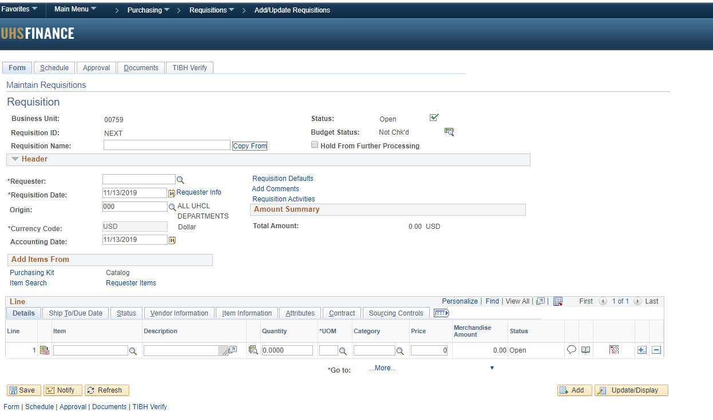
PeopleSoft Requisition

Slide 8
PURCHASE ORDER REQUISITION PROCESS SNAPSHOT
Supporting Documentation required be uploaded to requisition
1. A current quote from the vendor.
2. Good specifications including a detailed description, dimensions, quantities, etc.
3. Any forms required by the vendor.
4. Any emails or supporting documentation that would be helpful in placing the order.
Supplier’s quote includes terms and conditions
Ask vendor if they will sign UHS’ standard contract addendum.
If they won’t sign ask them to remove the terms and conditions.
Submit the quote with the terms and conditions and completed OCA coversheet to be sent to legal for review.

Slide 9
CONTRACT REQUISITION PROCESS SNAPSHOT
Department prepares contract and obtain signatures.
Department enter contract requisition in PeopleSoft. Print the requisition coversheet.
Obtain the required signatures on the requisition coversheet and the contract document(s).
Scan the fully executed contract with all supporting documentation (including COI) and upload to the contract requisition.
Enter the contract requisition into workflow.
Contract Administration processes the requisition and issues a contract number.
For Services - Vendor submits an invoice.
Department submits a Receiving Report & Invoice to AP
AP pays vendor via ACH (or exception method requested)

Slide 10
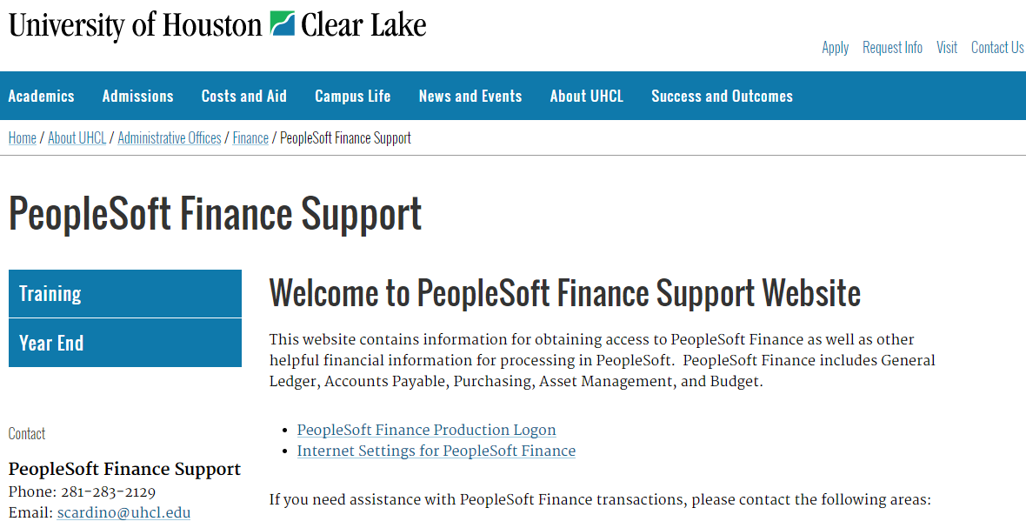
https://www.uhcl.edu/about/administrative-offices/finance/peoplesoft-finance/training

Slide 11
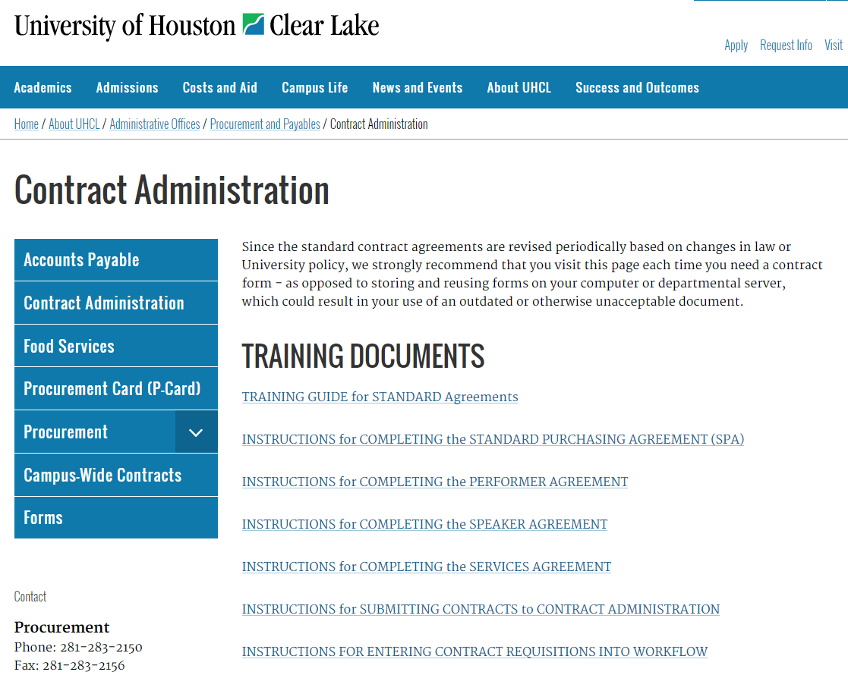

Slide 12
Questions?

