Slide 1
Procurement – P-Card Training

Slide 2

P-Card Contacts
P-Card Administration – x 2150
Lidia Quiroga P-Card Administrator
Accounts Payable – x 2130
Randy Baggett Director of Accounts Payable

Slide 3
Purpose
This training supports mandatory training for all P-Card cardholders, business administrators and account managers.
Program Purpose
To establish a more efficient, cost-effective method of purchasing.
As an alternative to the traditional purchasing process but not intended to avoid or bypass appropriate purchasing, contracting or payment guidelines and procedures.
Reduction in the volume of purchase orders and vouchers.
Expedite the receipt of goods & materials.

Slide 4

Resources for Information and Training
Complete training documents including forms and sample documentation can be accessed from the P-Card web page at this url: https://www.uhcl.edu/about/administrative- offices/procurement-contracts/p-card
Documentation required to process a P-Card purchase mirrors the documentation required to process a voucher. Voucher guidelines, reasons for voucher denial and other helpful information can be found on the Accounts Payable web page at: https://www.uhcl.edu/about/administrative-offices/accounts-payable/voucher-guidelines
4

Slide 5

Obtaining/Increasing/Closing P-Card – one DocuSign form
Departmental/Supervisor Decision/Background Check required for new card, followed by annual background check
P-Card Training – Must pass quiz prior to P-card issue
P-Card Application – Submit to Procurement
Notification of new card received
P-card Use training prior to issue
Activate Card and set PIN

Slide 6
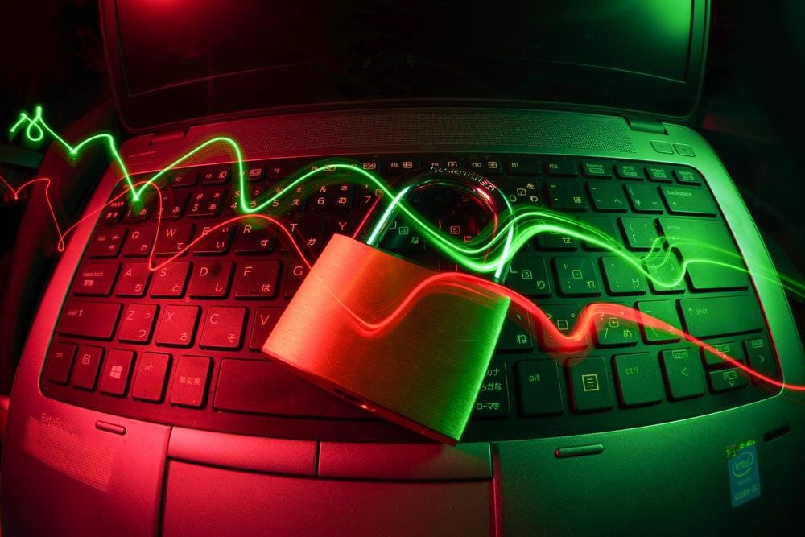
Safeguarding Your Card
Do not give another employee your card number. The cardholder whose name is on the card is the only person authorized to use that card.
Never send the full card number, expiration date and 3-digit CCV number via email or PeopleSoft, as neither system is secure.
Before terminating or transferring to another department, the cardholder must return their P-Card to the P-Card Administrator.
If a card is lost or stolen, the cardholder should notify both Citibank and the UHCL P-Card Administrator.
Citibank – 1-800-248-4553
P-card Administration Office – 281-283-2150

Slide 7

Acceptable Purchases
Some examples of acceptable purchases are:
Advertising – Must be pre-approved by either Communications or Human Resources (HR)
Automobile Repair Parts
Books & Videos
Computer Related Items – Must be pre-approved by the Office of Information Technology (OIT)
Meals – Candidate meals & business lunches, NOT travel per diem meals
Office Supplies
Promotional Items – Logo items must be pre-approved by Communications
Small Tools and Hardware
ALL pre-approval documentation must be uploaded along with the backup documentation for each transaction. Advertising transactions should include a copy of the ad.
7

Slide 8

Unacceptable Purchases
Some examples of unacceptable purchases:
NOTE: This list is not to be considered all-inclusive. If you are unsure as to whether a purchase is allowed, contact the P-Card Administrator (X2150) for clarification BEFORE you complete the transaction.
Any purchase using State funds
Alcoholic Beverages
Animals (submit purchase requisition)
Capital Equipment (Unit value is $5,000 and above.)
Computer Hardware (monitors, CPU’s, printers, etc.)
Consulting Services
Controlled Assets (These items include any type of electronic gadget and
any computer related equipment that costs over $500.)
More Unacceptable Purchases continued on next slide
8

Slide 9

Unacceptable Purchases (cont.)
The following are more examples of unacceptable purchases:
Controlled, hazardous or radioactive materials (requisition instead)
Fuel
Orders that require written confirmation or signature (purchase order)
Personal Items – No exceptions!
Professional Services
Service Contracts (labor only)
Temporary Personnel
Travel Expenses (airlines, car rentals, hotels, meals, etc.)
REMINDER: This list is not to be considered all-inclusive. If you are unsure as to whether a purchase is allowed, contact the P-Card Administrator (X2150) for clarification BEFORE you complete the transaction.
9

Slide 10
Transaction Limits
Purchases made with the P-Card are limited to $5,000 per transaction. Exceptions: memberships, registrations & subscriptions
DO NOT ask the vendor to split the charges to circumvent this limit. Split transactions are considered to be more than one transaction on the same day to the same vendor for which the total amount exceeds $5,000 or any activity that can be perceived as an attempt to circumvent the P-Card transaction limit.
Individual P-Card credit limits will be reviewed and adjusted annually based upon prior year expenses; any requests for increases are granted based on justified business need and are temporary – no exceptions.
Do not confuse split transactions with split reallocations in GCMS.
10

Slide 11

Placing an Order
P-Cards can be used at any merchant that accepts MasterCard :
In-store purchases
Internet (must be a reputable merchant with a secure web site)
Telephone orders
Fax orders
DO NOT send your card number, expiration date and 3-digit CCV number via email. When placing an order, call or fax this information to your vendor. You may also submit it via a secure website (https).
11

Slide 12
Vendor Tax Status with the State of Texas (Transactions over $500)
The State Comptroller’s office assists the State in collecting delinquent debts and taxes.
We cannot do business with a prohibited vendor who is “on hold” with Texas.
Cardholder must verify the vendor’s status prior to completing any transaction.
Vendor status search is available: https://mycpa.cpa.state.tx.us/coa/
Documentation from the search showing the vendor’s good standing must be included in the
backup documentation for the transaction.

Slide 13

Sales Tax
Follow normal purchasing procedures regarding sales tax:
Inform the merchant of the University’s tax-exempt status prior
to placing the order.
Texas Sales Tax Exemption Certificate Requests - email a request to the Procurement Department (include name and address of vendor).
If you are charged sales tax on a purchase, contact the merchant for a refund of the tax. If the refund is not received during the same reallocation period as the original charge, be sure to include documentation of your request for refund in your backup documentation.
13

Slide 14

Reallocating Your Purchases
The cardholder is responsible for obtaining the proper documentation for each P-Card purchase.
The department is responsible for the filing of the backup documentation.
Backup documentation must be scanned and uploaded to PeopleSoft. Documentation includes:
  Invoice, itemized sales receipt or online printout of internet purchases.
  Any required pre-approval from Communications, HR, Office of Sponsored Programs or OIT.
  Vendor Taxpayer Status printout (if purchase is over $500)
  Expense Report from GCMS (must be signed by the cardholder’s
immediate supervisor)
  Transaction Log (optional).

Slide 15

Documenting Transactions for Business Meals
The following guidelines apply:
All business meals must have itemized receipts, and a detailed description of the nature and purpose of the business meal must be provided.
Tips exceeding 20% are not allowed.
A list of attendees is required for groups of 10 or less. The name of the group or organization must be provided for groups larger than 10.
It is OK for restaurants to charge sales tax.
Alcohol cannot be charged to your p-card.
The expense description for the transaction should include this information: Who, What, When, Where, Why, and business purpose or benefit to the University.
15

Slide 16
Returns and Credits
Unauthorized Charges
Unauthorized or fraudulent charges are those made to a cardholder’s account by a person other than the cardholder without the knowledge / consent of the cardholder. These charges must be reported to the P-Card Administrator within 10 days after the end of the billing cycle in which they occur.
Cardholders should make every attempt to resolve the issue directly with the vendor to receive credit for returns and refunds.
Refunds and credit for returns must be in the form of a credit placed on the card.
If you are unable to come to an agreement with the vendor regarding a return or credit, contact your supervisor regarding the use of the item(s) and discuss your need to dispute through CitiBank.

Slide 17
Transaction Log
The purpose of the transaction log is:
To provide a simple method of keeping track of expenditures made with the P-Card.
To track purchases and refunds so that you do not exceed your credit limit for that
statement cycle.
A separate transaction log is required for each billing cycle. For billing cycles with no
transactions, a transaction log does not need to be uploaded to PS.
Record each transaction on the log, including any refunds or credits.
  All information on the transaction log is necessary for the completion of the GCMS reallocation process.
  An expense description and the account number and cost center is required for each transaction.
  Proper completion of the transaction log will greatly expedite the reallocation process.

Slide 18
Penalties for Misuse
Additional training
Supervisor notification
Card Cancellation (temporary or indefinite)
Fraudulent use (i.e., intentional use for personal or non-University purposes) will be
handled in accordance with SAM 01.C.04.
When in doubt, contact
the P-Card Administrator (X2150) before you make the purchase.
18

Slide 19

Additional Resources
P-Card web page https://www.uhcl.edu/about/administrative-
offices/procurement-contracts/p-card
P-Card Training – New Cardholders https://www.uhcl.edu/about/administrative-offices/procurement-contracts/p-card/p-card-reallocation
CitiManager - Expense Management https://www.globalmanagement.citidirect.com/static/public-
portal-ui/login-signin-
component?invalidLogin=true&cobrandHost=citigroup
Additional P-Card information:
How to upload backup documentation
Checklist for backup documentation
Texas Sales Tax Exemption Certificate Requests - email the request
for the certificate including the name and address of the vendor to
UHCLProcurement@uhcl.edu

Slide 20

Next Steps
To receive credit for this training course, you must:
Pass the course quiz and
Forward your confirmation email to UHCLProcurement@uhcl.edu
20

