Slide 1
Contracts and Agreements
Training Session
July 17, 2023
Lidia Quiroga
Debbie Carpenter
Sherry Hawn

Slide 2
Table of Contents
Topic | Page
Session Purpose | 3
Contract Types | 4
Standard Contract/Agreement Examples | 5
Other Less Common Agreements | 6
Contract Threshold Tips | 8
Agreements Over $50k | 9
Non-Standard Contracts | 10
Amendments | 11
Bids Summary | 12
Legal review | 13
After Legal Review | 14
Risk, Purchases >100K, ISHSC & FAQs | 15 - 25

Slide 3
Session Purpose
This training will help you understand:
The types of contracts we have,
The contract process,
Compliance requirements,
How to satisfy University policies, federal and state laws, and regulations.

Slide 4
Contract Types
Standard
Uses a basic contract template developed by UH system, with no variation
The vendor makes no changes to the terms and conditions
Non-Standard
Uses a vendor’s contract template
Or a UH template with changes to the terms and conditions

Slide 5
Standard Contract or Agreement - Examples
Contract/Agreement | Use
* Standard Purchasing Agreement | For any type of services [not goods]
* Performer Agreement | For musicians, DJ’s, dancers
* Speaker Agreement | For workshops, presentations or any speaker event
* Professional Services Agreement | For for any medical professionals
* Revenue Contract | For anticipated revenue of $50k or more

Slide 6
Other Less Common Agreements
Articulation Agreement
Agreement with Jr and Community Colleges
Interagency Agreement
Agreement between two or more Texas agencies
Interlocal Agreement
Agreement between UHCL and local government

Slide 7
Other Less Common Agreements. Cont’d
Affiliation Agreement/ Credit & Non-Credit
Use for field practicum and internships
Facility License Agreement
Use for campus recreation special events
Can be zero-dollar
Has strong indemnification/hold harmless terms
Memorandum of Understanding
Formalizes a relationship, arrangement, or understanding between UHCL and another party.
May not be legally binding unless so specified in the agreement.

Slide 8
Contract Threshold Tips
Dollar Amount | Tip
$0-$15k | No bid required
Over $15k | Specify procurement method: Sole source Bid Solicitations Cooperative Contracts Emergency Purchases
Over $50k Not Construction | Needs OCA cover sheet (Even if standard contract) Legal review Procurement manages document flow
Over $100k Construction | Needs OCA cover sheet Legal review Procurement manages document flow

Slide 9
Revenue Agreements Over $50k
Allow adequate review time !
UHS Tax office must review prior to execution. Please allow time for this step.
Submit a complete packet !
Procurement needs BOTH:
Revenue Contract Coversheet and
OCA Coversheet.
UHCL routes documents for approval by tax and legal departments

Slide 10
Non-Standard Contracts
A non-standard contract happens when your vendor has different terms and conditions than our basic contract template contains.
Either use a Standard Contract Addendum (SCA) to add their terms to ours – Procurement then legal review required.
Or, the vendor uses their own template – Procurement then legal review required.

Slide 11
Amendments
Any change to an existing contract requires the following:
Attach the original contract.
Process it before the original contract expires.
Same approval level or higher as the original contract.
Legal review required; allow adequate time.
Typically, no extensions past 5 years.

Slide 12
Bids - Summary
Informal Bids - $15,001 - $25,000 – Not posted to ESBD
Department recommends a vendor in writing
Procurement will solicit a minimum of 3 informal bids
Two must be “HUB” vendors
Historically underutilized businesses
Bids are not posted to Texas Electronic State Business Daily
Formal Bids – Over $25,000 – Posted to ESBD
Department recommends a vendor in writing
Procurement will solicit a minimum of 3 formal, written bids
Two must be HUB vendors
Bid posted to Texas Electronic State Business Daily for 14 days
Emergency purchases – contact Procurement for details

Slide 13
Legal Review
When is it required?
Any change in contract terms and conditions
Exceeding threshold limits [see slide 8]
Submit a complete packet !
OCA Coversheet
Fill in editable areas (vendor name, address, cost center, amount, a brief description of scope of work, etc.
Initial first five lines under certification (left side)
Indicate if request is a rush
Authorized Signatory
Procurement Method (if applicable)
All contract documentation (Agreement, T&C’s, COI, Etc.)
Do NOT sign the agreement before legal review.

Slide 14
After Legal Review
Department steps
Reviews documentation / obtain corrections if needed
See slide 20 for review checklist
DO NOT SIGN YET
Sends to vendor for review/approval
Vendor returns signed contract
UHCL authorized signatory signs contract
Sends fully executed copy to Procurement
Has final stamp:

Slide 15
Risk Management
Certificate of Insurance (COI)
Required for any vendor providing services on campus.
Limits must match contract or addendum insurance clauses
Services are intangible benefits, not tangible goods.
List UHCL as Certificate Holder and Additional Insured.
Waiver of subrogation required
Endorsement required from vendors to avoid being held liable for claims that occur on their jobs here.
UHS reviews any/all insurance waivers
Allow 7-14 days

Slide 16
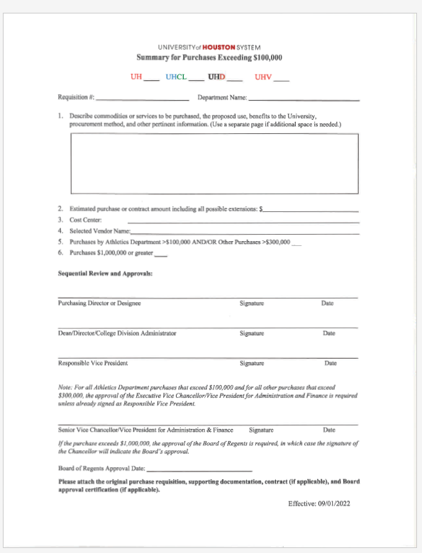
Summary for Purchases Exceeding $100,000
Use this form with any service or good purchase that exceeds $100,000 that will be reviewed by OGC.

Slide 17
Information Security Hosted Services Contract Checklist
This form is an assessment of information security items to be completed for contracts that include hosting of University information on non-UHS servers.
This includes information specific to individual persons.
This sheet should be submitted along with the proposed contract to the procurement department.
After assessment by UHS Information Security, this completed checklist will be included in the packet submitted to the Office of Contracts Administration (OCA)

Slide 18
Message from Associate Vice Chancellor of Legal Affairs
The quality control on all contracts and agreements starts at the department.
It is the responsibility of the department to read the terms of the contract for accuracy.

Slide 19
FAQs
Checklist
Sample Coversheet
Tip sheet
Time Required
Delegation of Authority
Information Security Hosted Services Contract Checklist

Slide 20
Checklist
Determine the type of contract / agreement
SPA SCA MOU Affiliation Articulation vendor provided
Is amount >50K yes no, (if yes fill out OCA Coversheet to legal)
Is the contract a service yes no, if yes need COI
Is the contract >15K yes no, if yes, need Procurement Method
Sole Source Emergency COOP Bid
Has UHCL contract been changed/redlined yes no, if yes need OCA
Typical contract packet to legal should include:
OCA Coversheet
Procurement Method (if applicable)
Contract / Agreement
COI (if applicable)
Additional Documentation (terms & conditions, policies, proposal/quote, etc.)

Slide 21
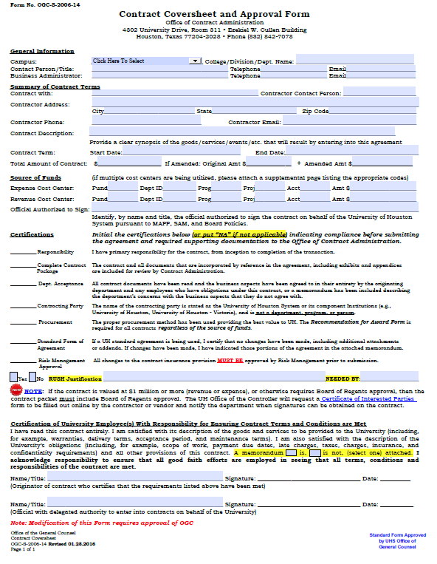

Slide 22
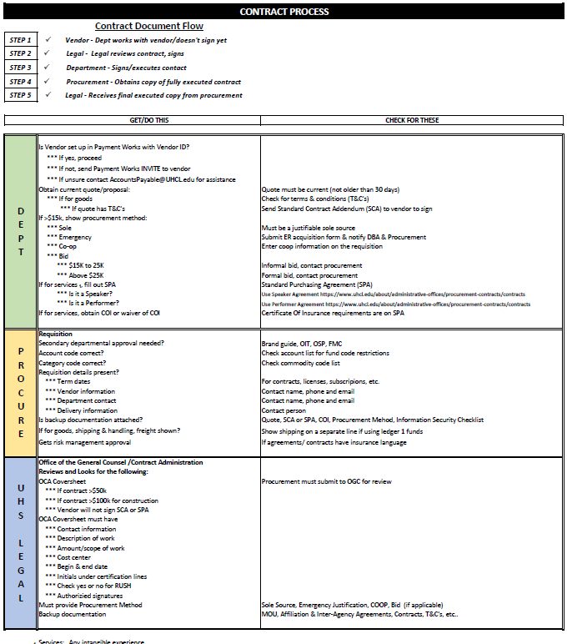

Slide 23
Time Required
TIME REQUIRED FOR CONTRACT PROCESSING
BY UHCL OFFICE OF CONTRACTS
AGREEMENT TYPE |  |  |  |  | # BUS. DAYS REQUIRED
Standard contract |  |  |  |  | 13
Non-standard contract |  |  |  |  | 18
Requiring Chancellor/Pres. signature |  |  |  |  | Add 10 days to above
Requiring Board approval |  |  |  |  | 90
* Leases may require additional time, depending upon complexity

Slide 24
Delegation of Authority List
President, Dr. Richard Walker – Up to $300,000
Academic Affairs & Provost, Sr. VP Christopher Maynard – $25K to $300K
Delegated by Christopher Maynard Kathryn Matthew, Assoc. Vice President Academic Affairs – Up to $300,000
Delegated by Christopher Maynard, Miguel Gonzalez, Dean, College of Science and Engineering – Up to $25,000
Delegated by Christopher Maynard, Joan Pedro, Dean, College of Education – Up to $25,000
Delegated by Christopher Maynard Glenn Sanford, Dean, Human Sciences and Humanities – Up to $25,000
Delegated by Christopher Maynard Ed Waller, Dean, College of Business – Up to $25,0000
Admin. & Finance, Mark Denney, VP Admin. & Finance – Up to $300,000
Delegated by Mark Denney, Sherry Hawn, Associate VP, Business Operations – Up to $300,000
University Advancement, Joe Staley, VP University Advancement - Up to $300,000
Strategic Enrollment Management, Dr. Matt Aschenbrener, VP for Strategic Enrollment Management - Up to $300,000
Student Affairs, Tina Powellson, VP Student Affairs – Up to $300,000
Construction and Facilities, Bubba Jones, Interim Associate VP for Facilities Management and Construction - Up to $100,000
Purchasing, Debra Carpenter, Executive Director of Purchasing & Payables – Up to $100,000
Purchasing, Kimberly August, Procurement Specialist II – Up to $100,000
Above $300,000 – Below $500,000, Senior Vice Chancellor / VP for Administration & Finance, UH Raymond S. Bartlett
$500,000 – Below $1,000,000, UHS Chancellor & UH President, Dr. Renu Khator
$1,000,000 & above, Board of Regents, approval required.

Slide 25
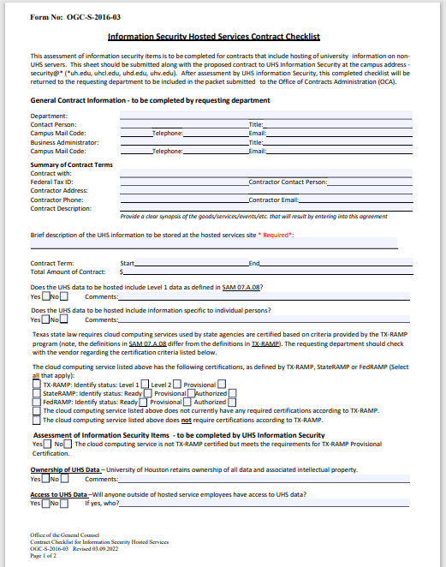

Slide 26
Questions Discussion

