Slide 1
CONTRACTS & AGREEMENTS

Slide 2
Session Purpose
Training will help you understand:
Types of contracts
Contract process
Compliance requirements
How to satisfy University policies, federal and state laws, and regulations.

Slide 3
Contract Types
Standard
Uses a basic contract template developed by UH System.
The vendor makes no changes to the terms and conditions.
Non-Standard
Uses a vendor’s contract agreement
Or a UHS template with changes to the terms and conditions.

Slide 4
Standard Agreements - Examples
Contract/Agreement | Use
* Standard Purchasing Agreement | For any type of services [not goods]
* Performer Agreement | For musicians, DJ’s, dancers
* Speaker Agreement | For workshops, presentations or any speaker event
* Professional Services Agreement | For for any medical professionals
* Revenue Contract | For anticipated revenue of $50k or more

Slide 5
Other Less Common Agreements
Articulation Agreement
Agreement with Junior and Community Colleges
Interagency Agreement
Agreement between two or more Texas agencies
Interlocal Agreement
Agreement between UHCL and local government

Slide 6
Other Less Common Agreements Cont’d
Affiliation Agreement/Credit & Non-Credit
Use for field practicum and internships
Facility License Agreement
Use for campus special events
Can be zero-dollar
Has strong indemnification/hold harmless terms
Memorandum of Understanding
Formalizes a relationship, arrangement or understanding between UHCL and another party
*May not be legally binding unless so specified in the agreement

Slide 7
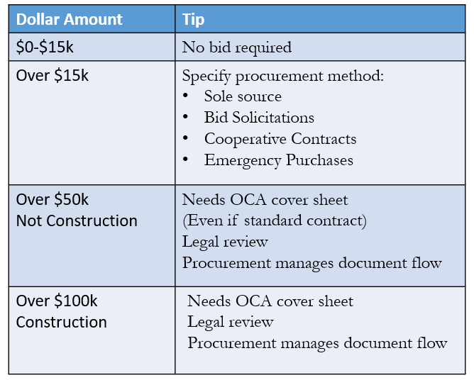
Contract Threshold Tips

Slide 8
Non-Standard Contracts
A non-standard contract happens when your vendor has different terms and conditions than our basic contract template contains.
Either use a Standard Contract Addendum (SCA) to add their terms to ours – Procurement then legal review required.
Or, the vendor uses their own template – Procurement then legal review required.

Slide 9
Amendments
Any change to an existing contract requires the following:
Attach the original contract
Process it before the original contract expires.
Same approval level or higher as the original contract.
Legal review required; allow adequate time.
Typically, no extensions past 5 years.

Slide 10
Bids - Summary
Informal Bids - $15,001 - $25,000 – Not posted to ESBD
Department recommends a vendor in writing
Procurement will solicit a minimum of three (3) informal bids
Two must be Historically Underutilized Business (HUB) vendors
Bids are not posted to Texas Electronic State Business Daily
Formal Bids – Over $25,000 – Posted to ESBD
Department recommends a vendor in writing
Procurement will solicit a minimum of three (3) formal, written bids
Two must be HUB vendors
Bid posted to TX Electronic State Business Daily for minimum of 14 days
Emergency purchases – contact Procurement for details

Slide 11
Revenue Agreements - Over $50K
Allow adequate review time!
UHS Tax office must review prior to execution. Please allow time for this step.
Submit a complete packet!
Procurement needs BOTH:
*Revenue Contract Coversheet and
*OCA Coversheet
UHCL procurement routes documents for approval by tax & legal departments

Slide 12
Legal Review
When is it required? *Any change in contract terms and conditions *Exceeding threshold limits (See slide #10)
Submit a complete packet!
*OCA Coversheet *Fill in editable areas (vendor name, address, cost center, amount, a brief description of scope of work, etc.
*Initial first five lines under certification (left side)
*Indicate if request is a rush
*Authorized Signatory
*Procurement Method (if applicable)
*All contract documentation (Agreement, T&Cs, COI, Etc.)
Do Not sign the agreement before legal review.

Slide 13
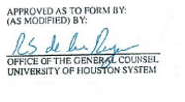
After Legal Review
Department steps
Reviews documentation / obtain corrections if needed
DO NOT SIGN YET
Send to vendor for review/approval
Vendor returns signed contract
UHCL authorized signatory signs contract
Sends fully executed copy to Procurement
Has final stamp

Slide 14
Risk Management
Certificate of Insurance (COI)
Required for any vendor providing services on campus. *Limits must match contract or addendum insurance clauses *Services are intangible benefits, not tangible goods.
List UHCL as Certificate Holder and Additional Insured.
Waiver of subrogation required
*Endorsement required from vendors to avoid being held liable for claims that occur on their jobs here.
UHS reviews any / all insurance waivers
*Allow 7-14 days

Slide 15
Information Security Hosted Services Contract Checklist
This form is an assessment of information security items to be completed for contracts that include hosting of University information on non-UHS servers.
This includes information specific to individual persons.
This sheet should be submitted along with the proposed contract to the procurement department.
After assessment by UHS Information Security, this completed checklist will be included in the packet submitted to the Office of Contracts Administration (OCA).

Slide 16
Checklist
Determine the type of contract / agreement
SPA SCA MOU Affiliation Articulation vendor provided
Is amount >50K yes no, (if yes fill out OCA Coversheet to legal)
Is the contract a service yes no, if yes need COI
Is the contract >15K yes no, if yes, need Procurement Method
Sole Source Emergency COOP Bid
Has UHCL contract been changed/redlined yes no, if yes need OCA
Typical contract packet to legal should include:
OCA Coversheet
Procurement Method (if applicable)
Contract / Agreement
COI (if applicable)
Additional Documentation (terms & conditions, policies, proposal/quote, etc.)

Slide 17
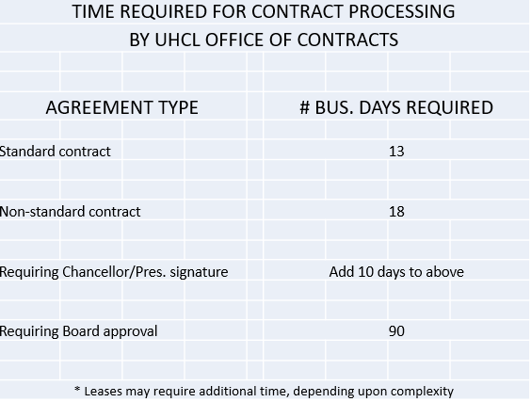
Time Required

Slide 18
Don’t forget to obtain signatures on your contract after legal review is completed.
Submit a requisition to obtain a contract number and complete the procurement cycle.
Submit fully executed agreement to vendor with contract number so they will be able to invoice once services are completed.

