Slide 1
Budget Development Process for DBA/CBA’s
Budget Development Checklist
CoogPlan HR Funding Sources
CoogPlan Budget Data Extractor
Funding Requests

Slide 2
FY 22 Budget Development Timeline
Week of April 26th : Budget analyst begins compiling the tables.
May 3rd through May 14th : DBA/CBAs will work on completing both the Data Extractor and HR tables.
May 17th through May 31st: Budget analyst will begin inputting the data from the tables into Hyperion.
  Changes can still be made during this time by the DBA/CBA; utilize the columns to communicate that additional changes are being requested.
  All changes from the DBA/CBAs should be requested by May 31^{st.}
June 1st through June 30th: Budget analyst will work on other areas of the budget development process
  DBA/CBAs can request last minute changes during this time for unforeseen circumstances or new hires that need to be sync in Hyperion.
  DBA/CBAs must have all reports and tables complete/saved to their budget development folders by June 30th – this folder will act as your “Budget Packet”.

Slide 3
Budget Development Folder
Each DBA/CBA will have an excel file saved under their name in the Budget Development folder section.
This folder will act as the budget packet for the DBA/CBA where it will store
  Reports
  Budget Development tables
  Any additional documentation that assisted with the budget development cycle

Slide 4
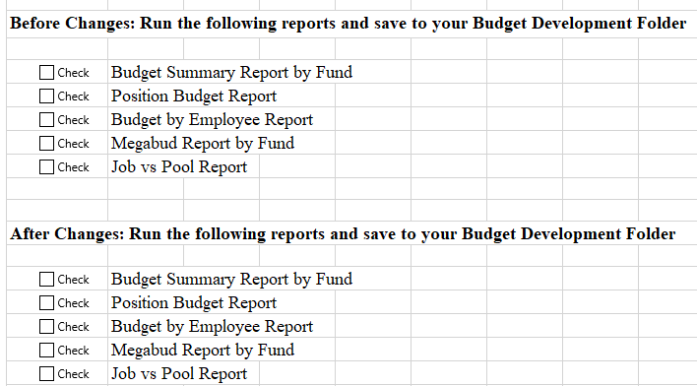
Budget Development Checklist
This tab was added as a guide to ensure reports are being saved to the budget development folder
Utilize this page and check off after each report is ran and saved.
The Budget Development folder will act as the Budget Packet, so any documentation, not just the reports listed, that was beneficial to development should be saved.

Slide 5
CoogPlan HR Funding Sources
The HR Funding Sources table will show every position including allocation, FTE and Job amount, that is in that DEPT.
This table will be included in the same excel file as the data extractor table.
Besides the CC information, there are 9 other columns listed:
Employee: This is the employee that is assigned to the position and CC listed
  May also show as VACANT or Lumpsum
Position: This is the position that is assigned to the employee and CC listed
Percent Allocation: This is the percentage of the position that is funded by the CC listed
Alloc Job Amount: This is the funding amount for this position for the CC listed.
Alloc Job FTE: This is the FTE that the position holds

Slide 6
Changes Needed: Any changes needed to the position will be listed here. Changes may include:
  Employee/Position status: If a position/employee needs to be vacated or synced into Hyperion
  Percent Allocation: If the funding allocation changes, state the new percent amounts.
    If it is being split funded then include the other CCs information
  Alloc Job FTE: If the FTE is being moved to another CC, include the information of the CC that is taking the FTE.
Note from PBO: PBO will utilize this column to keep the CBA/DBA aware of when their requests have been processed.
  If the note says “Changes Made” then the CBA/DBA must go into Hyperion and ensure those changes are correct.
  If this column is empty then no changes have been made yet.
  Any other comments noted here should be addressed.
Response from DBA/CBA: Utilize this section to let PBO know that you reviewed the changes made in Hyperion OR if you need additional changes made.
  If you need to make changes AFTER changes were already made by PBO, state you need additional changes in this column.
    If you need additional changes made: change the column(s) needed to reflect this new change including the comments section (include the date of the new request)- don’t erase the previous comments; needed for tracking.
      Follow up with an email to PBO letting them know you updated your table with additional changes. That way it is not missed.
    Once the new changes are made then PBO will note that.
Budget Changes Complete per DBA/CBA: Utilize this section to indicate the budget for the CC is complete
  DBA/CBAs need to run the Budget Request form for each CC to ensure that the budget changes have been made.
  Once the Cost Center is reviewed for changes and no additional changes are needed then the DBA/CBA will write “finished” in this column. **Only mark finish if you are sure no additional changes are needed**
  This indicates that the budget process for this particular cost center is now complete.

Slide 7
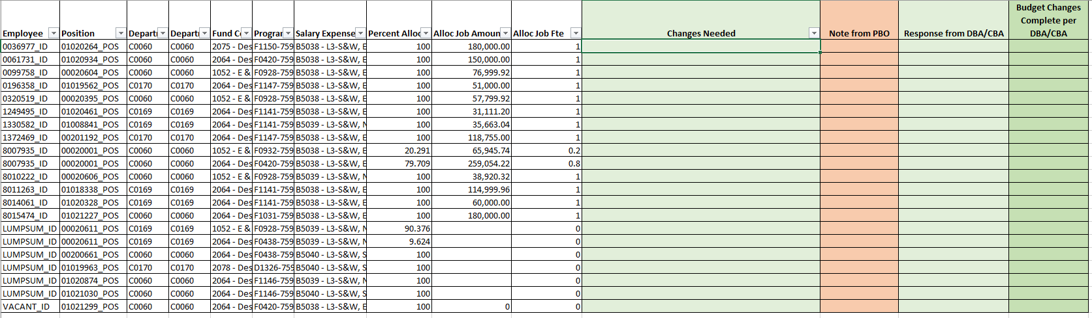
This is what the table will look like BEFORE changes are made. You may filter the table by Dept or Fund, etc to make it easier to view.
The green columns are the only sections editable by the DBA/CBA
Be as informative as possible in the “Changes Needed” column.

Slide 8
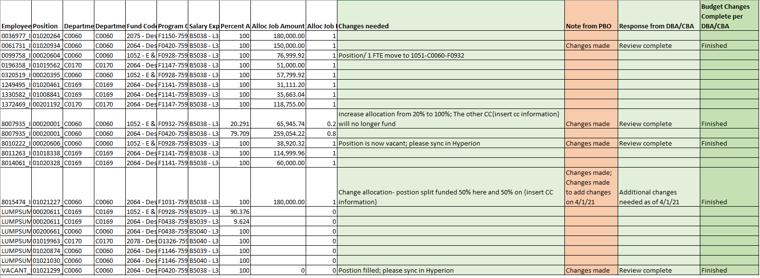
Example of a complete table

Slide 9
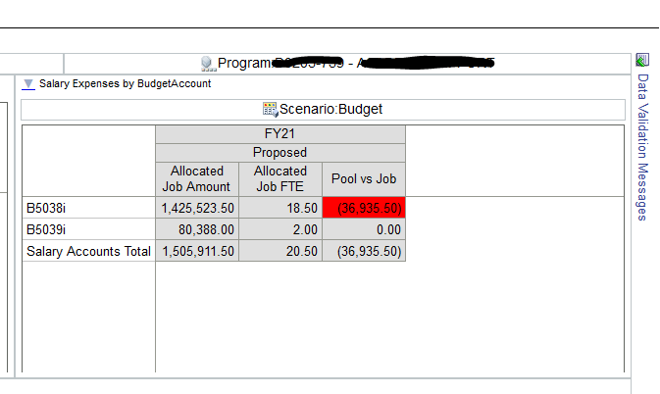
After changes are made to positions….
Always go into Hyperion and check to see if you have adequate funding after the position changes are made.
You can do this by..
Going into Hyperion → Coogplan → Search and Enter Budgets
Search by Departments then right click on the department you want to view and select “ View Cost Center Summary”
The table on the right will show you if you have enough funding for the jobs that are allocated.
  If there is not enough funding then the boxes will be red, as shown below
If you have red boxes then you need to update the data extractor table to move enough funding into that node.
- In this example, it shows that B5038 will be 36,935.50 short on funds.

Slide 10
CoogPlan Budget Data Extractor
The Coogplan Budget Data Extractor will show the base budget allocated for each cost center by budget node. It also shows the base FTEs in the cost center.
Besides the Cost Center chartfields, there are 11 other columns on this table:
Budget Year: This is year that we are proposing the budget for (FY 22)
  The example will say FY21 but that is because it was created before the FY 22 budget load and the amounts are from the FY21 load.
Base Budget Amount: This is the base budget that was loaded on April 1, 2021. This column will show the amounts allocated for each budget node.
  This column should not be edited by the DBA/CBA
Proposed Budget Amount: This is where you are going to create your FY22 Budget.
  You will use this column to shift funding around and place it in the appropriate CC or nodes for FY 22.
  If you need to add new nodes then add a line and fill out the chart field information for the new node then continue with the rest of the columns.
Budget Change Amount: This column will show the change from the proposed column when compared to the base column.
  Utilize this column to ensure you stay in balance.
  This column is auto-calculated and should not be edited by the DBA/CBA
Base Budget FTE: This is the total number of FTEs allocated to that CC
  This total should be the same total reflected on the Coogplan HR Funding Source table
  This column should not be edited by the DBA/CBA.

Slide 11
Proposed Budget FTE: This is where you are going to make your FTE changes if you need to move positions.
  Any changes to FTE on this section should also be reflected on the Coogplan HR Funding Source Table.
    You need to identify which Position(s) are being changed. This is important because you can change the FTE in Hyperion without changing the Position. They both need to be changed to be accurate.
Budget Change FTE: This column will show the change from the proposed column when compared to the base column.
  Utilize this column to ensure all your FTEs are accounted for
  This column is auto-calculated and should not be edited by the DBA/CBA
Comments: Explain what is being changed, why and where the change(s) will occur. Be informative, this will help if we need to look back and see why something was done.
Note from PBO: PBO will utilize this column to keep the CBA/DBA aware of when their requests have been processed.
  If the note says “Changes Made” then the CBA/DBA must go into Hyperion and ensure those changes are correct.
  If this column is empty then no changes have been made yet.
  Any other comments noted here should be addressed.
Response from DBA/CBA: Utilize this section to let PBO know that you reviewed the changes made in Hyperion OR if you need additional changes made.
  If you need to make changes AFTER changes were already made by PBO, state you need additional changes in this column.
    If you need additional changes made: change the column(s) needed to reflect this new change including the comments section (include the date of the new request)- don’t erase the previous comments; needed for tracking.
      Follow up with an email to PBO letting them know you updated your table with additional changes. That way it is not missed.
    Once the new changes are made then PBO will note that in the “Note from PBO” column.
Budget Changes Complete per DBA/CBA: Utilize this section to indicate the budget for the CC is complete
  DBA/CBAs need to run the Budget Request form for each CC to ensure that the budget changes have been made.
  Once the Cost Center is reviewed for changes and no additional changes are needed then the DBA/CBA will write “finished” in this column. **Only mark finish if you are sure no additional changes will be needed**
  This indicates that the budget process for this particular cost center is now complete.

Slide 12
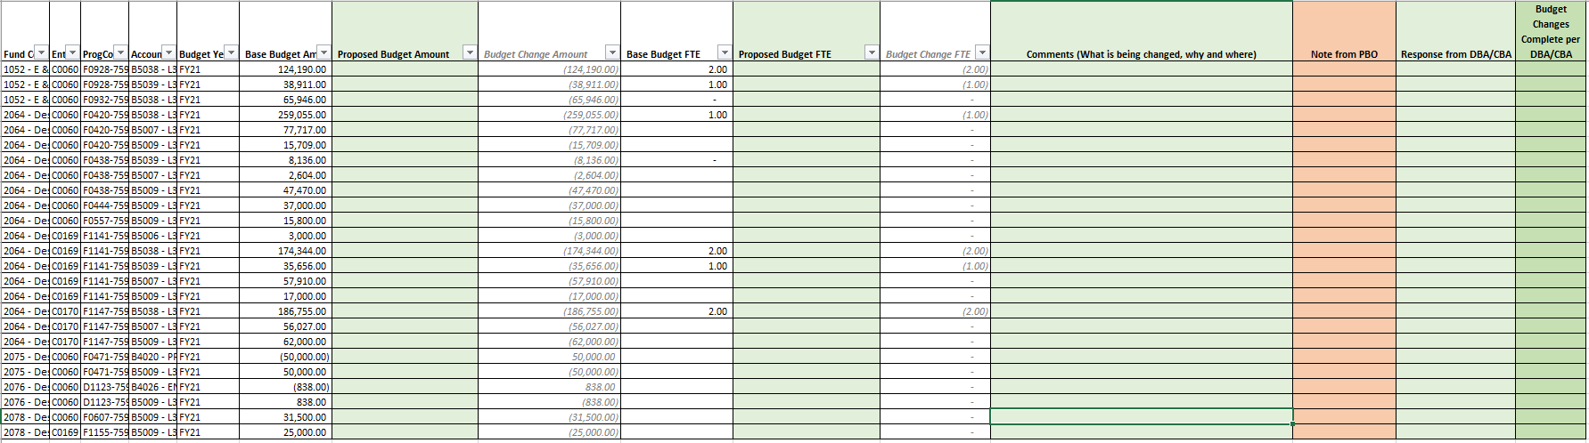
This is what your table will look like when you open your file- BEFORE you make changes.
The green columns are the only ones that the DBA/CBAs will edit.
PBO suggests DBA/CBA’s to filter by FUND CODE to ensure that funds stay in balance.
Utilize the comment section to give full information; this will be beneficial for both DBA/CBA and PBO.

Slide 13
Example
Juan needs to move a position and funding from one CC to another:
He is going to filter out all fund codes except the one being changed.
His funding was updated to reflect the changes needed
This column equals zero meaning he stayed in balance
His FTE was updated to reflect the changes needed
This column equals zero meaning his FTE count is accurate
Tell WHAT you are moving (funding amounts, nodes, etc) Tell WHY and Tell WHERE (full CC information)**Since a change is being made to a position/FTE, this change needs to reflect on the Coogplan HR Funding Source table so changes are made to the correct position.
Both parties indicate changes are made and the changes in Hyperion are accurate.
DBA/CBA confirms that BRF matches budget changes and the CC is finished

Slide 14
Example
Mila needs to reduce revenue
Since revenue is being reduced then expenses need to be reduced
Confirms the CC is still balanced
Informative comment

Slide 15
Moving Funds from One Area to Another- Across multiple DBA/CBAs
Transfers from one area to another may show the fund as out of balance on your table.
  For example: EASF funding moved into several other CCs
    The original EASF CC will show it being out of balance because the remainder of the funding is in other CCs.
    The other CCs will also show out of balance because the funds are not coming from that certain area.
What to do?
    In cases like this, simply state in the comments the full CC information of where the funding is coming from and going to including the amounts.
      This will allow PBO the ability to cross reference to ensure that the funds stay in balance.

Slide 16
Adding New Budget Nodes or Cost Centers
If a new budget node or new cost center needs to be established then the DBA/CBA can add a new line to the Budget Data Extractor.
The DBA/CBA will fill out the Chartfield lines with the Cost Center information including the Budget Node.
  In the Budget Year column enter the word “ADD”.
  The base budget amount will remain zero as this field can not be edited.
  The DBA/CBA will enter the amount in the proposed column
  The same steps will be followed if FTEs are needing to be moved to the new cost center and/or node.

Slide 17
Example
Cindy needs to add a budget node and move funding into that node.
Line added to accommodate the new budget node that is needed.
Funding updated to reflect changes.
This column shows he is in balance
No changes being made to FTE
Comments include original changes AND additional changes that were requested after PBO made the first changes
DBA/CBA is letting PBO know that they need additional changes made

Slide 18

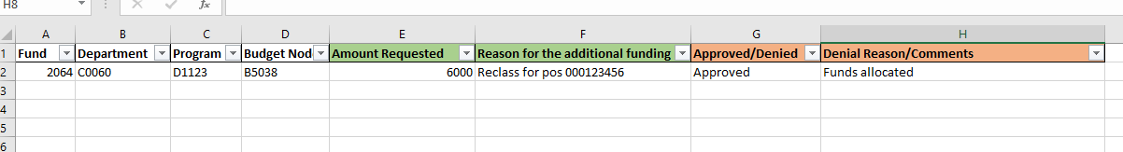
GAP Funding Requests for State and 2064
If GAP funding is needed, there will be a tab labeled “Funding Requests” on the excel sheet.
This is where you will type in all the information needed and you can keep track whether the request was approved or denied.

Slide 19
Reminders
Run reports BEFORE any corrections are made
  The type of reports can be found Y:\Budget Development\Budget_Development_Checklist_2-24-21.docx OR on the Budget Development Checklist tab in the excel file.
  Other useful reports in Hyperion to help with projections
    Expense Detail by CC
    Account Balances by CC
Review all positions, make sure they have funding and are in the correct Cost Center
  Allocate the appropriate amount of Fringe including longevity. Longevity goes into B5006
    PBO will do fringe for 2064
Stay in balance!
  If funds are moved within multiple areas then communicate that and be informative in the comments.
Always communicate with PBO if you have issues, concerns or need help.
  A log will be kept during Budget Development to track common issues or areas of improvement for the next cycle.

