Slide 1
Accounts Payable Training
University of Houston Clear Lake – Accounts Payable

Slide 2
Overview
Invoice Numbering in PeopleSoft
Duplicate Payments
Date Accuracy
Fund Restrictions on Food And Entertainment
Voucher Guidelines
Reasons for Voucher Denials

Slide 3
Invoice Numbering

Slide 4
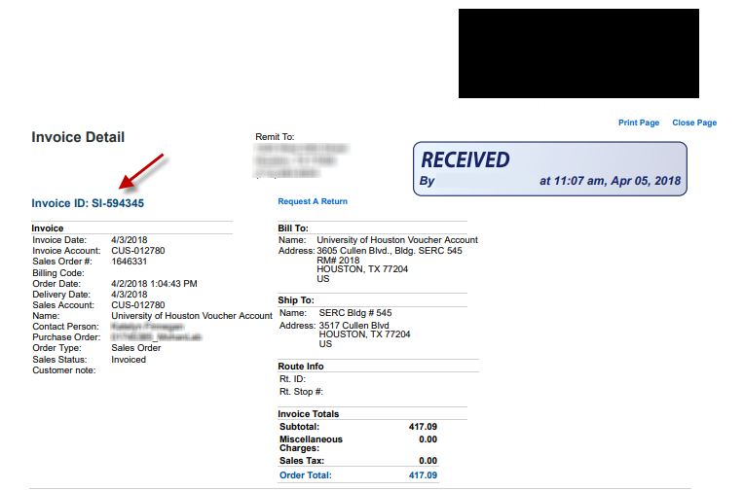
Processing Vendor Issued Invoices
Invoice number in PS must match vendor invoice number. Also, please DATE STAMP invoice when received.
Invoice must have date stamped!

Slide 5
Invoice Number Format
Please use a consistent format when creating invoice numbers.
  Example: Reimb S Hawn MM/DD/YY
Handy definitions
Fields in PeopleSoft | What to Enter
Invoice Received | Date receipt submitted to dept.
Invoice Date | Date of Purchase
Goods Rec’d/Acceptance | Same as Invoice Date

Slide 6
Duplicate Payments

Slide 7
Did the vendor invoice show a number previously used...??
Ensure that you are not generating a duplicate payment !!
  If first vendor invoice was #12345, then enter invoice # “12345.1” for the second invoice if the vendor is reusing #12345.
Add comments
  State that vendor reused the same invoice number and it is not a duplicate.

Slide 8
Other Tips On Avoiding Duplicate Payments
Check for ‘fat finger’ mistakes
  Data entry errors, such as a misread number or a typo
  Added spaces, special characters, or zeros to invoice number
Pay only once
  Verify payment in PeopleSoft
  Do not automatically pay invoices via P-card.

Slide 9
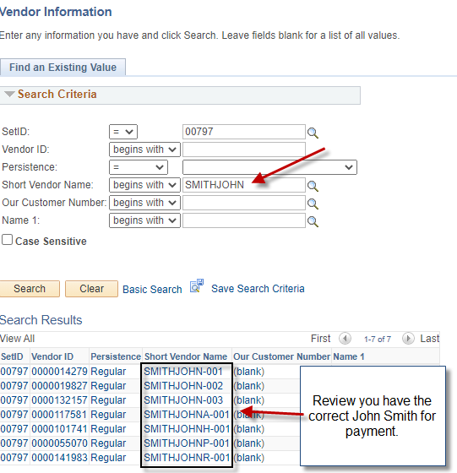
Tips On Employee or Individual Vendors
Correct Vendor - Verify the address to ensure that we select the correct vendor.
  There are multiple vendors with the same name in the system.
  Check reimbursement vouchers for employee payments to ensure that the employee has not been reimbursed before for same receipt.

Slide 10

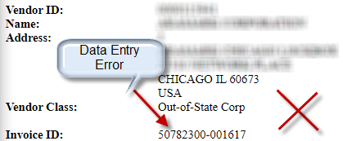
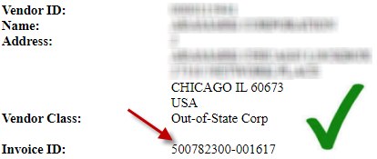
Example: Voucher number entry error
Incorrect Invoice Number:
Voucher will be denied to correct voucher entry
Correct Invoice Number:
Voucher entry correctly matches the Invoice Number.

Slide 11
Date Accuracy

Slide 12
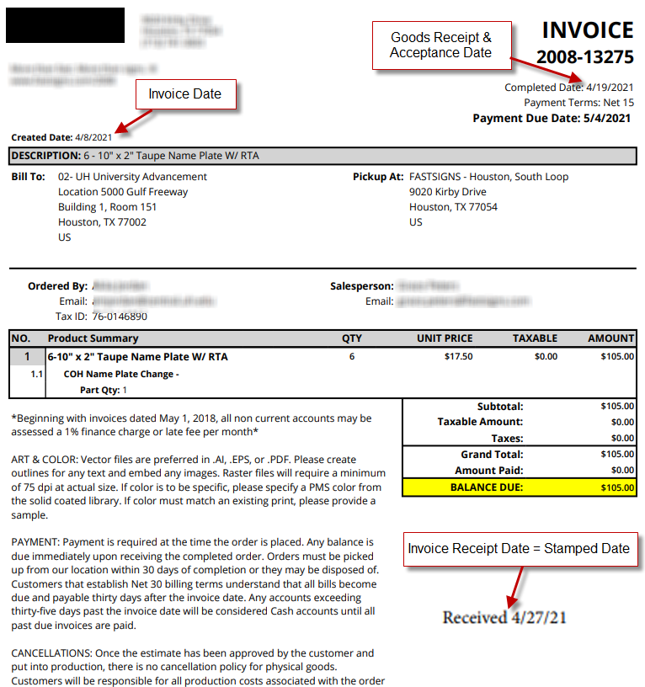
Date Accuracy
TERMS TO KNOW
  Invoice Date = Date on the invoice
  Invoice Receipt Date = Earliest Stamped Date on Invoice
  Goods Receipt Date & Acceptance Date = the day you received, inspect, and accept the goods
    This may not be printed on the invoice.

Slide 13
Dates can cost us…be aware!
Each buyer is responsible for ensuring that invoice payment is treated correctly under the Texas Prompt Payment law.
Do not use your PCard to pay for late invoices.
Our payment is due on the 30th day after the latest of:
  The date the agency receives the goods, or
  The date the performance or service is completed, or.
  The date the agency receives an invoice for the goods or services.

Slide 14
Details on Invoice Receipt Date
Invoice received via Email
  Date the email was received
  Use email as backup documentation
  Highlight or circle this date so it is easily identifiable
Invoice received by snail mail
Invoice received twice
  Received by one employee, handed to another employee on a later date
  Use date the first employee receives the invoice

Slide 15
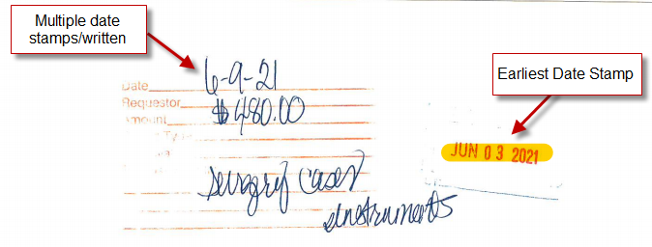
Example: Invoice Receipt Date Choices
If invoice stamped on one date and counter-stamped on another date – use the FIRST DATE.

Slide 16
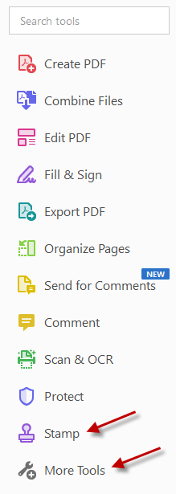
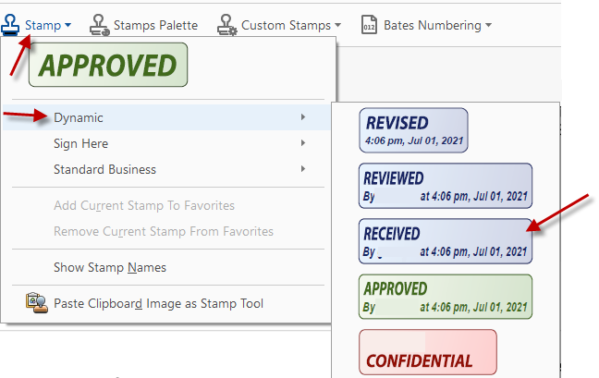
Adding Receipt Stamp via Adobe Acrobat
Select Stamp tool or search for Stamp tool under More Tools.
On drop down menu select Dynamic, choose the RECEIVED stamp.

Slide 17
Goods Receipt vs. Acceptance Date
Typically they mean the day you receive, inspect, and accept the goods. If these activities occur on two different dates, choose the later date as acceptance.

Slide 18
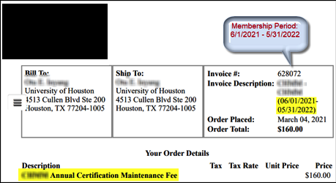
Goods Receipt vs. Acceptance Date
Memberships or Subscriptions
  Both dates should be the end date of the membership/ subscription period.
Example:
  05/31/2022

Slide 19
60-Day WorkFlow Message in PeopleSoft
  After entering a voucher into WorkFlow, PeopleSoft may prompt users to enter a justification when >60 days have elapsed between:
    Goods received/acceptance date and the Invoice Date, or
    Invoice Receipt Date and the Invoice Date.

Slide 20
Prompt Example

Slide 21
Ensuring Your Invoice is Received Timely
    The biggest challenge is getting the invoice
    to the unit that placed the order !
    When placing an order ask the vendor to log your contact information on the invoice or the order so they know where to send the invoice.

Slide 22
Fund Restrictions -
Food And Entertainment
Related accounts

Slide 23
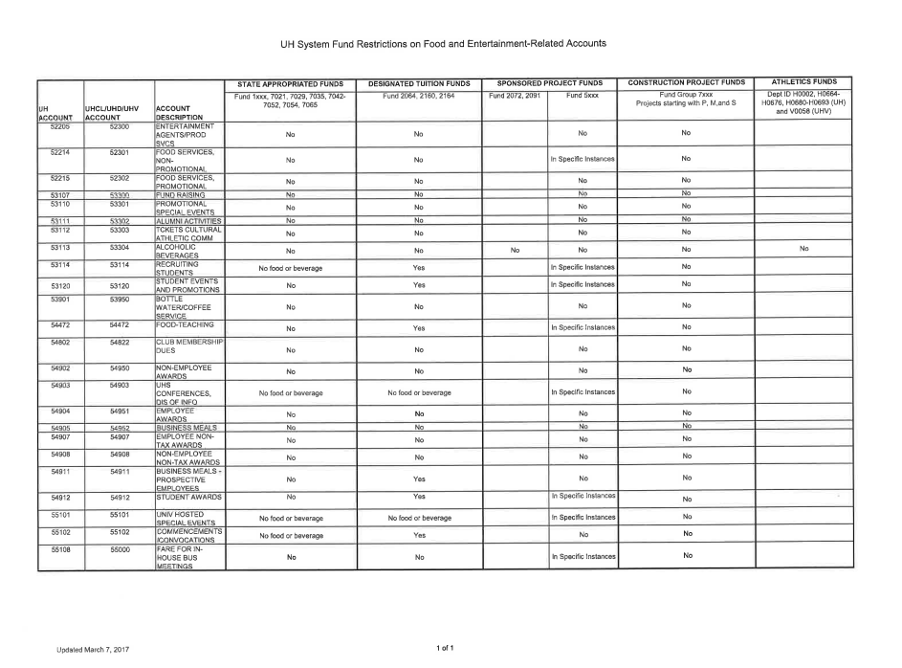
Refer to legible handout

Slide 24
Voucher Guidelines

Slide 25
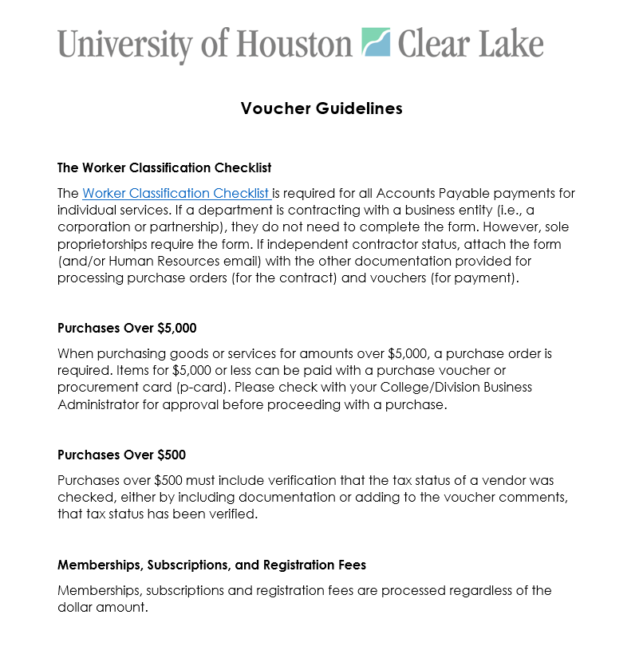
Refer to legible handout

Slide 26
Reasons for Voucher Denials

Slide 27
Common Voucher Denial Reasons
Incorrect account code
Missing justification for paying invoice over 60 days old
Amounts on receipts do not match voucher
Benefit statement was not added to voucher
Missing Brand Guide approval on promotional items
Quote unacceptable, please obtain an invoice
Claiming/Paying for state sales tax

Slide 28
Common Voucher Denial Reasons
Computer related items need OIT prior approval. Exceptions:
  blank CD/DVDs
  cases for laptops/tablets
  desktop sit/stand stations (e.g. Varidesks)
  ergonomic keyboard and mouse arm rests
  jump drives
  keyboard trays (mounts to a desk)
  monitor arm mounts
  mouse pads
  printer ink and/or toner
  contact OIT Support Center if you are not sure about your technology order

Slide 29
Common Voucher Denial Reasons
Dates incorrect or missing
Food Waiver form required/uploaded for food >$100 off campus ($500 for Pearland)
HR approval needed for employment ads
Business meal - if attendee is signature authority their supervisor must also sign voucher
Memberships and subscriptions must have beginning and end dates
Missing back up, late pay justification, comments explaining when, where, why, what and who

Slide 30
Common Voucher Denial Reasons
Missing itemized receipts on meals
Not printing names next to illegible signatures
Attendee names not listed on entertainment If <10 must list
Only one invoice number per voucher
Reimbursements must be signed by supervisor
Reimbursement coversheet must be signed by requester
Missing proof/method of payment for reimbursements
No gift card reimbursement for third party purchases; request card from Business Operations via packet

Slide 31
Common Voucher Denial Reasons
Late filed reimbursements (>60 days) require Exhibit B form uploaded and routed through the TAX-AP path in workflow
Improper restricted fund was used
Route through OSP, not AP, on payment via grant funds
Sensitive information has not been redacted
Vendor hold status for purchases over $500 not uploaded
Wrong address-does not match invoice (when paying by check)
Wrong documentation uploaded
Wrong invoice number

Slide 32
Knowing what to create… tips
CREATE | WHEN | FOR THIS | NOT THIS
VOUCHER – | PS transaction that pays an invoice. You may have already received the goods, or are making payment during order. Goes to ap via workflow | Non-PO payments Employee reimbursements Registrations Subscriptions Memberships | T R A V E L
P-CARD - | Small dollar purchases, reduces quantity of POs and vouchers, and associated processing costs. Must follow general procurement and accounts payable guidelines. | Non-PO payments Store purchases Internet / phone / fax purchases Registrations Subscriptions Memberships | STATE FUNDS PERSONAL USE ALCOHOL TRAVEL CONTROLLED ASSETS EQUIPMENT COMPUTER HW PROFESSIONAL OR CONSULTING SERVICES CONTRACTS TEMPS

Slide 33
Knowing what to create… tips
CREATE | WHEN | FOR THIS | NOT THIS
TAP TRAVEL CARD – | Issued upon request 10 days in advance for specific hotel and tax cost. One-time use. Not for phone, Wi-Fi, parking, room service. Not issued to students. These will be phased out when Concur is implemented. There will be 3 basic credit cards instead. See Travel Guide. | Hotel – Room & Tax | PERSONAL AIRFARE FUEL MEALS PARKING TAXI/SHARE RIDE AUTO RENTAL NON-PO PAYMENT EMPLOYEE REIMBURSE. REGISTRATIONS SUBSCRIPTIONS MEMBERSHIPS

Slide 34
Questions?

